Slide 1
IPL Match Prediction Using Machine Learning

Slide 2
Agenda
SEE ALL SLIDES AND ADD AGENDA....
ADD SNAPSHOTS FROM CODE

Slide 3
Abstract
Machine Learning for Sport Analysis and Betting.
For Prediction, Several Methodologies are used.
ML Algorithms like Regression, XGBoost, Bayes are used.
Dataset Include Runs,Wickets,Overs of the match.
Applications are done on real team data and results are obtained.

Slide 4
Introduction
Internet of Sports in IT environment.
Foremost Objective is forecasting prediction of match.
Consider Teams, Leagues,Players and Results.
Design ML model on three conditions:
Result Without Toss
Prediction of Target Score
Prediction of Chasing Batting Second
Analysis on Different Classifiers
Plot Accuracy on three models.

Slide 5
Objectives
Predict the data analysis of the past rsults with team win or loss.
Use of Classifiers for results predictions
Compare the results and choose optimal classifier for match prediction.
Visualize the results using bar chart and scatter plot.
Develop Accuracy, Classification report using correctly classified and misclassified data.

Slide 6
SYSTEM DEVELOPMENT

Slide 7
SYSTEM DEVELOPMENT(CONTD...)

Slide 8
Model Algorithms
SVM
XGBoost

Slide 9
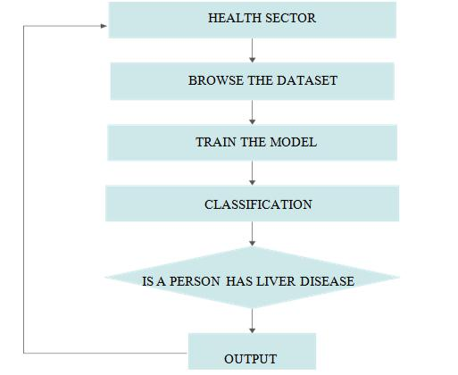
Support Vector Machine

Slide 10
Support Vector Machine

Slide 11
XGBoost

Slide 12
Snapshots

Slide 13
Snapshots

Slide 14
Snapshots

Slide 15
Snapshots

Slide 16
Snapshots

Slide 17
Snapshots

Slide 18
Conclusion
Predict the data analysis of the past rsults with team win or loss.
Use of Classifiers for results predictions
Project is very Flexible in Nature.
Calculated Probability could be used in process of making bets.

Slide 19
References
Rory P. Bunker, Fadi Fayez”A MACHINE LEARNING FRAMEWORK FOR SPORTS BETTING PREDICTION”, September 2017.
Fabián Enqri Moya, “STATISTICAL METHODOLOGY
FOR PROFITABLE SPORTS GAMBLING”, 2001.
L. Breiman, [Random Forests], “MACHINE LEARNING”, Oct. 2001
Tianqi Chen, Carlos Guestrin, “XGBOOST: A SCALABLE TREE BOOSTING SYSTEM”, 2016

Slide 20
THANK YOU

