Slide 1
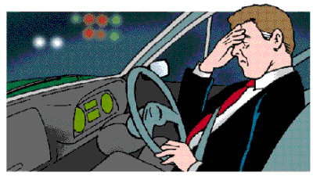
Driver Drowsiness Detection

Slide 2
Abstract
▶ Driver drowsiness has become one of the main reasons for large number of road accidents.
▶ The main aim of this project is to overcome the problem of road accidents which are related to drivers experiencing fatigue leads to a need arises to design a system that keeps the driver focused on the road.
▶ With the evolution and improvement in Computer Vision technologies, smart/intelligent cameras are developed to predict drowsiness in drivers, thereby alerting drivers which in turn reduce accidents when they are feeling drowsy.
▶ In this work, a new approach is taken using deep learning to detect driver drowsiness based on Eye state while driving the vehicle.
▶ To detect the face and extract the eye region from the face images, OpenCV algorithms and haar cascade classifier are used

Slide 3
Problem statement (Motivation)
▶ Sleep disorders increase the risk of road accidents by 300%, finds a World Bank study.
▶ Many of these truck drivers or bus drivers who drive vehicles on highways suffer from Obstructive Sleep Apnea (OSA), a disorder that majorly goes undetected because of lack of testing.
▶ 0% of all road accident victims are found suffering from sleep disorders and OSA and more than 23% of truck drivers have sleep deprivation. Clearly, these drowsy drivers can cause fatal accidents on roads.

Slide 4
Proposed Idea (Novelty)
▶ The drowsiness detection based on eye state has been done accurately based on the varying features and factors, and also with the help of experts knowledge.
▶ Predicting the facial landmarks and detecting the eye-state and displaying the driver status on the screen and producing alert sound if the driver is drowsy for drowsiness detection.
▶ Generally, the driving person feels drowsy due to continues driving for long hours or Physical illness or might be drunken and this leads to major road accidents.
▶ Our aim is to detect the drowsiness, make them alert to prevent accidents and generate an alarm sound.

Slide 5
Beneficiaries of the proposed solution(Societal Impact)
▶ with this Python project, we will be making a drowsiness detection system. A countless number of people drive on the highway day and night. Taxi drivers, bus drivers, truck drivers, and people traveling long-distance suffer from lack of sleep. Due to this, it becomes very dangerous to drive when feeling sleepy.
▶ The majority of accidents happen due to the drowsiness of the driver. So, to prevent these accidents we will build a system using Python, OpenCV, and Keras which will alert the driver when he feels sleepy.

Slide 6
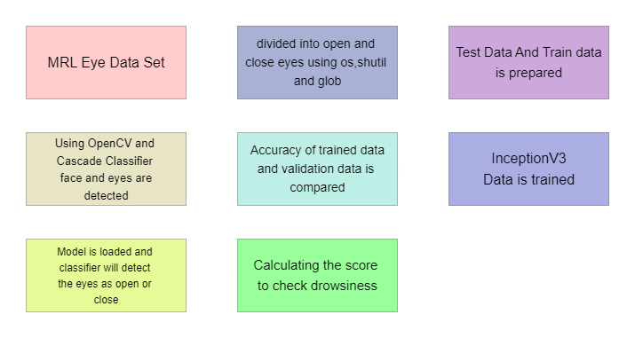
Block Diagram

Slide 7
Hardware and Software details
▶ a webcam through which we will capture images
▶ opencv-python (face and eye detection)
▶ tensorflow (keras uses TensorFlow as backend).
▶ keras (to build our classification model).
▶ Pygame (to play alarm sound).
▶ Data Set To build and train our model

Slide 8
Project Description
▶ OpenCV By using it, one can process images and videos to identify objects, faces, or even handwriting of a human.
▶ Detect Face in the Image and Create a Region of Interest (ROI)
▶ Detect the eyes from ROI and feed it to the classifier
▶ Classifier will Categorize whether Eyes are Open or Closed
▶ Calculate Score to Check whether Person is Drowsy

Slide 9
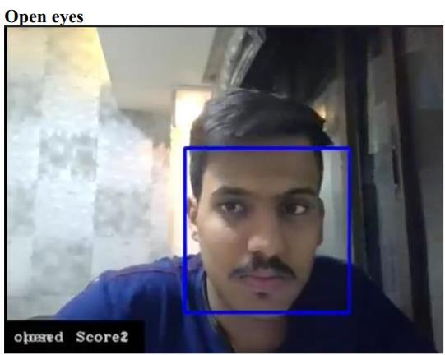
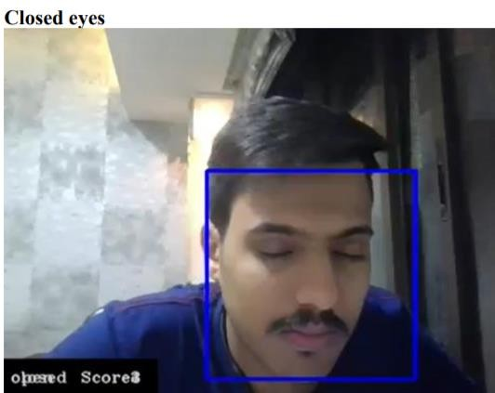
Results

Slide 10
References
▶[1] Manu, B. N. 2016. Facial features monitoring for real time drowsiness detection. 2016 12th International Conference on Innovations in Information Technology (IIT).
[2] Alshaqaqi, B., Baquhaizel, A. S., Amine Ouis, M. E., Boumehed, M., Ouamri, A., & Keche, M. 2013. Driver drowsiness detection system. 2013 28th International Workshop on Systems, Signal Processing and Their Applications (WoSSPA).
[3] Baek, J. W., Han, B.-G., Kim, K.-J., Chung, Y.-S., & Lee, S.-I. 2018. Real-Time Drowsiness Detection Algorithm for Driver State Monitoring Systems. 2018 Tenth International Conference on Ubiquitous and Future Networks (ICUFN).
[4] You, F., Li, X., Gong, Y., Wang, H., & Li, H. 2019. A Real-time Driving Drowsiness Detection Algorithm with Individual Differences Consideration. IEEE Access, vol. 7, pp. 179396-179408.
[5] Dasgupta, A., Rahman, D., & Routray, A. 2018. A Smartphone-Based Drowsiness Detection and Warning System for Automotive Drivers. IEEE Transactions on Intelligent Transportation Systems, 1–10.

