Slide 1
Machine Learning for COVID-19 detection in Chest X-Rays
Supervised by :
19.01.2022

Slide 2
Content
Introduction, Background and Motivation
Problem Statement
State-of-the-art Literature Review
Implementation
Explainability
Evaluation and Results
References
19.01.2022

Slide 3
Introduction, Background and Motivation
The COVID-19 or the SARS-CoV-2 originated from the district of Wuhan, China has transpired to be a pandemic worldwide [1].
Due to shortage and limited efficiency of testing mechanism through RT-PCR test kits [2], it motivated the possibility of diagnosing patient being COVID-19 positive or negative based on Chest X-Rays (CXRs) and CT-Scans.
This is also a highly active topic among artificial intelligence community and this motivated to involve Machine Learning and Computer Vision methodologies in application.
19/01/2022
3

Slide 4
Problem Statement
Our research experiment, tries to predict COVID-19 on CXRs with Interpretable Machine Learning Models and tries to explain the predictions.
How well could classifiers perform on Chest X-Rays?
Although state-of-the-art approaches extensively works with Neural Networks (Black-Box Model) to classify, Can simple and intrinsically explainable classifiers achieve a base Accuracy, F1-Score and AUC similar to state-of-the-art using CXR?
Can we come up with explanation of our model’s decision and prediction?
We aim to build a pipeline that on given CXRs predicts whether the image is a COVID-19 +or- based on 14 radiological features [3 , 4] and explains it based on it’s contribution to prediction.
19/01/2022

Slide 5
State-of-the-art literature review
Reference | Image Type | Machine Learning Techniques Used
Brunese, Luca, et al. | CXRs | VGG16, GradCam
Wang, Linda, et al. | CXRs | COVIDNet, VGG19, ResNet15
Zhang, Jianpeng, et al. | CXRs | DeepCNN, Anomaly Detection
Wu, Yu-Huan, et al. | CT | VGG16, Unet, DSS, EGNet, PoolNet
Kassani, Sara Hosseinzadeh, et al. | CXRs and CT | CNN Deep Features with Decision Tree, Random forests, XGBoost, AdaBoost, Bagging Classifier, LightGBM
Pereira et al. | CXRs | Multi-class classification using k-Nearest Neighbots (kNN); Support Vectors Machine (SVM); Multilayer Perceptrons (MLP); Dicision Trees (DT); and Random Forests (RF)
Chatterjee, Soumick, et al. | CXRs and CT | Techniques Surveyed: ResNet18, ResNet34, InceptionV3, InceptionResNetV2, DenseNet161
19/01/2022
Table 1. State-of-the-art literature-review: Similar approaches

Slide 6
Implementation
Data Collection The ground truth consists of 313 Positive COVID CXR and 1000 Negative CXR collected from four different sources to make our version of the dataset to work upon.
This includes COVIDx dataset from [33], Kaggle CXR Pneumonia dataset by Paul Mooney [34],
CXR images of adult subjects from the RSNA Pneumonia Detection Challenge [35], original and augmented versions of COVID-19 examples from [36].
We split the data set in ratio of 70:30 and trained the models with 920 data points and 393 test points.
19/01/2022
Figure 1 Source: https://jalajvora.github.io/COVID-19-predictions-on-Chest-X-Rays-using-Interpretable-Machine-Learning/

Slide 7
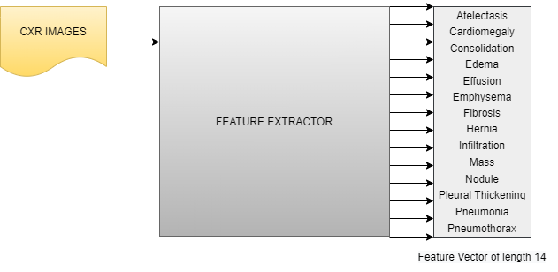
Implementation
Feature Extraction: Used CheXNet architecture as feature extractor detecting 14 radiological features from raw Chest X-Ray images.
19/01/2022
Figure 1 Source: https://jalajvora.github.io/COVID-19-predictions-on-Chest-X-Rays-using-Interpretable-Machine-Learning/

Slide 8
Implementation
Machine Learning Models
kNN
Linear Regression
SVM
Decision Tree
Random Forests
19/01/2022
Figure 1 Source: https://jalajvora.github.io/COVID-19-predictions-on-Chest-X-Rays-using-Interpretable-Machine-Learning/

Slide 9
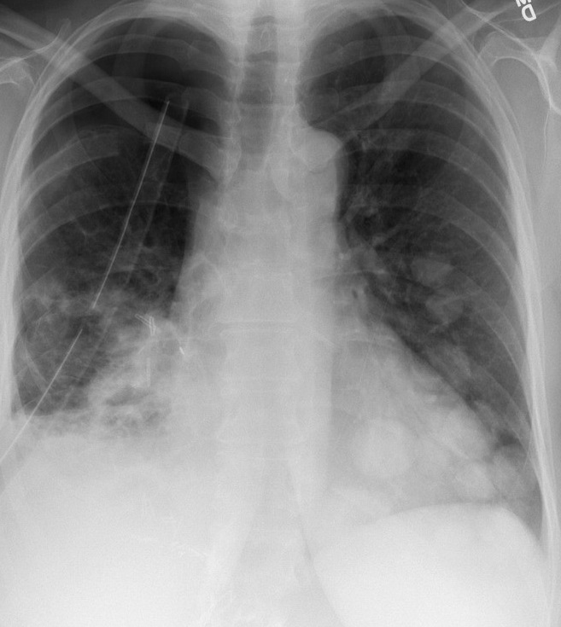
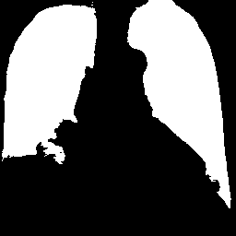
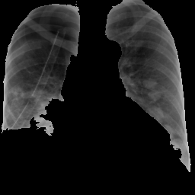
Approach: Pre-processing
Region of Interest: Masking and Segmentation of Lungs
19/01/2022
Figure 2 Source: https://jalajvora.github.io/COVID-19-predictions-on-Chest-X-Rays-using-Interpretable-Machine-Learning/

Slide 10
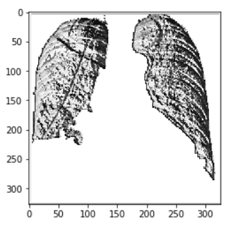
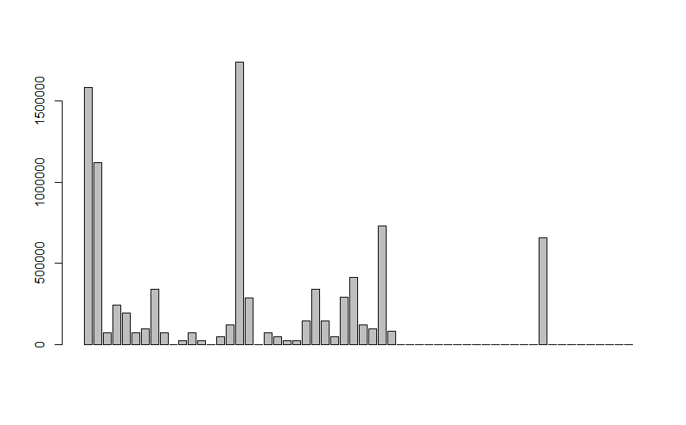
Feature Extraction: Local Binary Patterns
X-Ray Image
LBP Image
LBP Histogram
19/01/2022
Figure 3 Source: https://jalajvora.github.io/COVID-19-predictions-on-Chest-X-Rays-using-Interpretable-Machine-Learning/

Slide 11
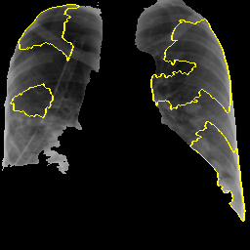
Explanation using LIME
19/01/2022
Figure 5 Source: https://jalajvora.github.io/COVID-19-predictions-on-Chest-X-Rays-using-Interpretable-Machine-Learning/

Slide 12
New Approach: Radiological Features
These 14 radiological features are namely:
Atelectasis
Cardiomegaly
Consolidation
Edema
Effusion
Emphysema
Fibrosis
Hernia
Infiltration
Mass
Nodule
Pleural Thickening
Pneumonia
Pneumothorax
19/01/2022
12

Slide 13
New Approach: State-of-the-art literature review - Feature Extraction
Reference | Image Type | Machine Learning Techniques Used
Nanni et al. | Neonatal facial, fluorescence microscope and smear cells images | LBP, LPQ, EQP, LTP, EBP, ILBP CSLBP and SVM
Parveen and Sthik | CXR | DWT, WFT, WPT and fuzzy C-means clustering
Scalco and Rizzi | CT, PET and MR | Grey-level histogram, GLCM, NGTDM, GLRLM and GLSZM
Zhou et al. | CT | YOLOv3, VGGNet and AlexNet
Narin et al. | CT | ResNet50, InceptionV3 and Inception-ResNetV2
Wang and Wong | CXR | COVID-Net a deep neural network created to detect NCP
Khan et al. | CXR | CoroNet a CNN created to detect NCP
Ozturk et al. | CXR | DarkNet and YOLO
19/01/2022
Table 2 State-of-the-art-literature-review: Feature Extraction

Slide 14
New Approach: State-of-the-art literature review - Feature Extraction
Reference | Image Type | Machine Learning Techniques Used
Nanni et al. | Neonatal facial, fluorescence microscope and smear cells images | LBP, LPQ, EQP, LTP, EBP, ILBP CSLBP and SVM
Parveen and Sthik | CXR | DWT, WFT, WPT and fuzzy C-means clustering
Scalco and Rizzi | CT, PET and MR | Grey-level histogram, GLCM, NGTDM, GLRLM and GLSZM
Zhou et al. | CT | YOLOv3, VGGNet and AlexNet
Narin et al. | CT | ResNet50, InceptionV3 and Inception-ResNetV2
Wang and Wong | CXR | COVID-Net a deep neural network created to detect NCP
Khan et al. | CXR | CoroNet a CNN created to detect NCP
Ozturk et al. | CXR | DarkNet and YOLO
19/01/2022
Table 2 State-of-the-art-literature-review: Feature Extraction

Slide 15
New Approach: Feature Extraction - Observations
More emphasis on automatic learning of features represented as features via hidden layer representation (Narin et. al.)
In case of handcrafted features, (for example used in Nanni et. al. ) more than one kind of descriptor is used with core aim of classification (and Not Explanation).
Radiological feature extraction and usage of such explicitly for learning is rarely studied in the community. The added advantage is that, the same helps in explanation to medical domain personnel.
19/01/2022

Slide 16
New Approach: Feature Extraction - Observations
More emphasis on automatic learning of features represented as features via hidden layer representation (Narin et. al.)
In case of handcrafted features, (for example used in Nanni et. al. ) more than one kind of descriptor is used with core aim of classification (and Not Explanation).
Radiological feature extraction and usage of such explicitly for learning is rarely studied in the community. The added advantage is that, the same helps in explanation to medical domain personnel.
19/01/2022

Slide 17
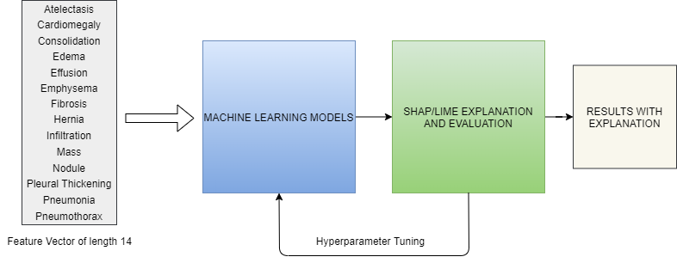
New Approach: Architecture
19/01/2022

Slide 18
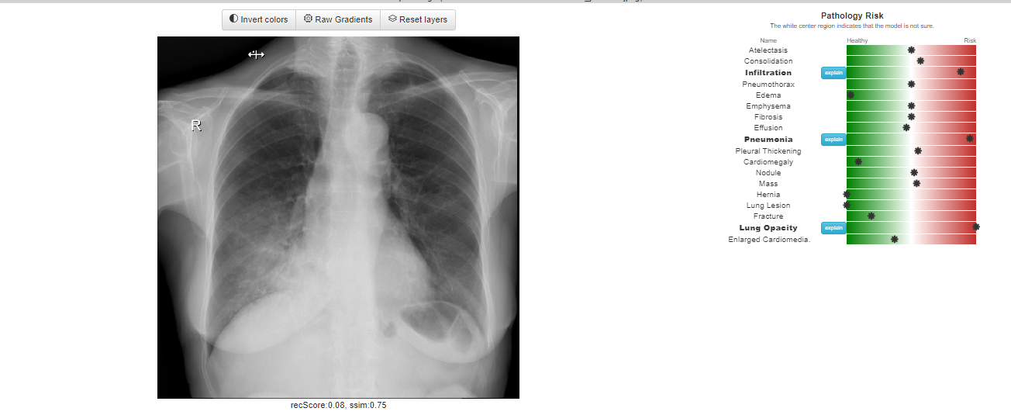
New Approach: UI/UX Design (tentative)
19/01/2022
Figure 7 Source: https://mlmed.org/tools/xray/

Slide 19
Evaluation
Factors based on which performance of models would be determined:
F1-Score
AUC/ROC
Accuracy
19/01/2022

Slide 20
References
Toussie, Danielle & Voutsinas, Nicholas & Finkelstein, Mark & Cedillo, Mario & Manna, Sayan & Maron, Samuel & Jacobi, Adam & Chung, Michael & Bernheim, Adam & Eber, Corey & Concepcion, Jose & Fayad, Zahi & Gupta, Yogesh. (2020). Clinical and Chest Radiography Features Determine Patient Outcomes In Young and Middle Age Adults with COVID-19. Radiology. 201754. 10.1148/radiol.2020201754.
Ye, Wenjing & Gu, Wen & Guo, Xuejun & yi, Ping & Meng, Yishuang & Han, Fengfeng & Yu, Lingwei & Chen, Yi & Zhang, Guorui & Wang, Xueting. (2019). Detection of pulmonary ground-glass opacity based on deep learning computer artificial intelligence. BioMedical Engineering OnLine. 18. 10.1186/s12938-019-0627-4.
Santosh, K.C.. (2020). AI-Driven Tools for Coronavirus Outbreak: Need of Active Learning and Cross-Population Train/Test Models on Multitudinal/Multimodal Data. Journal of Medical Systems. 44. 10.1007/s10916-020-01562-1.
Zare, Mohammad Reza & Alebiosu, David & Lee, Sheng. (2018). Comparison of Handcrafted Features and Deep Learning in Classification of Medical X-ray Images. 1-5. 10.1109/INFRKM.2018.8464688.
19/01/2022

Slide 21
Thank You!
Questions?
19/01/2022

