Slide 1
Face Verification Login in Social Web

Slide 2
Agenda
Abstract
Introduction
Aim & Scope
Existing System
Proposed System
System Architecture
System Design
References

Slide 3
Abstract
Biometrics in Social web applications.
Face Verification Login in fb, twitter, etc .
Face Verification techniques like OpenCV and HAAR-Cascades Algorithms to Verify faces.
Proposed technique amazingly enhances any face logins using feature Extraction.

Slide 4
Introduction
Creating and developing a computational prototype of face identification is quite challenging .
Face recognition/identification in world pandemic issue.
Facial recognition to identify infected individuals with COVID-19.
It can detect the body temperature of the folks on the streets, and it can assume who is infected with the virus or not via the facial expression and the temperature of each person on the streets and public places.

Slide 5
Aim
Develop a web-based application that performs in a way to define and recognize faces.
Fast, accurate, and reasonably simple
The face recognition/identification software can be used by governmental sectors such as finding criminal records and suspects in the checkpoints.

Slide 6
Scope
The application is applicable for society during pandemic.
The application is used in Logging into social websites like fb,twitter,Insta.
The System should be capable in E-Governance sectors.

Slide 7
Existing System
Biometric Recognition(Fingerprint).
Fake/Proxy Signature in Criminal Records
Worldwide Pandemic Issue

Slide 8
Proposed System
Proposed system will allow people to capture infected cases using facial expressions.
It can be used to recognize CCTV cameras footages which depicts clear image of accused in criminal offences.
Use of Face capture in logging into social websites.

Slide 9
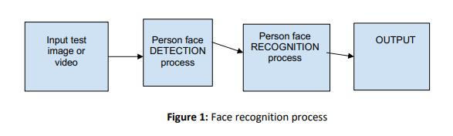
System Architecture

Slide 10
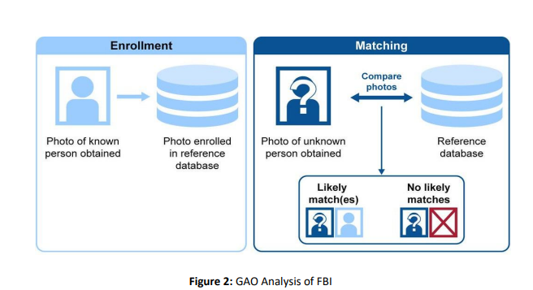
System Design

Slide 11
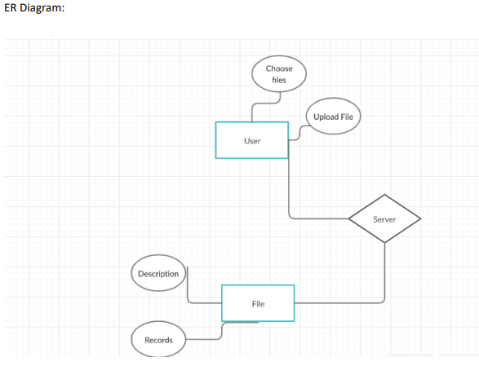
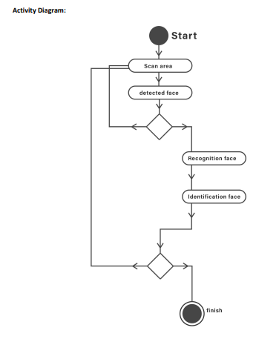
System Design

Slide 12
References
Brandon Amos, Bartosz Ludwiczuk, Mahadev Satyanarayanan. OpenFace; A general-purpose Face recognition library with mobile applications June, 2016.
Iman Ghoshm, Face Recognition World Map Visual Capitalist Website May, 2020
Ergun Gumos, Evaluation of face recognition techniques using PCA, wavelets and SVM Science Direct September, 2010.
Andreea Diana Dinca, Face Detection/Recognition Research Paper University of Birmingham November, 2017.

Slide 13
THANK YOU

