Slide 1
SAFE SOCIAL DISTANCE MONITORING SYSTEM
SUBMITTED BY
UNDER THE GUIDANCE OF

Slide 2
TABLE OF CONTENT
INTRODUCTION
OBJECTIVE
METHODOLOGY
REQUIREMENTS OF THE SYSTEM
ADVANTAGES AND APPLICATION
EXPECTED OUTCOME OF THIS PROJECT
REFERENCES

Slide 3

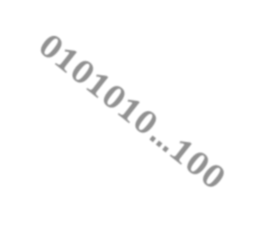
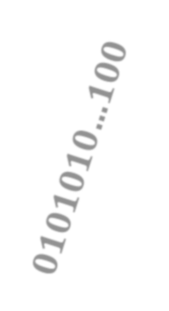
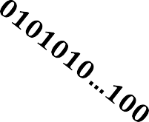

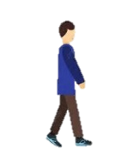



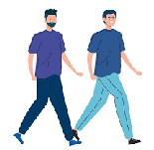

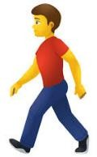

INTRODUCTION
To limit the spread of an infectious disease, for instance, Covid-19, is to
practice social distancing
Cloud
No Risk
Low Risk
High Risk

Slide 4
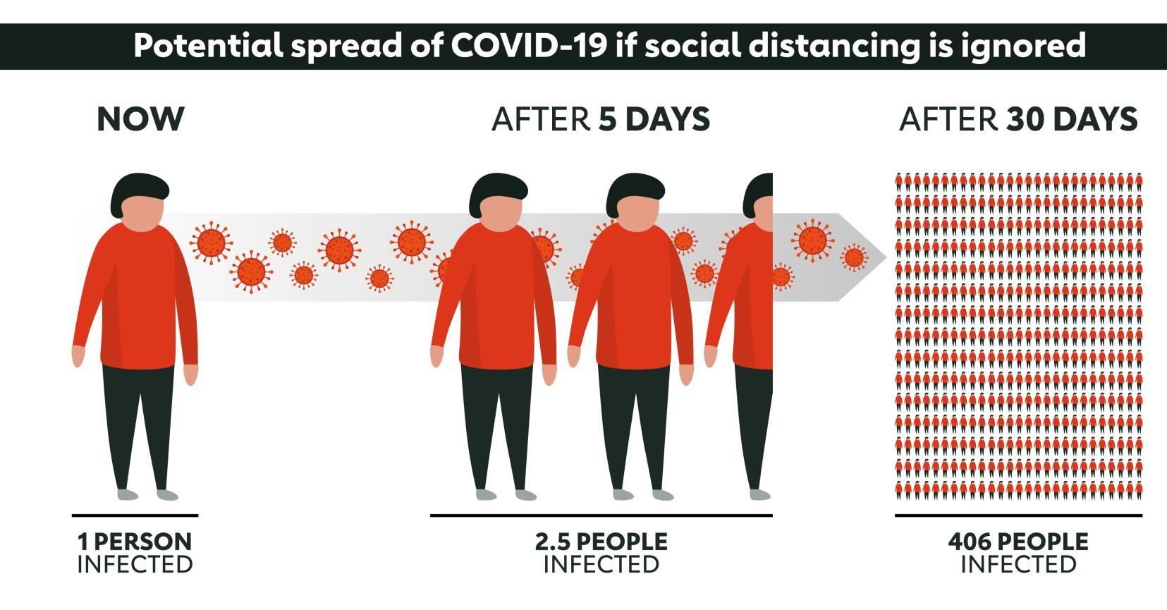
The objective is to reduce transmission, delaying the epidemic peak, reducing the size of the epidemic peak, and spreading cases over a longer time to relieve pressure on the healthcare system.

Slide 5
Methods of Social Distancing - Cancellation of events which involve large numbers of people gathering together, such as
Closure of Community Facilities
Closure of non-essential workplaces
Closure of schools - Closure of colleges and universities
Self-Shielding
Individuals limit face-to-face contacts
Individuals avoid public places
Individuals avoid public transport

Slide 6
OBJECTIVES
Detect humans in the video frame.
Calculates the distance between every human detected in the frame.
Shows how many people are at High, Low and not at risk.
Provide sound Alert for people at high risk to maintain safe social distancing.

Slide 7
METHODOLOGY
Camera
Send Email
Social Distancing Detection
Fig : Block Diagram of Proposed System
The proposed system focuses on how to identify the person on image/video stream whether the social distancing is maintained or not with the help of computer vision and deep learning algorithm by using the OpenCV, YOLO V3.

Slide 8
REQUIREMENTS OF THE SYSTEM
SOFTWARE REQUIREMENTS
Python
OpenCV
Yolov3
HARDWARE REQUIREMENTS
1) Camera
2) 16GB SD Card

Slide 9
ADVANTAGES OF THE SYSTEM
Reassuring Employees
Most of employee’s not wanting to return to the office until the workplace is made safe, having social distancing detection in the workplace is a great way of reassuring staff that the workplace has been made safe for their benefit.
Utilising Space
With the detection software we will have the ability to see which areas gain the most traction and are the offices ‘hotspots. From this data we will then be able to put the most relevant safety measures in place.
Monitoring & Measuring
The technology isn’t just for the office, for example, at a factory where employees are very close to each other, the software can be integrated into their security camera systems. Allowing them to monitor the working environment and highlight people whose distancing is below the minimum acceptable distance.
Queue Monitoring
For retail, healthcare and industries where queuing is avoidable, queue monitoring can be integrated into your cameras. The cameras will then have the ability to monitor and detect whether people are abiding by the social distancing guidelines. The solution can also be set up to work with automated barriers and digital signage for real-time notifications and health and safety information.

Slide 10
APPLICATIONS OF THE SYSTEM
Airports
Hospitals
Offices
Manufacturing Plants
Retail Shops
Metro Stations
Public Libraries
Schools
Religious Places

Slide 11
EXPECTED OUTCOME
The proposed system will be able to detect humans in the video frame.
Calculates the distance between the persons in the video frame.
Highlight the High, Medium and Low risk of people using bounding box.
Email the Alert at High Risk by indicating the failure of social
distancing to the remote-control room.
This system works effectively and efficiently in identifying the social distancing between the people and generating the alert that can be handled and monitored.

Slide 12
REFERENCES
Rahul Reddy Nadikattu, Sikender Mohsienuddin Mohammad and Pawan Whig, Novel Economical Social Distancing Smart Device for Covid19. International Journal of Electrical Engineering and Technology, 11(4), 2020, pp. 204-217
Sizhen Bian , Bo Zhou and Paul Lukowicz ,Social Distance Monitor with a Wearable Magnetic Field Proximity Sensor, Received: 1 August 2020; Accepted: 3 September 2020; Published: 7 September 2020
Gayathri Devi Ramaraj, Sriram Venkatakrishnan, Balasubramanian, Soorya Sridhar,” Aerial Surveillance of Public Areas with autonomous track and Follow using Image processing”, Department of Electrical and Electronics Sri Sairam Engineering College, Chennai, India /10.1109/ICONDA.2017.8270406
P. Dollar, V. Rabaud, G. Cottrell, and S. Belongie, “Behavior recognition ´ via sparse spatio-temporal features,” in 2005 IEEE International Workshop on Visual Surveillance and Performance Evaluation of Tracking and Surveillance. IEEE, 2005, pp. 65–72.

Slide 13
THANK YOU ……

