Slide 1
Phase-1 PRESENTATION ON
“CROP PREDICTION USING ML”

Slide 2
Crop Yield Prediction Using ML

Slide 3
DISCUSSION ON
INTRODUCTION
WHY CROP PREDICTION ?
HOW WE PREDICT ?
ARTIFICIAL NEURAL NETWORK
BACK-PROPOGATION ALGORITHM
DESIGN FLOW
FUTURE WORK
CONCLUSION
REFRENCES

Slide 4
INTRODUCTION
Crop prediction methodology is used to predict the suitable crop by sensing various parameter of soil( such as pH , Nitrogen , Phosphate , Potassium, ) and also parameter related to atmosphere( such as sunshine hours , rainfall , temperature).

Slide 5
CONT..
These weather conditions have a direct effect on crop yield.
There are various effective tool in modeling and prediction.
These tools have certain parameters that decide the crop type.
Hence these parameters are considered as the input for the proposed system and based on the manipulation with these inputs, the desired output must be produced.

Slide 6
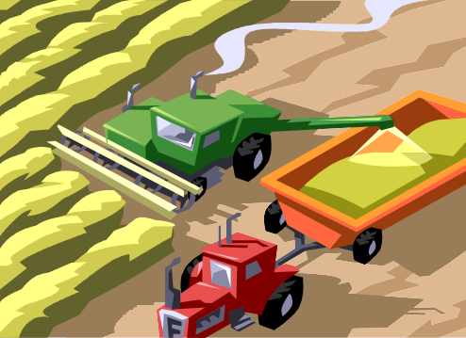
WHY ??
Agriculture is a business with risk and reliable crop yield prediction is vital for decisions related to agriculture risk management.
The vision of meeting world’s food demands for the increasing population throughout the world is becoming more important in these recent years.
Eventually, helps in achieving ZERO hunger.
Predictions could be used by crop managers to minimize losses when unfavorable conditions may occur.

Slide 7
HOW??
There is Scalable, Accurate, and Inexpensive and a versatile method to predict crop
yield i.e..,
“ARTIFICIAL NEURAL NETWORK”
Information processing architecture loosely modeled on the brain.
Consist of a large number of interconnected processing units.
Work in parallel to accomplish a global task .
Main function is to receive a set of input , perform progressively complex calculation and use the output to solve a problem.

Slide 8
An ANN is typically defined by three types of parameters:
The interconnection pattern between different layers of neurons( commonly called weight).
The learning process for updating the weights of the interconnections
The activation function that converts a neuron's weighted input to its output activation.

Slide 9
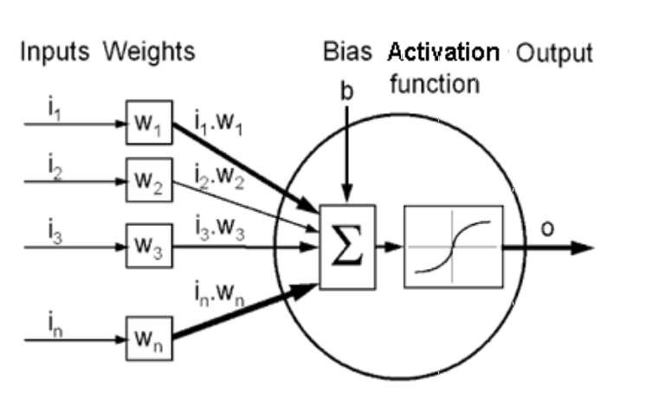
SINGLE LAYER NEURON DIAGRAM

Slide 10
BACK-PROPAGATION MODEL
One of the most widely used algorithms for training the multi-layer neural networks is the back-propagation algorithm.
The back-propagation algorithm attempts to find the minimum of the error function using methods based on the gradient descent which send their signals “forward”, and then the errors are propagated backwards.
The model have 3 layers: Input layer
Output layer
Hidden layer

Slide 11
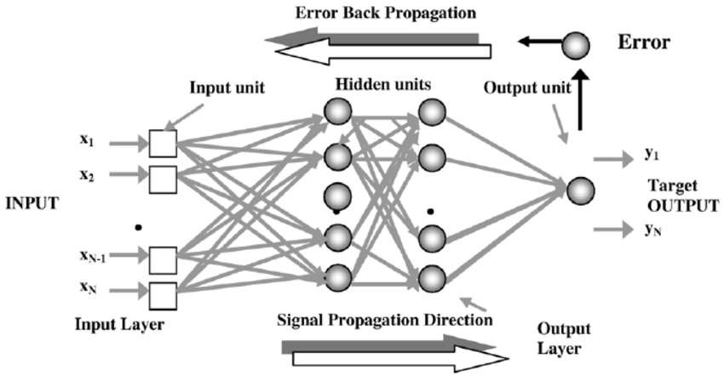
BACK PROPAGATION MODEL

Slide 12
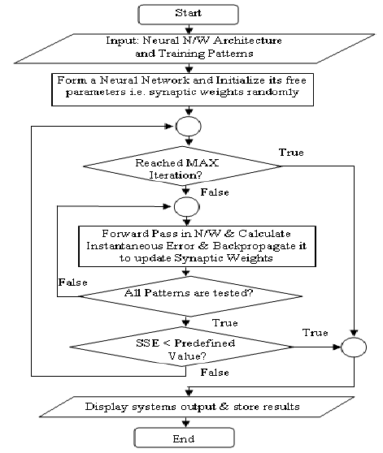
FLOWCHART

Slide 13
DESIGN FLOW
The process of developing the proposed system involves the following process:
Data collection/ Preparation
Build the Prediction Model
Classification
Fertilizer suggestion for respective crop.

Slide 14
Feed-forward back propagation mechanism and its shown below:
parameters are
No of input neurons=7 (pH, N ,K ,P , DEPTH ,TEMP ,RAINFALL) No of output neurons=1
No of hidden layers= more than 50
Learning rate varies from 0-1
No of iteration perform 10000-12000 activation functions

Slide 15
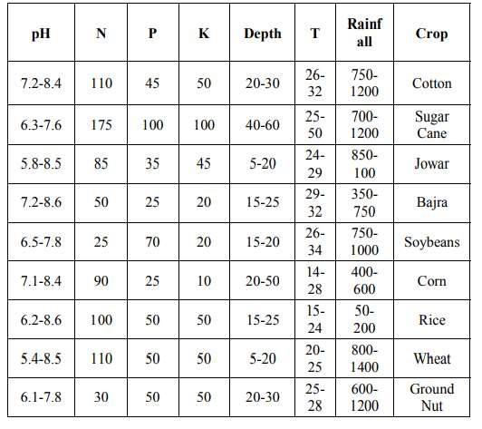
Data collection

Slide 16
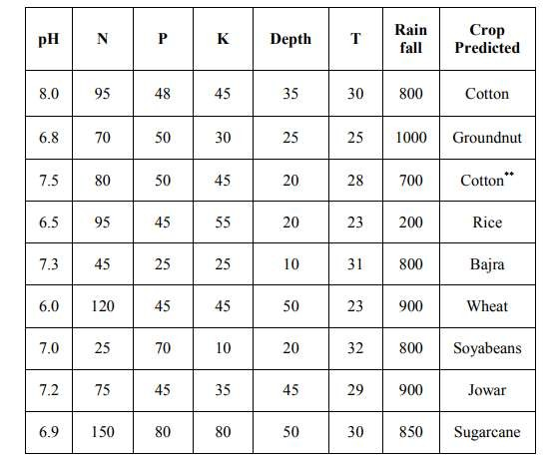
PREDICTED CROPS BY THE SYSTEM FOR VARIOUS INPUT
PARAMETERS

Slide 17
How to compute output:
y= ∑ wi*xi + bi
The output can be obtain using the formulae where,
t= target output,
y=actual output of output neuron.
n=the number of input units to the neuron, wi=the ith weight ,
xi=the ith input value to the neuron
E=1/2(t-y)^2

Slide 18
SUGGESTION OF FERTILIZERS
In such controversial situation the proposed system has an added advantage of suggesting the fertilizer for his land for his desired crop.
Here Nitrogen, Phosphate and Potassium are the three basic important minerals for a
crop growth and hence the fertilizer suggestion is based on these three values.
If there is the optimum availability of these basic nutrition in the soil, then no fertilizers are required. When there occurs the deficiency of nutrients then the fertilizers are suggested

Slide 19
REFERENCES
Agarwal Sachin (2001). Application of Neural Network to Forecast Air Quality Index.
B. J I ET AL Artificial neural networks for rice yield prediction in mountainous regions.
Raorane, A.A. and R.V. Kulkarni, 2012. Data mining: An effective tool for yield estimation in the agricultural sector. Int. J. Emerg. Trends Technol. Comput. Sci., 1: 75- 79.
McCue, C., 2006. Data Mining and Predictive Analysis: Intelligence Gathering and Crime Analysis. 1st Edn., Butterworth-Heinemann Ltd., UK., ISBN-13: 978-0750677967, Pages: 368.

Slide 20
THANK YOU…
ANY QUERIES??

