Slide 1
Face Analytics
Detecting Face, Emotion, Gender from Images,
using Convolutional Neural Networks

Slide 2



Product Features
Face Detection
Emotion Detection
Gender Detection

Slide 3
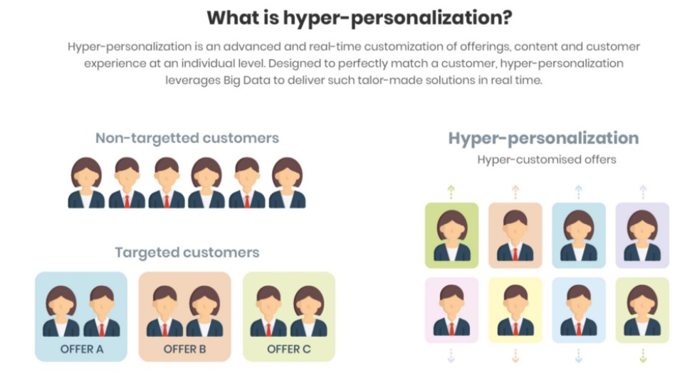
Problem Statement
This project aims to detect and classify human faces by emotions, gender to allow companies to better customise user experience, improve customer loyalty and generate additional sales
Improve understanding of emotions induced by products that customers interact with, and how these impact customer satisfaction and their decisions to purchase

Slide 4
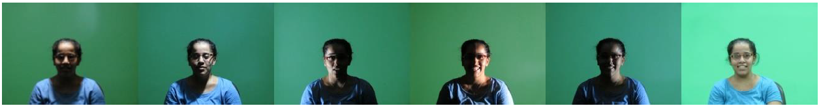
Data Collection, Pre-Processing & Exploratory Data Analysis
The Specs on Face (SoF) dataset (https://sites.google.com/view/sof-dataset)
Collection of images for 112 persons who wear glasses under different illumination conditions
Devoted to two main problems: face occlusions and harsh illumination environments

Slide 5
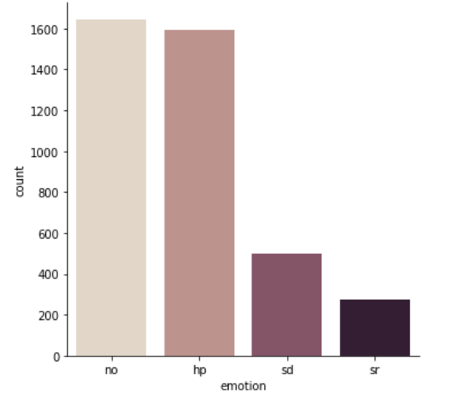
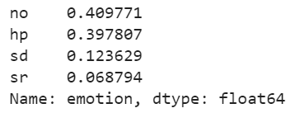
Data Collection, Pre-Processing & Exploratory Data Analysis
Four emotion labels provided in dataset
No: Neutral
Hp: Happy
Sd: Sad/Angry/Disgusted
Sr: Surprised/Fearful
Added CK+48 dataset (https://www.kaggle.com/shawon10/ckplus) to increase size of train data for hp/sd/sr emotion classes

Slide 6
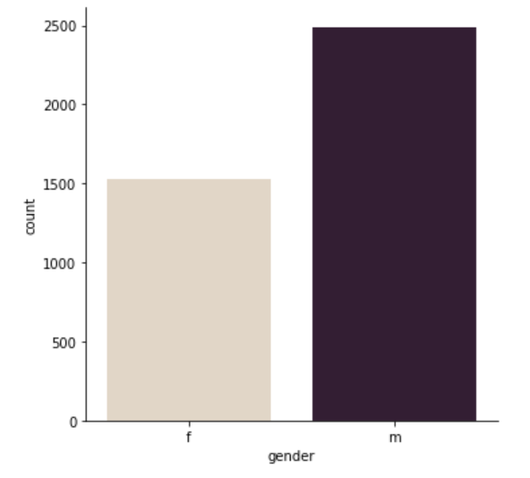
Data Collection, Pre-Processing & Exploratory Data Analysis
Gender labels also provided in SoF dataset

Slide 7
Data Collection, Pre-Processing & Exploratory Data Analysis
Resize to standardise all images (150x150 px)
Convert to greyscale and normalise images to reduce effect of poor lighting
Tried Adaptive Thresholding, but did not improve results
Image augmentation to increase size of train dataset (horizontal flipping)

Slide 8
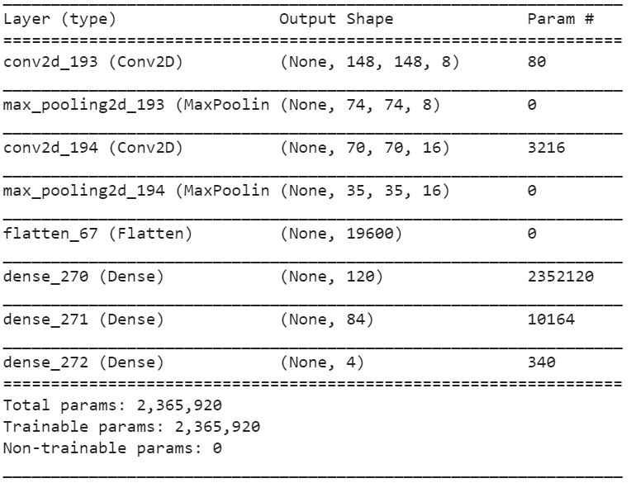
CNN Models Implemented
Face Detection – Transfer Learning using pre-trained MTCNN model
Emotion, Gender Detection – Reference from simple LeNet-5 architecture
Expected Emotion accuracy = 60.0%
Expected Gender accuracy = 93.6%

Slide 9
Emotion Detection Model: Initial Problems and Subsequent Improvements
Imbalanced classes
Class weights to penalise the model more for wrong predictions on images from smaller classes
Overfitting
Dropouts, Batch Normalization, Early Stopping methods
Difficult to tune hyperparameters manually given time and resource constraints
Hyperas/Hyperopt (Bayesian Sequential Model-based Optimisation)
Uses information from past trials to inform next set of hyperparameters to explore

Slide 10
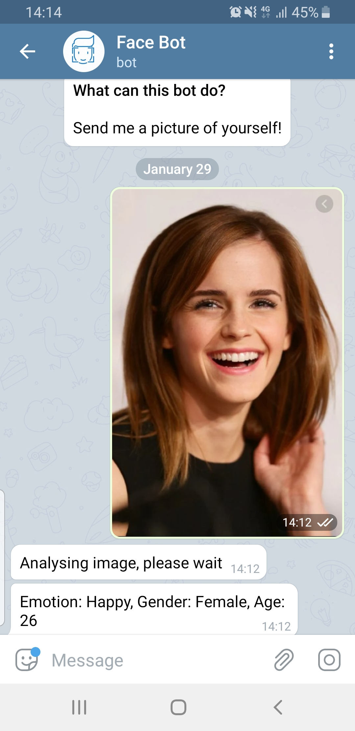
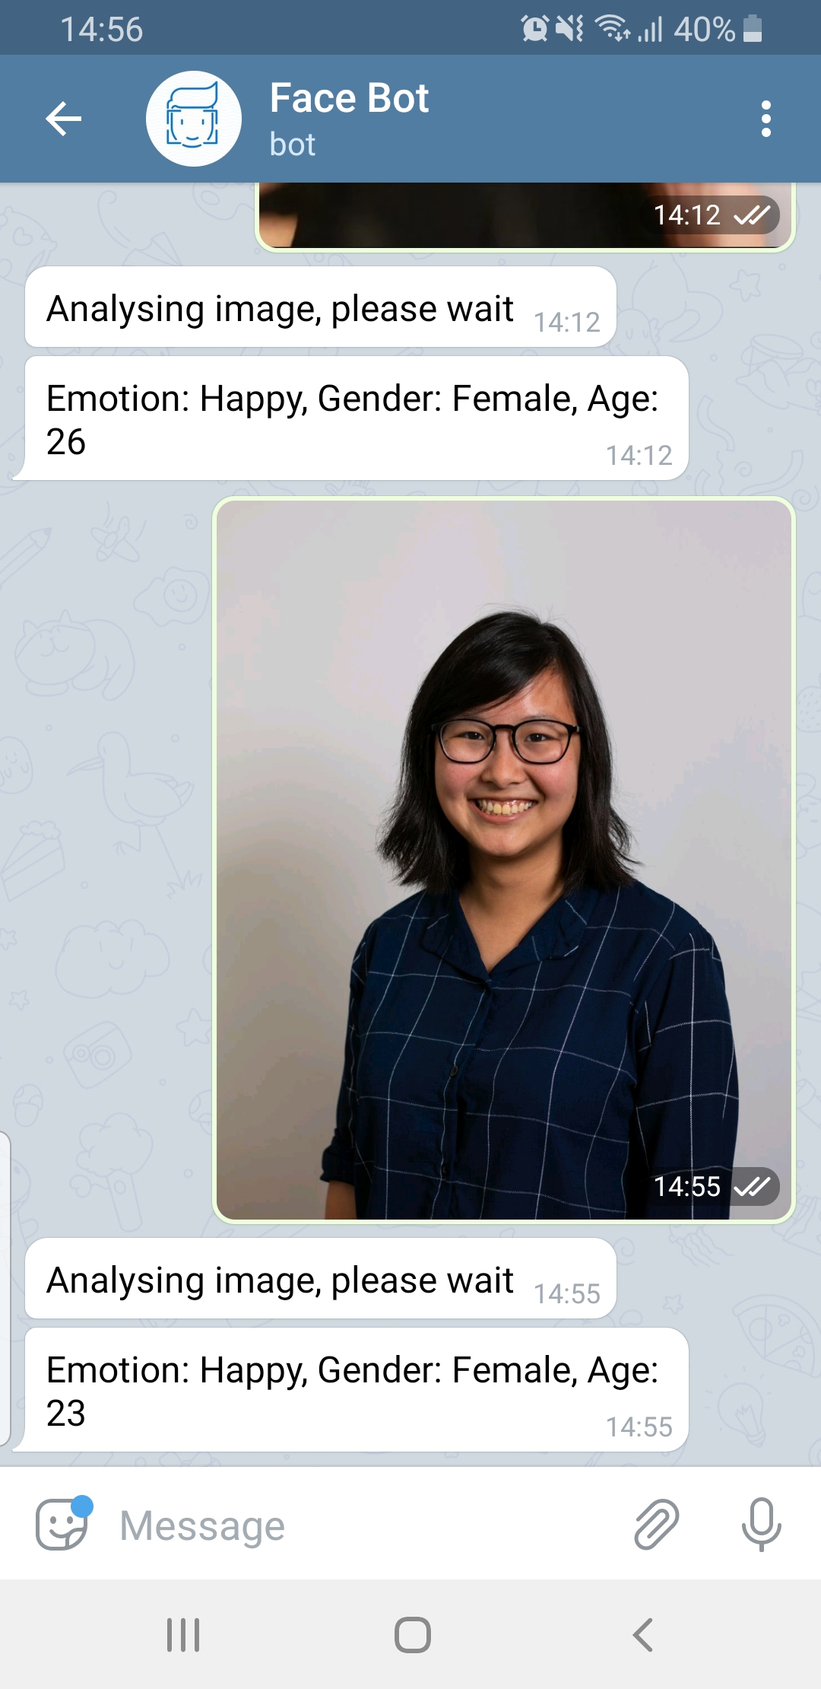
Deployment to Telegram App using Heroku
Telegram bot @FaceClassificationBot
Real time prediction of a person’s emotions, gender based on the image provided by the user

Slide 11
Project Limitations
Models trained on SoF dataset, which is not representative of population
Most volunteers were from Egypt, very few Asians
Age range mostly between 20-35 years old – model performs poorly on very young (e.g. babies) or very old people
Emotions are complex, even humans get it wrong sometimes
Challenging to judge someone’s emotions just by their facial expressions
Consider body language, choice of words, tone of voice

