Slide 1

KALPATARU INSTITUTE OF TECHNOLOGY,TIPTUR-572201 DEPARTMENT OF COMPUTER SCIENCE ENGINEERING
Project Title : Face Recognition Based On Student Attendance System Using OpenCV
Carried by
Under the guidance of
Department of Computer Science & Engineering
Kalpataru Institute of Technology, Tiptur-572201

Slide 2
AGENDA
Introduction
Problem Statement
Aims and Objectives
Project Features
Literature Review
Methodology
Proposed Block Diagram
Proposed System Design
Snapshots
Reference

Slide 3
INTRODUCTION
It is a system for managing the Student attendance effectively.
It helps to overcome the situation now are facing of using manual system like signature RFID,
Finger Print based attendance system but they fail to proof attendance system.
It helps the admin to manage:
Student Attendance record
Image process and manipulation
Student Details
Generating student attendance report

Slide 4
PROBLEM STATEMENT
The old system of keeping records in Attendance management system.
On which records are kept in a paper file by hand.
There were many problems such as :-
Lack of security
Time consuming
Consumes large volume of paperwork.
lack of storage.
Difficulty in data searching

Slide 5
AIMS AND OBJECTIVES
To develop a portable Smart Attendance System which is handy and self-powered.
To ensure the speed of the attendance recording process is faster than the previous system which can go as fast as approximately 3 second for each student.
To detect unique faces with the help of computer’s camera
Able to recognize the face of an individual accurately based on the face database.
Allow parents to track their child’s attendance.
Develop a database for the attendance management system.
Provide a user-friendly interface for admins to access the attendance database and for non-admins (parents) to check their child’s attendance by mailing the attendance.

Slide 6
PROJECT FEATURES
Long term storage of records
High accuracy in calculation.
Time saving Work space
Data consistency
Optimize the resource
Efficiency in modification, sorting and retrieval of data.
Inexpensive updating in facilities and terms of organizations.

Slide 7
LITERATURE REVIEW
Signature Based Attendance System
Fingerprint Based Attendance System Using Microcontroller and LabView
RFID Based Student Attendance System
Face Recognition Attendance System

Slide 8
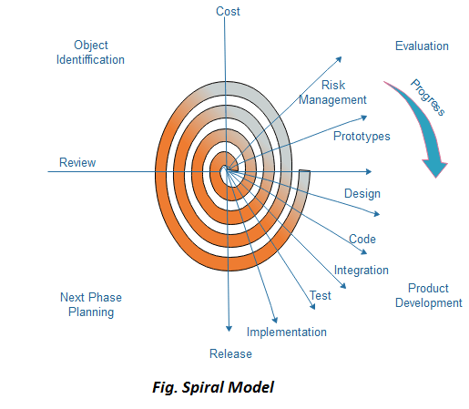
METHODOLOGY
Initially proposed by Boehm, is an evolutionary software process model that couples the iterative feature of prototyping with the controlled and systematic aspects of the linear sequential model.
It implements the potential for rapid development of new versions of the software. Using the spiral model, the software is developed in a series of incremental releases.

Slide 9
SPIRAL MODEL
Each cycle in the spiral is divided into four parts:
Objective Setting:
Risk Assessment and reduction:
Development and validation:
Planning:

Slide 10
WHEN TO USE SPIRAL MODEL?
When the deliverance is required to be frequent.
When the project is large
When requirements are unclear and complex
When changes may require at any time
Large and high budget projects
High amount of risk analysis
Useful for large and mission-critical projects

Slide 11
ADVANTAGES OF SPIRAL MODEL
High amount of risk analysis
Useful for large and mission-critical projects

Slide 12
SOFTWARE DESCRIPTION
OpenCV: open-source library used for computer vision
HAAR-Cascade Detection in OpenCV
The HAAR cascade is a machine learning approach where a cascade function is trained from a lot
of positive and negative images.
OpenCV provides the trainer as well as the detector.
Two primary states of the cascade image classifier first one is training
and the other is detection.
Two types of samples:
Negative sample: It is related to non-object images.
Positive samples: It is a related image with detect objects.

Slide 13
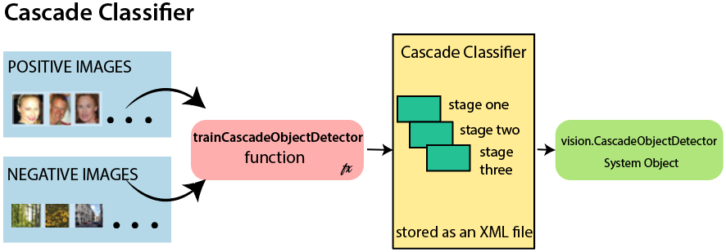
CASCADE CLASSIFIER MECHANISM

Slide 14
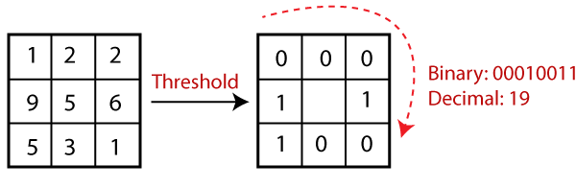
LBPH(Local Binary Pattern Histogram):
LBPH algorithm is a simple approach that labels the pixels of the image thresholding the neighborhood of each pixel.

Slide 15
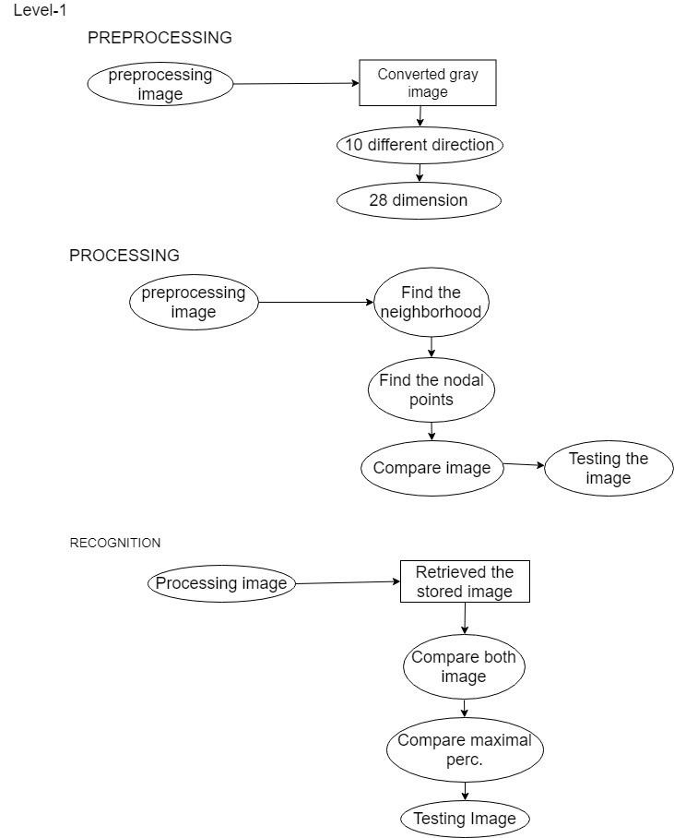
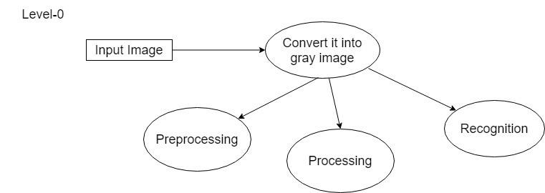
PROPOSED BLOCK DIAGRAM

Slide 16
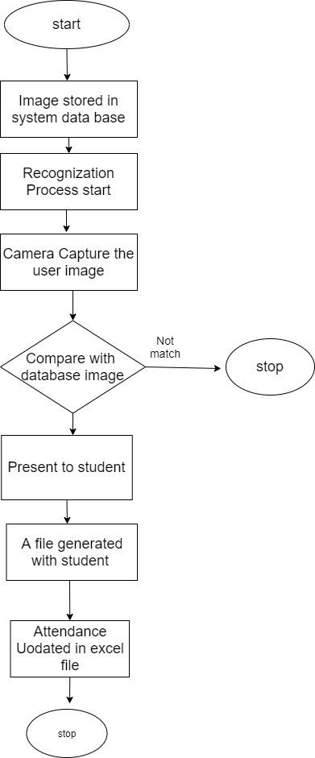
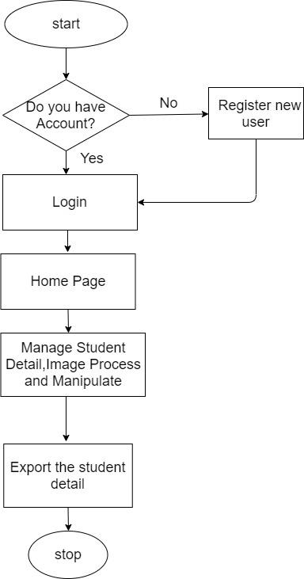
WORKING PRINCIPLE
Flow chart for Admin and Face Recognition System

Slide 17
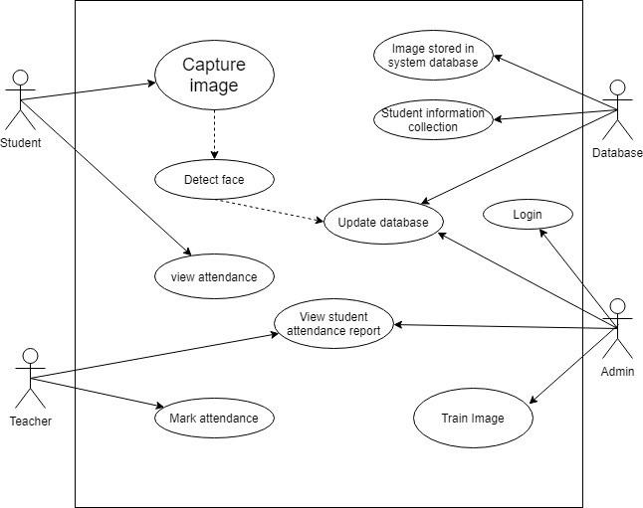
PROPOSED SYSTEM DESIGN
Use Case Diagram

Slide 18

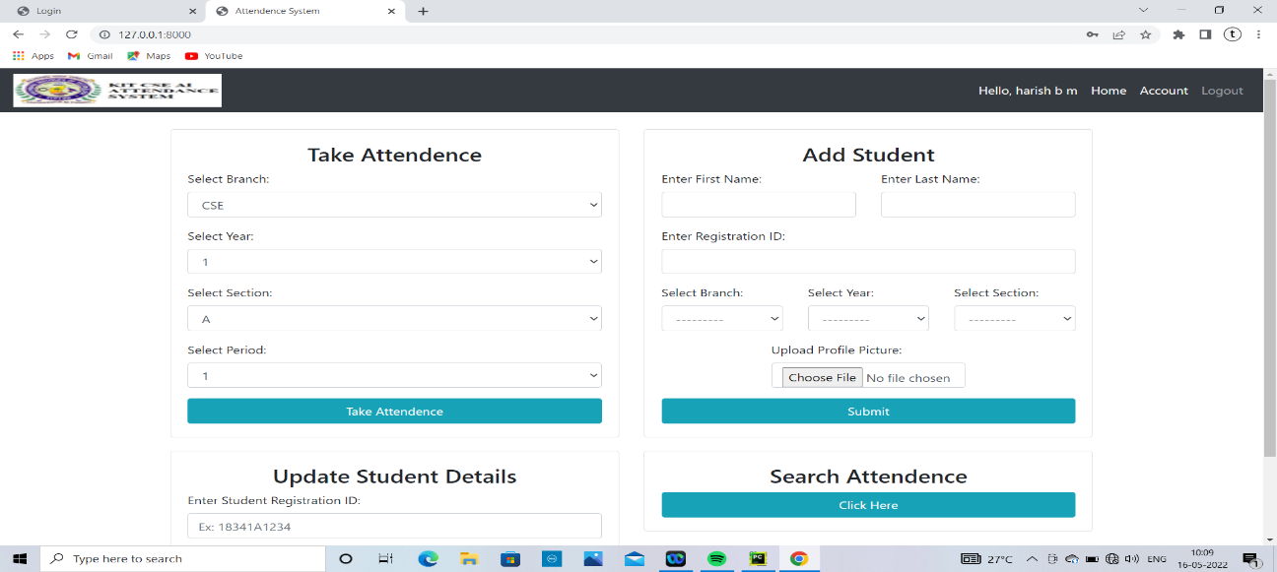
SNAPSHOTS
Login page
student Management Interface

Slide 19
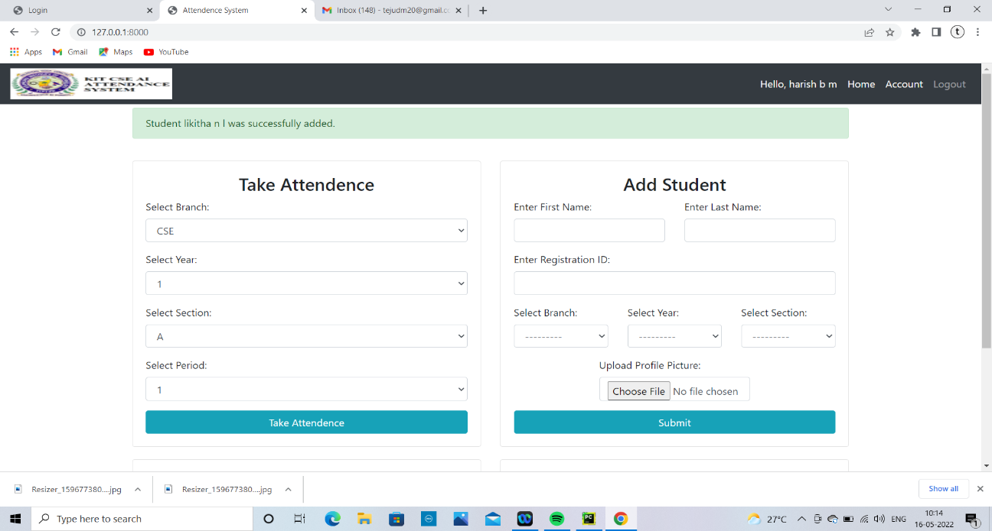
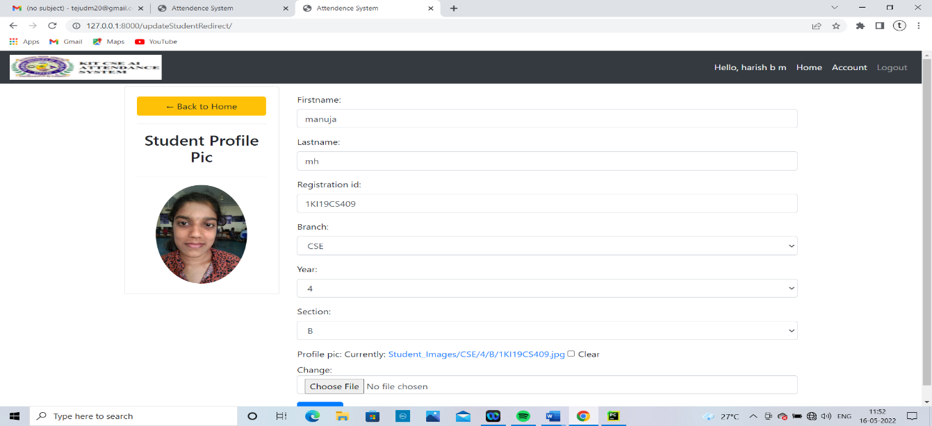
Student Registration Page
Student Profile Page

Slide 20
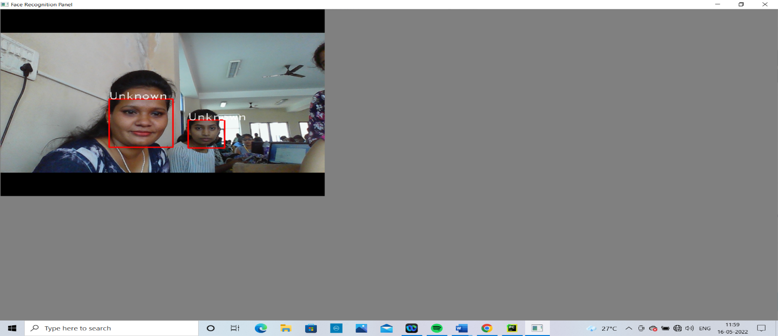
Face Detection with accuracy
Unknown Face with less accuracy

Slide 21
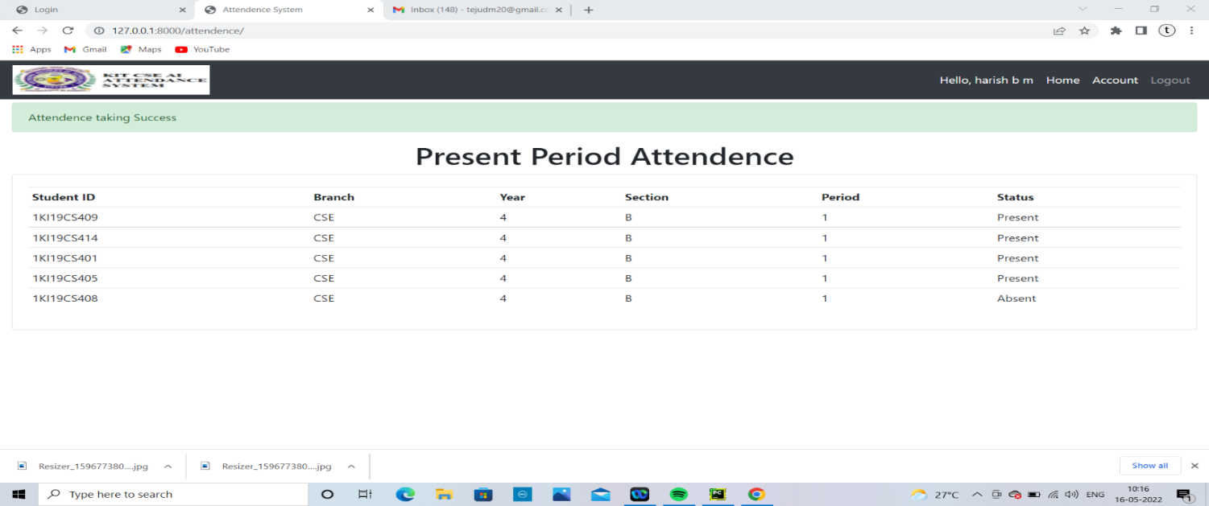

Student Attendance Details
Deleting Student Attendance Details

Slide 22
REFERENCES
[1] “Smart Attendance Management and Analysis with Signature Verification”(Hardika Chauhan, Chitaliya Nehal,2017)
[2] “Fingerprint Based Attendance System Using Microcontroller and LabView” (Kumar Yadav, Singh, Pujari, Mishra, 2015)
[3] “A Proposed RFID Based Student Attendance System “(Fawzi M Al-Naima and Maryam Alaa Saleh, (1 May) 2015)
[4] Charles A. Walton, electronic identification & recognition system Filed: Dec. 27, 1971 Appl. No.: 212,281.
[5] https://www.javatpoint.com/
[6] Smart Attendance System using Computer Vision and Machine Learning ( Dipti Kumbhar#1 , Prof. Dr. Y. S. Angal*2 # Department of Electronics and Telecommunication, BSIOTR, Wagholi, Pune, (7 July) 2017)

Slide 23
Thank YOU

