Slide 1
Topic:Disease Detection in Plants using Machine Learning

Slide 2
Table of Contents
•
•
•
•
•
•
•
•
•
•
•
Abstract Introduction Motivation Literature Survey Problem Statement Objective and Scope System Requirement
Architecture
Modules for Training and Testing Modules for Image Processing Algorithm

Slide 3
Abstract
The project presents plant disease detection using image processing techiques for automated visison system used at agricultural field.
In agriculture research of automatic plant disease detection is essential one in monitoring large fields of crops, and thus automatically detects symptoms of disease as soon as they appear on plant leaves.
•
For this approach, automatic classifier CNN will be used for
classification based on learning with some training samples of that two category. Finally, the simulated result shows that used network classifier provides minimum error during training and better accuracy in classification.
Farmer approach to agricultural consultant for recognization of plant disease.
•

Slide 4
Introduction
Definition of Machine learning.
Prevention of diseases is essential
Experts cannot give consistent diagnosis
Computer aided system have been made to automatically detect diseases in plant leaves

Slide 5
Motivation
It is very difficult for farrners to identified various disease in plants.
The estimated annual crop losses due to plant disease at world wide is
$60 Billions.
The traditional toots and techniques are not very useful since it takes up lots of time and manual work.
However with the help of disease detection system these difficulties will no longer prevent.

Slide 6
Problem Statement
"To Detect diseases on leaves of plant and recommend the Solution as per the types of disease to Farmer"

Slide 7
Objective And Scope
Objectives:-
To find the interactions between the disease causing agents and host plant in relation to overall environment.
To identify various diseases in plants.
To implement a method for preventing the diseases and providing management for reducing the losses/damages caused by diseases.
Scope: -
Prevent diseases on plants for Farmers.
Help out the pesticide company in predicting the new pesticide solutions.

Slide 8
Literature Survey
Sr.No | Author Name | Title | Date | Conclusion
1 | Dhruvi Gosai; | Plant Disease | 2018 | This paper worked on the ResNets algorithm. A
 | Binal Kaka; | Detection and |  | residual neural network (ResNet) is a subpart of the
 | Dweepna | Classification |  | artificial neural network (ANN). ResNet algorithm
 | Garg; Radhika | Using Machine |  | contains a residual block that can be used to solve the
 | Patel | Learning Algorithm |  | problem of vanishing/exploding gradient. ResNet algorithm is also used for creating Residual Network.
 |  |  |  | For the image classification, ResNets achieve a much
 |  |  |  | well result. The ResNets techniques applied some of
 |  |  |  | the parameters like scheduling learning rate, gradient
 |  |  |  | clipping, and weight decay. Using the ResNet
 |  |  |  | algorithm, the researchers expect high accuracy
 |  |  |  | results and detecting more diseases from the various
 |  |  |  | harvests.

Slide 9
Sr.No | Author Name | Title | Date | Conclusion
2 | Divyanshu Varshney; Burhanuddin Babukhanwala | Plant Disease Detection Using Machine Learning Techniques | 2019 | The focus of this article was on leaf plant disease. A new plant leaf disease detection technique has been developed that is based on a transfer learning methodology such as deep learning, where CNN is employed as a feature extractor and SVM is used for classification. A benchmark dataset called PlantVillage was used to assess the evaluation of the proposed model. The suggested model was examined and compared to current methodologies, and it outperformed previous work, achieving an 88.77 percent training accuracy.

Slide 10
Sr.No | Author Name | Title | Date | Conclusion
3 | Shima Ramesh; Ramachandra Hebbar; Niveditha M. | Plant Disease Detection Using Machine Learning | 2018 | proposed paper includes various phases of implementation namely dataset creation, feature extraction, training the classifier and classification. The created datasets of diseased and healthy leaves are collectively trained under Random Forest to classify the diseased and healthy images. For extracting features of an image we use Histogram of an Oriented Gradient (HOG). Overall, using machine learning to train the large data sets available publicly gives us a clear way to detect the disease present in plants in a colossal scale.

Slide 11
Sr.No | Author Name | Title | Date | Conclusion
4 | Amrita S. | Plant Leaf | 2020 | This plant leaf disease detection technique can
 | Tulshan; | Disease |  | be applied to detect a disease from the input
 | Nataasha Raul | Detection |  | images. This process involved steps like image
 |  | using |  | pre-processing, image segmentation, feature
 |  | Machine |  | extraction. Furthur K Nearest Neighbor (KNN)
 |  | Learning |  | classification is applied on the outcome of
 |  |  |  | these three stages. Proposed implementation
 |  |  |  | has shown 98.56% of accuracy in predicting
 |  |  |  | plant leaf diseases. It also presents other
 |  |  |  | information regarding a plant leaf disease that
 |  |  |  | is Affected Area, Disease Name, Total
 |  |  |  | Accuracy, Sensitivity and Elapsed Time.

Slide 12
System Requirements
Hardware Requirements
System Processors Speed
Hard Disk RAM
: Intel processor
: 2.4 GHz
: 150 GB
: 8 GB
Software Requirements
Operating System :Windows 10. Programming Language: Python
IDE
Database
:Spyder
: MySQLite

Slide 13
Domain- Machine learning Algorithm(CNN)
CNN Algorithms
Convolutional Neural Networks specialized for applications in image & video recognition. CNN is mainly used in image analysis tasks like Image recognition, Object detection & Segmentation.
There are Four types of layers in Convolutional Neural Networks:
Convolution Layer: In a typical neural network each input neuron is connected to the next hidden layer. In CNN, only a small region of the input layer neurons connect to the neuron hidden layer.
Pooling Layer: The pooling layer is used to reduce the dimensionality of the feature map. There will be multiple activation & pooling layers inside the hidden layer of the CNN.
Flatten: - Flattening is converting the data into a 1-dimensional array for inputting it to the next layer. We flatten the output of the convolutional layers to create a single long feature vector.
Fully-Connected layer: Fully Connected Layers form the last few layers in the network. The input to the fully connected layer is the output from the final Pooling or Convolutional Layer, which is flattened and then fed into the fully connected layer.
CNN implementation steps :
Step 1: Convolution Operation(Filter image) Step 1(b): Re LU Layer
Step 2: Pooling (used max pooling function) Step 3: Flattening (Covert Matrix into 1D Array)
Step 4: Full Connection. Step 4(b): Dense()
Step 4(c): Optimizer()

Slide 14
Modules for Training & Testing
Convolution Layer
•
•
•
An image matrix (volume) of dimension(h*w*d) A filter matrix (fh*fw*fd)
Output of volume dimension(h-fh+1 )*(w-fw+1 )*1
1 | 1 | 1 | 0 | 0
0 | 1 | 1 | 1 | 0
0 | 0 | 1 | 1 | 1
0 | 0 | 1 | 1 | 0
0 | 1 | 1 | 0 | 0
1 | 0 | 1
0 | 1 | 0
1 | 0 | 1
*
5*5 Image Matrix
3*3 Filter Matrix

Slide 15
Modules For Training & Testing Continued…
ReLU (Rectified-Non Linear Unit)
•
•
ReLU purpose is to introduce non-linearity in our ConvNet. Tanh function is used.
15 | 10 | -4 | 5 | 2
4 | -20 | 5 | 101 | 55
43 | 7 | -8 | 77 | 25
11 | 32 | 96 | 89 | -10
66 | 87 | -21 | 76 | 45
15 | 10 | 0 | 5 | 2
4 | 0 | 5 | 101 | 55
43 | 7 | 0 | 77 | 25
11 | 32 | 96 | 89 | 0
66 | 87 | 0 | 76 | 45

Slide 16
Modules For Training & Testing Continued…
Pooling Layer
•
•
•
•
•
Reduce the number of parameters when the images are too large. Types:-
Max Pooling Average Pooling Sum Pooling
Max pool with 2*2 filter
1 | 1 | 2 | 4
5 | 6 | 7 | 8
3 | 2 | 1 | 0
1 | 2 | 3 | 4
6 | 8
3 | 4

Slide 17
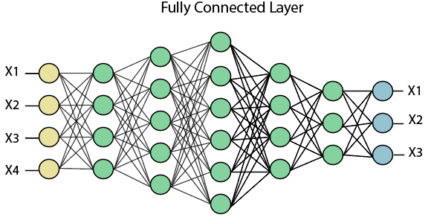
Modules For Training & Testing Continued…
Fully connected Layer
We flattened our matrix into vector and feed it into a fully connected layer with a neural network

Slide 18
Modules For Image Processing
Pre-processing
•
•
•
•
Image Realization
Size reduction is used in CNN. Input image is converted fixed size. Eg.
Alternate pixel elimination
10 | 20 | 30 | 40
2 | 55 | 41 | 54
41 | 44 | 86 | 59
89 | 45 | 77 | 46
10 | 30
2 | 41
41 | 86
89 | 87

Slide 19
Modules For Image Processing
The objective of the proposed system is to early detection of diseases as soon as it starts spreading on the outer layer of the leaves. The main goal of this project is to detect and classify different types of leaf diseases.

Slide 20

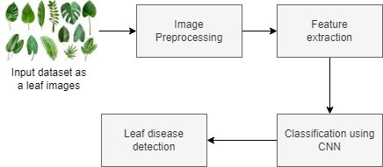
Characterization and Detection Diagram

Slide 21
Modules Description
Input as dataset: First Upload dataset in system.
Pre-processing: In pre-processing, clean dataset like remove unwanted
or Noise data, Convert image into RGB-Gray and Gray-Binary, also resize and rescale image.
Feature Extraction: The technique of detecting and representing specific elements of interest inside an image for further processing is based on the image extraction.
Classification: A technique for classifying or predicting the class of
a given object in an image is image classification. This technique’s major purpose is to accurately identify the characteristics in an image.
In system used CNN classifier and then detect output.
Output : Output as to detect leaf is diseased or Not.

Slide 22
Snapshots

Slide 23
Snapshots

Slide 24
Conclusion
This project proposed to point out disease in the leaf with a union of shape, texture and color feature withdrawal. Initially the farmers sends a digital image of the diseased leaf of a plant and these images are read in System through image preprocessing and processed automatically based on CNN algorithm. The output of this project is to get hold of relevant results that can spot out diseased leaf of certain commonly caused disease to plants.

Slide 25
Future Enhancement
This application will aid farmers by facilitating the recognition and treatment of plant diseases in a timely manner and help them make informed decisions when utilizing chemical pesticides. Also, future work will involve spreading the use of the model across a wider land area by training it to detect plant diseases on aerial photos from orchards and vineyards captured with drones, in addition to convolution neural networks for object detection.

Slide 26
References

Slide 27
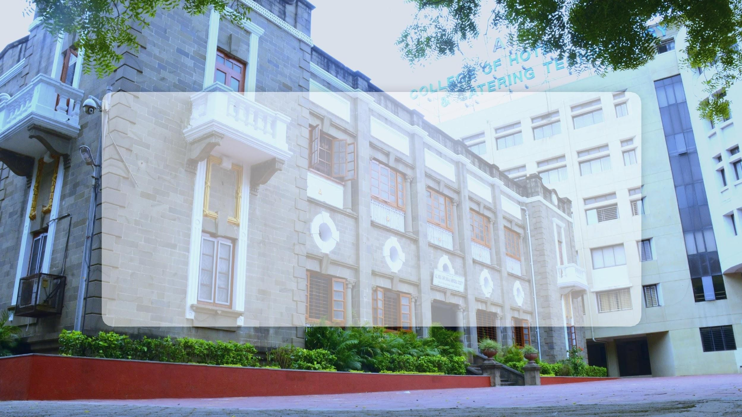
Thank You…!

