Slide 1
”AI Based Covid-19 Prediction ”
By :
Under the guidance of :

Slide 2
CONTENTS OF THIS PROJECT
MISSION STATEMENT: Develop a covid vaccine support program to help health institutes in analysing data, and provide a system for tracking vaccinated patients using blockchain technology.
COVID
EXPLORER
COVID BUDDY
BLOCKVAX
CONTRACT
Using Streamlit and Altair for dashboard Functionality,
Machine Learning Algorithms to analyse trends among different countries &
Python for other advanced data analysis.
Chat-bot to communicate and answer questions with the Public about covid related queries.
Using Solidity to create a patient contract to verify whether patient has been vaccinated or not.
DATA SOURCE: https://github.com/owid/covid-19-data
We implemented a function to download the latest data from the website.

Slide 3
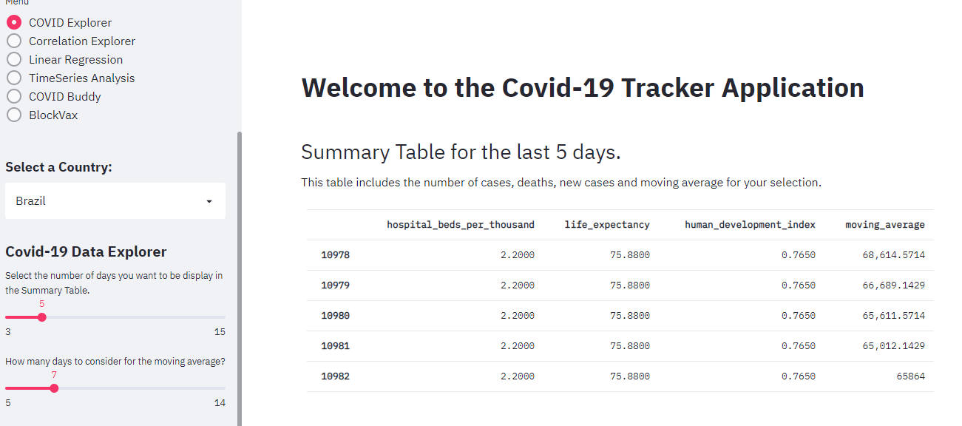
COVID DATA EXPLORER

Slide 4
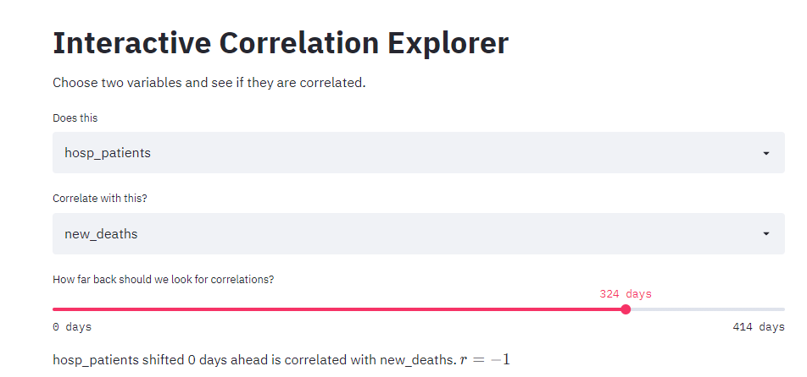
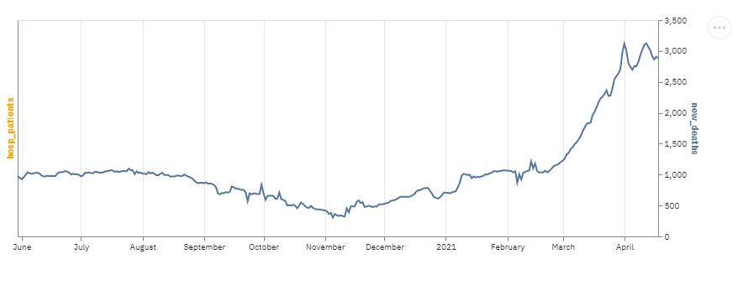
COVID EXPLORER - CORRELATIONS
This function was developed to check whether variables are correlated.
Out of 56 variables in our data set only 7 variables are used to compare correlation data.
Based on the total data available in the csv file, the program is calculates how many days worth of data is available.
Using the Slider, we choose the number of days we want to plot the correlation between two variables for.

Slide 5
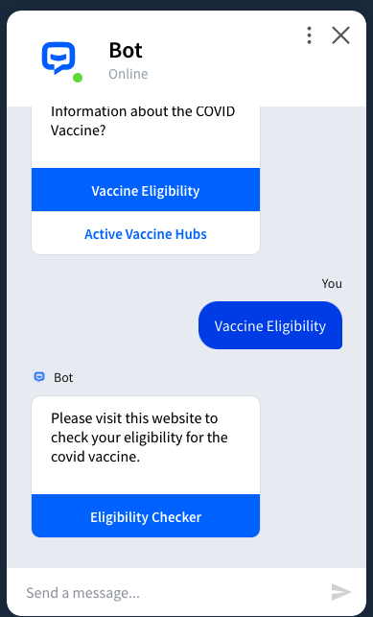
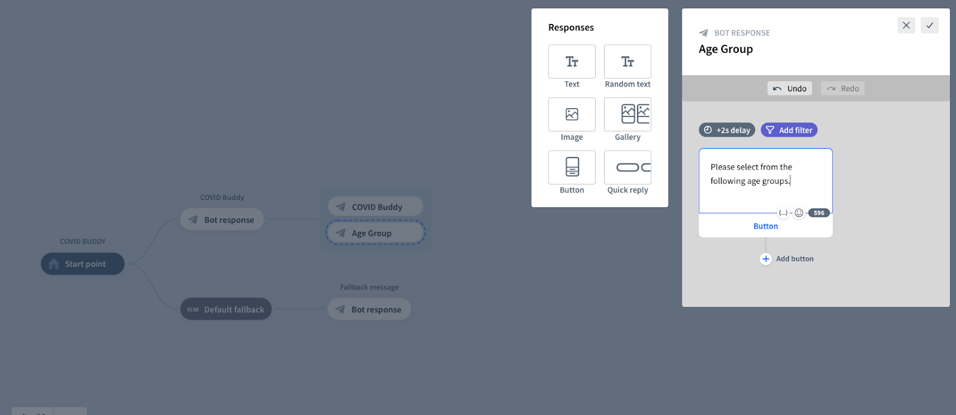
COVID BUDDY – INTERACTIVE CHATBOT
CHAT BOT FUNCTIONALITY

Slide 6


BLOCK VAX
Smart Contract - 3 Functions
User Registration
Address
Patient ID Number
Photo ID (URI)
Vaccine Data Update
Registered Provider
Vaccine Name
Mint ERC721 Token (VAX)
Set Token URI
Vaccinated Profile Check
x

Slide 7
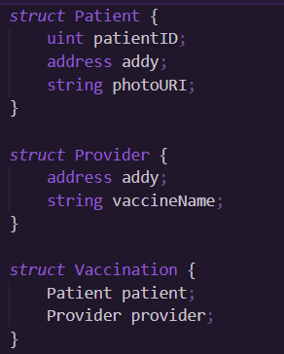
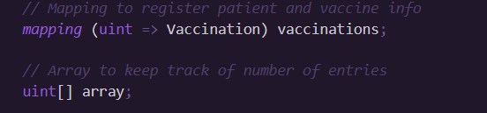
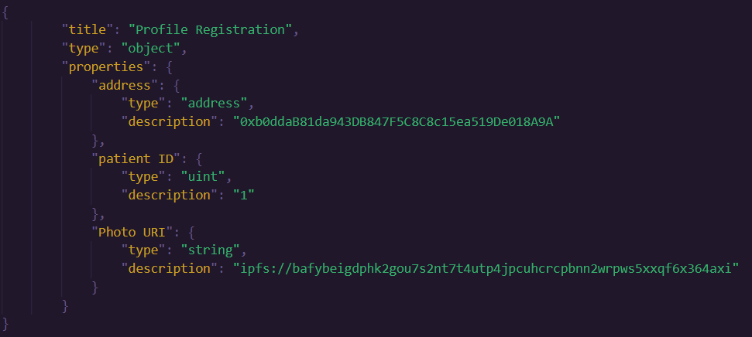
BLOCK VAX PROFILE & VACCINE REGISTRATION

Slide 8
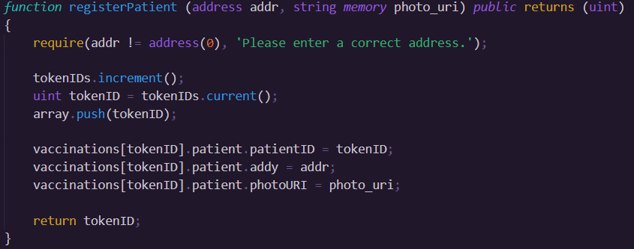
BLOCK VAX PATIENT REGISTRATION

Slide 9
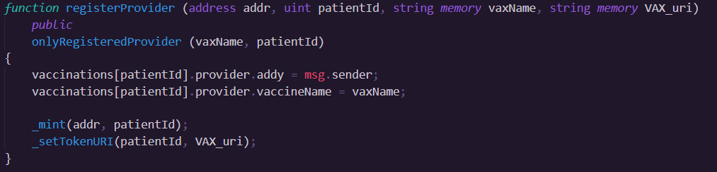
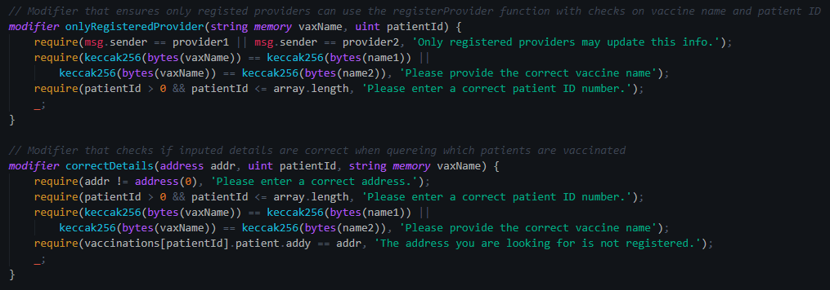
BLOCK VAX REGISTER PROVIDERS & VALIDATE

Slide 10
References
1.https://discuss.streamlit.io/ 2. https://streamlit.io/gallery?type=apps&category=geography-society 3. https://www.youtube.com/watch?v=k-d27B5hnqc 4. https://github.com/E-Health/vac-chain/blob/develop/contracts/Encounter.sol 5. https://app.chatbot.com/dashboard/608903c2be6c8d0007f958a1

Slide 11
Questions ?

Slide 12
Thank You…

