Slide 1
FaceSearch: Anti Face Recognition Technology Using Google Reverse Search Engine model

Slide 2
Agenda
Abstract
Introduction
Scope
Existing System
Proposed System
System Architecture
System Design
AFR FrameWork
References

Slide 3
Abstract
The rapid adoption of facial recognition (FR) technology by both government and commercial entities in recent years has raised concerns about civil liberties and privacy.
Searches for faces in a given image using the Google Reverse Image Search engine.
create a systematic framework for analyzing the benefits and tradeoffs of different AFR approaches.

Slide 4
Introduction
The Google reverse image search input as image.
We know the face, not the name. We can use it.
Search particular face in the image by using OpenCV and its Cascade Classifier. .
Searching for face yields better results.
Google has a static link to which one can simply send a POST request (using requests in python) to upload an image.
The returned response contains a header named 'Location' which is the URL of search results found by Google.

Slide 5
Scope
Worldwide as we get information by Image.
The Application is used in E-Governance and Criminal offences.
A little bit of research showed it to be possible without any API, since Google has a static link

Slide 6
Existing System
my news feed that there were a lot of unknown people in many of the photos.
In Google search engine, we search by inputting words or sentences to retrieve images,docs, news and videos.
Finding information by image is tedious task.

Slide 7
Proposed System
Proposed system will allow to gather information by inputting stranger pic.
We can collect all wikis related to pic given as input.
It is used in following Applications:
Criminal Findings caught by CCTV footages.
Financial Data Collection by Using Aadhar
Missing Data can be retrieved.

Slide 8
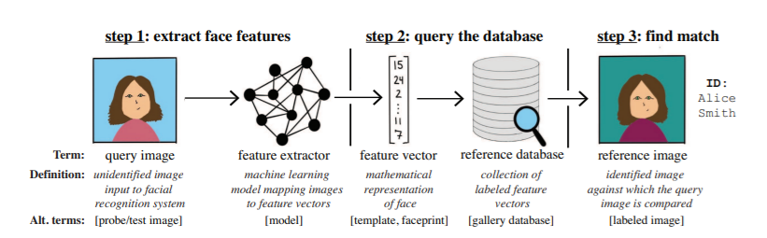
System Architecture

Slide 9
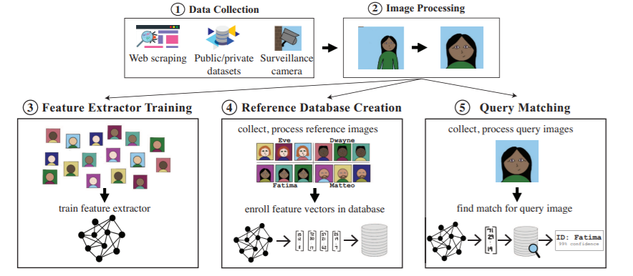
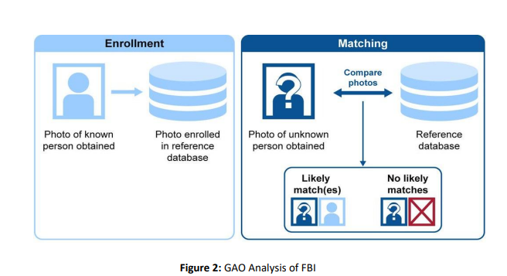
System Design

Slide 10
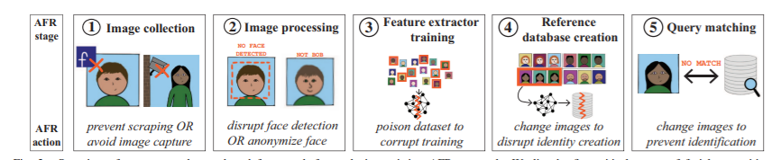
AFR Framework

Slide 11
References
C. Garvie, A. Bedoya, and J. Frankle, “The perpetual lineup,” Georgetown Law Center on Privacy and Technology, 2016.
J. Chin and C. Burge, “Twelve days in xinjiang: How china’s surveillance state overwhelms daily life,” The Wall Street Journal, 2017.
P. Mozur, “One month, 500,000 face scans: How china is using ai to profile a minority,” The New York Times, vol. 14, 2019
K. Hill, “The secretative company that may end privacy as we know it,” The New York Times, 2020.

Slide 12
THANK YOU

