Slide 1
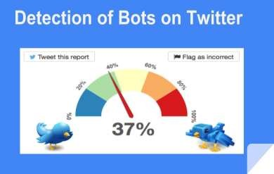
Detection of bots on Twitter

Slide 2
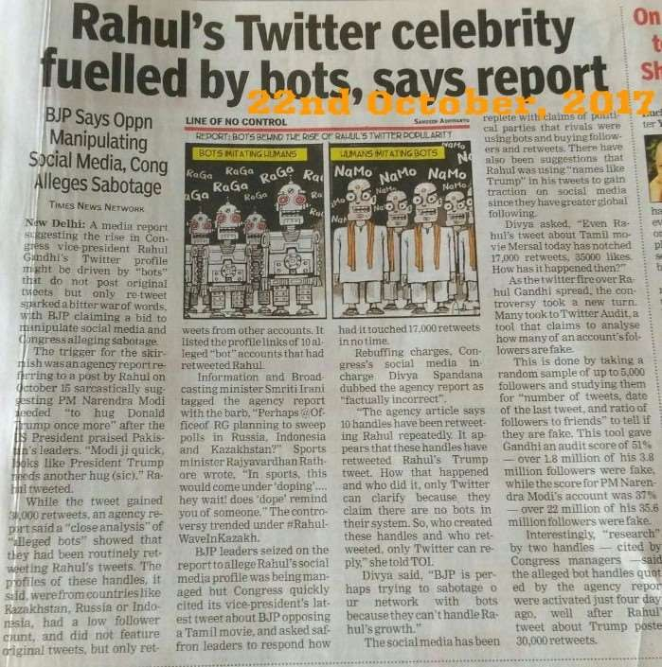

Slide 3
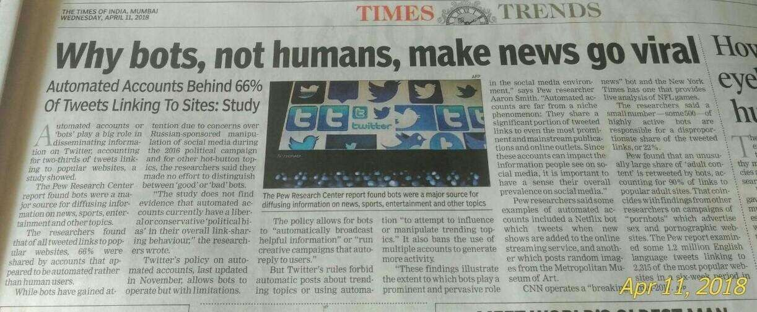

Slide 4
Literature Review

Slide 5

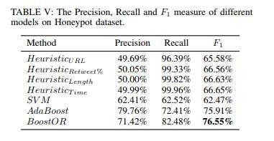
Online Human-Bot Detection, Estimation, Characterization
Interactions:
and
A New Approach to Bot Detection: Striking the Balance Between Precision and Recall
Who is Tweeting on Twitter: Human, Bot, or Cyborg?
Using clustering analysis to characterize bots as
Spammers
Self-Promoter
Accounts that post content from connected applications.
The best classification performance of 0.95 AUC was obtained by the Random Forest algorithm.
In some cases, the boundary separating the bot and human is not sharp.
Too many feature sets used.
Bot detection which considers recall in its formulation along with precision using AdaBoost and algorithm.
Increased calculation complexity.
Decreased precision.
Need of a boosting
algorithm.
To classify a Twitter user as a human or a bot by observing the difference among human and bot in terms of tweeting behavior, tweet content, and account properties.

Slide 6
The problem
Objective
Context
Problem statement
Classify a Twitter user as a human or a bot by observing the difference among human and bot in terms of tweeting behavior, tweet content, and account properties.
Around 9 percent to 15 percent of Twitter's active monthly users are bots
So, out of 319 million active monthly users, that translates into 28.7 million to 47.9 million bots.
To assist human users in identifying who they are interacting with,our project focuses on the classification of human and bot accounts on Twitter,by using the combination of features extracted from user's’ account to determine the likelihood of being a human or bot.

Slide 7
Process
Features
Classification
Analytics
Identifying Features
We will use various features, like followers to friends ratio, URL ratio, etc. for identification.
Classify bots from
humans
The decision maker uses the features identified to determine whether is a human or bot and classify the account user accordingly.
Visualization of Analysis
Visualise each feature showing the differentiating characteristics of a bot.
And displaying the final analysis/classification.

Slide 8
1. Huge amount of following, small amount of followers (Followers to Friend Ratio)
Features
To Identify a Bot
2. Coming from an API (Tweeting device)
3. URL Ratio
Reciprocity
Entropy

Slide 9
Methodology

Slide 10
Logistic Regression - The Classifier
Logistic regression does not try to predict the value of a numeric variable given a set of inputs. Instead, the output is a probability that the given input point belongs to a certain class(human or bot).
0 = you are absolutely sure that the user is a human.
1 = you are absolutely sure that the user is a bot.
Any value above 0.5 = you are pretty sure about that user being a bot. Say you predict 0.8, then you are 80% confident that the user is bot. Likewise, any value below 0.5 you can say with a corresponding degree of confidence that the user is
not a bot.
ned regions
It is clear that the data points MUST be separable into the two aforementio
by
a linear boundary.

Slide 11
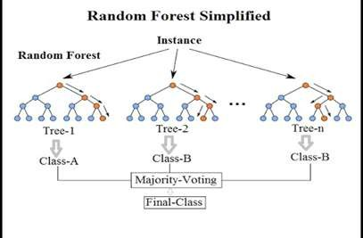
Random Forest - The Classifier
Random forest classification algorithm is used for training the dataset.It is the collection of decision trees. The random forest learning is also robust when training with imbalanced data set. It provides high accuracy rate when training with large dataset.
In random forest classification algorithm, a random instance of data is chosen from the training dataset. With the selected data, a random set of attributes from the original dataset is chosen.In a dataset, where M is the total number of input attributes in the dataset, only m attributes are chosen at random for each tree where m<M.
Bot
Human
Bot
Bot

Slide 12
Algorithm
User visits the web application.
User signs in using his/her Twitter account and allows the web application to read the user’s twitter feed.
The web application, uses the access given by the user to fetch the user’s Twitter feed using the Twitter API
For every tweet in the user’s Twitter feed, the web application sends the userId of the tweeter’s account to the server.
The server, on receiving an user-id, check the Redis cache for an existing classification output.
If the cache has the classification output, then return this output to the web application
Else,
i.
The server uses the Twitter API to fetch details necessary for the classification model to predict the
output.
The server, on successful fetch of user details, sends them to the AWS Lambda function for classification.
The Lambda function, on receiving the user details, fetches the trained machine learning model
ii.
iii.
from Amazon S3 and uses it to classify the user. It returns this output back to the server.
iv. The server, on receiving the output, formats it accordingly and sends the output to the web application.
6.
The web application, on receiving the classification output, displays it along with the tweet to the user.

Slide 13
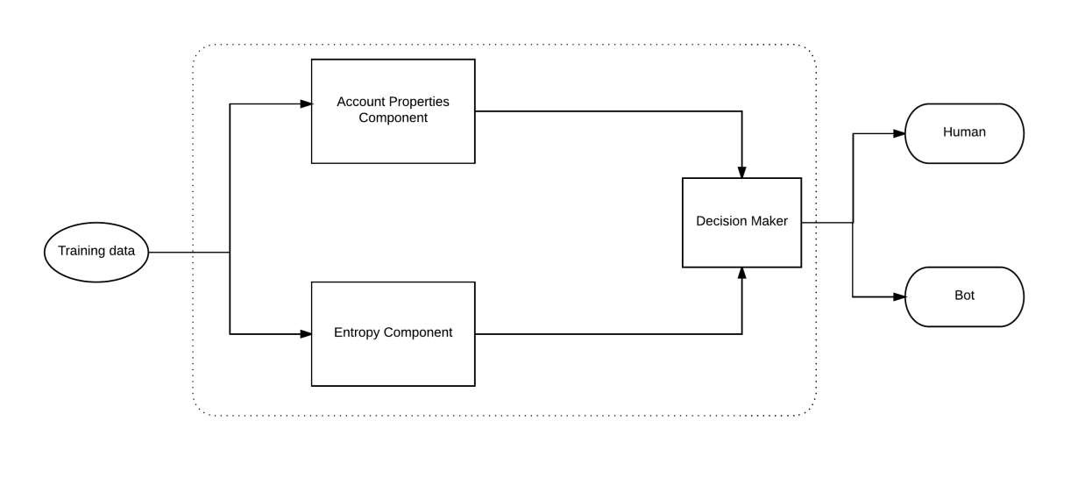
Block Diagram
Fig: Block Diagram of Training Phase

Slide 14
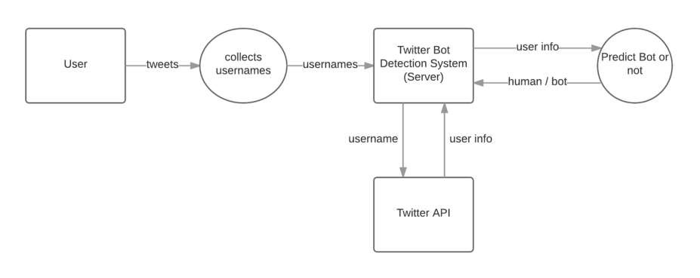
DFD Level - 1

Slide 15
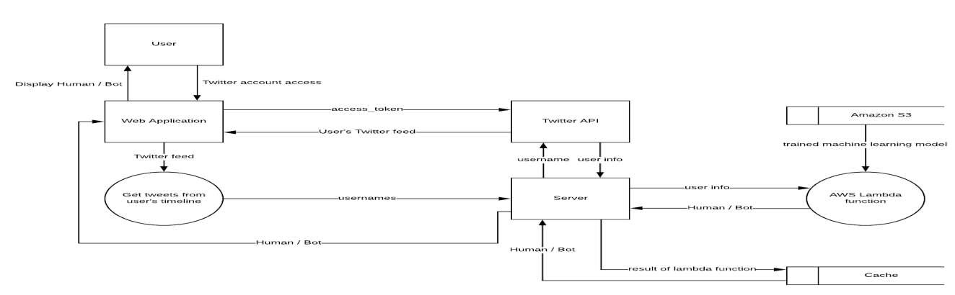
DFD Level - 2

Slide 16
Python
Scikit-learn for machine learning algorithms
AWS (Lambda, API Gateway, S3)
Seaborn for graphing and visualization.
MongoDB (Database)
Python libraries like pickle
Twitter API
Redis (Cache Store)
Nodejs (Back End)
HTML, CSS, JS, JQuery ,Bootstrap, AJAX (FrontEnd)
Technologies
Algorithms Libraries Tools

Slide 17
References
Title: Who is Tweeting on Twitter: Human, Bot, or Cyborg?
Authors: Zi Chu, Steven Gianvecchio, Haining Wang and Sushil Jajodia
URL: http://www.pensivepuffin.com/dwmcphd/syllabi/hcde530_wi17/twitter_readings/chu-who.tweets.ACSAC2010.pdf
Title: A New Approach to Bot Detection: Striking the Balance Between Precision and Recall
Authors: Fred Morstatter, Liang Wu, Tahora H. Nazer, Kathleen M. Carley and Huan Liu
URL: http://www.public.asu.edu/~fmorstat/paperpdfs/asonam16.pdf
Title: Online Human-Bot Interactions: Detection, Estimation, and Characterization
Authors: Onur Varol, Emilio Ferrara, Clayton A.Davis, Filippo Menczer, Alessandro Flammini
URL: https://arxiv.org/pdf/1703.03107.pdf
Title: Using AWS for deploying trained model Author: Jose Miguel Arrieta
URL: https://datascience.com.co/creating-an-api-using-scikit-learn-aws-lambda-s3-and-amazon-api-gateway-d9d10317e38d

Slide 18
Thank You

