Slide 1

NEPAL COLLGE OF INORMATION TECHNOLOGY Balkumari, Lalitpur​ (Affiliated by Pokhara University)
A P R O P O S A L P R E S E N TAT I O N O N
“ Face Recognition Based Student Attendance Systemin Python using OpenCV with Tkinter GUI ”
P R O J E C T M E M B E R S :
K E S H AV R A J P O U D E L
KHOM RAJ THAPA MAGAR
AMISH THAPA MAGAR
D a t e : March, 2 0 2 1

Slide 2
CONTENTS
Title
Introduction
Problem Statement
Aims and Objectives
Literature Review
Methodology
System Analysis and design
Result and analysis
Reference

Slide 3
Project features
Long term storage of records
· High accuracy in calculation.
· Time saving Work space
Data consistency
· Optimize the resource
· Efficiency in modification, sorting and retrieval of data.
· Inexpensive updating in facilities and terms of organizations.

Slide 4
INTRODUCTION
´ It is a system for managing the Student attendance effectively
´ It helps to overcome the situation now are facing of using manual system like signature ,RFID, Finger Print based attendance system but they fail to proof attendance system
´ It helps the admin to manage:
Student Attendance record
Image process and manipulation
student Details
Generating student attendance report

Slide 5
PROBLEM STATEMENT
´ The old system of keeping records in Attendance management system. On which records are kept in a paper file by hand. There were many problems such as :-
Lack of security
Time consuming
Consumes large volume of paperwork.
lack of storage.
Difficulty in data searching

Slide 6
Aims and Objectives

Slide 7
Literature Review

Slide 9
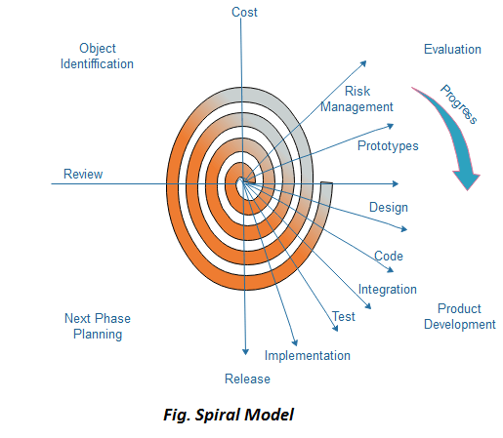
Methodology
Initially proposed by Boehm,
is an evolutionary software process model that couples the iterative feature of prototyping with the controlled and systematic aspects of the linear sequential model.

Slide 10
Spiral Model
Each cycle in the spiral is divided into four parts:
Objective Setting:
Risk Assessment and reduction:
Development and validation:
Planning:

Slide 11
When to use Spiral Model?
When the deliverance is required to be frequent.
When the project is large
When requirements are unclear and complex
When changes may require at any time
Large and high budget projects
High amount of risk analysis
Useful for large and mission-critical projects

Slide 12
Advantages of Spiral Model
High amount of risk analysis
Useful for large and mission-critical projects

Slide 13
Disadvantages of Spiral Model
Can be a costly model to use.
Risk analysis needed highly particular expertise
Doesn’t work well for smaller projects.

Slide 14
Software Description
OpenCV: open-source library used for computer vision
HAAR-Cascade Detection in OpenCV
The HAAR cascade is a machine learning approach where a cascade function is trained from a lot of positive and negative images.
OpenCV provides the trainer as well as the detector.
Two primary states of the cascade image classifier first one is training and the other is detection.
two types of samples:
• Negative sample: It is related to non-object images.
• Positive samples: It is a related image with detect objects.

Slide 15
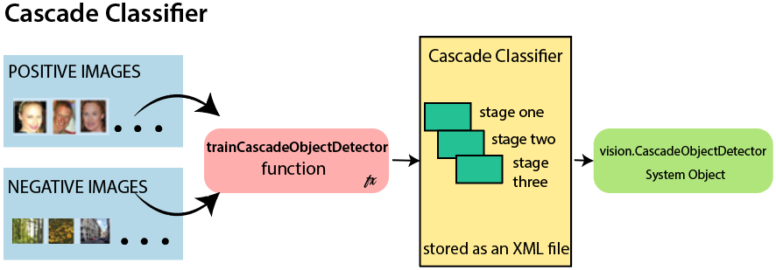
Cascade Classifier Mechanism

Slide 16
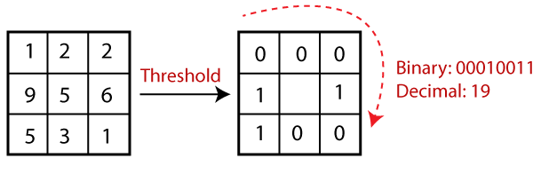
LBPH(Local Binary Pattern Histogram):
LBPH algorithm is a simple approach that labels the pixels of the image thresholding the neighborhood of each pixel.

Slide 17
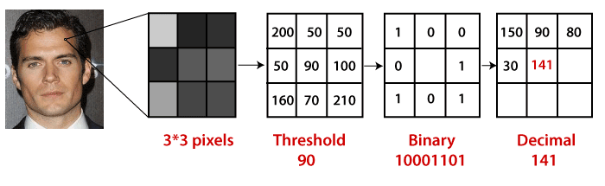
LBPH: Steps of the algorithm
1. Selecting the Parameters: The LBPH accepts the 4 parameters : Radius, Neighbors, Grid X, Grid Y
2. Training the Algorithm
3.Using the LBP operation

Slide 18
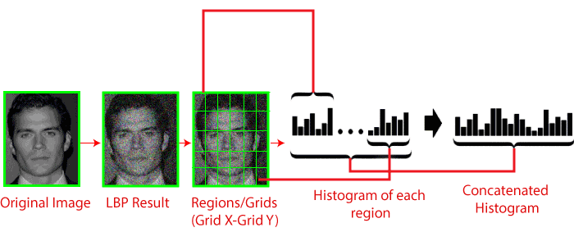
LBPH: Steps of the algorithm
4. Extracting the Histograms from the image

Slide 19

LBPH: Steps of the algorithm
5. Performing face recognition:
Use Euclidean distance based on the following formula:

Slide 20
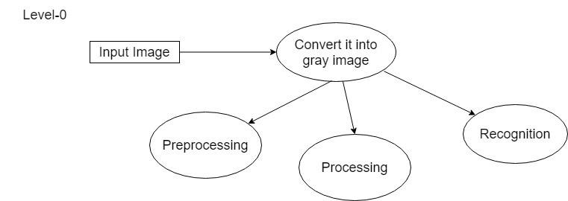
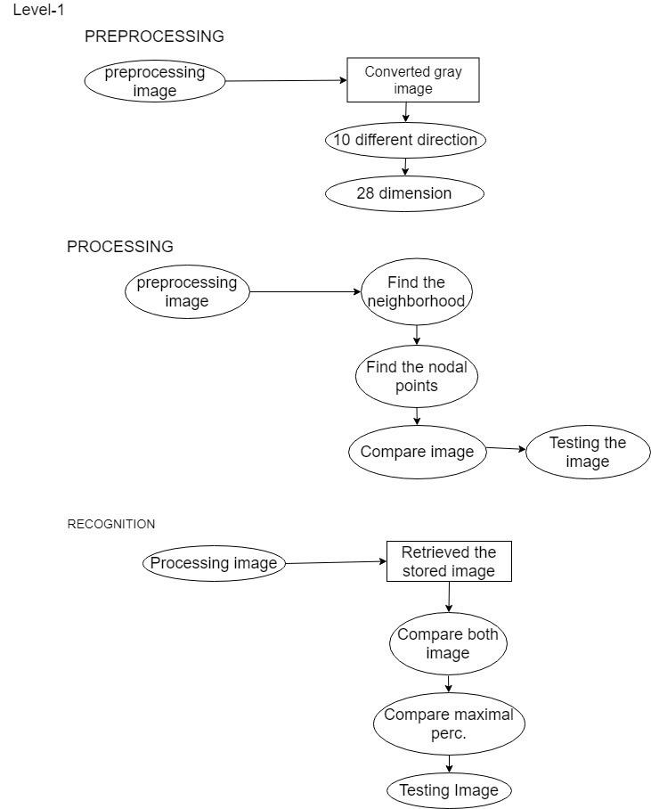
Proposed Block Diagram

Slide 21
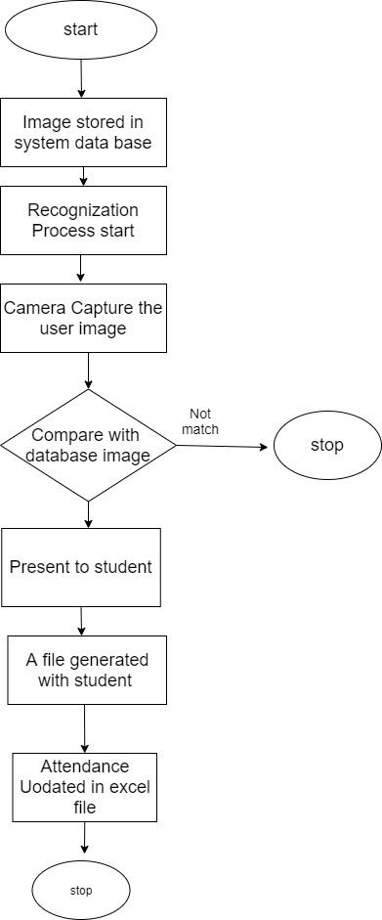
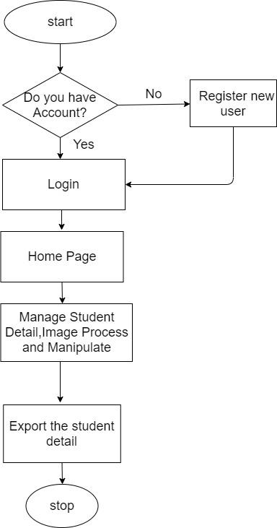
Working Principle
Flow chart for Admin and Face Recognition System

Slide 22
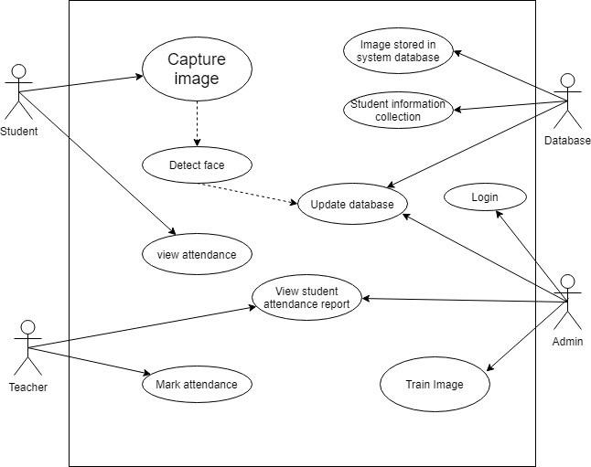
Proposed System Design
Use Case Diagram

Slide 23
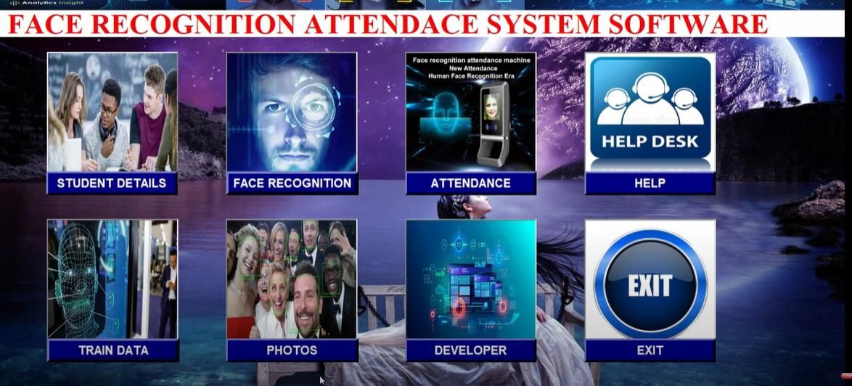
Result and Analysis
Expected Output:

Slide 24
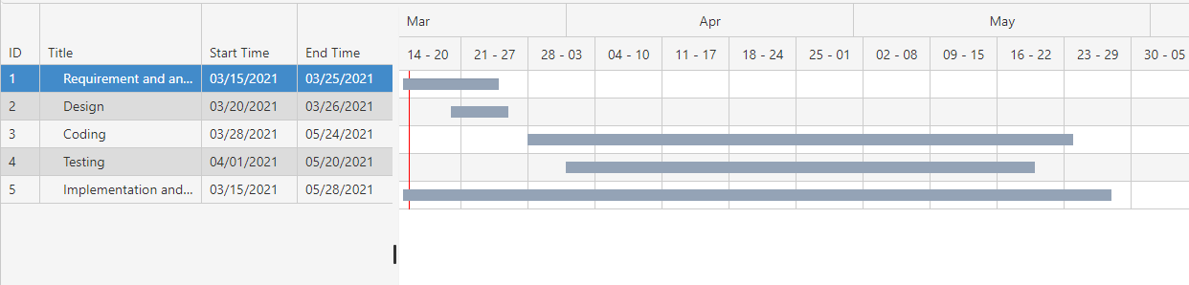
Work Schedule
Gantt Chart:

Slide 25
Reference
[1] “Smart Attendance Management and Analysis with Signature Verification”(Hardika Chauhan, Chitaliya Nehal,2017)
[2] “Fingerprint Based Attendance System Using Microcontroller and LabView” (Kumar Yadav, Singh, Pujari, Mishra, 2015)
[3] “A Proposed RFID Based Student Attendance System “(Fawzi M Al-Naima and Maryam Alaa Saleh, (1 May) 2015)
[4] Charles A. Walton, electronic identification & recognition system Filed: Dec. 27, 1971 Appl. No.: 212,281.
[5] https://www.javatpoint.com/
[6] Smart Attendance System using Computer Vision and Machine Learning ( Dipti Kumbhar#1 , Prof. Dr. Y. S. Angal*2 # Department of Electronics and Telecommunication, BSIOTR, Wagholi, Pune, (7 July) 2017)
[7] Bifari, E.N.; Elrefaei, L.A.“Automated Fingerprint Identification System Based on Weighted Feature Points Matching Algorithm”, 978-1-4799-3080-7114/$31.00 ©2014 IEEE
[8]. OpenCvDocumentation - https://opencv.org
[9]. Numpy - https://numpy.org
[10].CNN: https://www.academia.edu/Documents/in/CNN

