Slide 1

Modelling the COVID Pandemic in Ireland with Bayesian Methods in Python
Peter Nolan
databeaker@gmail.com
https://github.com/dpnolan/pandemic
@dpnolan
Python Ireland,
Wednesday 7 July 2025
Workday, Dublin
From a protest at the Riskdag, the Swedish parliament, 29 April 2020

Slide 2

About Me
Born and raised in south county Dublin
Trinity business, economics and maths
Worked in the Dáil as a student
London City University / Bayes Business School - Mathematical Finance M.Sc.
Then emerging markets trading, in the middle of multiple financial crises, including Asia 1997, Russia 1998, Enron 2001, credit crisis 2007, Euro crisis 2008 - working on pricing and risk models
National College of Ireland for M.Sc.Data Analytics last year
Always been a writer, at college and then for the print media in Ireland, UK and elsewhere
How information flows and is used is the commonality between the Irish Times newsroom, Leinster House, bank trading floors or social media analysis
All this has taught me: “The future is already here. It’s just not evenly-distributed yet.”
databeaker@gmail.com

Slide 3

My Motivations
In 2020, I was working on a major change project in Stockholm
Nolan’s Law: ‘Murphy was an optimist’
Family legacy - grandmother died of TB when my mother was 8, leaving nine children
In Asia, bird ‘flu killed an infant in Hong Kong in late 1997 and there were outbreaks throughout through Asia afterwards, now spreading in the Americas
Fear after 9/11 and the anthrax bio-terror attacks pushed research, including on mRNA vaccines, and pandemic preparedness
In 2005, I wrote in Magill magazine and appeared on David McWilliams’ TV show to say that my 5-person software firm had done more pandemic planning than any part of the Irish government. A HSE report that autumn recommended adding a modeller
The Swedish government were relatively relaxed in their response, private sector data analysts and traders were very risk-averse from the start
Where and when was this photo taken?

Slide 4
Research Question
What models can we use for measuring and forecasting the evolution of epidemics and how can I understand the published model outputs?

Slide 5
To give a summary in one slide...

Slide 6
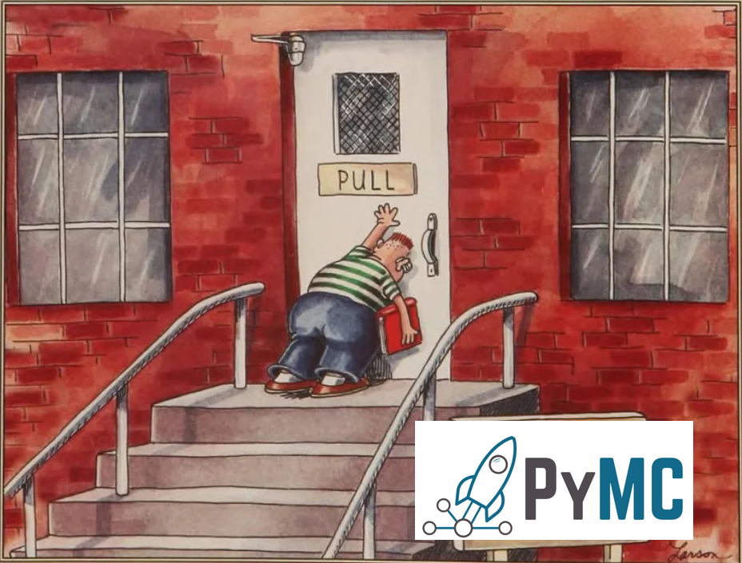

Slide 7
My Approach
Survey the literature, the models and data and policy analysis, before and during the pandemic aim to understand the terminology
Create and run the models myself
My experience with finance has taught me that machine learning absent domain knowledge and empirical orientation is mostly a waste of time
Fill a gap in the Irish media and political news, as the public understanding of the modelling issues is sparse
This analysis combines everything that I don't know about epidemiology with all I don't understand about Bayesian statistics.
Nevertheless, our open-source community, academic publications and open data made this project possible, so show our open-source, data providers, academic and government modellers support.
‘All models are wrong, some are useful’. Mine are more likely than most to be wrong, so feel free to comment here or later.

Slide 8

Surveying the Literature
Dr Adam Kucharski, mathematical epidemiologist at LSHTM
His popular science book on epidemic models was published on 13 February 2020
One chapter covers the century-long history of standard SIR epidemic models and he describes his work with crises like Zika virus
Epidemic models are also applied for other purposes including forecasting shootings in inner-city America

Slide 9
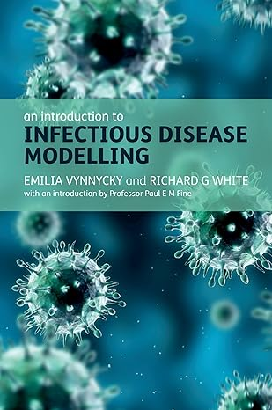
Surveying the Literature
Vynnycky and White give a broad survey of the mathematical models in this 2010 widely-used textbook
Not hugely mathematical in the treatment, no code
Starts with ‘compartment’ or ‘population’ models
Difference and differential equations underly the population models, first used more than 100 years ago to describe disease dynamics as a function of time by Kermack-McKendrick, two Scottish public health doctors working in India
Agent-based model individuals, simulate behaviour of individuals, but the theories are more recent, and more computationally intensive,
Social networks models look at interactions, but are also more recent mathematics
Personal characteristics - age, gender, recent travel, location, can dealt with by separate models, or hierarchical model, but can be included as a model variable

Slide 10
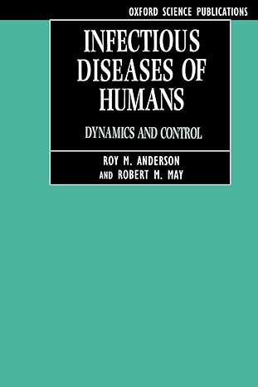
SIR Model Dynamics
The population models assume otherwise homogenous populations with stable parameters - population, no births, deaths, migration or travel. Also;
No reinfection - otherwise SIRS, SIS etc.
Disease characteristics - no drift or variants
No changes in any vaccination
No Non-Pharmaceutical Interventions (NPI) like social distancing
Dynamics can be more complex: Work by Robert May et al. (1994) showed how chaotic, unpredictable behaviour arose within simple, models without many inputs, a lesson all modellers need to take on board

Slide 11
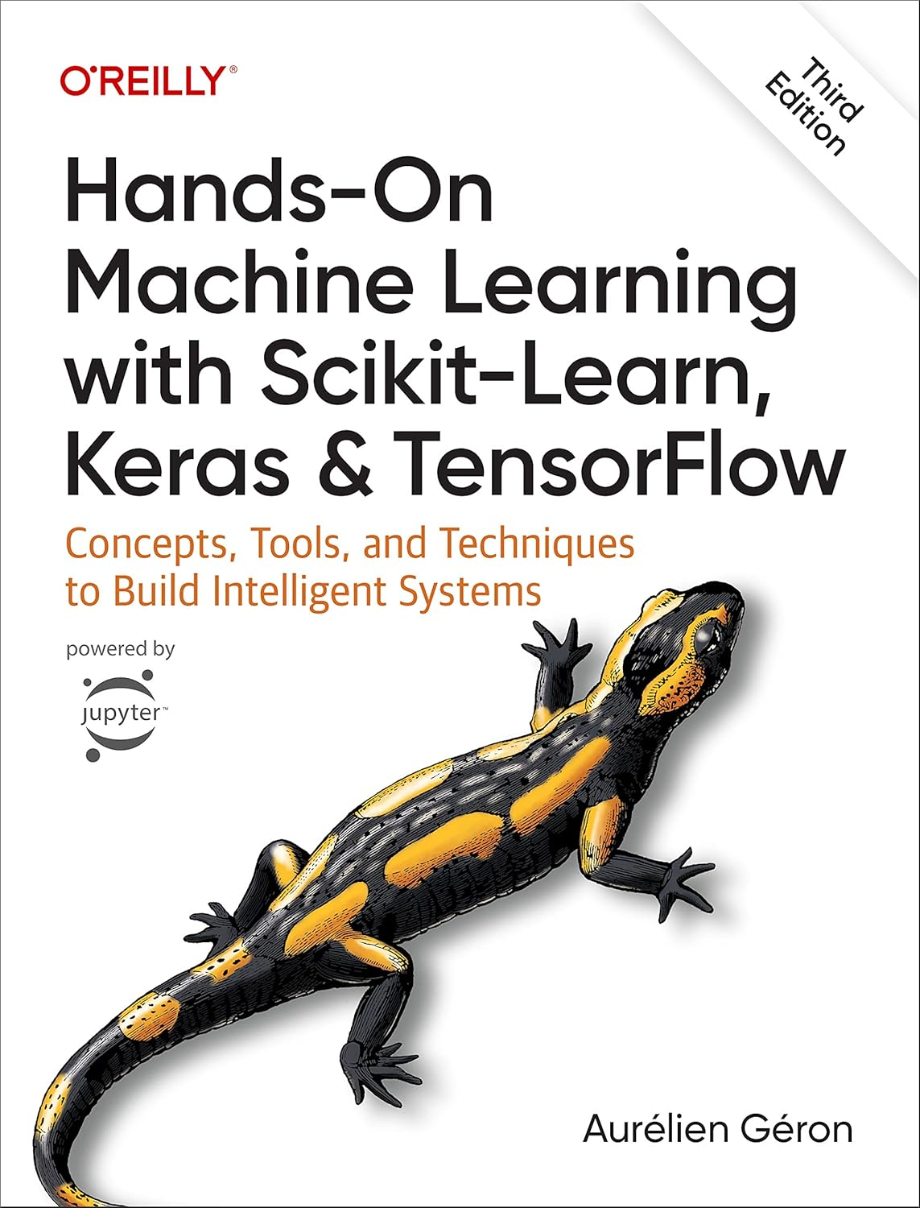
Literature Review - Machine Learning
The Irish Epidemiological Modelling Advisory Group (IEMAG) was an independent team advising National Public Health Emergency Team and the Chief Medical Officer. They independently produced the analysis for the government to act on.
There were considerable differences in opinion: The government was surprised by the winter surges in infections 2020 and 2021 and reluctant to lock down further
Some politicians gathered other data and models to challenge or ‘peer review’ IEMAG’s work. FF health minister Stephen Donnelly wanted more of a ‘big data’ and ‘artificial intelligence’.
External consulting firms supported this under the “1 Government Centre” programme. They wanted to access many forms of data including VISA card payments, CCTV and mobile phone network mobility data.
In spite of support from the politicians, IEMAG did not back down and the alternatives supported its scenarios
No real Dail, press or academic scrutiny of the Irish models

Slide 12
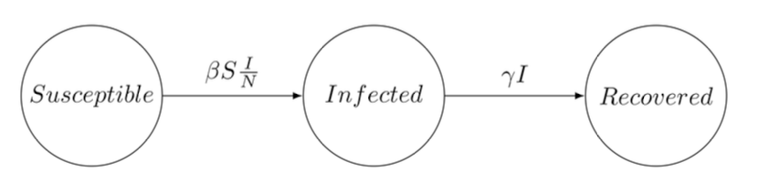
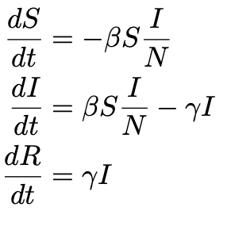
The SIR Model - Specification
These divide the population into homogenous groups or compartments representing stages in the infection process
SIR is commonly used for ‘flu, stages are different for each disease e.g. SEIR, SIS, etc.
Use difference and differential equations, math tools were available 100 years ago
N is total population modelled, for example the population of the Republic of Ireland
S_t, Susceptible may be infected, a portion become so based on beta, 𝜷, the transmission rate, the constant rate of infectious contact between individuals
I_t, Infected have caught the disease and show symptoms and are infectious
R_t, Recovered, have got better or die at the recovery rate gamma, 𝜸, from among the Infected I(t).

Slide 13
The SIR Ordinary Differential Equations
S reduced by new infections, calculated by infected as proportion of Beta, 𝜷, the transmission rate, the constant rate of infectious contact between individuals, scaled by S(t) and I(t)
I_t, Infected increase with new infections, transmit the infection in turn, reduced by recovery
R_t, Recovered, have got better or die at a rate gamma, 𝜸, among the Infected
N, the total population at start time, and N = S + I +R
Personal characteristics - age, gender, recent travel, location, usually dealt with by separate models, or hierarchical model, but can be included as a model variable

Slide 14
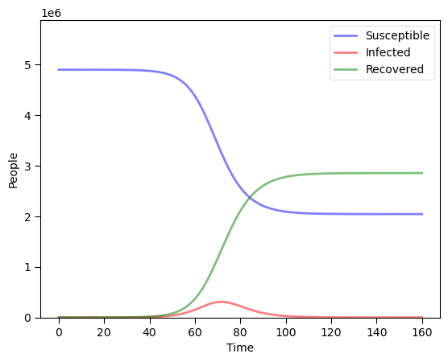
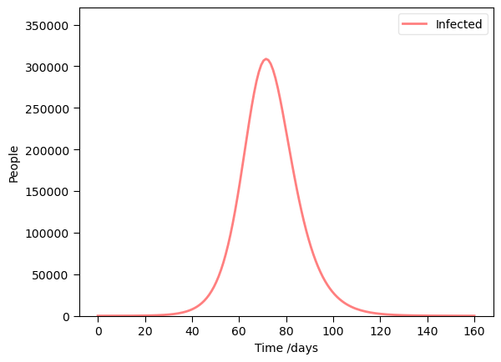
SIR Model Dynamics
Dynamics - typical changes over time, growth, rise and fall in infections
See Jupyter workbook 1
Flu example based on ‘flu in Ireland, β = 0.5, 𝝲 = 1/3, N = 4.9 million people
Susceptible become Infected, the Infected Recover or die
Infections peak, but as a small part of the total population at any one time

Slide 15
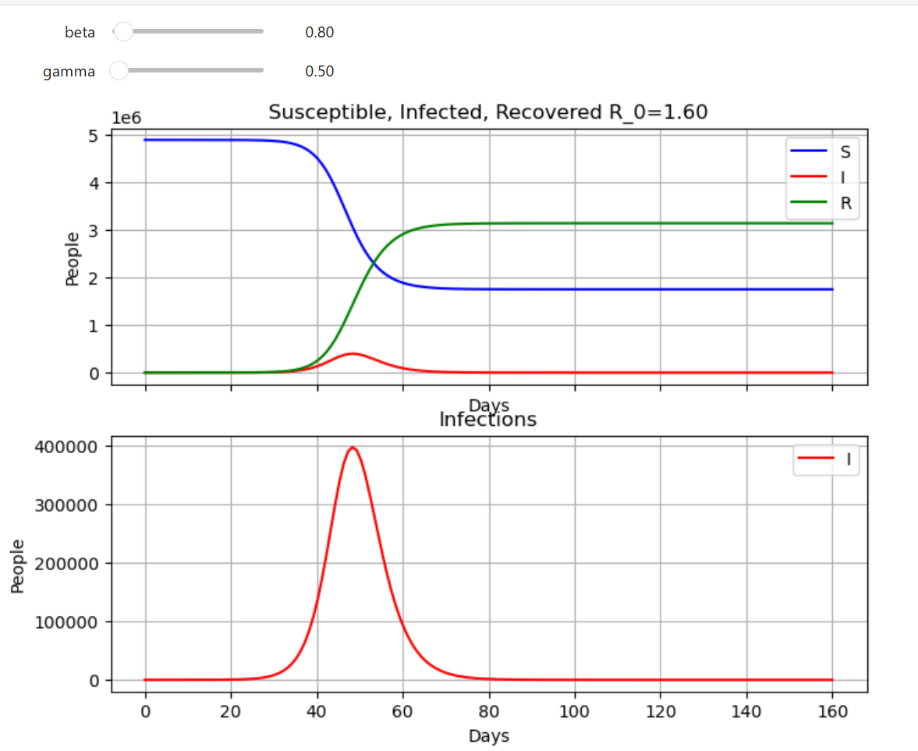
Interactive SIR model in the Jupyter notebook 'Simulate SIR flu model'

Slide 16
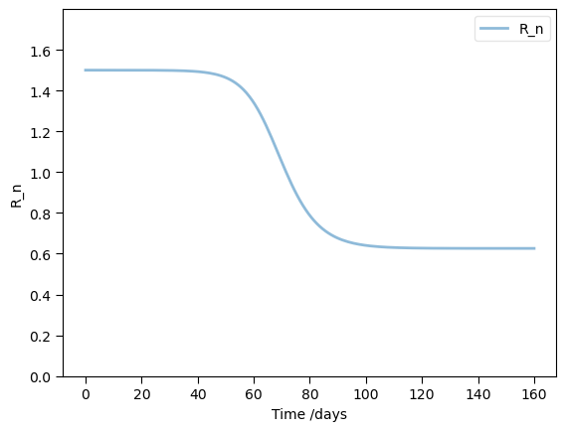
SIR Model Dynamics
R_0 (‘R zero’) is the average number of infections from the first infected person in the population
R_0 = β/𝝲 = 0.5/( 1/3) * (S/N) = 1.5
COVID began around 4, 1.5 to 2 is typical for seasonal ‘flu, measles around 20
R_t or ‘R number’ is the variable used in forecasting to alter change
IF R_t <1, then the infection is not growing, if R_t>1, it will grow
Over time, R_t declines as more of the population pass through infection, as S declines
In our example, when S/N = 2/3 then, R_t=1, called the Herd Immunity Threshold. The epidemic will no longer grow, which vaccines or reinfections. Vaccination strategy targets this.
‘Contagion’ movie explainer: https://www.youtube.com/watch?v=X-YR3UlH3aA

Slide 17
Bayesian Estimation
Model the parameters as random variables to be estimated
From the perspective of early to mid 2020, the underlying parameters for COVID were only going to become clear over time as evidence was gathered and published
Making assumptions about distributions would be premature
Some informative data is available early on and we best incorporate it into our analysis
Expert opinion should be incorporated where useful
Also, our uncertainty and updates to it as more and data is observed should be updated over time
All these argue for a Bayesian rather than a simple ODE approach

Slide 18
SIR Model Estimation
Textbooks such as Vynnycky & White (2010) and a shelf full of others in Trinity’s library do not cover estimation, to my surprise
Searching during 2020 for an estimation of a simple population model, I found almost nothing published
One simple approach was to solve the Ordinary Differential Equation (ODE) system
One non-specialist, some Russian developers at Microsoft and students, implemented this in Python using scipy.integrate.odeint to model and scipy.optimize to fit the data up to June 2020: See Petrova et al. at https://github.com/shwars/SlidingSIR/tree/master

Slide 19
Surveying the Literature
Grinsztajn et al. (2021) work in mathematical epidemiology and published a model estimating population models for COVID, although in 2021
Paper at https://doi.org/10.1002/sim.9164
Code + data https://github.com/charlesm93/disease_transmission_workflow/tree/main
also in the STAN documentation https://mc-stan.org/learn-stan/case-studies/boarding_school_case_study.html
A small, simple dataset on a 1978 ‘flu outbreak in an English school is commonly used in this literature, including by Grinsztajin
Paper https://pmc.ncbi.nlm.nih.gov/articles/PMC1603269/pdf/brmedj00115-0064.pdf
Data https://www.kaggle.com/datasets/antonymgitau/influenza-england-1978-school-csv
IEMAG published a second edition of their model methodology in October 2021, updating an earlier model from May 2020.
Gleeson JP, Murphy TB, O’Brien J, O’Sullivan D. (2021) “A population-level SEIR model for COVID-19 scenarios (updated),” https://assets.gov.ie/122667/8379f0cc-5be3-4c89-9a1e-3b7328ae03af.pdf
Code and data https://github.com/obrienjoey/ireland_covid_modelling
Full CIDR dataset 19.geohive.ie/datasets/d8eb52d56273413b84b0187a4e9117be_0/about
A wider historical literature review is in Lit Review Epidemic Models.pdf in the GitHub at https://github.com/dpnolan/pandemic

Slide 20
A Model to Answer the Research Question
What is the past and present and possible future state of the epidemic?
Infections can be observed by symptoms, a patient needing treatment, or a test result
Inputs are the known observed infected numbers, I(t)
Candidate models will be the simple SIR population model
Task is estimation, output for decision-makers are the historical R_t and the future cases
Estimation done with Bayesian methods

Slide 21
Bayesian Estimation
Count discrete, non-independent events, which occur in clusters in time or space
The first version of the model in May 2020 used the Poisson distribution.
Exponential distribution is often used model time between outbreaks, where 𝝺 parameter is the time between events and also the mean of the Poisson distribution of events per year.
Negative Binomial distribution was used instead to count the cases: was used instead in the data and model from November 2020, probably to deal with greater variation in the pandemic case numbers than the Poisson, which assumes mean and variance are the same value.
Inverse overdispersion with exponential distribution with mean 1/𝝲.
NB uses I(t) as the mean and a parameter for inverse overdispersion phi, 𝞍 i.e. smaller phi means more dispersion
𝝱 and 𝝲 are assumed non-negative. Not strong assumptions in these priors, so used both Half-Normal and Wald distributions for this.

Slide 22
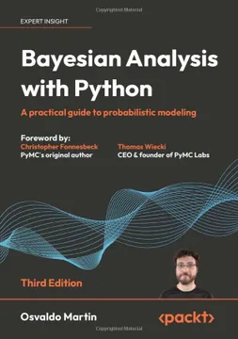
Workflow
Martin (2024) and PyMC core developer Thomas Wiecki suggest something like https://gist.github.com/twiecki/43def0aa16ee6a23f822a124eb429958
Plot the data
Build model
Check prior predictions
Fit models
Assess convergence
Run posterior predictive check
Improve model

Slide 23
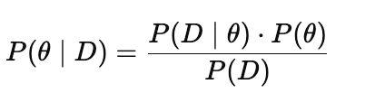

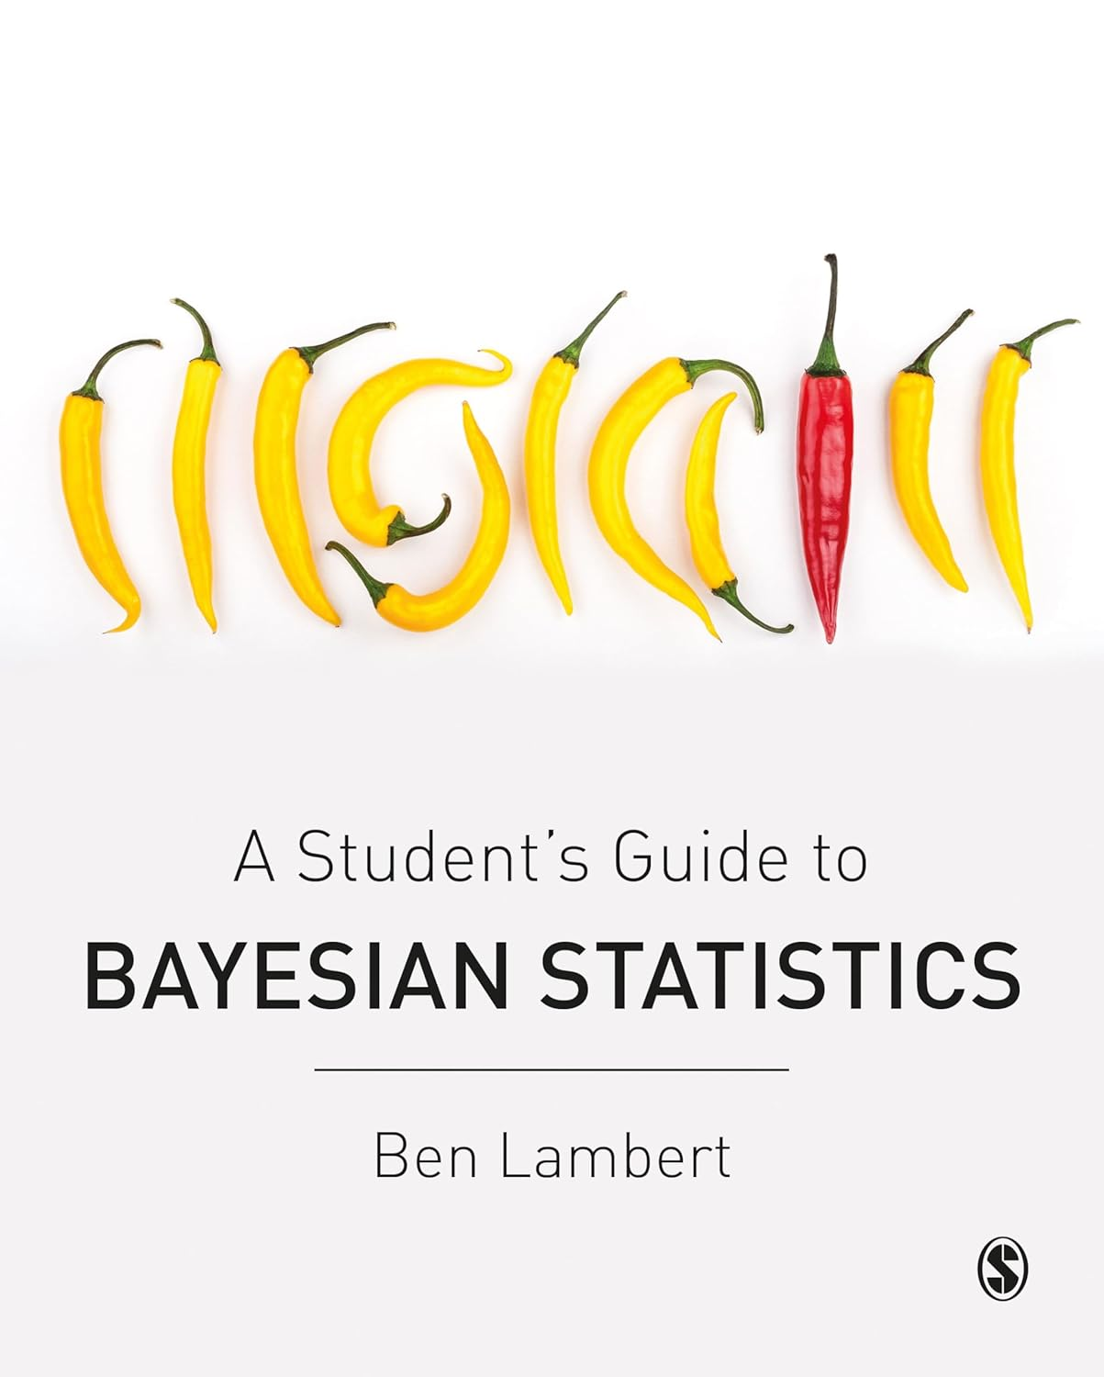
Markov Chain Monte Carlo
Without a simple arithmetic Conjugate Prior from our chosen distributions, we estimate using simulation with MCMC
Monte Carlo - simulate by random draws
Markov Chain - future state depends on the current state only
We sample from P(𝝷 | Data) using the prior and likelihood distributions to set the frequency with which we sample from each region of the posterior
From this we calculate the characteristics of our posterior distribution
PyMC uses No U-Turns (NUTS) version of the Hamiltonian sampling algorithm, searching parameter space using gradient, then stopping search when the sample search turns back to its previous steps on the path

Slide 24







Python Libraries
Usual data analysis libraries
SciPy for the old Fortran odeint() solver
PyMC for running the MCMC
STAN language was used with R for Bayesian models
ArviZ for MCMC diagnostics and metrics
However, much more of the published models run on R, which seems favoured by epidemiologists, and often uses the STAN language

Slide 25
Simulated SIR Model Dataset
See Jupyter Notebook 2

Slide 26
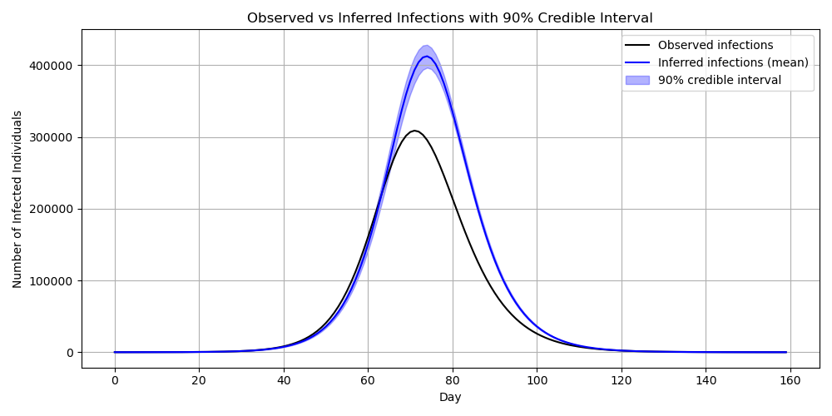
Simulated SIR Model MCMC Estimation
See Jupyter Notebook 2

Slide 27
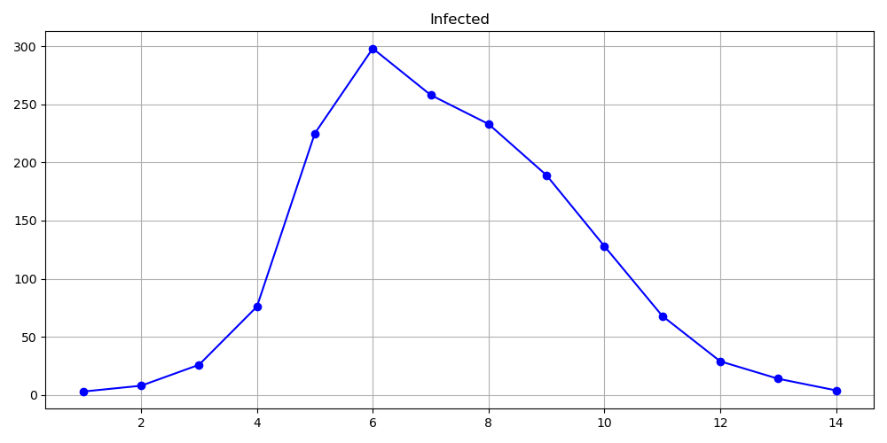
School Dataset
See Jupyter Notebook 3

Slide 28
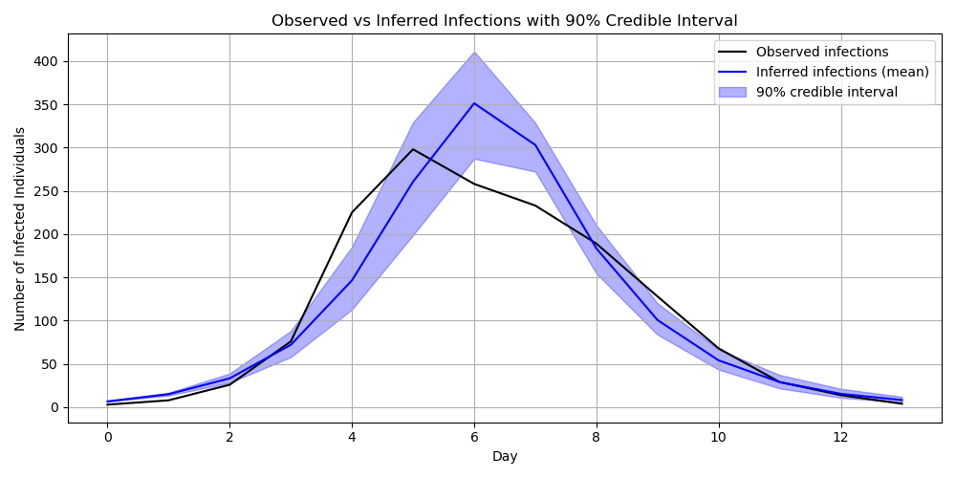
School Epidemic MCMC estimate
See Jupyter Notebook 3

Slide 29
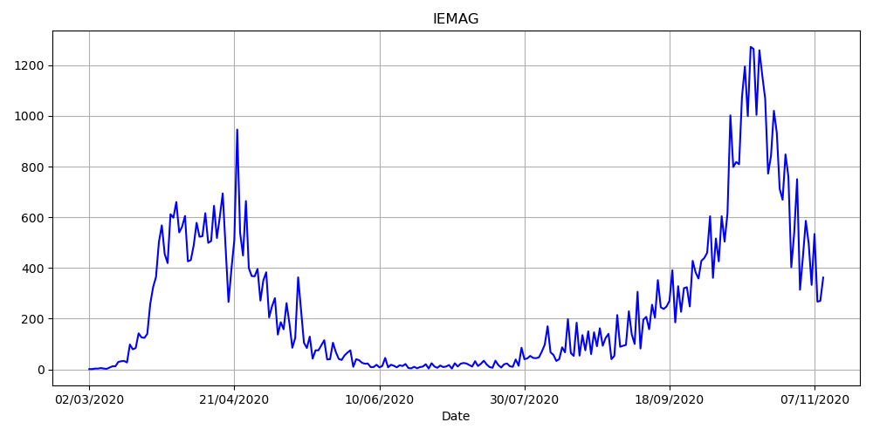
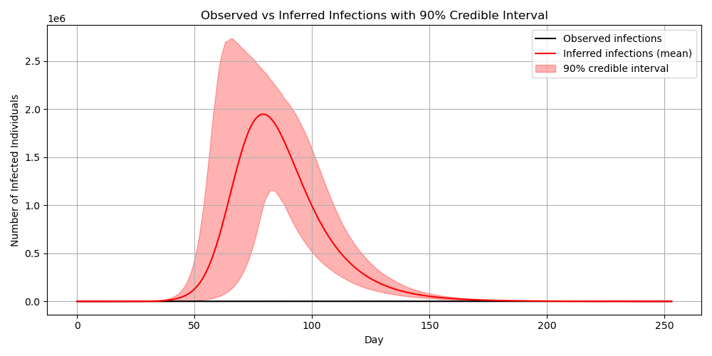
IEMAG Data
See Jupyter Notebook 4

Slide 30
IEMAG MCMC Estimate
See Jupyter Notebook 4

Slide 31
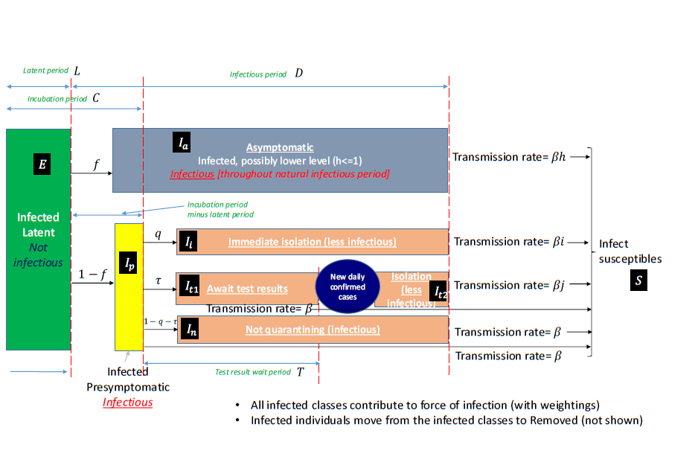
Next Steps
Estimate full IEMAG model: Production model uses SEIR, but 5 different estimates for I, 4 transmission rates
Compare with Northern Ireland’s similar epidemic model, perhaps in one hierarchical model
Compare with UK model population https://www.gov.uk/government/publications/reproduction-number-r-and-growth-rate-methodology/reproduction-number-r-and-growth-rate-methodology#fnref:1
Implement age-based model
Social network-based model
Agent-based model
Add economic effects

Slide 32

The Irish COVID Enquiry
The Irish Epidemiological Modelling Advisory Group (IEMAG)team head Prof. Philip Nolan discusses his experience at an RIA panel, commenting that the ‘follow the science’ approach was authoritarian https://www.youtube.com/watch?v=Estl2VBSKcc
Irish enquiry into the pandemic is now under way by a panel of academics scrutinising the plans and responses, but with relatively limited powers, no cross-examination and no power of compel appearance. Contact details are online at https://www.covid19evaluation.ie/
My own view is that the analysis needs prior preparation, probably with nominated specialists and a menu of data sources, models and tools, with the data infrastructure set up in advance

Slide 33
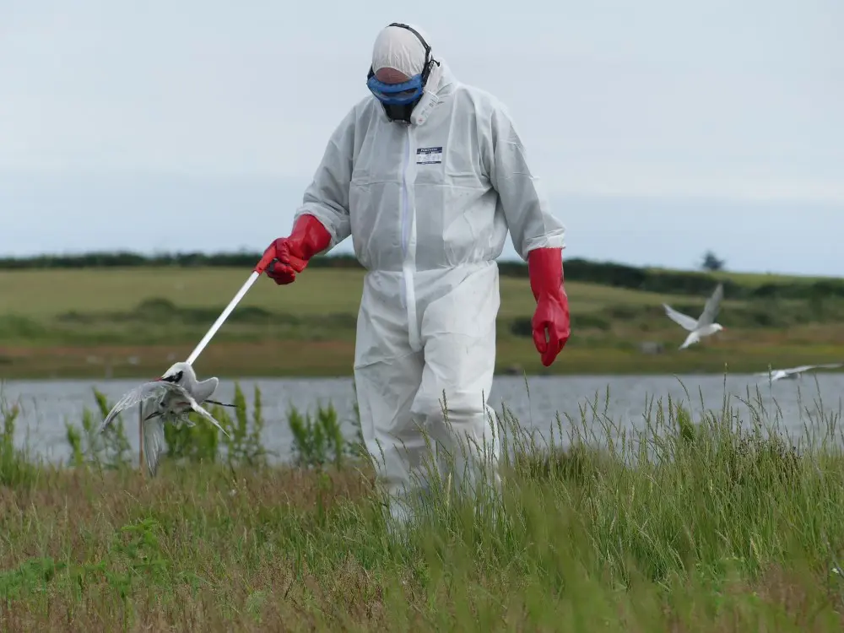
Conclusions
PyMC can estimate simple SIR models, coming close to published results or simulations
Ecosystem of libraries and published work for epidemiology in R and STAN is larger
IEMAG2 uses measurements from health system processes and the SIR models
SIR models are the transparent and useful tool for measuring and forecasting the pandemic, perhaps THE most useful
What comes next? Bird 'flu remains a threat and spreads through farmed and wild animal populations, with more than half the Common Terns breeders dying off here in Dublin Port https://birdwatchireland.ie/devastating-bird-flu-impacts-on-irish-seabirds-revealed-in-new-study/

Slide 34
Modelling the COVID Pandemic in Ireland with Bayesian Methods in Python
Peter Nolan
databeaker@gmail.com
https://github.com/dpnolan/pandemic
@dpnolan
Python Ireland,
Wednesday 7 July 2025
Workday, Dublin
From a protest at the Swedish Parliament, 29 April 2020

