Slide 1

Modelling the COVID Pandemic in Ireland with Bayesian Methods in Python
using PyMC and STAN
Peter Nolan
https://github.com/dpnolan/pandemic
databeaker@gmail.com
@dpnolan
Python Ireland
Sunday 16 November 2025
UCD

Slide 2

My Motivations
Where and when was this photo taken?
https://github.com/dpnolan/pandemic

Slide 3
My Motivations
In 2020, I was living in Stockholm - Here I am in March at Nobel's tomb
Family legacy - my grandmother died of TB when my mother was 8, leaving 9 more children under 16
In February 2006 on David McWilliams’ TV show, I said my 5 person software firm had done more pandemic preparation than the Irish government
The Swedish government were relatively relaxed but data analysts in NGOs and business acted quickly and radically
https://github.com/dpnolan/pandemic

Slide 4
Research Question
What models can we use for measuring and forecasting the evolution of epidemics?
What are the tools in Python?
https://github.com/dpnolan/pandemic

Slide 5
My Approach
Create and run the models myself
A test in real-time of the Python solutions
Nevertheless, our open-source community, academic publications and open data made this project possible, so let’s show our support.
’All models are wrong, some are useful’. Mine are more likely than most to be wrong, so feel free to comment here or later.
https://github.com/dpnolan/pandemic

Slide 6
Summary
Literature review - history of models
The Susceptible - Infected - Rcovered (SIR) model parameters and dynamics
Estimating the SIR model parameters
https://github.com/dpnolan/pandemic

Slide 7
To give a summary in one slide...
https://github.com/dpnolan/pandemic

Slide 8


To give a summary in one slide...
https://github.com/dpnolan/pandemic

Slide 9

Literature Survey - Popular Science
Dr Adam Kucharski, mathematical epidemiologist at LSHTM and practising epidemiologist, including for COVID and Zika, and the BBC Pandemic project
His popular science book on epidemic models was published on 13 February 2020
One chapter covers the century-long history of the Susceptible-Infected-Recovered (SIR) epidemic models ads
Epidemic models are also applied for other purposes including advertising messages, forecasting shootings in inner-city America
https://github.com/dpnolan/pandemic

Slide 10

Literature Survey - Maths Textbook
Vynnycky and White give a broad survey of the mathematical models in this 2010 textbook
A mathematical textbook in the treatment, no code
Starts with Susceptible-Infected-Recovered(SIR) ‘compartment’ or ‘population’ models
Difference and differential equations underly the SIR, first used more than 100 years ago to describe disease dynamics as a function of time by Kermack & McKendrick, two Scottish public health doctors working in India
Simplest models include no reinfections, drift in virus, vaccinations, travel, age or behavioural effects
These work well to model the first stage of the epidemic
Agent, geographic, non-homogenous models are more complex
https://github.com/dpnolan/pandemic

Slide 11
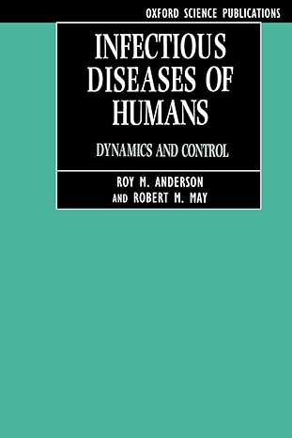
Literature Survey - Model Dynamics
Dynamics can be more complex: Work by Robert May et al. (1994) showed how chaotic, unpredictable behaviour arose within simple models without many inputs
Real-world experience, as May worked as UK Chief Scientific Advisor, including on Foot and Mouth epidemic and bird ‘flu
https://github.com/dpnolan/pandemic

Slide 12

Literature Review - Machine Learning
Should we use epidemic models or is an theoretical machine learning approach better?
The Irish Epidemiological Modelling Advisory Group (IEMAG) was an independent team building models for the National Public Health Emergency Team (NPHET).
Politicians gathered other data and models to challenge or ‘peer review’ the IEMAG's work. FF health minister Stephen Donnelly wanted more of a ‘big data’ and ‘artificial intelligence’ approach
External consulting firms supported this under the “1 Government Centre” programme. They wanted to access many forms of data including card payments, CCTV and mobile phone network mobility data.
IEMAG and NPHET did not back down and the alternative model results supported its scenarios
https://github.com/dpnolan/pandemic

Slide 13
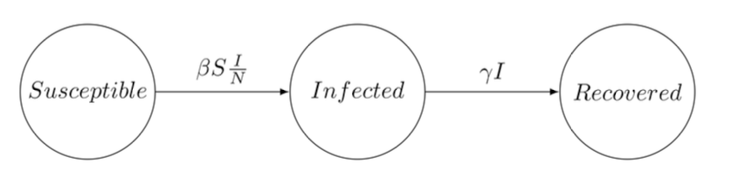
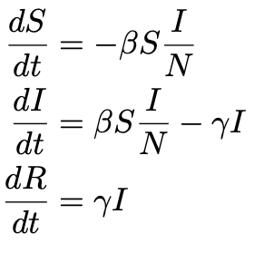
The SIR Model - Specification
These divide the population into homogenous groups or compartments representing stages in the infection process
SIR is commonly used for ‘flu, stages are different for each disease e.g. SEIR, SIS, etc.
Use difference and differential equations, math tools were available 100 years ago
N is total population modelled, for example the population of the Republic of Ireland
S_t, Susceptible may be infected, a portion become so based on beta, 𝜷, the transmission rate, the constant rate of infectious contact between individuals
I_t, Infected have caught the disease and show symptoms and are infectious
R_t, Recovered, have got better or die at the recovery rate gamma, 𝜸, from among the Infected I_t.
https://github.com/dpnolan/pandemic

Slide 14
The SIR Ordinary Differential Equations
S reduced by new infections, calculated by infected as proportion of Beta, 𝜷, the transmission rate, the constant rate of infectious contact between individuals, scaled by S(t) and I(t)
I_t, Infected increase with new infections, transmit the infection in turn, reduced by recovery
R_t, Recovered, have got better or die at a rate gamma, 𝜸, among the Infected
N, the total population at start time, and N = S + I + R
Personal characteristics - age, gender, recent travel, location, usually dealt with by separate models, or hierarchical model, but can be included as a model variable
https://github.com/dpnolan/pandemic

Slide 15
A Model to Answer the Research Question
What is the past and present and possible future state of the epidemic?
Inputs are the known observed infected numbers, I(t), observed by testing or symptoms
Candidate models will start with the simple SIR
Task is estimation, output for decision-makers are the SIR parameters
Estimation done with Bayesian methods
https://github.com/dpnolan/pandemic

Slide 16
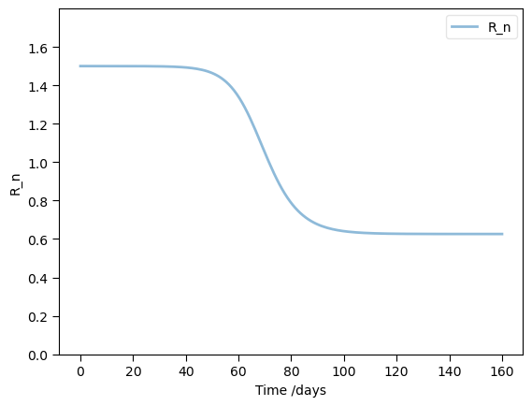
SIR Model Dynamics
PYMC directory, Jupyter Notebook 2
R_0 (‘R zero’) is the average number of infections from the first infected person in the population
R_0 = β/𝝲 = 0.5/( 1/3) * (S/N) = 1.5
COVID began around 4. Seasonal 'flu typically is 1.5 to 2, measles around 20
R_t or ‘R number’ is the variable used in forecasting future cases
IF R_t <1, then the infection is not growing, if R_t>1, it will grow
Over time, R_t declines as more of the population pass through infection, as S declines
In our example, when S/N = 2/3 then, R_t=1, called the Herd Immunity Threshold. The epidemic will no longer grow, which vaccines or reinfections. Vaccination strategy targets this.
‘Contagion’ movie explainer: https://www.youtube.com/watch?v=X-YR3UlH3aA
https://github.com/dpnolan/pandemic

Slide 17
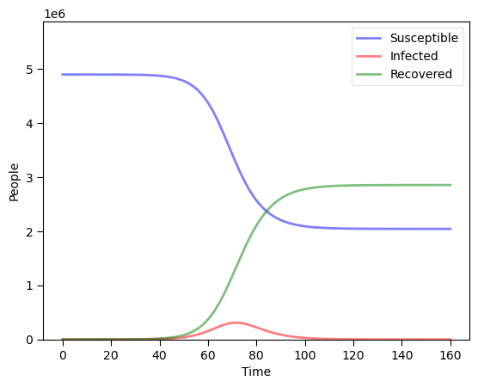
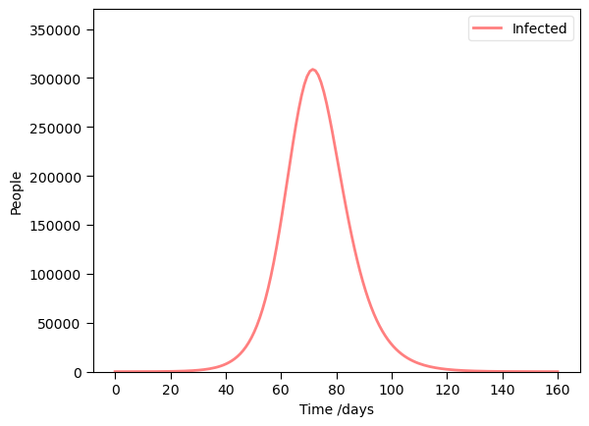
SIR Model Dynamics
Dynamics - typical changes over time, growth, rise and fall in infections
See Jupyter workbook 1
Flu example based on ‘flu in Ireland, β = 0.5, 𝝲 = 1/3, N = 4.9 million people
Susceptible become Infected, the Infected Recover or die
Infections peak, but as a small part of the total population at any one time
https://github.com/dpnolan/pandemic

Slide 18
SIR Model Estimation
Textbooks such as Vynnycky & White (2010) and a shelf full of others in Trinity’s library do not cover estimation, to my surprise
Searching during 2020 for an estimation of a simple population model, I found almost nothing published
One simple approach was to solve the Ordinary Differential Equation (ODE) system
One non-specialist, some Russian developers at Microsoft and students, implemented this in Python using scipy.integrate.odeint to model and scipy.optimize to fit the data up to June 2020: See Petrova et al. at https://github.com/shwars/SlidingSIR/tree/master
https://github.com/dpnolan/pandemic

Slide 19
Bayesian Estimation - How and Why?
Model the parameters as random variables to be estimated
From the perspective of early to mid 2020, the underlying parameters for COVID were only going to become clear over time as evidence was gathered and published
Making assumptions about distributions would be premature
Some informative data is available early on and we best incorporate it into our analysis
Expert opinion should be incorporated where useful
Also, our uncertainty and updates to it as more and data is observed should be updated over time
All these argue for a Bayesian rather than a simple ODE approach
https://github.com/dpnolan/pandemic

Slide 20
Case Studies - GitHub ‘papers’ directory
Grinsztajn et al. (2021) work in mathematical epidemiology and published a model estimating population models for COVID, working through from simple SIR, this is the closes l
Paper at https://doi.org/10.1002/sim.9164
Code + data https://github.com/charlesm93/disease_transmission_workflow/tree/main
also in the STAN documentation https://mc-stan.org/learn-stan/case-studies/boarding_school_case_study.html
A small, simple dataset on a 1978 ‘flu outbreak in an English school is commonly used in this literature, including by Grinsztajin
Paper https://pmc.ncbi.nlm.nih.gov/articles/PMC1603269/pdf/brmedj00115-0064.pdf
Data https://www.kaggle.com/datasets/antonymgitau/influenza-england-1978-school-csv
IEMAG published a second edition of their model methodology in October 2020, updating an earlier model from May 2020.
Gleeson JP, Murphy TB, O’Brien J, O’Sullivan D. (2021) “A population-level SEIR model for COVID-19 scenarios (updated),” https://assets.gov.ie/122667/8379f0cc-5be3-4c89-9a1e-3b7328ae03af.pdf
Code and data https://github.com/obrienjoey/ireland_covid_modelling
Full CIDR dataset 19.geohive.ie/datasets/d8eb52d56273413b84b0187a4e9117be_0/about
A wider historical literature review is in Lit Review Epidemic Models.pdf in the GitHub
https://github.com/dpnolan/pandemic

Slide 21
Bayesian Estimation
Count discrete, non-independent events, which occur in clusters in time or space
The first version of the IEMAG model in May 2020 used the Poisson distribution.
Exponential distribution is often used model time between outbreaks, where 𝝺 parameter is the time between events and also the mean of the Poisson distribution of events per year.
Negative Binomial distribution was used instead to count the cases: was used instead in the data and model from November 2020, probably to deal with greater variation in the pandemic case numbers than the Poisson, which assumes mean and variance are the same value.
Inverse overdispersion with exponential distribution with mean 1/𝝲.
NB uses I(t) as the mean and a parameter for inverse overdispersion phi, 𝞍 i.e. smaller phi means more dispersion
𝝱 and 𝝲 are assumed non-negative and different priors were used in repeated estimates.
https://github.com/dpnolan/pandemic

Slide 22
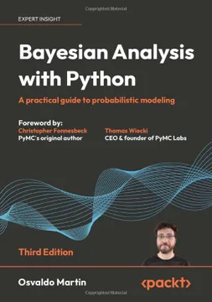
Workflow
Martin (2024) and PyMC core developer Thomas Wiecki suggest something like https://gist.github.com/twiecki/43def0aa16ee6a23f822a124eb429958
Plot the data
Build model
Check prior predictions
Fit models
Assess convergence
Run posterior predictive check
Improve model
https://github.com/dpnolan/pandemic

Slide 23
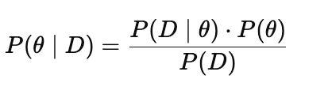

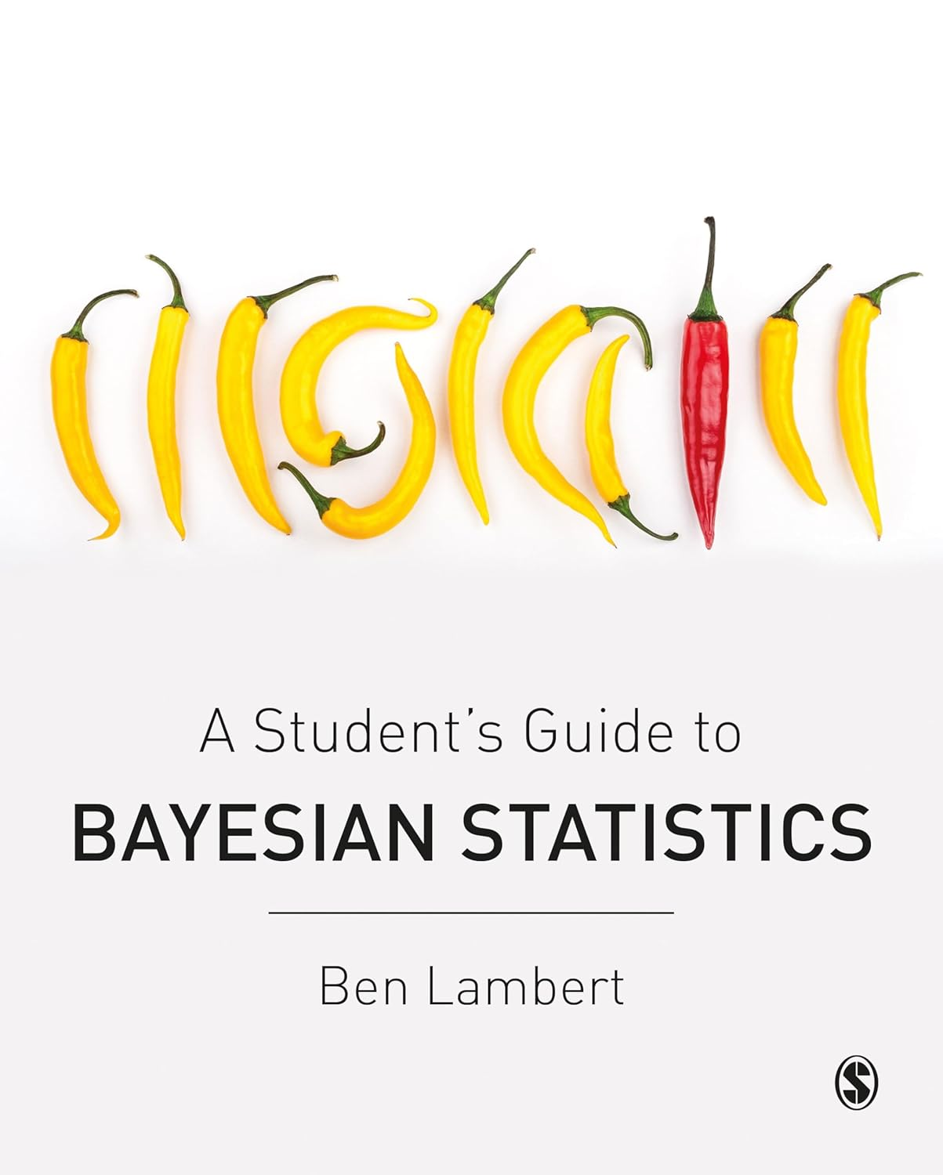
Bayes and Markov Chain Monte Carlo
Without a simple arithmetic Conjugate Prior from our chosen distributions, we estimate using simulation with MCMC
Monte Carlo - simulate by random draws
Markov Chain - future state depends on the current state only
We sample from P(𝝷 | Data), distribution of Probability of the model+parameters using the prior and likelihood distributions to set the frequency with which we sample from each region of the posterior
From this we calculate the characteristics of our posterior distribution
PyMC uses No U-Turns (NUTS) version of the Hamiltonian sampling algorithm, searching parameter space using gradient, then stopping search when the sample search turns back to its previous steps on the path
STAN uses Hamiltonian Monte Carlo, with the NUTS engine
https://github.com/dpnolan/pandemic

Slide 24






Python Libraries
Usual data analysis libraries
SciPy for the old Fortran odeint() solver
PyMC for running the MCMC, ran on Windows 11
STAN language was used with cmdstanpy a wrapper for STAN, in Windows System Linux, and on Google Colab.
Installing PyStan, cmdstanpy failed repeatedly in Windows and MacOS
ArviZ was for MCMC diagnostics and metrics
No one platform would run both, hence the separate files and static versions in the GitHub
Runs on Google Colab and with one 4090 GPU , runs took 5-25 minutes
https://github.com/dpnolan/pandemic

Slide 25
Diagnostics from ArviZ
Require log-likelihood from PyMC or STAN output in idata output
Summary statistics for estimated parameters
R-hat - compares between-chain variance to within-chain variance for the parameter: if chains have mixed well and are sampling the same stationary distribution, those variances match and R-hat <= 1.05
Trace plots show marginal distribution of estimated parameter and time-series per chain of samples - look for convergence and the shape of the estimates
Pair plots - joint posterior of selected parameters often with divergent transitions overlaid. They show correlations or non-linear relationships,or multimodality
Energy plots shows the Hamiltonian used by HMC/NUTS, movement, wide range means exhaustive search
Posterior plot - show the distribution, the mean, mode and dispersion and compare to the original sample
WAIC - Watanabe Information Criterion, estimates out-of-sample predictive accuracy from MCMC draws using the pointwise log-likelihood, this incorporates the posterior uncertainty in assessing accuracy, the higher the better
LOO - Leave One Out, another Information Criterion, higher the better
https://github.com/dpnolan/pandemic

Slide 26
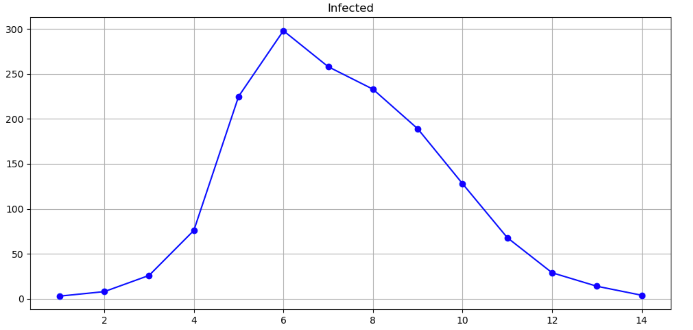
School Dataset
‘Flu outbreak in an English school, dataset published in 1978
PyMC - See Jupyter Notebook 3
STAN - Seee STAN/CmdStanPy1.ipyn section ‘School Example’

Slide 27
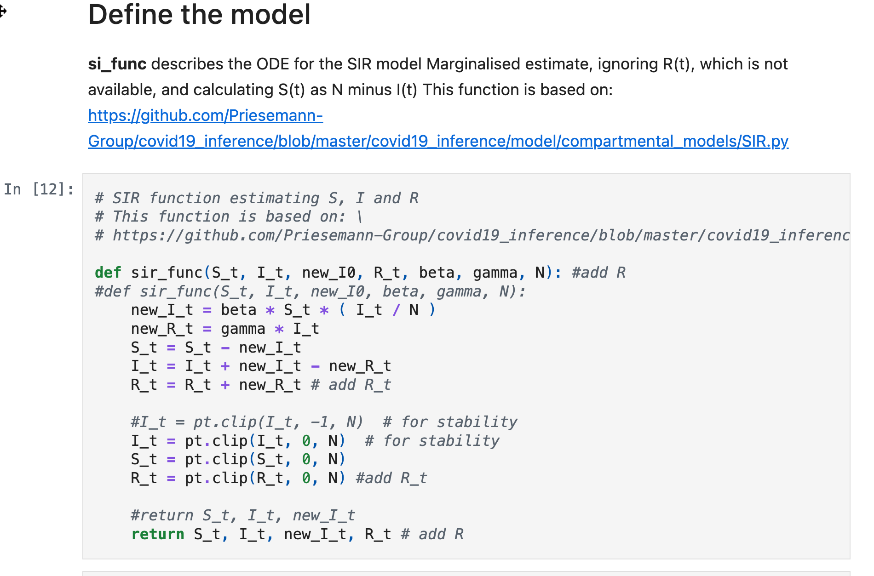
School Case-Study - SIR ODE
SIR function is defined in Python
I found the logic in a comment on a PyMC forum, the only published SIR I found
Marginalisation - we ignore R(t), integrating over all values

Slide 28
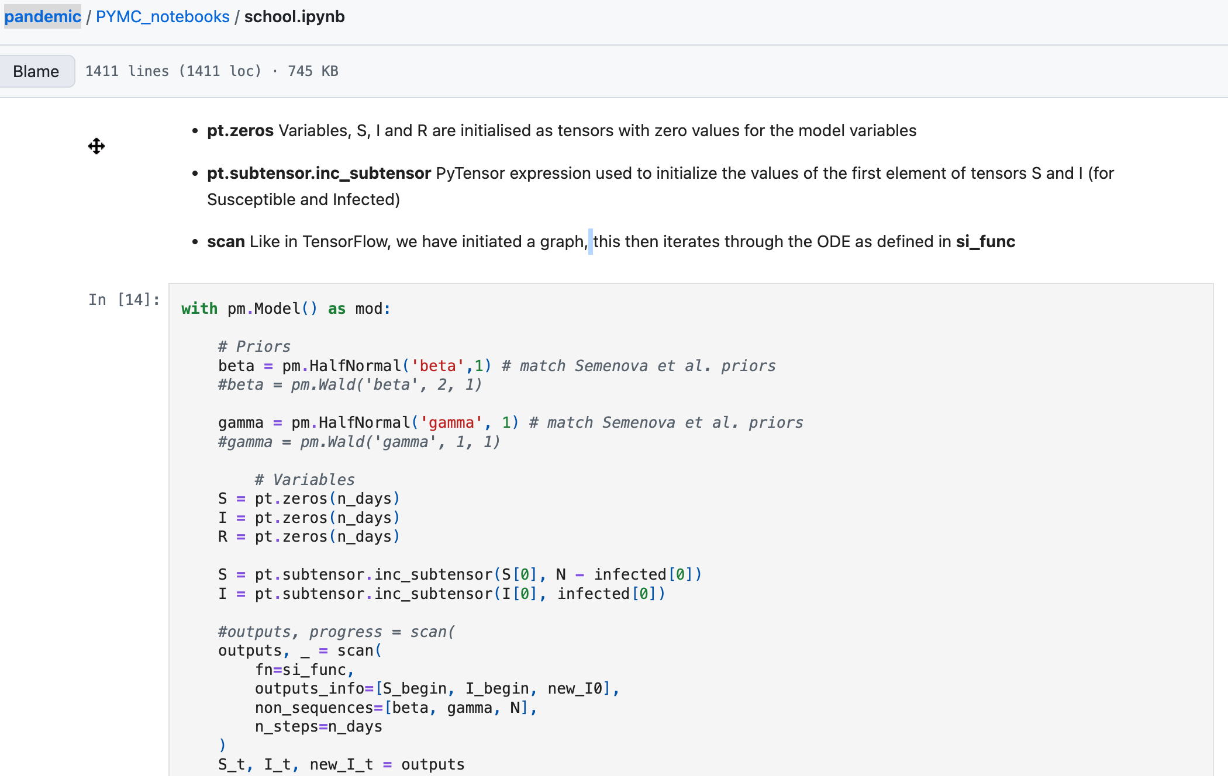
School Case-Study - Define the Priors

Slide 29
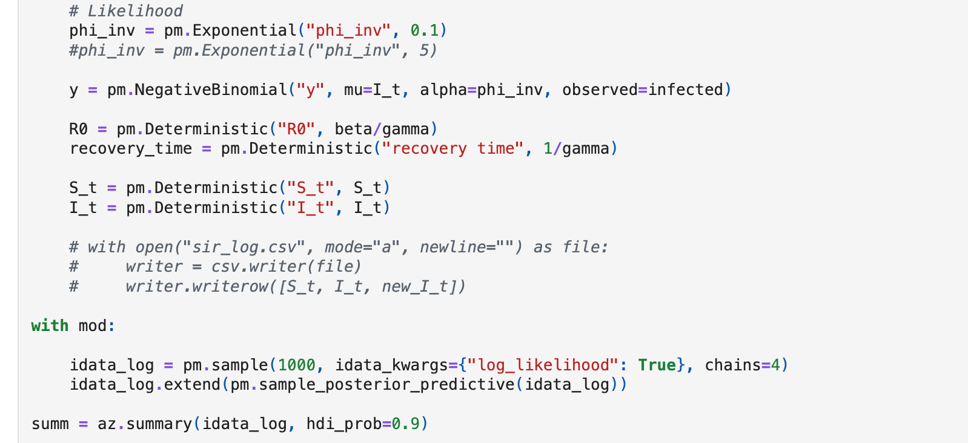
School Case-Study - MCMC Functions, Sampling, Logs, Output to ArviZ

Slide 30
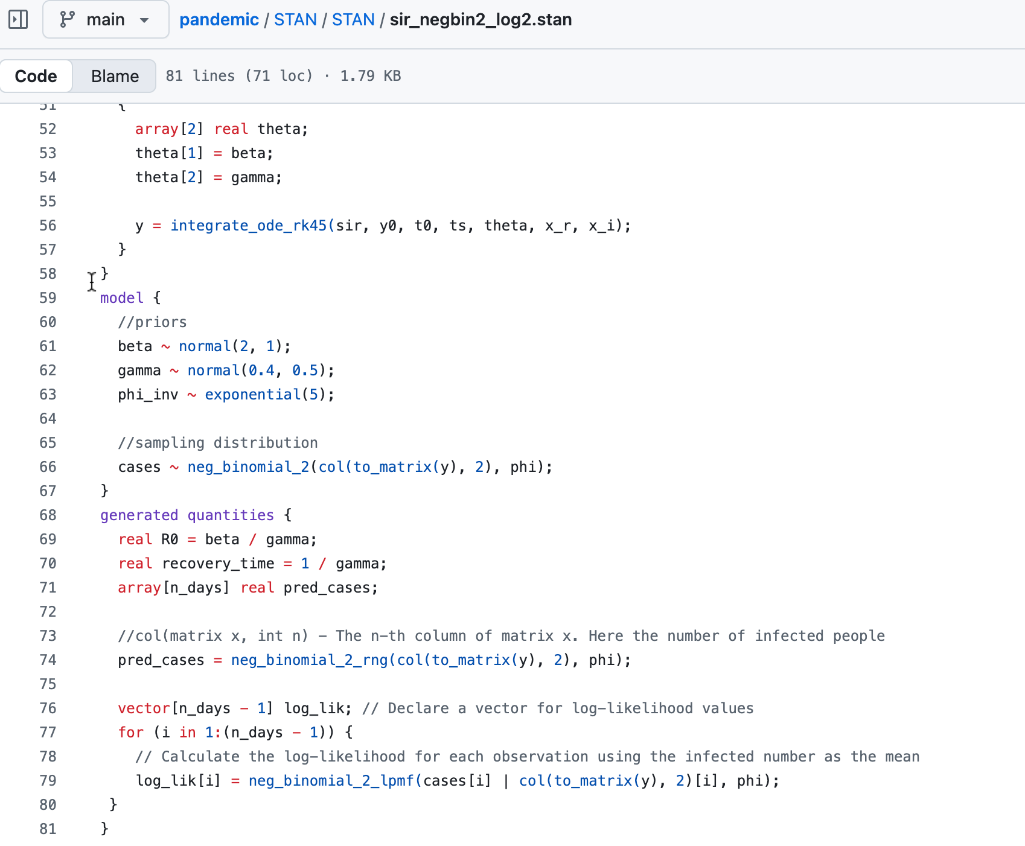
School Case-Study - STAN code
Line 60 - Priors defined
Line 74 - Negative binomial for infections
Line 76 - log-likelihood generated for ArviZ to access

Slide 31
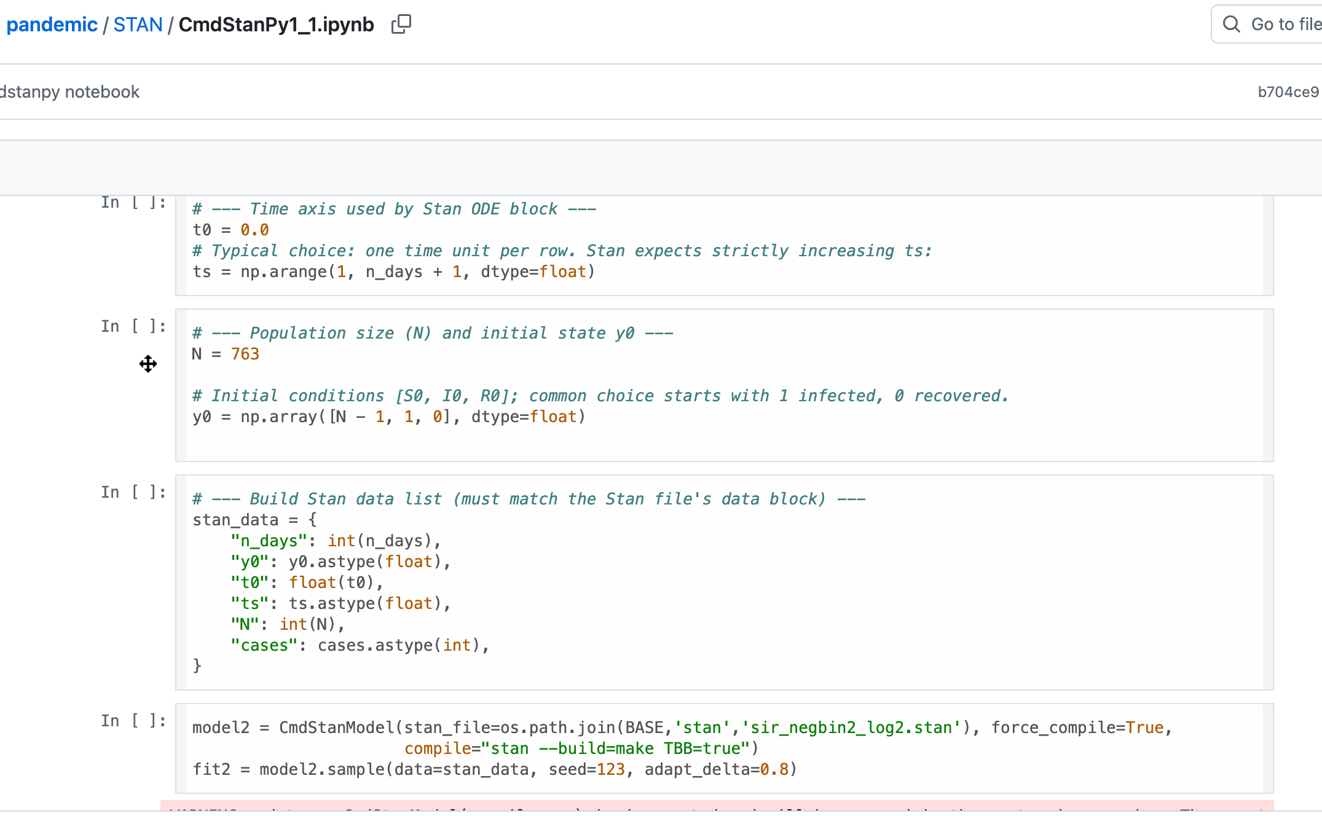
School Case-Study - Calling STAN
Feed STAN code and data to the simulation via CmdStanModelI()

Slide 32
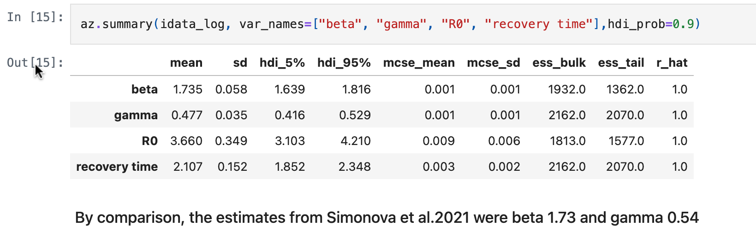
School Case-Study - Summary
Stats look close to those in the published model
R-hat shows good matching of variance in search within and across chains, a sign of a robust and wide search

Slide 33
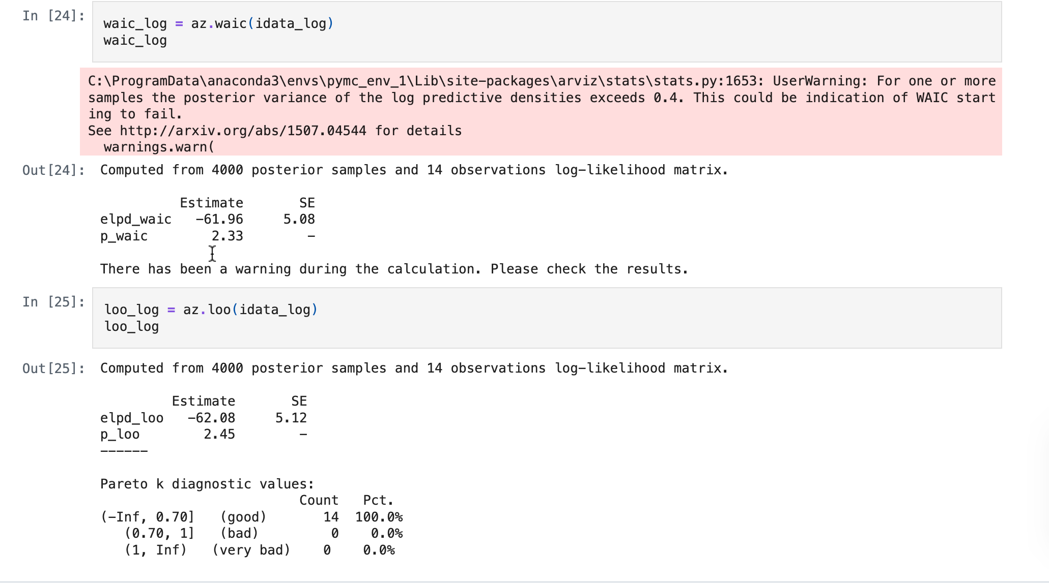
School Case-Study - Diagnostics WAIC and LOO

Slide 34
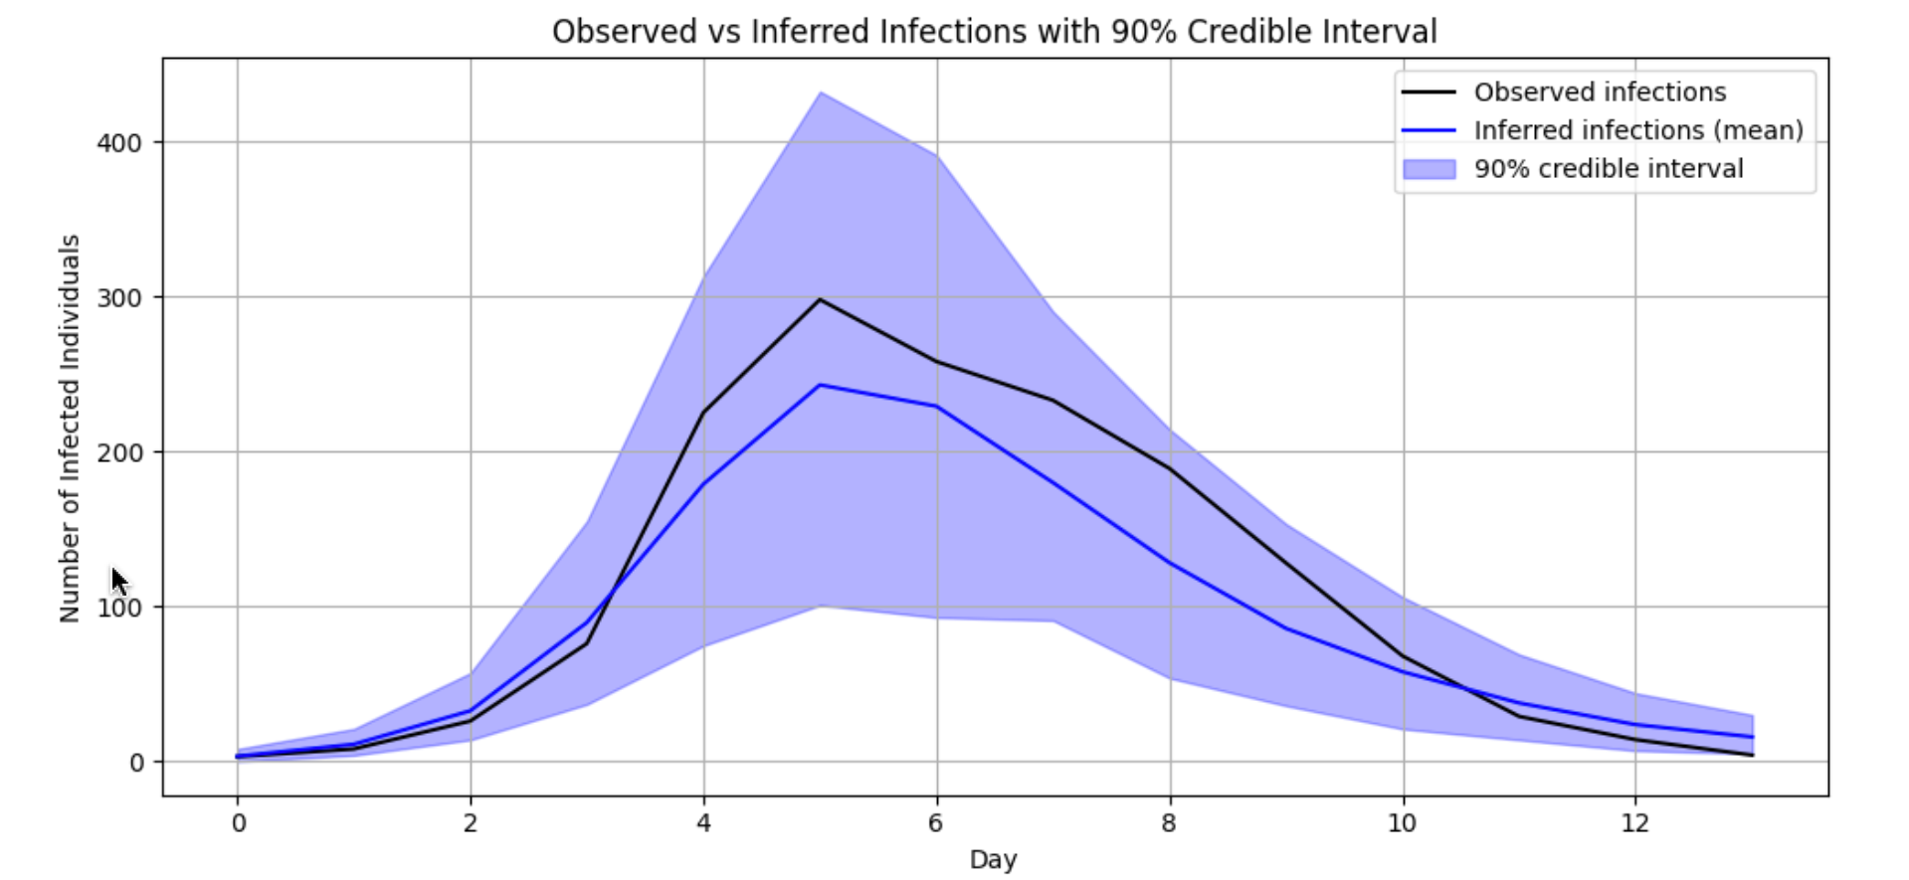
School Case-Study - Diagnostics - Graph
Diagnostics - posterior v observations
Most commonly reported
This is from the STAN / ArviZ output

Slide 35
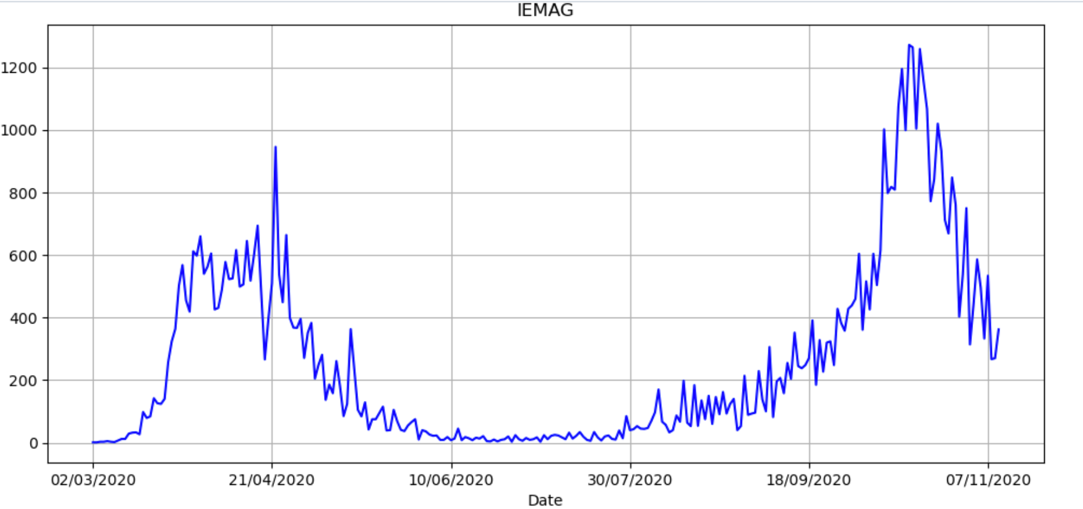
IEMAG Data
See Jupyter Notebook 4
STAN - Seee STAN/CmdStanPy1.ipyn section ‘IEMAG Irish Pandemic Data’
IEMAG models fitted in May and October
Strong seasonality and effect from control measures

Slide 36
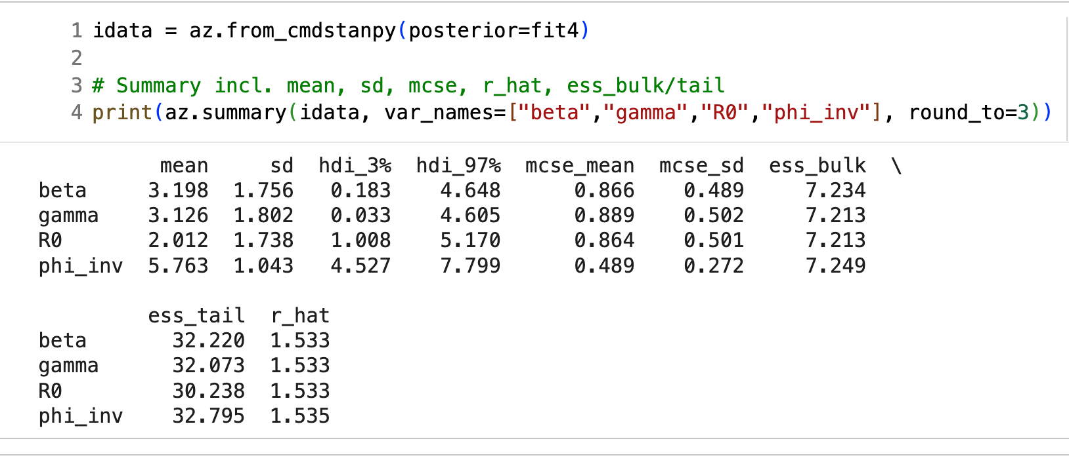
IEMAG Data Run 1 - Summary Statistics
First model sir_incidence3.stan
Use same priors as Swiss data in Simonova et al.
beta ~ normal(2, 1),
gamma ~ normal(0.4, 0.5);
phi_inv ~ exponential(5);
Estimates show very high r_hat, chains don’t converge
WAIC -1967

Slide 37
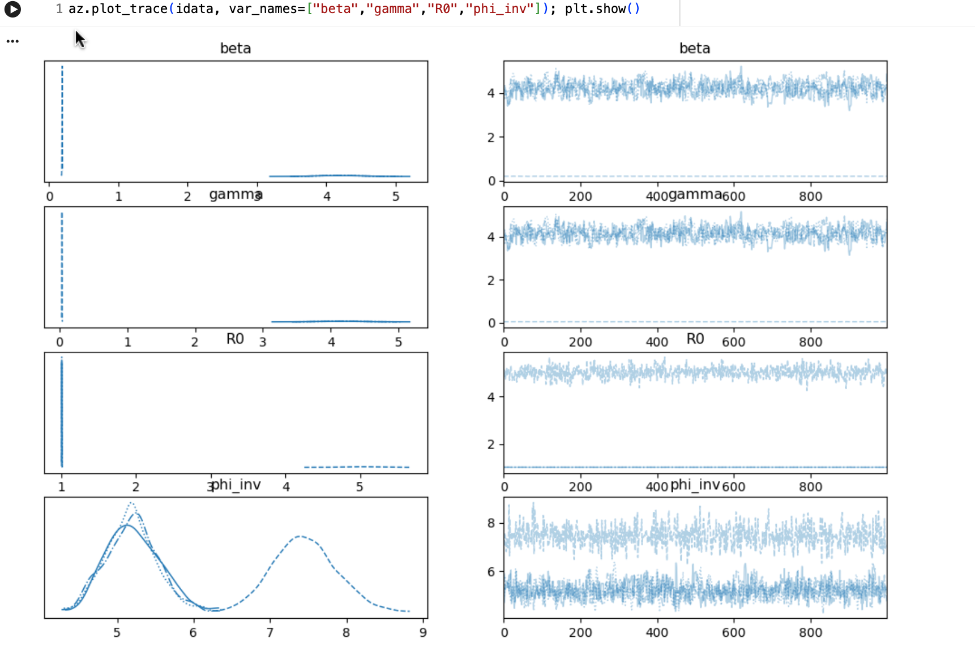
IEMAG Data Run 1 - Summary Statistics
Trace diagrams show no distribution of estimates
Split chain 4 shows data may be multimodal non-stationary

Slide 38
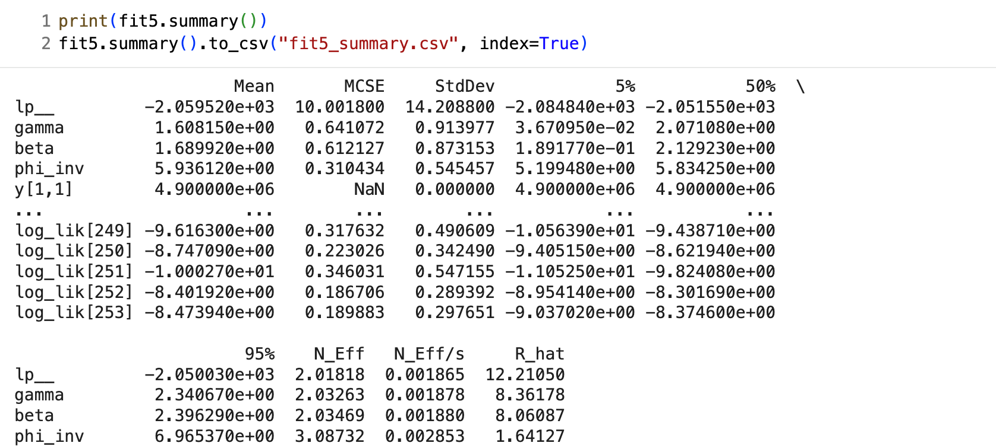
IEMAG Data Run 2 - Irish Data with Tighter Priors
Second model sir_incidence4.stan
Use tighter priors as in Simonova et al.
beta ~ normal(2, 0.5);
gamma ~ normal(0.4, 0.2);
phi_inv ~ exponential(10);
Estimates show very high r_hat, chains don’t converge
Still very bad
WAIC -2007

Slide 39
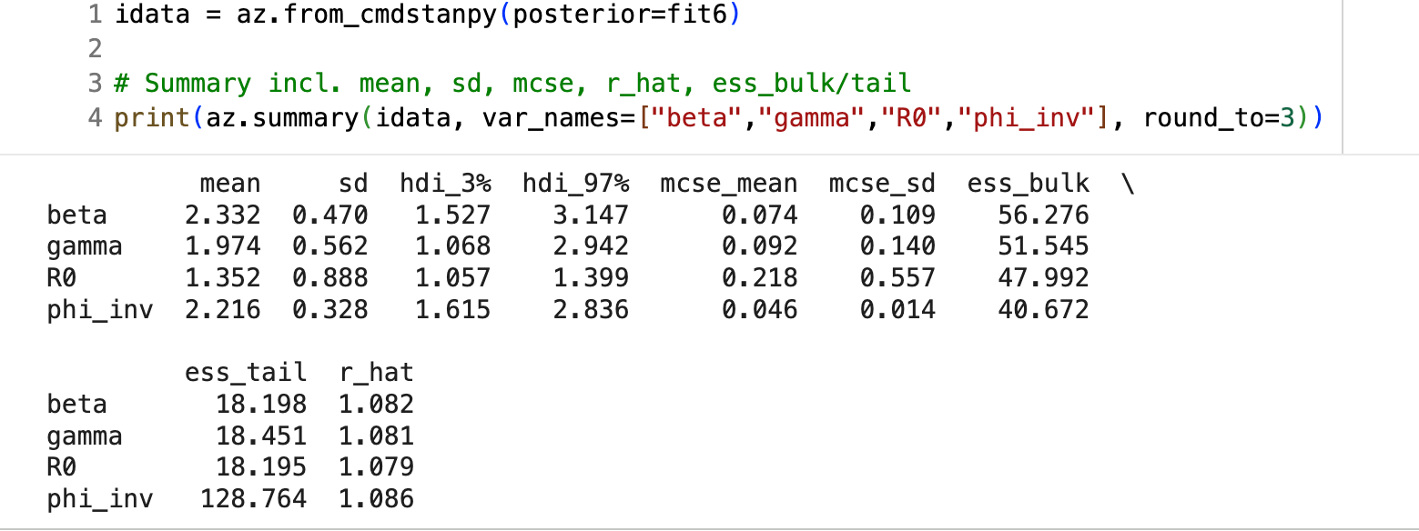
IEMAG Data Run 3 - Irish Data, first 3 months
Original priors model sir_incidence3.stan
Avoid periods of lockdowns and reinfections handled with extra parameters in Simonova et al.
Estimates show high but not absurd r_hat
Not great
WAIC -58

Slide 40
IEMAG Data Run 4 - Irish Data, first 3 months, tighter priors
Original priors model sir_incidence3.stan
Avoid periods of lockdowns and reinfections handled with extra parameters in Simonova et al.
Estimates show high but not absurd r_hat
Worse again
WAIC -428

Slide 41
IEMAG Data Model Outcomes
The fit for the simple PYMC model is very poor
This was not, as I thought first, a bug, but a misspecification of the model
Tightening the prior conditions led to better performance on the sampling Rhat and WAIC
Moving to estimation from Feb to Oct 2020 to within a narrower period of 3 months' data, initial spread, peak, then fall in summer and autumn, performed better this way also also, likely due to stationary in the data
The fit is not perfect, but the process seems to be productive; more factors should improve performance

Slide 42
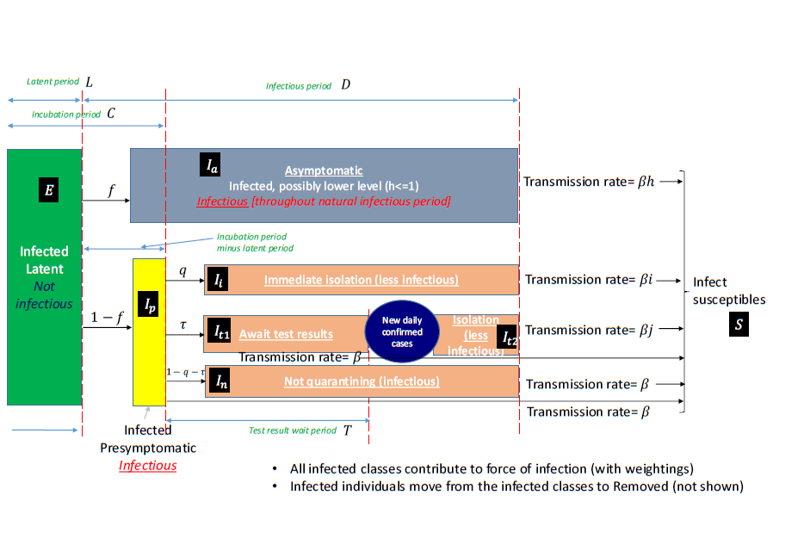
Next Steps
PyMC and STAN
Compare with Northern Ireland’s similar epidemic model, perhaps in one hierarchical model
Social network models
Compare with UK models https://www.gov.uk/government/publications/reproduction-number-r-and-growth-rate-methodology/reproduction-number-r-and-growth-rate-methodology#fnref:1
Implement age-based model
Add economic effects

Slide 43

The Irish COVID Enquiry
The Irish Epidemiological Modelling Advisory Group (IEMAG) team head Prof. Philip Nolan discusses his experience at an RIA panel, commenting that the ‘follow the science’ approach was authoritarian https://www.youtube.com/watch?v=Estl2VBSKcc
Irish enquiry into the pandemic is now under way by a panel of academics scrutinising the plans and responses, but with relatively limited powers, no cross-examination and no power of compel appearance. Contact details are online at https://www.covid19evaluation.ie/
My own view is that the analysis needs prior preparation, probably with nominated specialists and a menu of data sources, models and tools shared within the EU and globally, with the data infrastructure set up in advance
https://github.com/dpnolan/pandemice

Slide 44
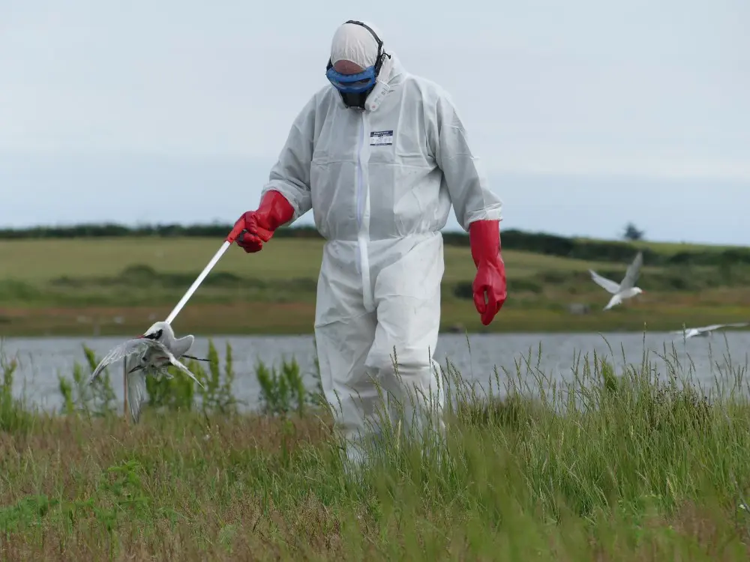
Conclusions
PyMC can estimate simple SIR models, coming close to published results or simulations
Ecosystem of libraries and published research for epidemiology in STAN is larger, better-supported and gives same output
Setup for PyMC was harder than STAN
SIR models are the transparent and useful tool for measuring and forecasting the pandemic, perhaps THE most useful
Bird 'flu remains a threat and spreads through farmed and wild animal populations, with more than half the Common Terns breeders dying off in the Dublin Port colony https://birdwatchireland.ie/devastating-bird-flu-impacts-on-irish-seabirds-revealed-in-new-study/
https://github.com/dpnolan/pandemice

Slide 45
Modelling the COVID Pandemic in Ireland with Bayesian Methods in Python
using PyMC and STAN
Peter Nolan
https://github.com/dpnolan/pandemic
databeaker@gmail.com
@dpnolan
Python Ireland
Sunday 16 November 2025
UCD

