Slide 1
AI in software delivery workshop
What Gartner sees, and what it means in your context

Slide 2
Why we are here
Improving software delivery with AI and flow principles

Slide 3
Better delivery needs AI and flow principles
The starting point
1 The consensus
2 AI alone is not enough
3 Flow principles as well
There is agreement that the software delivery processes need to improve.
The aim is better delivery from request to support, not only faster tasks.
These two days turn that agreement into specific changes.
AI speeds up tasks, but work still waits between roles and sprints.
Faster tasks do not automatically give faster end-to-end delivery.
When roles and workflows stay the same, the gains stall at the task level.
Flow principles improve how work moves, waits and is handed over.
AI improves how each piece of work is done.
Used together, they improve the whole delivery process.
Source for column 2: G00857393. Section 3 covers these points in detail
3

Slide 4
What we will do and what you will take away
Over the two days
What each team takes away
See what Gartner research says about AI and delivery flow.
Put it in your own context, in teams, using your own projects and services.
Agree where AI and flow principles would help, and what stands in the way.
Your key stakeholders, their goals and success criteria.
Your top three delivery challenges.
Drawings of your current SDLC and your future SDLC.
One AI agent design, with a small test.
Your barriers to adoption, with mitigation steps.
The aim: a future SDLC improved by AI and flow principles, and steps you can act on.
4

Slide 5
Agenda: five sections over two days
Day | Section | What Gartner sees | In your context
Day 1 | Why we are here | Why delivery needs to improve, with AI and flow principles | What we will produce (30 minutes)
Day 1 | 1 Stakeholders | Who takes part in delivery, what goes wrong in engagement and what to do | Your stakeholders, their goals and success criteria (55 minutes)
Day 1 | 2 Delivery challenges | Eighteen common challenges in project management, requirements and QA | Brainstorm and prioritise your own challenges (60 minutes)
Days 1–2 | 3 AI and the SDLC | How AI changes the SDLC, and how to adopt it | From your current SDLC to your future SDLC (3 hours, across both days)
Day 2 | 4 Designing an AI agent | Seven design questions, with a worked example | Design one AI agent on the canvas (1 hour 50 minutes)
Day 2 | 5 Overcoming challenges | The barriers Gartner sees, and what helps | Your challenges and barriers, grouped, with mitigation steps (60 minutes)
Each section follows the same pattern: what Gartner sees, an exercise in your context, then a share-back.
5

Slide 6
Day 1 timings: 09:00 to 17:00
Time | Session | What happens | Min
09:00 | Welcome and why we are here | Why we are here, what we will produce and the agenda | 30
09:30 | 1 Stakeholders: what Gartner sees | Who to engage, what goes wrong and what to do | 30
10:00 | 1 Exercise in teams | Your stakeholders, their goals and success criteria | 55
10:55 | Break |  | 20
11:15 | 1 Share-back | Teams share their stakeholder flipcharts with the room | 15
11:30 | 2 Delivery challenges: what Gartner sees | Eighteen common delivery challenges | 30
12:00 | Lunch |  | 60
13:00 | 2 Exercise in teams | Brainstorm your challenges, then prioritise them | 60
14:00 | 2 Share-back | Teams share their top three challenges | 15
14:15 | 3 AI and the SDLC: what Gartner sees | How AI changes the SDLC, and how to adopt it | 70
15:25 | Break |  | 20
15:45 | 3 Exercise in teams, steps 1 and 2 | Draw your current SDLC and mark where work waits | 65
16:50 | Review of day 1 | Progress so far and the plan for day 2. Close at 17:00 | 10
6

Slide 7
Day 2 timings: 09:00 to 17:30
Time | Session | What happens | Min
09:00 | Recap of day 1 | The current SDLC drawings and the plan for the day | 10
09:10 | 3 Exercise in teams, steps 3 and 4 | Choose where AI helps most, then draw your future SDLC | 95
10:45 | Break |  | 20
11:05 | 3 Share-back | Each team presents its future SDLC | 25
11:30 | 4 Designing an AI agent: what Gartner sees | Seven design questions, a worked example and a video | 40
12:10 | Lunch |  | 60
13:10 | 4 Exercise in teams | Design one AI agent on the canvas and agree a small test | 110
15:00 | Break |  | 20
15:20 | 4 Share-back | Teams share their agent design and their test | 15
15:35 | 5 Overcoming challenges: what Gartner sees | The barriers to adoption, and what helps | 30
16:05 | 5 Exercise in teams | Your barriers to adoption, grouped, with mitigation steps | 60
17:05 | Share-back, next steps and close | Teams share their mitigation steps. Close at 17:30 | 25
7

Slide 8
Major software project stakeholders and engagement challenges
Who to engage, what goes wrong and what to do

Slide 9
Ten stakeholder groups take part in software delivery
Who to engage: delivery and execution
Group | Stakeholder | Role in delivery
Product and delivery leaders | Product managers | Own roadmaps, align budgets and teams, and set product direction from business priorities.
 | Software engineering leaders | Coordinate product and project teams, set shared terms and establish adaptive governance.
Execution teams | Development teams | Build specific products or services. Need clarity on ownership and expected outcomes.
 | Architects | Define technical contracts, such as APIs, to manage dependencies between teams.
Sources: references 3, 4 and 7 (see the References slide)
9

Slide 10
Ten stakeholder groups take part in software delivery
Who to engage: business, customers and support
Group | Stakeholder | Role in delivery
Business and strategic | Business stakeholders | Own business capabilities, define outcomes and state what success looks like.
 | Governance partners | Security, compliance and risk. Embed controls in workflows, not in retrospective checks.
 | Finance and budget holders | Decide funding and resource allocation against strategic priorities.
Customers and users | Customers or internal user groups | Give feedback, validate product value and drive prioritisation.
Support functions | Platform teams | Run enabling services and infrastructure for product teams.
 | Service providers | In outsourced delivery, carry out defined activities to agreed milestones and service levels.
Sources: references 3, 4 and 7 (see the References slide)
10

Slide 11
Eight issues recur in stakeholder engagement
What goes wrong: issues 1 to 4
1
Unclear roles and expectations
2
Technical language
Stakeholders hold different views of success and of who is accountable. Engineering leaders are often left out of strategic business discussions.
About half of software engineering leaders say they can state a business case in business terms. Executives need outcomes, not technical metrics.
3
Late, transactional engagement
4
Collaboration gaps
45% of software engineering leaders spend less time building stakeholder partnerships than they would like.
Product leaders report too little collaboration with customer success (37%), sales (32%) and marketing (28%).
Sources: references 1, 2, 5 and 7 (see the References slide)
11

Slide 12
Eight issues recur in stakeholder engagement
What goes wrong: issues 5 to 8
5
Conflicting priorities
6
Low transparency
Stakeholders with different incentives or risks resist change. Their concerns are labelled as blockers and are not addressed.
Stakeholders lose trust when decisions and trade-offs are not shared. Collaboration slips when no one is accountable for it.
7
Scaling and role complexity
8
Agile and non-agile dependencies
One product manager cannot cover a complex product. Security, architecture and specialist views arrive late or not at all.
Cadences and governance models conflict. Dependencies are not agreed in advance, which causes delay.
Sources: references 1, 2, 5 and 7 (see the References slide)
12

Slide 13
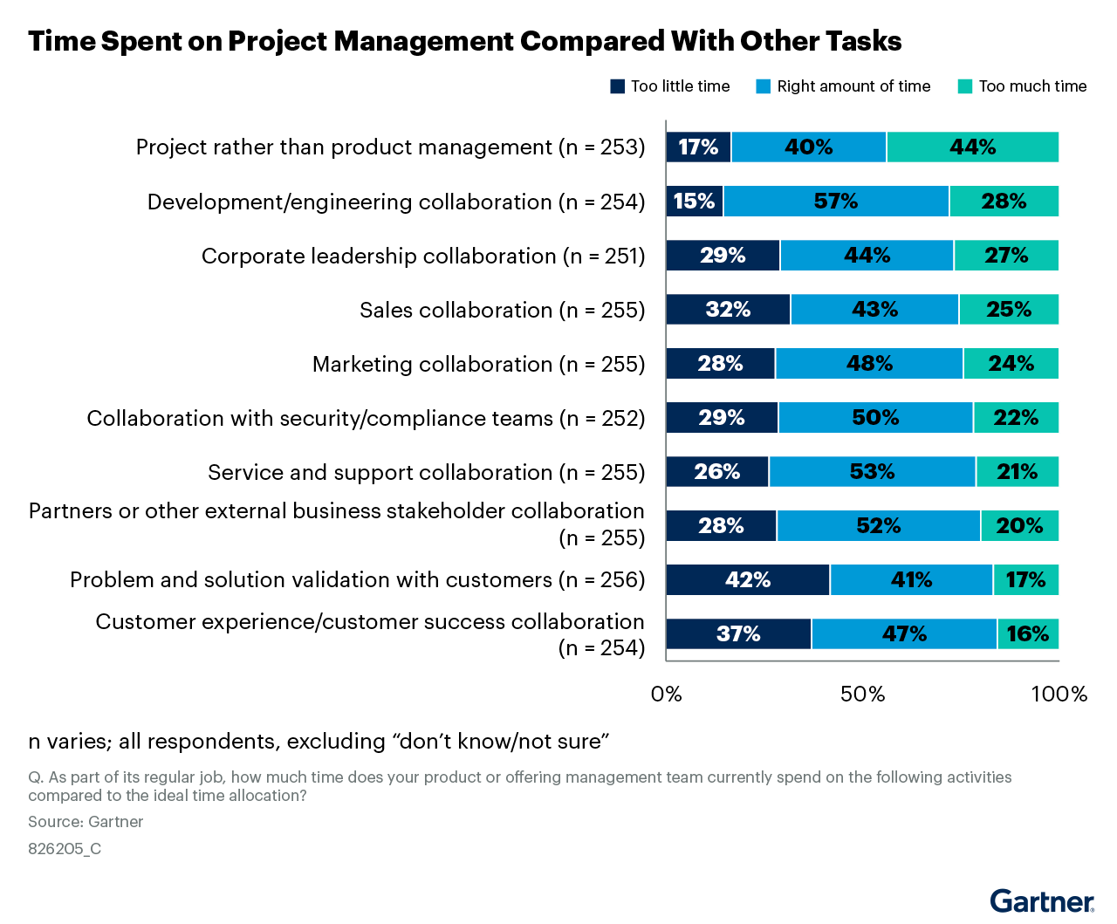
Product teams spend too little time with customers
What goes wrong: supporting figure
What the figure shows
42% of product leaders say their teams spend too little time validating problems and solutions with customers.
37% report too little time with customer experience and success, 32% with sales, and 29% with security and compliance.
44% say too much time goes on project management.
n varies from 251 to 256. 2024 Gartner Product Management Survey.
How to apply it
Add product owner and product operations roles, so that product managers can rebalance their time.
Figure source: reference 5 (see the References slide)
13

Slide 14
Twelve signals that engagement is not working
What goes wrong
Poor communication flows
Unclear accountability
Misaligned incentives
Gaps in engagement structure
Stakeholders are surprised by decisions or delays.
Technical and business language do not match.
Discussions happen in silos.
Responsibilities overlap or are ambiguous.
No single point of ownership for outcomes.
Governance and compliance review comes too late.
Stakeholder groups have conflicting goals and no shared priority framework.
Success metrics are not tied to business outcomes.
Resistance is dismissed, not managed.
Interaction is transactional and happens only at project boundaries.
Finance, customer success and compliance are not included early.
Specialist roles are absent or underused.
Sources: references 1, 2 and 5 (see the References slide)
14

Slide 15
Eight actions to improve stakeholder engagement
What to do: actions 1 to 4
1
Engage early and continuously
2
Speak in business terms
Set regular touchpoints from the start. Treat engagement as a partnership, not a series of approvals.
Translate technical work into the outcomes that matter to each stakeholder.
3
Define roles and shared terms
4
Build an extended product team
State who is accountable for what. Agree what project, product, agile and waterfall mean.
Add product owners and product operations. Bring in security, architecture and subject matter experts from the start.
Sources: references 1, 2, 4, 5 and 7 (see the References slide)
15

Slide 16
Eight actions to improve stakeholder engagement
What to do: actions 5 to 8
5
Make the product team a hub
6
Align teams to value streams
Share decisions, inputs and reasoning with every part of the organisation.
Map the flow from request to delivery, so that each team sees how its work connects to enterprise outcomes.
7
Adapt governance
8
Coordinate cadences
Co-create guardrails with delivery teams and embed them in workflows.
Identify dependencies early and agree how they will be met, without slowing agile teams.
Sources: references 1, 2, 4, 5 and 7 (see the References slide)
16

Slide 17
Engage early, speak in business terms and define roles
What to do: actions 1 to 3
1 Engage early and continuously
2 Speak in business terms
3 Define roles and shared terms
Set regular stakeholder touchpoints at the start of the project.
Include finance, customer success, security and compliance early, not only at project boundaries.
Involve stakeholders in decisions, so that they act as partners and not as order takers.
State the business case in business terms.
Report outcomes such as revenue impact, time to market and customer satisfaction, not technical metrics alone.
Tailor the message to the priorities of each stakeholder.
Define roles and accountability explicitly. Avoid shared or ambiguous responsibility.
Define and socialise project and product terminology across teams.
Do not present one delivery model as superior. Fit the model to the work.
Sources: references 2 and 6 (action 1); reference 1 (action 2); references 4 and 8 (action 3). See the References slide
17

Slide 18
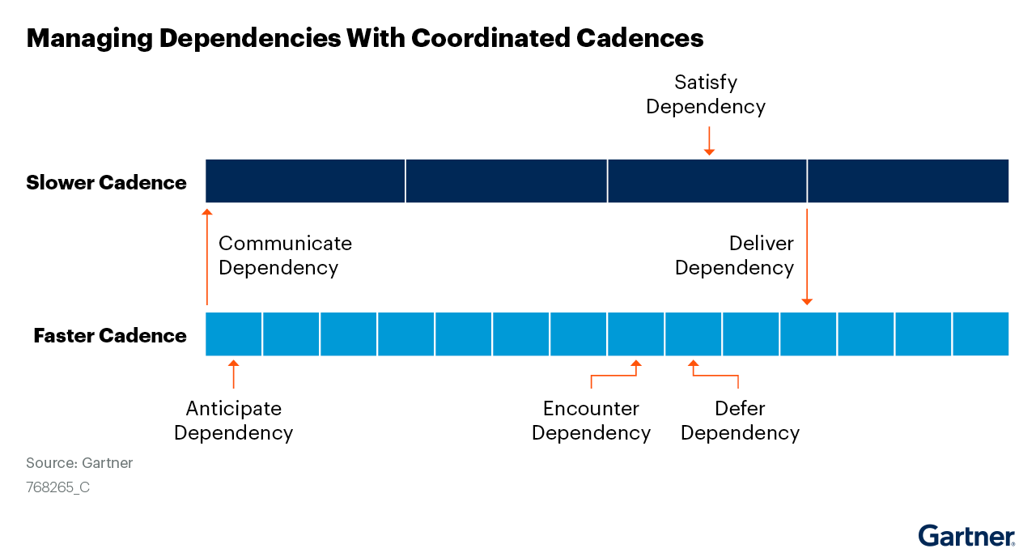
Agree dependencies early and keep the faster cadence
What to do: action 8
What the figure shows
Teams on a faster cadence depend on teams on a slower cadence.
The dependency is communicated early, encountered before it is satisfied, deferred and then delivered.
How to apply it
Identify dependencies as early as possible.
Agree with the other team how each will be met.
Continue on the assumption that it will be met, then run integration tests on delivery.
Figure source: reference 7 (see the References slide)
18

Slide 19
From the research to your stakeholders
What Gartner sees
In your context
Ten stakeholder groups take part in software delivery.
Engagement often fails through unclear roles, late involvement and conflicting priorities.
The first actions are to engage early, speak in business terms and define roles.
Identify your own stakeholders.
Select the seven who matter most to delivery.
Capture what each one wants and how they will judge success.
The exercise: 55 minutes in your teams.
19

Slide 20
Exercise: our stakeholders, their goals and success criteria
In your team (55 minutes)
For step 3, ask
Choose one current project or service. Pick one person to write on a flipchart.
What do they want to achieve?
How will they judge success?
By when?
What would they count as failure?
Brainstorm as many stakeholders as possible. Everyone contributes.
15 min
1
Select the seven key stakeholders who most affect delivery, or are most affected by it.
10 min
2
Capture the goal of each stakeholder and how they will judge success.
30 min
3
Use these three columns on the flipchart. Example:
Stakeholder | Their goal | Their success criteria
User representatives | Software that is easy to use and fits their daily work | Staff complete the main tasks without help, and support calls fall
Add a ? beside any goal or criterion you need to check with the stakeholder. Be ready to share your flipchart with the room.
20
Notes:
Team exercise: 15 minutes to brainstorm as many stakeholders as possible, 10 minutes to narrow the list to seven key stakeholders, and 30 minutes to capture their goals and success criteria. The timings total 55 minutes. Arrange any whole-room share-back after the team exercise. During the brainstorm, everyone contributes and the scribe captures all ideas without filtering. Include internal and external people or groups who use, fund, support or influence the software, including those affected by it. Then combine duplicate suggestions and select seven based on their influence on delivery or how strongly delivery affects them. Keep the full brainstorm list. The person taking notes also contributes. If the group does not share a project, choose one member’s real example and briefly explain it. Use one table row for each of the seven selected stakeholders. Ask teams to state each success criterion so that it can be observed or measured. Goals and criteria are hypotheses unless confirmed by the stakeholder. The table row is an illustrative example. Keep the three-column table visible during the exercise.

Slide 21
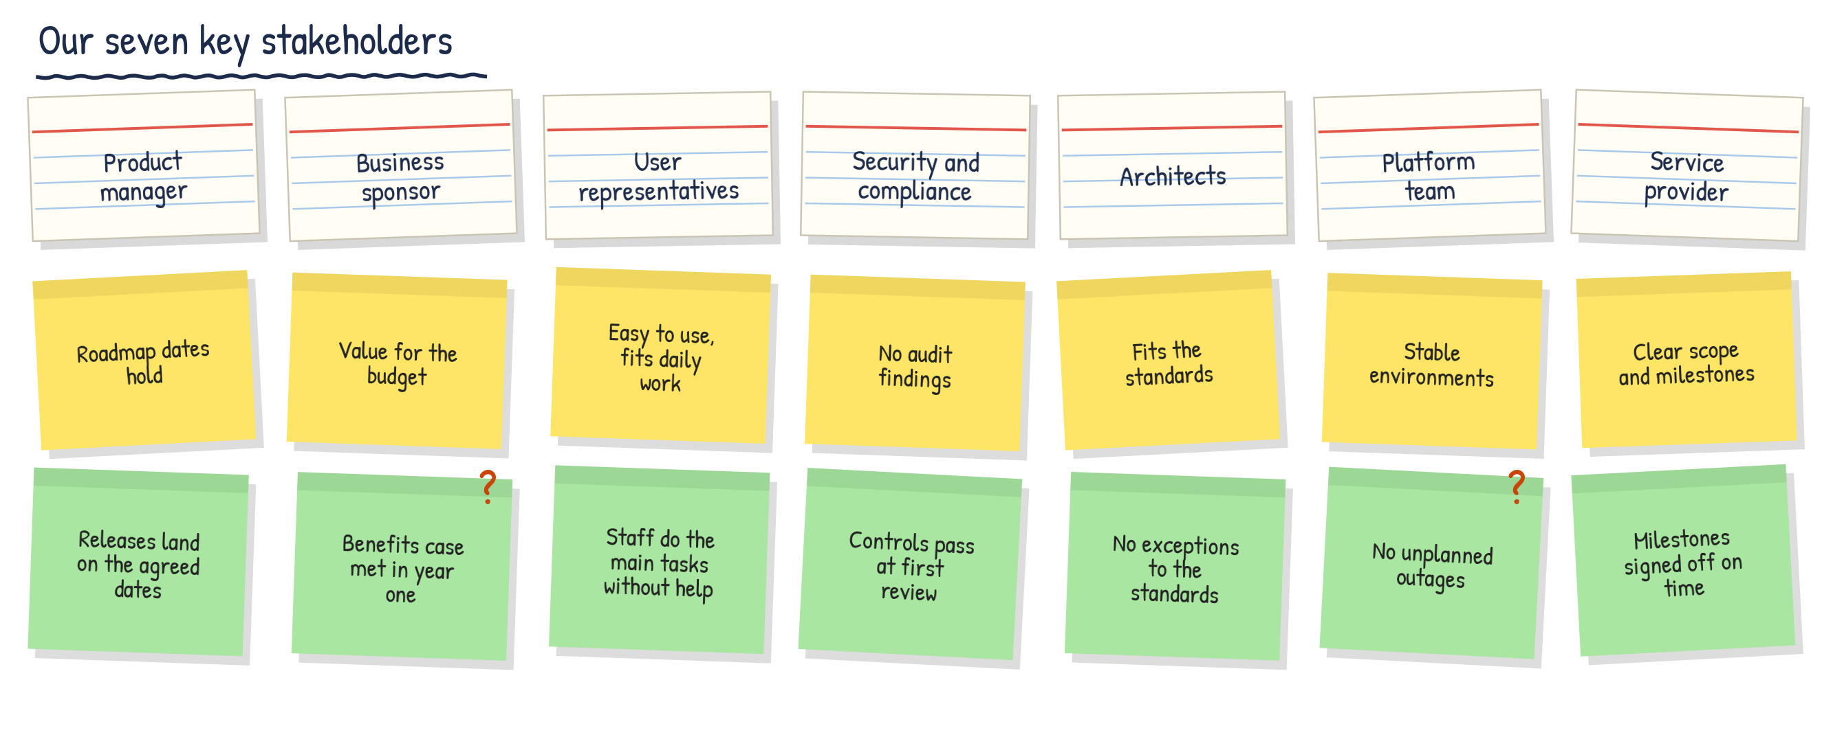
Example: what a team might produce
Index card: a key stakeholder
Their goal
Their success criterion
? = check with the stakeholder. Illustrative example
21

Slide 22
Major challenges facing software development teams
Project management, requirements, QA and the wider challenges

Slide 23
Eighteen challenges across three areas
Project management
Requirements management
Quality assurance and testing
1
Weak stakeholder collaboration
6
Speed ahead of customer value
12
Central QA bottlenecks
2
Oversized, complex projects
7
Insufficient customer discovery
13
Testing added at the end
3
Incomplete agile adoption
8
No product manager in tiny teams
14
Unused production insights
4
Blurred roles and tactical overload
9
Cross-team coordination
15
Tight budgets, fragmented resources
5
Shifting business strategy
10
Fragmented regulation
16
GenAI hallucination and bias
11
Agility versus compliance
17
Privacy and compliance exposure
18
Skill erosion
The three areas are tightly coupled. A weakness in one area creates pressure in the others.
23

Slide 24
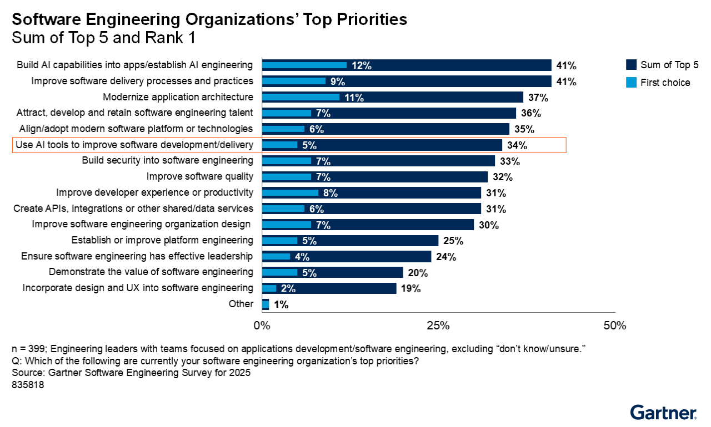
Delivery practice and quality are top leadership priorities
What the figure shows
Building AI capabilities and improving software delivery processes and practices lead. Each is a top-five priority for 41% of leaders.
Using AI tools to improve development and delivery is a top-five priority for 34%.
Improving software quality is a top-five priority for 32%.
n = 399 engineering leaders. Gartner Software Engineering Survey for 2025.
Why it matters
Delivery practice and quality sit high on the leadership agenda. The challenges in this section are obstacles to both.
Figure source: Manage Critical Risks of Using Generative AI to Augment Testing
24

Slide 25
Projects fail on collaboration, size and delivery method
Project management
1
Stakeholder collaboration is weak
2
Projects are too large and complex
3
Agile adoption is incomplete
The main cause of failure is poor engagement between IT and mission stakeholders.
Mission unit feedback and operational knowledge are not built into planning and delivery.
Large monolithic projects carry disproportionate risk.
Incremental deliverables reduce cost exposure and speed up feedback.
Many teams still use waterfall or hybrid approaches.
This delays early feedback, slows the delivery of usable increments and weakens accountability.
21%
61%
of government software projects succeed
success rate for smaller projects
Source: Why Government Software Projects Fail and What to Do About It
25

Slide 26
Blurred roles and shifting strategy weaken delivery
Project management
4
Product managers carry project management work
Responsibilities are not clearly defined. Product managers take on work better suited to specialist roles such as delivery managers.
The overhead slows project response and reduces accountability.
44%
of product manager effort goes on project management tasks, not strategic product leadership
5
Business strategy shifts too often
Frequent shifts disrupt prioritisation and create rework.
Without stable direction, teams lose confidence in planning assumptions.
41%
of product leaders cite frequent shifts in business strategy as the top barrier to alignment
Source: (Re-)Defining Product Management to Optimize for Customer Value
26

Slide 27
Faster delivery is not yet producing customer value
Requirements management
6
Speed is ahead of customer value
7
Customer discovery is insufficient
AI-accelerated development lets very small teams ship features quickly. Low usage suggests features are built for speed, not customer need.
50%
Without customer insight, teams risk building features that do not match real needs. Product-market fit suffers.
42%
of product leaders report AI feature usage at or below 30%
of product leaders say teams spend too little time on validation
8
Tiny teams lack a product manager
9
Cross-team coordination is difficult
Distributed teams of fewer than five people often have no dedicated product manager to make prioritisation decisions. This creates coordination gaps and weakens strategic alignment.
With many small teams delivering quickly, it is hard to coordinate backlog items, manage competing priorities, keep prioritisation transparent and track feature impact. Cross-team orchestration is needed.
Sources: AI Race: The Roadmap Can’t Keep Up. The Real AI Crisis for Software Vendors; (Re-)Defining Product Management to Optimize for Customer Value
27

Slide 28
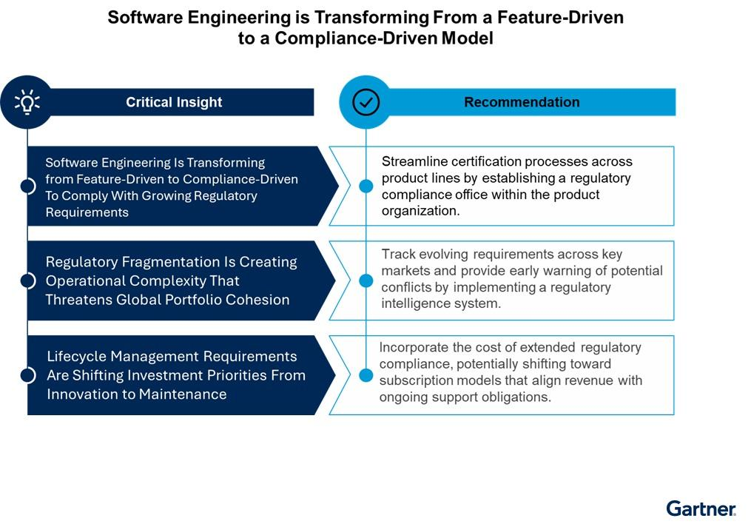
Compliance is now a core requirement
Requirements management
10
Regulation is fragmented
Mandates such as the EU Cyber Resilience Act make security and documentation fundamental requirements. Rules differ by jurisdiction and can conflict, so teams manage different requirements by market. This lengthens timelines and diverts engineering effort from innovation.
11
Agility and compliance are in tension
Compliance calls for documentation, formal risk assessment and verification. Agile practice favours minimal documentation and rapid iteration. Teams have to track innovation and compliance in parallel.
Source and figure source: Emerging Tech: C-Level Buyers Shift Focus as Compliance Takes Priority in Software Engineering
28

Slide 29
Centralised, late-stage testing creates bottlenecks
Quality assurance and testing
12
Central QA teams become bottlenecks
13
Testing is added at the end
Central teams face more demand than quality engineers can meet, which causes backlogs. Prioritisation meetings, manual forms and context-switching across products slow response. Central QA growth is often underfunded.
When QA sits in a separate team, quality stays an end-of-cycle activity. Quality is not built in and the chance to detect defects early is missed.
14
Production insights go unused
15
Budgets are tight, resources fragmented
Teams prioritise new features over full lifecycle ownership. Production data on system behaviour and user impact is neglected. Software is less robust and mistakes recur.
There is little appetite to add testing headcount or tooling because it takes resources from feature delivery. Testing efforts remain siloed, which duplicates work.
Sources: Decentralize Quality Assurance Testing Teams to Drive Productivity; Improve Software Quality and Reduce Security Risks With Shift-Right Testing
29

Slide 30
Generative AI in testing introduces new risks
Quality assurance and testing
16
Hallucination and bias
17
Privacy and compliance exposure
18
Skill erosion
GenAI can produce test cases for features that do not exist, or omit critical edge cases.
It cannot question assumptions or identify blind spots. Human oversight is needed to separate valid tests from fabrications.
GenAI testing tools can expose personal or sensitive data, in breach of GDPR, CPRA and the EU AI Act.
Teams need strict policies on test data, vendor training exclusions and AI usage documentation.
Overreliance on AI is linked to declining analytical reasoning and independent QA judgement.
The risk is superficial testing practice.
Source: Manage Critical Risks of Using Generative AI to Augment Testing
30

Slide 31
From the research to your challenges
What Gartner sees
In your context
Eighteen common challenges across project management, requirements and quality assurance.
The three areas are tightly coupled. A weakness in one creates pressure in the others.
Delivery practice and quality are top leadership priorities.
Brainstorm what makes software delivery difficult for your team.
Place each challenge by frequency and impact.
Choose your top three priorities.
The exercise: 60 minutes in your teams.
31

Slide 32
Exercise, part 1: brainstorm your delivery challenges
In your team (20 minutes)
What makes software delivery difficult for your team?
Everyone contributes.
1
Write one challenge per sticky note.
2
Capture as many ideas as possible before prioritising.
3
32
Notes:
First stage of a one-hour exercise for teams of seven. Allow 20 minutes for brainstorming. Give each person sticky notes and a pen. Ask everyone to contribute challenges from their own experience of software delivery, with one challenge per note. Capture all ideas at this stage. Introduce the frequency-versus-impact grid only after the brainstorm.

Slide 33
Exercise, part 2: prioritise your challenges
In your team (40 minutes)
Draw four boxes on a flipchart or wall.
1
High
Place each note in the box that fits your experience.
2
Frequency
3
Circle or dot-vote your top three priorities.
Low
Impact means the effect each time the issue occurs. Be ready to share your top three with the room.
Low
High
Impact
33
Notes:
Second stage of the one-hour exercise. Allow 40 minutes to prioritise the brainstormed challenges. Draw four boxes in a two-by-two grid on a flipchart or wall. Frequency is low in the bottom row and high in the top row. Impact is low in the left column and high in the right column. Agree what low and high mean for the team. Impact means the effect each time the issue occurs. Place each sticky note in the cell that best reflects the team’s experience. The shaded upper-right box highlights challenges with high frequency and high impact. Circle the three priorities the team wants to tackle first. Use judgement and real examples, including when a rare issue has severe consequences.

Slide 34
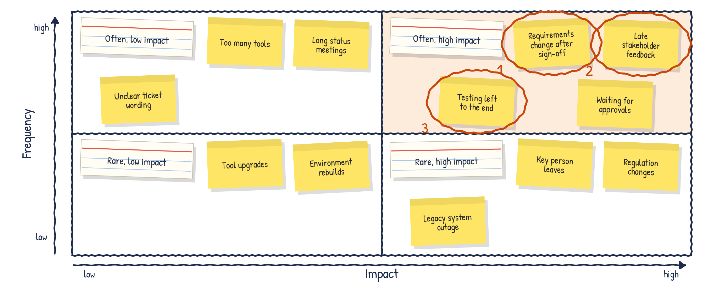
Example: what a team might produce
Index card: names the box
Sticky note: one challenge
Circled and numbered: the top three priorities. Illustrative example
34

Slide 35
How AI changes the SDLC, and how to adopt it
What changes in requirements, phases, roles and ways of working, and the steps to adopt AI and redesign delivery

Slide 36
Redesign turns faster tasks into delivery results
CBRE redesigned roles, team structures and the SDLC, and measured the result
15%
30%
28%
25%
Reduction in lead time with tiny teams during early pilots and rollout
Reduction in escaped defects in user acceptance testing and production
Reduction in cycle time
Cost-per-point efficiency gain realised, with 33% forecast at complete rollout
Without redesign, gains stall. Gartner predicts that by 2028 more than half of the organisations that scale agentic AI without evolving roles and workflows will see productivity gains stall at the task level.
Source: G00857393
36

Slide 37
AI speeds up tasks, but work still waits
Plan and analyse
Design
Develop
Test
Deploy and maintain
Optimise user stories
Prioritise the backlog automatically
Generate summaries
Turn text into designs for mock-ups
Generate, refactor and explain code
Review pull requests automatically
Write test cases and scripts
Repair failing tests to cut build times
Analyse the build pipeline
Generate infrastructure as code
Request
Work
Waiting
Delivery
Between roles: silos between product, UX, development and QA create wait time.
Between sprints: work sits idle until the next sprint boundary or ceremony.
1
About one-third of software engineering leaders already use agents for code generation, testing and modernisation.
2
Faster tasks do not automatically give faster end-to-end delivery.
3
AI-accelerated work moves quickly. Planning, approvals and release still run at a slower, human pace.
4
Separation between product, architecture, engineering and quality leaves finished work waiting for reviews or sprint checkpoints.
Source: G00857393 (Figure 1, partial representation)
37

Slide 38
The constraint moves from coding to intent and validation
As AI tools absorb execution work, constraints shift from coding towards requirement clarity, coordination and validation.
Before: human-paced delivery
1
Requirements and design
Write, test and debug code by hand
Constraint
Review and release
Engineers move from execution to defining intent, refining specifications and validating AI-generated output.
2
When workflows stay the same, AI relocates effort. Friction and overhead go up, not down.
With AI agents
3
Define intent and specifications
Constraint
Agents generate code and tests
Fast
Coordinate and validate output
Constraint
Gartner position: with Backlog Zero, deciding what to build becomes the primary constraint.
4
Sources: G00850352 (points 1 to 3); G00858441 (point 4). Diagram: illustration of these points
38

Slide 39
AI changes each step of requirements engineering
Step | What AI takes on | What people keep
Elicit | Transcribes and summarises workshops, finds themes across interviews and channels, and runs interview agents for early discovery. | Facilitate actively. Ask probing questions to uncover root causes and hidden assumptions.
Analyse | Audits draft requirements. Surfaces architectural conflicts, hidden dependencies and gaps in evidence. | Stay the final arbiter of investment decisions, trade-offs and strategic alignment.
Specify | Writes user stories, acceptance criteria and traceability links. Turns natural language into given-when-then scenarios. | Focus on planning and analysis.
Validate | Flags ambiguity and missing logic as requirements are written. Scores them against standards such as INCOSE and EARS. | Audit all AI-generated specifications for strategic alignment and technical feasibility.
Manage | Assesses the impact of each change, maintains traceability and answers questions on project history. | Decide on changes with the full project context.
27% of software engineering leaders cite AI as a primary driver of efficiency in requirements work today.
Source: G00858533
39

Slide 40
Requirements become views of a living brief
Inputs
AI workflows capture the reasons behind requirements: business objectives, customer evidence and decision rationale.
Stakeholder interviews
1
The living brief
Objectives
Insights
Risks
Discovery workshops
Requirements as dynamic views
AI connects data across wikis, workflow tools and communication platforms, which removes knowledge silos.
Support tickets
2
Operational incidents
Requirements, user stories and backlogs become temporary, generated views of the living brief.
Architecture decisions
3
The living brief is a continuously evolving, AI-curated representation of product and business context.
Each new requirements step starts with richer context than the last.
4
Source: G00858533 (Figure 2)
40

Slide 41
Phases compress into intent and implementation
CBRE compressed planning, design and architecture into intent, and develop, test, deploy and maintain into implementation.
Design
1
Planning
Continuous agentic delivery
Architect
Planning became continuous. Richer specifications and AI-assisted acceptance criteria replaced long planning ceremonies and fragmented user stories.
2
Engineers increasingly orchestrate and review AI-generated work. AI generates most test cases alongside the code.
Maintain
Develop
3
Deploy
Test
Production release remains explicitly approved by people.
4
Intent
Implementation
Source: G00857393 (Figure 3, adapted from CBRE)
41

Slide 42
What changes, what goes and what stays
What changes
Steps to remove
What stays
Fixed planning, sprint and release cycles
Strict role boundaries and large teams
A sequential, phase-based SDLC
Tracking of activity metrics, such as story points and velocity
Large-scale manual testing
Tickets to provision development and test environments
Routine, repetitive human approvals
Iterative and continuous delivery
Business intent, prioritisation and stakeholder feedback
Accountability for business outcomes
Non-negotiable quality, security and governance controls
User empathy and change management
Test each step. Ask why the process exists. Remove it if it only adds wait time. Keep the controls that improve quality, flow or risk management.
Sources: G00857393 (Figure 2, adapted from CBRE); G00843405 (steps to remove)
42

Slide 43
The engineer's inner loop becomes agentic
People articulate intent. Agents implement and return the work.
1
Human
Agents ground themselves in a context environment of architecture rules and domain knowledge, and update it.
Implements
Articulates intent
2
Agent
Codifies
People codify that context as structured, version-controlled artefacts.
3
Updates
Grounds
Without consistent context, agents drift. At Revvity, agents tried to move secrets and API keys into the client.
Context environment
Architecture rules
Domain knowledge
4
Source: G00850352 (Figure 2)
43

Slide 44
Work becomes asynchronous and parallel
Agents work in parallel with a human in the loop
Agentic coding tools turn AI from a code assistant into a feature builder. Multistep tasks take time, so engineers run several in parallel.
Automated code review
1
Vulnerability remediation
Engineer
Articulates intent and orchestrates agents
Engineer
Reviews output and stays accountable
Agents handle maintenance in the background while people focus on feature development.
Bug fixes from earlier releases
2
Refactoring
Agent output is not yet fully consistent or predictable, so human-in-the-loop oversight is mandatory.
3
Agent tasks
Source: G00843405
44

Slide 45
Roles compress and teams get smaller
Agile team roles | AI-native team role | Responsibilities
UX Researcher, UX Designer | Product Designer | Defines user journeys and workflows. Provides user context to guide AI-generated design. Validates usability against user needs.
Product Manager, Solution Architect | Product Architect | Owns business goals and priorities. Defines system architecture and design. Translates needs into technical blueprints.
Product Owner, Software Engineer | Product Engineer | Translates business intent into executable logic. Orchestrates AI agents. Reviews and validates AI-generated outputs.
Quality Engineer | Quality and Context Engineer | Enforces test-driven development. Ensures the quality of data and inputs to AI systems. Validates AI-generated outputs for reliability.
Scrum Master | Scrum Master | Manages cross-team dependencies. Tracks delivery risks and keeps the team aligned.
1
CBRE moved from teams of 8 to 9 people with strict role boundaries to tiny teams of 3 to 4 people with AI agents.
2
Role compression is uneven. Some roles merge, some expand and others become lighter or shared.
3
Tiny teams need strong platform support, clear outcome ownership and enough talent density.
4
Expect trade-offs: less team cohesion and more cross-team dependency management.
Source: G00857393 (Figures 4 and 5, adapted from CBRE)
45

Slide 46
The direction is a zero-friction SDLC
Outer loop: intent
Human-driven, declarative
Inner loop: implementation
Agent-driven, platform-supported
People specify intent
System of AI agents
Environment
Software outcome
Observe
Orient
Decide
Act
Governance
1
People specify intent. That includes the success metrics, business assumptions and validation criteria, not only the requirements.
2
Agents generate code, run tests, fix defects and refine prototypes within architectural, compliance and security constraints.
3
Gartner describes "AI dark factories" with an agentic intake gate that validates requirements and a human verification gate before production.
Sources: G00856957 (Figure 3 and points 1 and 2); G00858441 (point 3)
46

Slide 47
How to adopt AI and redesign your SDLC
From first use cases to a redesigned, governed delivery flow

Slide 48
Adoption follows four steps
1 Get grounded
2 Define value
3 Implement
4 Measure and scale
Set realistic expectations. Identify and prioritise use cases. Select tools. Define the skills developers need.
Agree expectations between developers and executives. Win over hesitant developers. Plan team composition and costs.
Manage security, governance and compliance risks. Protect quality. Integrate tools through MCP, APIs and CLIs.
Check adoption and success against baselines. Extend AI beyond coding to the rest of the SDLC.
Source: G00844726
48

Slide 49
Set realistic expectations first
64%
61%
51%
0%
Teams using AI that report less time spent on engineering tasks
Teams that see faster code reviews
Teams that see notably faster speed to market for new features
Engineering leaders who agree with the 43% of developers who believe they exceed speed-to-market expectations
Start with general-purpose AI tools, then add specialised tools in phases.
Invest in change management and upskilling.
1
2
Manage vendor relationships, so that marketing claims do not set the expectations.
Focus on high-value, low-efficiency parts of the SDLC.
3
4
Source: G00844726
49

Slide 50
Map the value stream before redesigning
Measure lead time, cycle time, wait time and defect escape to find where AI-accelerated work still sits idle.
Where mismatches appear
1
At role boundaries
Between phases of work
In metrics that no longer reflect how value moves through an AI-augmented workflow
Look at handoffs between teams and at the inner loops within each phase.
2
Put basic automation in place first: continuous integration, static code analysis and automated deployment.
3
The goal is to remove the slowest steps without compromising quality, flow or governance.
AI is not the answer to every blocker. CBRE found that an existing observability tool solved slow error monitoring better than a new AI tool.
4
Sources: G00857393 (point 1 and the panel); G00843405 (points 2 to 4)
50

Slide 51
Identify and prioritise use cases
Map all phases of the SDLC and identify the inefficiencies.
Prioritise use cases with transformational benefit, not only incremental gains.
1
4
Use targeted surveys and data collection to find specific pain points.
Build an AI-centric culture and the skills that teams need.
2
5
Assess technical viability and business value with established frameworks.
Involve security, legal and procurement, so that governance, compliance and cost are aligned.
3
6
Look beyond coding. Fewer than half of organisations use AI upstream (requirements, ideation, design, user stories) or downstream (code review, deployment, monitoring).
Sources: G00844726 (points 1 to 6); G00843405 (note)
51

Slide 52
Select tools through controlled pilots
1
Use cases and KPIs
Define precise use cases and KPIs. Choose tools that cover several SDLC phases.
2
Evaluation team
Include technical, business and operational stakeholders.
3
Evaluation criteria
SDLC coverage, productivity impact, change effort, vendor credibility, compliance and cost.
4
Controlled pilots
Validate tools in real workflows and gather developer feedback.
5
Vendor partnership
Look for transparency, support, integration and fit with the technology roadmap.
6
Compliance and return
Check data quality, security and risk requirements, and the cost justification.
Source: G00844726
52

Slide 53
Build three foundations before scaling
1 Context engineering
2 Platform engineering
3 Workflows and roles
Keep architectural rules, coding standards and policy constraints as structured, version-controlled artefacts with clear owners. Keep them current and usable by engineers and AI tools.
Scale AI through paved roads that embed validation, guardrails and security controls by default. Enforcement moves from individual developers to platform teams.
Adapt continuously as constraints move: apply AI, assess how constraints shift, then adjust roles and accountability. Expand autonomy only once variance, rework and coordination overhead decline.
Cautions: early success can mislead, because expert engineers compensate by hand for what is missing. Individual review cannot keep pace as agent output grows. Do not redesign workflows up front, and do not leave change until after rollout.
Source: G00850352
53

Slide 54
Implement the redesign in three phases
Phase 1: resolve constraints
Phase 2: reimagine with asynchronous workflows
Phase 3: realise a zero-friction SDLC
Map the software delivery value stream
Resolve bottlenecks with AI and with non-AI automation
Improve the experience of all roles, not only developers
Establish internal developer platforms for consistency and scale
Run tasks in parallel using asynchronous agents
Decide which steps to remove and which to keep
Extend the platform to govern, monitor and control agents
Implement autonomous self-improvement loops and address the pitfalls
Expand platform support for autonomous delivery and operations
Set human oversight by business criticality, acceptable risk and architectural complexity
Source: G00843405
54

Slide 55
Manage quality, risk and cost
Quality
Security and governance
Cost
Keep mandatory human oversight and code review
Add AI code review and security scanning to continuous integration
Automate testing and track quality metrics
Restrict vibe coding to low-risk uses
Set documented governance with cross-functional oversight
Secure the software supply chain with layered controls
Automate policy enforcement, and review after deployment
Evaluate vendors rigorously and pilot gradually
Start-up: licences, integration, infrastructure upgrades and initial training
Recurring: subscriptions, cloud compute, maintenance, continuing training and compliance
Token spend: 7% of organisations report more than $2,000 per developer per month
Aim: AI output that stays trustworthy, compliant and in line with architectural standards.
Sources: G00844726 (quality, security, governance and cost categories); G00858441 (token spend)
55

Slide 56
Example flow: how AI helps from discovery to hand-off
1 Discovery
2 Story development
3 Specification
4 Test case generation
5 Hand-off to development
Transcribes and summarises workshops and interviews
Finds themes across tickets, emails and chat
Runs interview agents for early discovery
Drafts user stories and acceptance criteria
Turns ideas into wireframes and prototypes
Links each story to its business objective
Breaks broad requirements into detailed, testable specifications
Writes structured given-when-then scenarios
Flags ambiguity, conflicts and missing logic
Generates test cases from the acceptance criteria and scenarios
Keeps tests traceable to requirements
Packages the specification, tests and context as input that developers and coding agents can use
Assesses the impact of later changes
People stay in control: they facilitate discovery, decide priorities and trade-offs, and review and approve every AI-generated story, specification and test before hand-off.
Sources: G00858533 (steps 1 to 3 and 5); G00857393 (step 4)
56

Slide 57
Set human oversight by criticality, risk and complexity
Human on the loop
Human in the loop
Internal business enablement applications
Minor bug fixes, dependency updates and configuration changes
Refactoring to fix code smells or replace deprecated APIs
Documentation, unit tests and test data
Autonomous workload optimisation
Product management, feature prioritisation and software architecture
Business-critical software that is core intellectual property
Code for financial calculations, sensitive data or authorisation
Changes that affect systems of record or shared modules
Verification of AI output for business-critical or safety-critical uses
On the loop: agents execute, and people step in on exceptions, anomalies or alerts. In the loop: people approve before an agent executes a decision.
Source: G00843405 (Figure 11)
57

Slide 58
Measure against a baseline, then scale
Measure adoption and results
Check that the foundations are in place
Set baselines before adoption: cycle time, defect density and developer satisfaction
Track licence use, time savings and cycle time across the SDLC
Combine tool data with surveys, retrospectives and pilot evaluations
Link results to business outcomes: return on investment, time to market and customer satisfaction
Context freshness: at least 70% of context artefacts updated in the last 30 days
Platform usage: the share of AI activity run through approved, platform-managed workflows
Rework and variability: trends in review churn, failed handoffs and cycle-time variance
Then scale: extend AI to requirements analysis, design, testing, security, deployment and operations.
Sources: G00844726 (measurement and scaling); G00850352 (foundation measures)
58

Slide 59
Summary: what changes and how to adopt it
1
The constraint moves
From writing code to defining intent and validating output.
2
Requirements change most
AI takes on the administrative work. Requirements become views of a living brief.
3
Phases and roles compress
Blended roles work in tiny teams. Production release stays under human approval.
4
Start from evidence
Set expectations and a baseline. Map the value stream to find where work waits.
5
Build the foundations
Context, platform and continuous workflow redesign. Pilot before scaling.
6
Scale within controls
Match human oversight to risk. Manage quality, security and cost.
Sources: G00850352; G00858533; G00857393; G00843405; G00844726
59

Slide 60
From the research to your SDLC
What Gartner sees
In your context
AI speeds up tasks, but work still waits between roles and sprints.
The constraint moves from coding to intent and validation, so requirements work changes most.
Adoption works when roles and workflows are redesigned step by step, within controls.
Draw your current SDLC. Mark where work waits, where errors occur, and where requirements are uncertain or ambiguous.
Choose where AI agents would help most.
Draw your future SDLC with agents supporting you.
Be bold. Do not pave the cow path: redesign the work, do not only automate the steps you have today.
The exercise: 3 hours in your teams. This is the main exercise.
60

Slide 61
Exercise: from your current SDLC to your future SDLC
In your team (3 hours)
Questions to help
1
Draw your current SDLC as it really works, from request to delivery.
35 min
Where does finished work sit waiting?
Which steps only add wait time?
Where do you depend on other teams or people?
Where does task switching cost you time?
Where must people stay in the loop?
What needs to be in place first: context, platform or roles?
2
Mark where work waits, is reworked or depends on others.
30 min
Break
10 min
3
Choose where AI would help most, and what you would do first.
45 min
4
Draw your future SDLC: what changes, what goes and what stays.
50 min
5
Share your future SDLC with the room.
10 min in total
Start from your top three challenges. Each team produces a drawing of its current SDLC with the bottlenecks, issues and dependencies, and a drawing of its future SDLC showing what the agents do and the benefits.
61

Slide 62
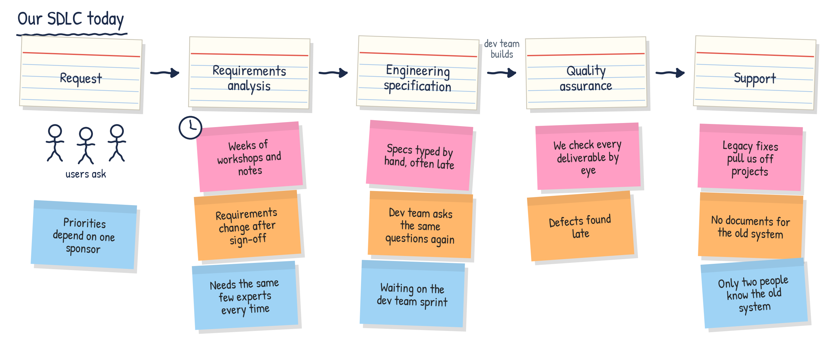
Example 1: capture your current SDLC
Bottleneck
Issue
Dependency
Illustrative example, not a model answer
62

Slide 63
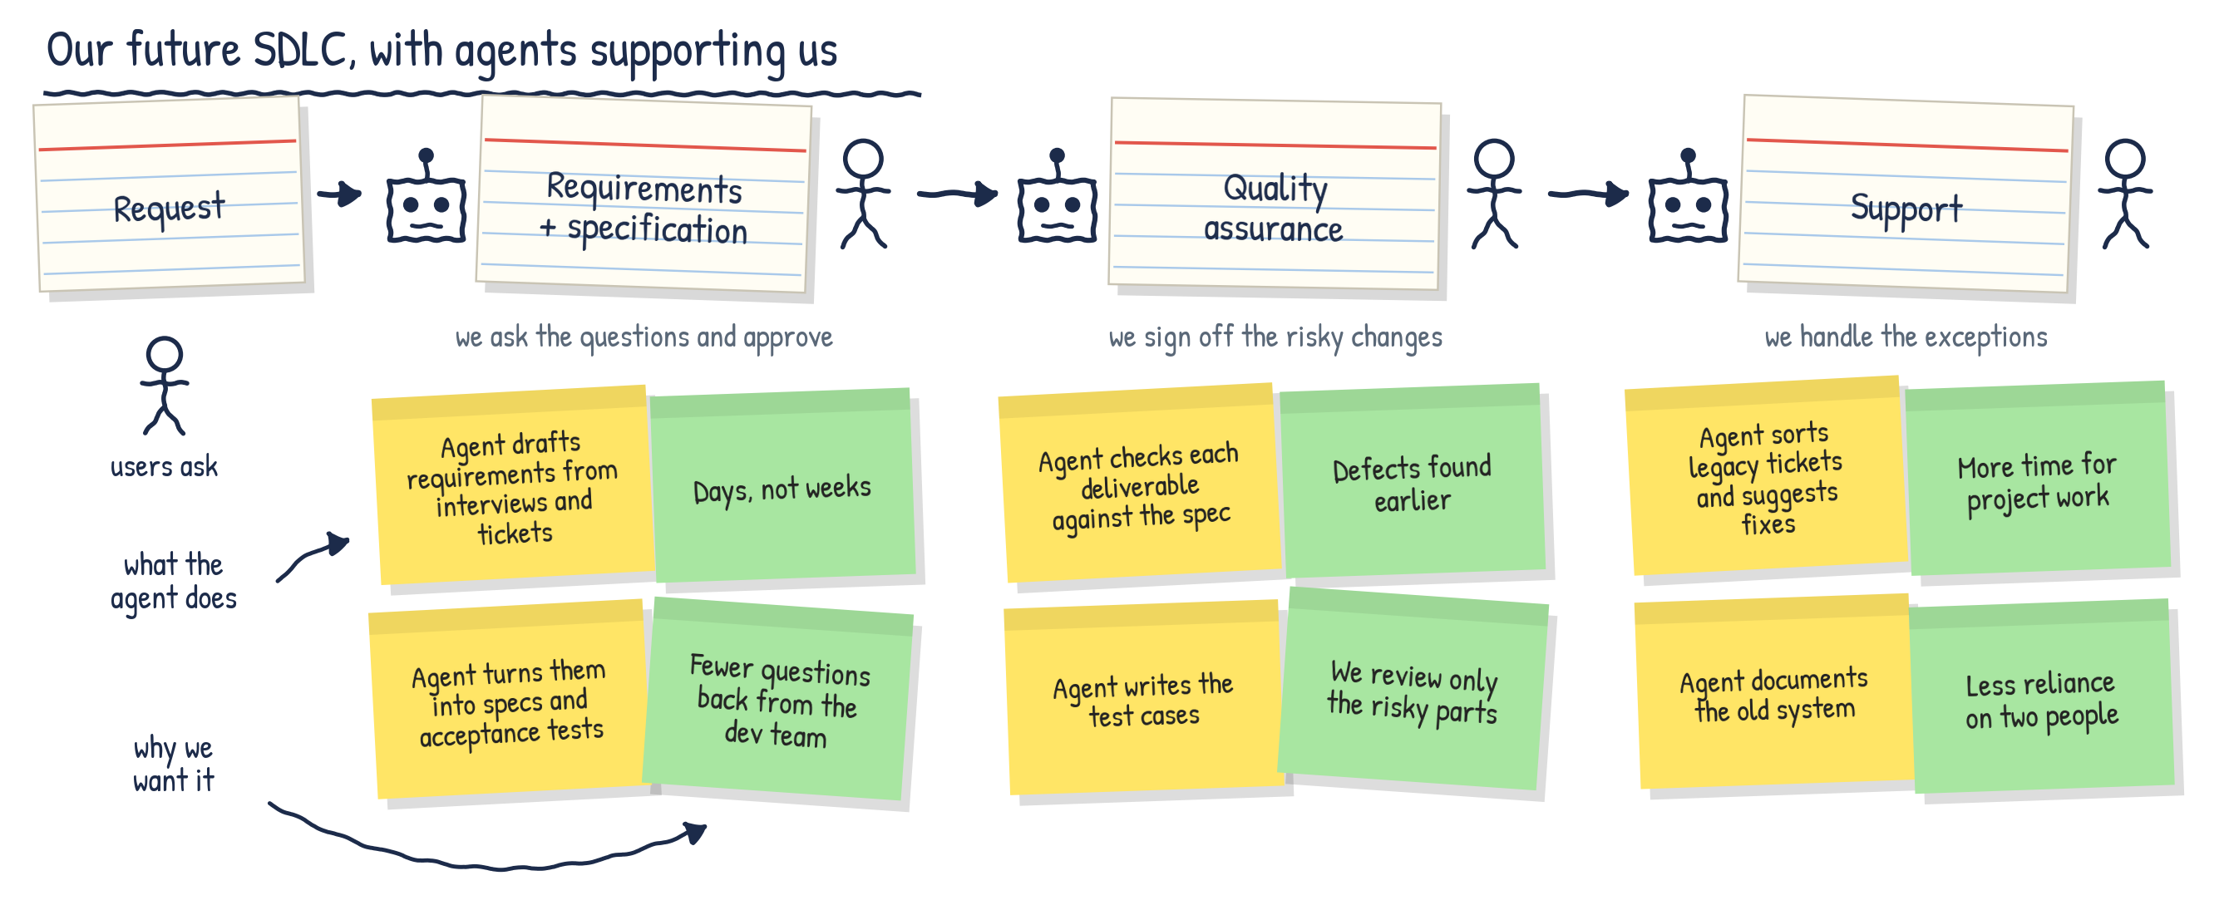
Example 2: draw your future SDLC with agents
What the agent does
Why we want it: the benefit
Illustrative example, not a model answer
63

Slide 64
Designing an AI agent
Seven design questions behind the team exercise, with a worked example

Slide 65
The worked example: one unclear story, three roles
The story: "Let customers change their delivery address." The engineering team needs to know when a change is allowed.
Alex
Engineering team
AI agent
AI helper
Sam
Product owner
Asks the questions. Checks that the team can build and test the story.
Organises the questions. Drafts a clearer story from the answers Sam gives.
Answers the business questions. Confirms the requirements.
In the exercise, a person plays the AI agent. No AI tool is needed. A fourth person, Priya in IT, checks whether the chosen AI tool may be used.
Worked example: workshop guide
65

Slide 66
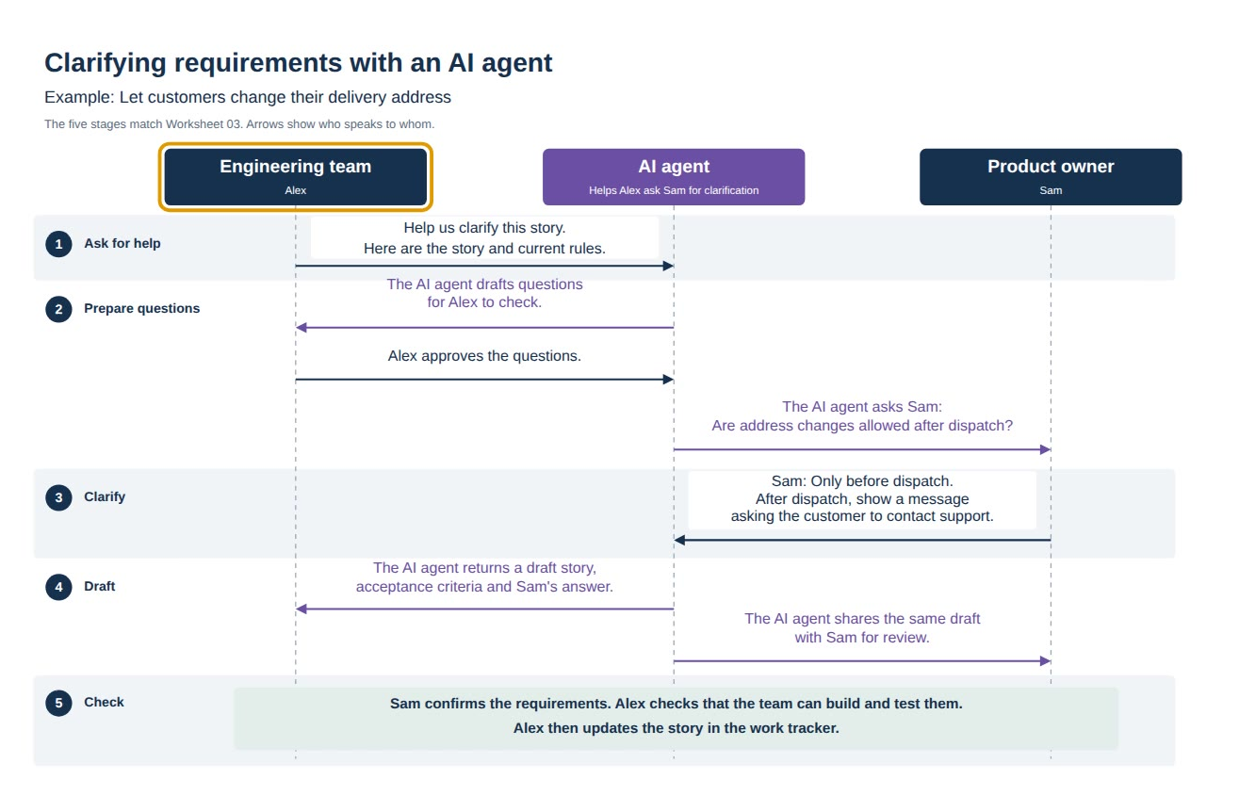
Watch: clarifying requirements with an AI agent
1
Ask for help
2
Prepare questions
3
Clarify
4
Draft
5
Check
66

Slide 67
An agent design answers seven questions
Step | Design question | What the answer defines
1 Pick one task | What do we want the AI agent to help with? | The task, and what better looks like
2 Draw the conversation | Who asks the AI agent, and who does it reply to? | The requests and replies, in order
3 List what the AI agent needs | What information does it need, and where from? | The inputs, their source and their owner
4 Say what the AI agent does | What steps, rules and policies must it follow? | The steps, the rules and policies, and the checks before it replies
5 Say what comes back | What does it return, and who checks it? | The output, the checks and what the AI agent may do alone
6 Test what could go wrong | What should it do when something is missing or wrong? | How the AI agent handles problems, and who acts next
7 Agree a small test | How will we try it, and how will we know it helped? | A test, its measures and the next action
Structure: workshop guide, seven steps
67

Slide 68
Step 1: pick one task
Step 1 of 7
What do we want the AI agent to help with?
Apply AI where execution is constrained. Look for work that waits or comes back in several rounds.
Worked example
1
Today: Sam answers in several rounds, which delays development.
The request: the AI agent finds the missing requirements and prepares one list of questions for Sam.
Better: one round of clarification, not three. Alex checks recent stories to confirm what happens today.
2
Choose one bounded task, keep the agents to well-bounded, repetitive tasks.
Say what better looks like, and find out what happens today.
3
Sources: G00850352 (points 1 and 2); G00844726 (point 3). Worked example: workshop guide
68

Slide 69
Step 2: draw the conversation
Step 2 of 7
Who asks the AI agent for help, and who does the AI agent reply to?
Engineering team
Alex
AI agent
Product owner
Sam
1
Ask for help
Help us clarify this story.
2
Prepare questions
Draft questions for approval
Alex approves the questions
Are changes allowed after dispatch?
3
Clarify
No. Only before dispatch.
4
Draft
Draft story and acceptance criteria
The same draft, for review
5
Check
Sam confirms the requirements. Alex checks that the team can build and test them, then updates the story.
Worked example: workshop guide and video. Pattern: people state intent, the agent implements, people check (G00850352)
69

Slide 70
Step 3: list what the AI agent needs
Step 3 of 7
What information does the AI agent need, and where does it come from?
Without consistent context, agents drift and give inconsistent results.
Information needed | Where it comes from | Who owns it
The story and its latest wording | The work tracker | Sam
The current rules on address changes | Supplied by Sam | Sam
The answers Sam gives | Recorded against the story in the work tracker | Sam
1
Name the actual tool, document or person. Context needs a clear owner and must be current.
2
Record what is still to be written or agreed, and who can help.
Still to agree: what happens after dispatch, and the exact customer message. Priya in IT confirms whether the AI tool may use the story and the answers.
3
Source: G00850352 (points 1 and 2). Worked example: workshop guide
70

Slide 71
Step 4: say what the AI agent does internally
Step 4 of 7
What steps, rules and policies must the AI agent follow?
1 Steps
2 Rules
3 Policies
4 Checks before replying
Reads the story and identifies the gaps. Drafts questions for Alex to approve. Then drafts the requirement from the answers Sam gives.
If Sam confirms a rule, draft a matching acceptance criterion. If an answer is missing or conflicts with another rule, flag it for Sam.
Use only information that is approved for the AI tool. Do not send questions until Alex approves them. Do not invent an answer.
Each criterion matches the confirmed answer. Both dispatch cases are covered. Every unresolved point appears as an open question.
Plain words, no code. Say who confirms each rule. In a real agent these become the harness: context files, enforcement hooks and verification gates, so that the agent is grounded, constrained and validated before its output is accepted.
Source: G00862738 (note). Worked example: workshop guide
71

Slide 72
Step 5: say what comes back and who checks it
Step 5 of 7
What does the AI agent return, who checks it, and what may it do alone?
What comes back
Who checks it
What the AI agent may do alone
A draft story with acceptance criteria for before and after dispatch, a link to the answers Sam gave and any open questions.
Sam confirms the requirements. Alex checks that the team can build and test them. Alex then updates the story.
The AI agent may read approved information and draft. Alex approves the questions before they are sent. People update the story.
The AI agent is a drafter, not the final authority. Name one person who is responsible for accepting the result.
Sources: G00858533; G00850352 (note). Worked example: workshop guide
72

Slide 73
Step 6: test what could go wrong
Step 6 of 7
What should the AI agent say or do when something is missing or wrong?
Problem to act out | What the AI agent says or does | Who acts next
Sam has not confirmed the rule | Asks Sam for clarification and leaves the rule unresolved. It must not invent the answer. | Sam, the product owner
The draft misstates the rule | Revises the draft once the error is flagged. Sam and Alex check again. | Alex or Sam flags the error
Also try: conflicting answers, a person who is unavailable, and an answer you cannot check.
1
Agents without clear context drift. At Revvity, agents tried to move secrets and API keys into the client.
2
Large volumes of agent output can overload the people who review it.
3
Every problem needs a named person who acts next.
Source: G00850352 (points 1 and 2). Worked example: workshop guide
73

Slide 74
Step 7: agree a small test
Step 7 of 7
How will we try it, and how will we know that it helped?
The small test
How we will know
The next action
Alex tests five unclear stories with Sam, once Priya confirms that the AI tool is suitable and access is allowed.
Alex compares clarification rounds and total staff time with today, including time spent checking. The team stops if an unconfirmed AI claim enters an agreed story.
Priya checks access by Monday. Alex and Sam review the results on Friday and decide whether to continue.
Gartner: pilot in real workflows and measure against a baseline. Without workflow change, AI can relocate effort and not reduce it, so count the time people spend checking.
Sources: G00844726 (pilots and baselines); G00850352 (relocated effort). Worked example: workshop guide
74

Slide 75
From the worked example to your own agent
What Gartner sees
In your context
AI agents are fit for purpose, not fit for everything.
Without clear context, agents drift.
The AI agent drafts. People stay accountable for the result.
Pick one task from your future SDLC.
Work through the seven boxes of the canvas.
Agree a small test.
The exercise: 1 hour 50 minutes in your teams.
75

Slide 76
Your team's turn
1
Pick one task from your future SDLC where an AI agent might help.
10 min
Choose your roles
Draw the conversation and act it out once.
20 min
One person plays the AI agent
One asks the AI agent for help
One answers its questions
A scribe writes the answers
Everyone else provides information or checks the results
2
3
List what the AI agent needs.
20 min
4
Say what the AI agent does: steps, rules and policies.
20 min
5
Say what comes back and who checks it.
15 min
6
Act out what could go wrong.
15 min
7
Agree a small test.
10 min
If you do not know, write "We need to find out" and name someone who can help. Then each team shares its diagram and its test.
Source: workshop guide (simplified, seven steps)
76

Slide 77
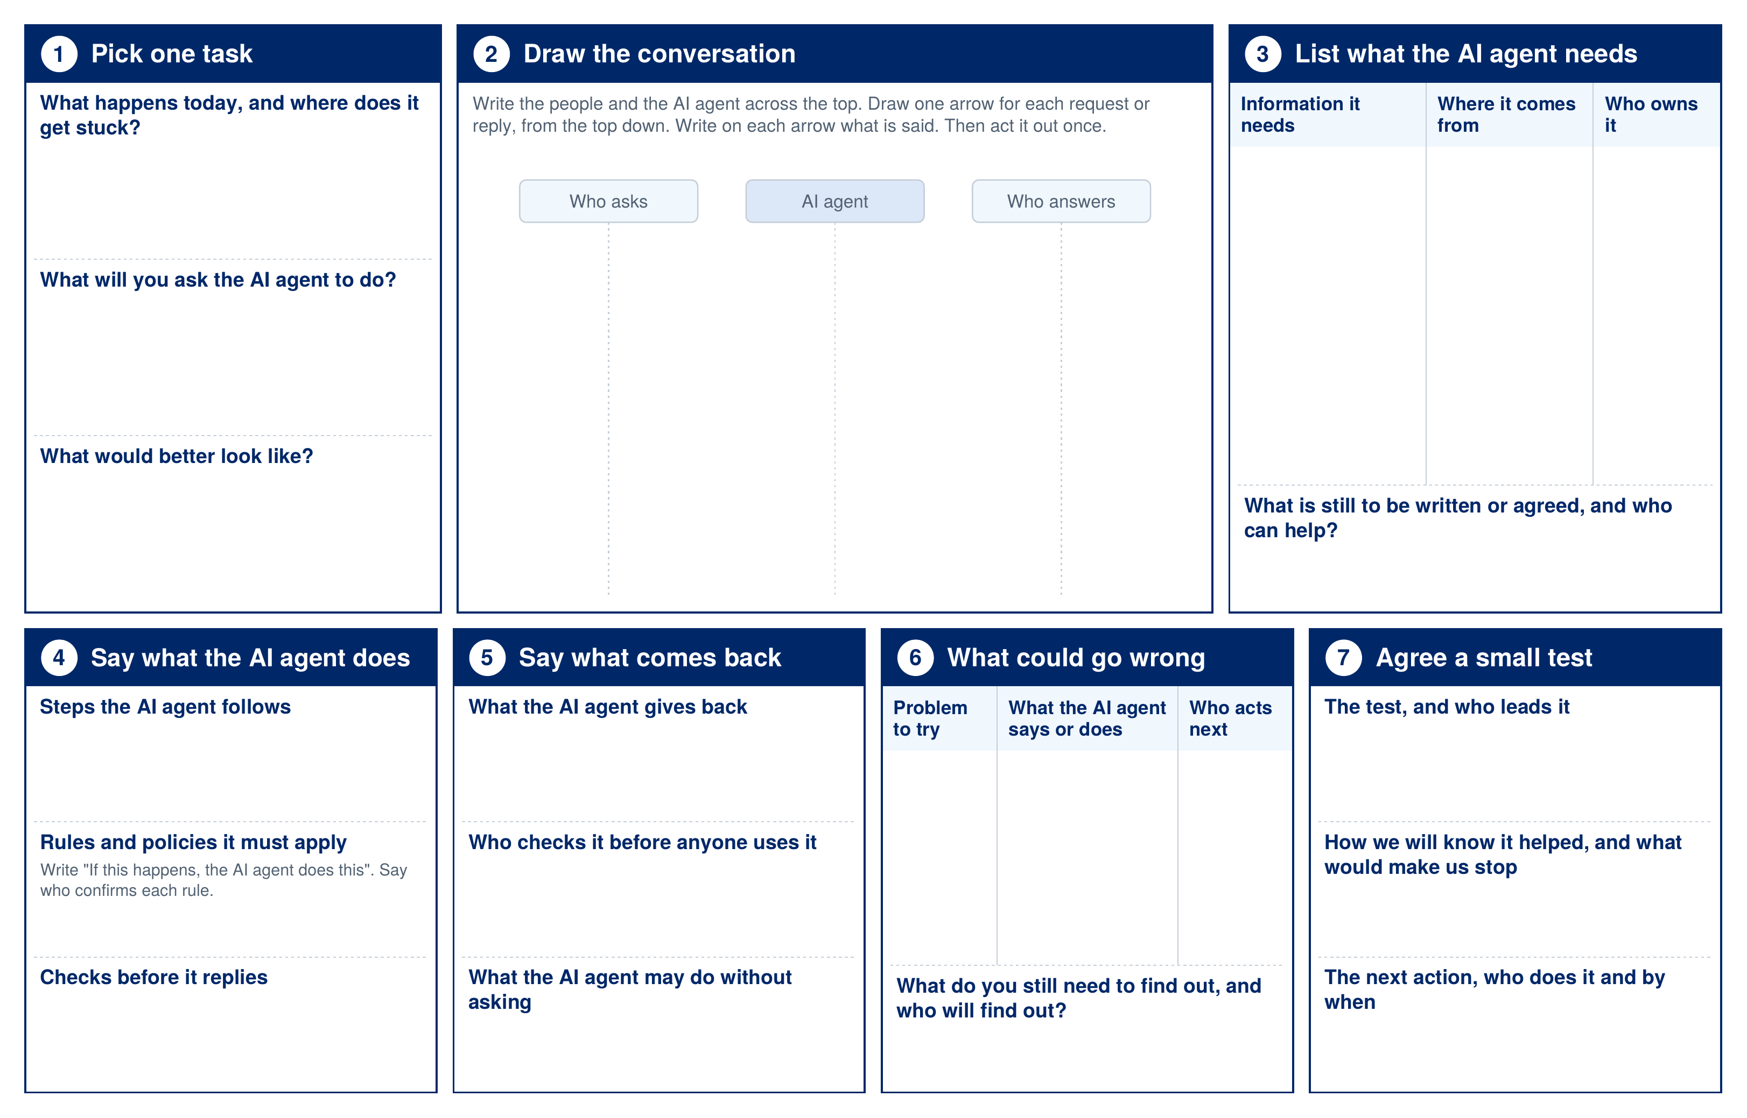
The agent design canvas
How to use it
One canvas for each team, printed at A3.
Work through the seven boxes in order.
Use it with the workshop guide, which has the example answers.
77

Slide 78
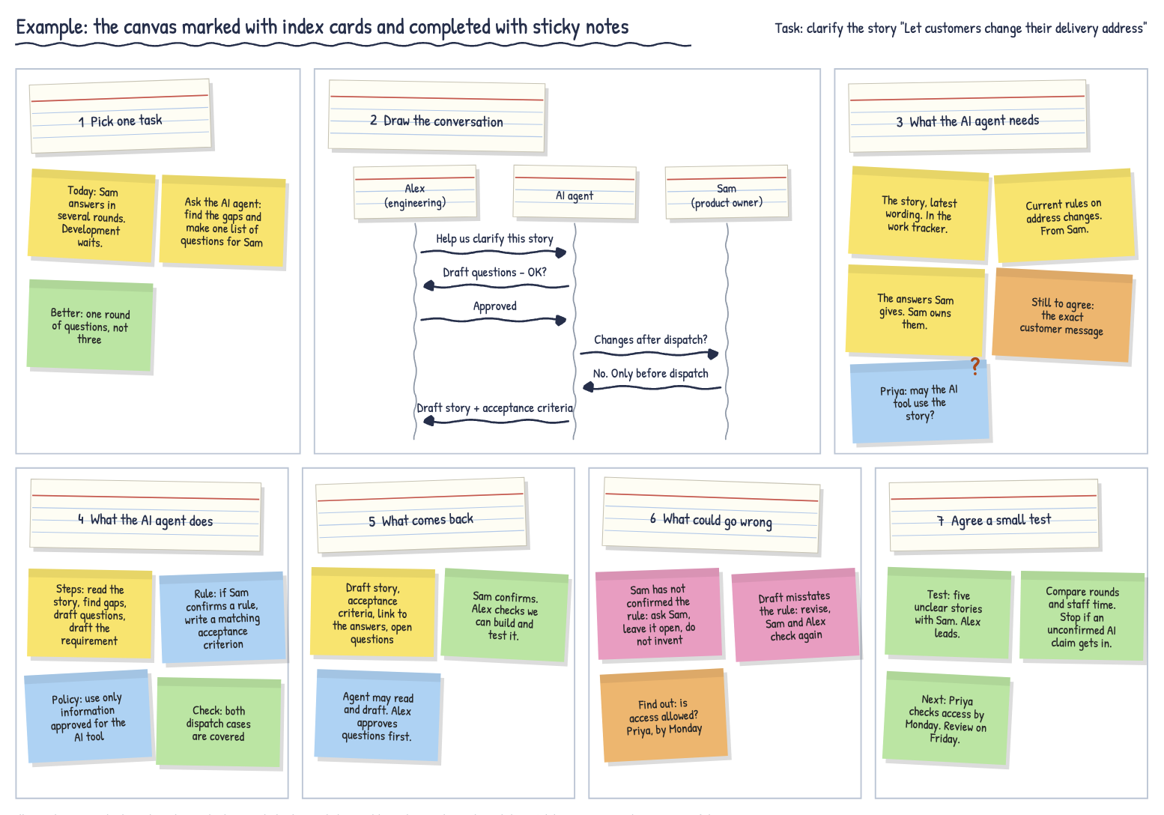
Example: the canvas completed
How to use it
Index cards mark each box.
Sticky notes carry the answers of the team.
The example uses the address-change story from the guide.
78

Slide 79
Overcoming challenges to adoption
The barriers Gartner sees, and what helps people who work in requirements, review, delivery and support

Slide 80
Most organisations do not feel ready for AI-driven change
90%
86%
84%
65%
Almost 90% of software engineering leaders and staff say their technology is not AI-ready
Say their workforce is not equipped for the changes AI will bring
Say their processes are not ready
Of software engineering organisations report a lack of AI engineering skills as a barrier to meeting business objectives
The barriers are practical, not a lack of belief. People are more likely to agree than disagree that AI tools have improved their work outcomes and fit their context.
Sources: G00836860 (90%, 86% and 84%); G00845017 (65%); G00855654 (note)
80

Slide 81
Four practical barriers hold back adoption
Share of developers who report each barrier
Uneven adoption is often read as resistance. Gartner sees a rational response to unclear tool choices, fast change, unreliable output and unclear accountability.
1
People feel accountable for the output of AI tools that they do not fully trust, control or understand.
2
The survey asked developers. The same four barriers apply to anyone asked to use AI in their work.
3
Source: G00855654 (2026 Gartner Impact of AI on Software Developers Survey, n = 303). Point 3 is an interpretation for this audience
81

Slide 82
AI moves effort to review, validation and risk
Developers who now spend more time, not less, on each task
AI is not so much saving time as redistributing it.
1
The effort moves to review, validation and risk management. This is the work of people who review deliverables and assure quality.
2
Count a change as a gain only when it improves the whole flow, cost or quality, not when one task gets faster.
3
Source: G00855654 (2026 Gartner Impact of AI on Software Developers Survey, n = 303). The second sentence of point 2 is an interpretation for this audience
82

Slide 83
What the barriers mean for roles that do not write code
Challenge | What Gartner sees | For requirements, review, delivery and support roles
Requirements become the bottleneck | Product teams struggle to turn business intent into engineering-ready work as fast as AI-assisted developers can use it. | Business analysts and specification authors become the constraint, and the place where AI helps most.
The review burden grows | 41% of developers cite the burden of reviewing and validating AI output. Review queues overload. | People who review deliverables receive more to check, and receive it faster.
Context is missing | Agents drift when they rely on tacit knowledge. They need structured, current context. | Business rules, specifications and knowledge of legacy systems have to be written down and kept current.
Roles and handoffs blur | Role compression is uneven. Unclear human-agent handoffs increase errors and reduce trust. | Delivery managers need to agree who decides, who approves and who is accountable.
Skills and confidence | 86% say the workforce is not equipped. People worry about job loss and skill erosion. | People need time to learn on real work, and a clear account of how their role changes.
Sources: G00858533; G00855654; G00850352; G00857393; G00845017; G00836860. The right-hand column is an interpretation for this audience
83

Slide 84
Culture decides whether adoption holds
Visible tooling and practices
AI tools and practices arrive piecemeal, team by team. Knowledge and the gains are not shared across the organisation.
Core values
Leaders and teams do not share values on how AI is used. Statements conflict, such as "we put quality first" against "we use AI to remove reviews".
Implicit beliefs and norms
The hardest level to change. Distrust of AI tools, status built on what each person produces alone, long hours as proof of commitment, and ranking that discourages sharing.
66% of professional developers distrust AI tooling.
Seven-fold rise in Gartner client discussions on AI and culture between 2023 and 2025.
Source: G00834021 (three levels adapted from Edgar Schein)
84

Slide 85
Shape the culture at each of the three levels
1 Make AI use visible
2 Agree the values
3 Rewrite the norms
Provide and endorse the tools openly, with training
Show the practice changes: shorter iterations, AI-assisted review, new roles
Set up communities of practice to share what works
Define with teams "the things we say about ourselves"
Examples: curiosity, frequent experimentation, adaptability, ongoing learning
Check that the values support quality and can be acted on
Repeated, successful use of AI changes beliefs
Tell people their judgement is the guardrail that keeps AI output sound
Remove incentives that discourage sharing
Aim for: AI augments people, and teams stay responsible for what they deliver
Address job concerns openly. Vizient uses an empathy map for each role to answer three questions: how will AI affect my job, my responsibility and my schedule?
Sources: G00834021; G00843405 (Vizient)
85

Slide 86
Move the burden from individuals to shared practices
Tool sprawl
Rapid AI change
Review burden
Risk concerns
Curate a set of approved AI tools
Define a paved road for each common task
For each use case, state the tool, the workflow, the data that may be used and the review required
Fund continuous learning as part of the work
Use peer-led demonstrations, AI champions and communities of practice
Hold office hours with platform and security experts
Share patterns that worked
Give AI better inputs: context kept in version-controlled artefacts
Automate routine checks before human review
Set review tiers by risk, so that people check what matters
Build data-use, security and compliance rules into tools and pipelines
Keep human approval for high-risk changes
Do not make each person the manual backstop for every risk
Gartner: "go safe to go fast". Make the compliant route easier than the unmanaged one.
Source: G00855654
86

Slide 87
Most AI agent failures are leadership failures
1 Treat agents as products
2 Be selective and keep it simple
3 Realign teams around the workflow
Before approving an agent, define its outcome, its level of autonomy, its risk boundary and how value will be measured. If a leader cannot explain these in one paragraph, the agent should not be approved.
Use agents where the work is too dynamic for traditional automation and the impact of errors is low. Where simpler automation gives the same outcome, use that. Review agents regularly and retire those that do not deliver.
Organise around AI-augmented workflows, not tools. Define when agents act alone, when people approve and how exceptions are handled. Invest in skills and continuous evaluation.
Gartner prediction: by 2028, organisations that transform their operating model around AI agents will achieve three times higher productivity and 50% lower operational risk than peers that deploy agents opportunistically.
Source: G00845017
87

Slide 88
Govern the new SDLC with a continuous view of flow
Governance built for the old SDLC | Governance for a continuous flow
Periodic stage gates and sign-offs | Continuous evaluation and monitoring of the work and of the agents
Activity measures, such as story points and velocity | Flow and outcome measures, such as quality, security and stability
Manual checks by each person | Guardrails built into the tools and the pipeline
Approval of every change | Human approval kept for high-risk changes and for release
What to watch, continuously
Lead time and cycle time
Wait time between steps
Defects that escape to users
Rework: review churn and failed handoffs
Share of AI work that runs through approved, controlled workflows
Why: approval-based controls do not work for systems that operate continuously. Oversight has to sit in day-to-day operations, not in a periodic review.
Sources: G00845017 (continuous evaluation); G00857393 (flow measures and release); G00850352 (rework); G00855654 (guardrails)
88

Slide 89
Prepare people through planning, practice and communication
Scenario planning
Hands-on learning
Two-way communication
Run workshops on how AI will reshape workflows, responsibilities and collaboration
Identify which tasks will be automated, augmented or newly created
Surface cultural concerns as well as technical ones
Build learning into day-to-day work
Run pilots that pair people with AI tools
Tie guilds and bootcamps to live projects
Develop creativity, critical thinking and the ability to work with AI agents
Say clearly what is changing and why
Give people a route to share successes and raise problems
Hold regular retrospectives on AI
Involve partners early: product, security, data, risk, legal, finance and business units. Move beyond buy-in to designing the approach together.
Source: G00836860
89

Slide 90
Find time to adopt AI and learn the new behaviours
1 Make learning part of the work
2 Learn on real work
3 Reinvest the time AI saves
Set aside recurring team capacity for practice, demonstrations and shared patterns
Do not rely on optional, one-off training. It decays quickly
Run pilots and pair people with AI tools on live tasks
Use AI champions, office hours and communities of practice
Make AI-assisted work visible by default, so that others can learn from it
AI creates value only when saved time is redirected to higher-value work
Reserve released time for learning and improvement before reducing capacity
Track the share of time spent on valuable work
The new behaviours that need the time
1
State the intent clearly before the work starts.
2
Check and challenge what the AI produces.
3
Write context down and keep it current.
4
Share what worked, and what did not.
Sources: G00855654 (points 1 to 3); G00858441 (released time); G00850352 and G00858533 (behaviours). The list of behaviours is a summary for this audience
90

Slide 91
CBRE: scaling through people, not by shrinking teams
CBRE piloted tiny teams of three to four people supported by AI agents, on well-scoped work.
Three conditions for success
1
Strong platform support
Clear ownership of outcomes
Enough talent density in each team
It did not scale by shrinking existing teams. People from the pilots carried the practices back to the wider organisation.
2
Training in leadership and AI, prompt engineering and agentic AI reached more than 90 employees.
About CBRE
Commercial real estate, headquartered in Dallas, Texas. Revenue of 40.6 billion US dollars and 155,000 employees in 2025.
3
A dedicated team kept delivery stable while teams formed and re-formed around the work.
4
Sources: G00857393; CBRE presentation slides for G00857393
91

Slide 92
Four cautions from the research
1
Friction is not scepticism
Do not assume that slow adoption means people doubt the value of AI. Look for the practical burden first.
2
Governance is not a separate approval layer
Turn policy into guardrails in the tools and the pipeline, so that the compliant route is the easy one.
3
A faster task is not success
AI can cut effort in one step and add review, testing or risk work in the next. Measure the whole value stream.
4
Senior people are not the permanent backstop
Experts should define patterns, constraints and review criteria. Automated validation should then carry the routine checks.
Source: G00855654
92

Slide 93
From the research to your barriers
What Gartner sees
In your context
The barriers are practical: tool sprawl, rapid change, review burden and risk.
Culture, governance of a continuous flow and protected time decide whether adoption holds.
Adoption needs leadership: clear outcomes, handoffs and accountability.
Brainstorm the challenges and barriers you expect.
Group them into themes.
Agree mitigation steps for each group, and who can help.
The exercise: 60 minutes in your teams.
93

Slide 94
Exercise: our challenges and barriers to adoption
In your team (60 minutes)
Prompts if you get stuck
What will be the major challenges and barriers to adopting AI?
Too many tools to choose from
More to review and check
Risk, privacy and compliance
No protected time to learn
Habits, norms and trust
Governance built for the old process
Brainstorm. Write every challenge and barrier you expect, one per sticky note. Everyone contributes.
15 min
1
Group similar notes together. Name each group on an index card.
15 min
2
For each group, agree the mitigation steps and who can help.
30 min
3
What you need: sticky notes for the challenges, index cards to name the groups, and a second colour of note for the mitigations.
Be ready to share your groups and your mitigation steps with the room.
94

Slide 95
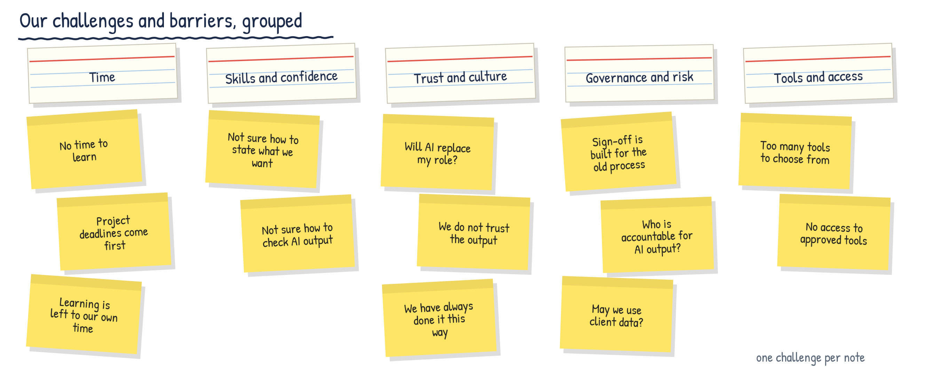
Example 1: brainstorm, then group the challenges
Index card: the name of a group
Sticky note: one challenge or barrier
Illustrative example
95

Slide 96
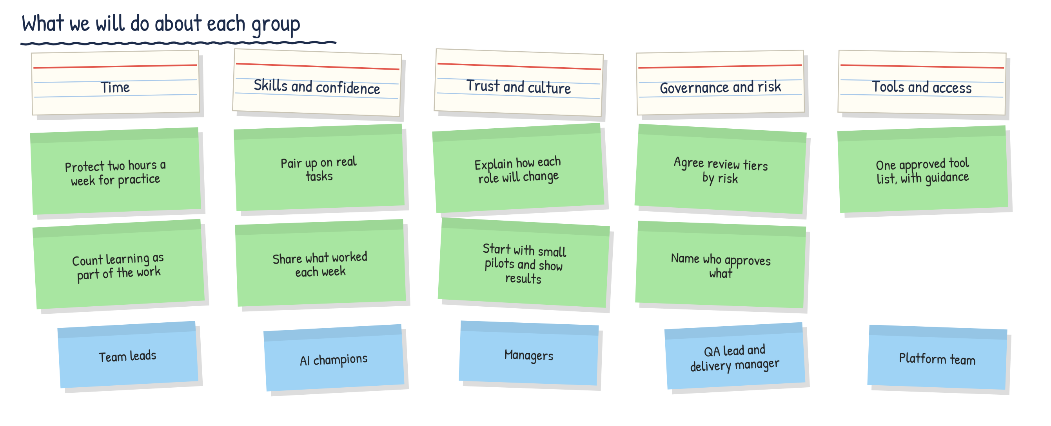
Example 2: agree mitigation steps for each group
Index card: the group
Mitigation step
Who can help
Illustrative example
96

