Slide 1
Mergers and Acquisitions

Slide 2
Mergers and Acquisitions
Agenda
Definition
Overview
Types
Motives
Process
Valuation
Methods of payment
Codes of conduct

Slide 3
Mergers and Acquisitions
Definition of Merger
Combining of two business entities under common ownership (Arnold 2005)
Or
Two firms coalesce and share resources in order to realise a common goal
But
One party almost always dominates so

Slide 4
Mergers and Acquisitions
Acquisition
One firm buys the assets or shares of another
Takeover implies the acquiring firm is larger than the target
Reverse takeover if the target is larger than the acquirer

Slide 5
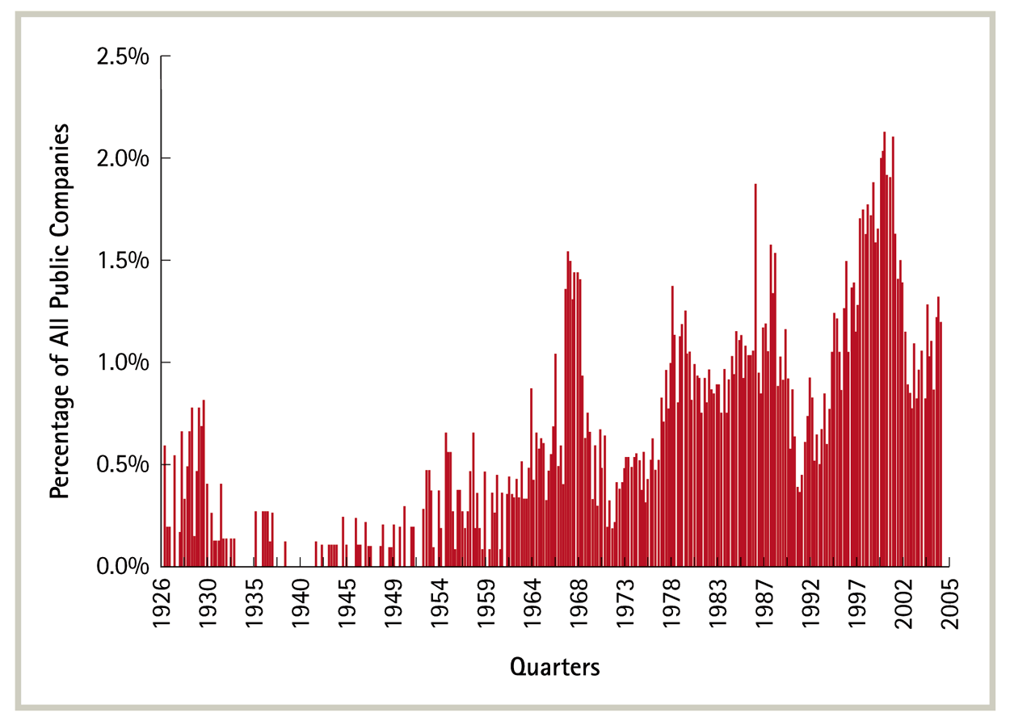
Mergers and Acquisitions
History
Mergers seem to occur in waves
Figure 28.1 Percentage of Public Companies Taken Over Each Quarter, 1926–2005

Slide 6
Mergers and Acquisitions
 | Period | Events coinciding with beginning of wave | Events coinciding with end of wave
Wave 1 | 1890’s- 1903 | Economic expansion; industrialisation processes; introduction of new state legislations on incorporations; development of trading on NYSE; radical changes in technology | Stock market crash; economic stagnation; beginning of First World War
Wave 2 | 1910’s – 1929 | Economic recovery after the market crash and the First World War; strengthen enforcement of antimonopoly law | Stock market crash; beginning of Great Depression
Wave 3 | 1950’s – 1973 | Economic recovery after the Second World War; tightening of anti-trust regime in 1950 | Stock market crash; oil crisis; economic slowdown
Wave 4 | 1981 – 1989 | Economic recovery after recession; changes in anti-trust policy; deregulation of fin. services sector; new financial instruments and markets (e.g. junk bonds); technological progress in electronics | Stock market crash
Wave 5 | 1993 – 2001 | Economic and financial markets boom; globalization processes; technological innovation, deregulation and privatisation | Stock market crash; 9/11 terrorist attack
New wave ? | 2003 - ? | Economic recovery after the downturn in 2000–2001 | n.a.
Adapted from Martinova and Renneboog 2008

Slide 7
Mergers and Acquisitions
1960’s Conglomerate deals
1980’s Hostile, ‘bust up’ deals
1990’s Strategic or global deals
2000’s ?

Slide 8
Mergers and Acquisitions
Types
Horizontal
Vertical
Product Extension (concentric)
Market Extension
Unrelated or conglomerate
or
Disciplinary
Synergistic

Slide 9
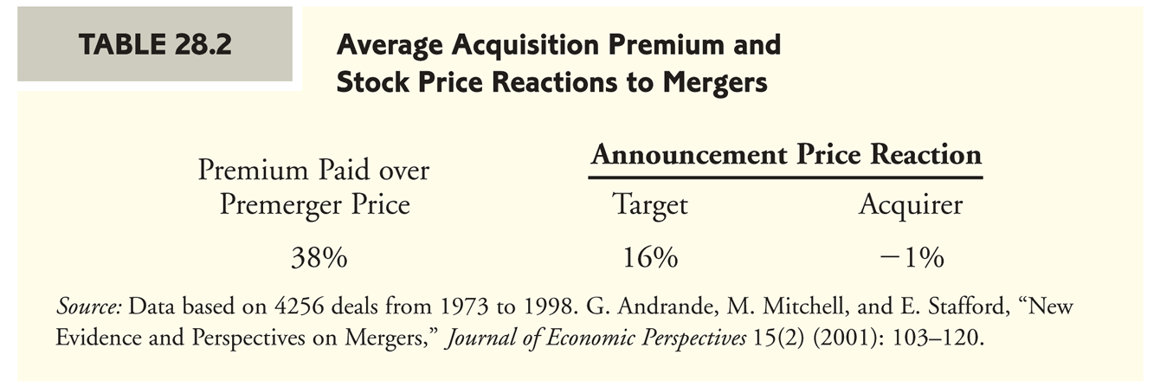
Mergers and Acquisitions
Do they work?

Slide 10
Mergers and Acquisitions
Motivation
So why?
To Maximise Shareholders Wealth
(well not really but it’s the theory)
Through
- differences in stock market valuations
- dissemination of skills
- synergies (2+2= 5)

Slide 11
Mergers and Acquisitions
Motivations
Economies of scale and scope
Scale – production in high volumes
Scope – combining marketing or distribution for different types of related products, maybe horizontal or concentric

Slide 12
Mergers and Acquisitions
Motivations
Secure supplies or supply chain and other interdependencies- Vertical
Expertise
Monopoly gains
Efficiency gains by elimination of duplication/operating synergies
Operating losses

Slide 13
Mergers and Acquisitions
Motivations
Diversification/Financial synergies
- Risk reduction/diversification
But of doubtful value to shareholders
And diversification results in 13-15 % loss in value (Berger & Olef 1950) vs
Maquiera, Megginson and Nail 1998 insignificant abnormal returns on
conglomerate mergers but significantly positive for non conglomerate.
- Debt capacity and borrowing costs/tax shield
- Liquidity
Earnings growth

Slide 14
Mergers and Acquisitions
Motivation
Earnings per share
Co A Co B
Present Earnings 20,000,000 5,000,000
Shares 5,000,000 2,000,000
EPS 4.00 2.50
Price of stock 64.00 30.00
PER* 16 12
*Price Earnings Ratio (PER) = Share Price
Earnings per Share

Slide 15
Mergers and Acquisitions
Motivation
Co A to pay 35 per share for Co B
To be paid for in stock of A
Exchange ratio
35 = .546875
64
New shares issued
.546875 x 2,000,000 = 1,093,750

Slide 16
Acquisitions and Mergers
Motivation
Merged Company
- Earnings 25,000,000
- Shares 6,093,750
- EPS 4.10
Question: What will new PER be?

Slide 17
Acquisitions and Mergers
Motivation
What if bought for cash?
EPS = 25,000,000 = 5.00
5,000,000
But
- PER?
- Where did the cash come from?
- What will increased leverage do to required rate of return?

Slide 18
Acquisitions and Mergers
Motivation
Growth
- Speed
- market share and power
Entry to new markets
- Need to be familiar with culture, rules
and regs
- Expertise gained
- No oversupply

Slide 19
Mergers and Acquisitions
Motivation
Managers’ Goals
Empire building
Security (size)
Fear
Hubris (Roll 1986)
- Talent, experience and entrepreneurial
flair (Arnold 2005)

Slide 20
Acquisitions and Mergers
Motivation
Third Parties
- Advisors
- Suppliers and
- Customers as drivers

Slide 21
Mergers and Acquisitions
Motivation
Undervaluation
Q Ratio
Market value of equity and debt
Replacement cost of net assets

Slide 22
Mergers and Acquisitions
Do They Work (DTW)
First Define Success
- Increase acquirer’s shareholder wealth so look at financial returns pre merger and post merger over time versus an industry benchmark
- Attain an objective
Via surveys to test managers experience

Slide 23
Acquisitions and Mergers
DTW
Mixed Data on success
Accounting studies
- Ignore changes in risk
- asset revaluation
- inter group profits
- depreciation
- time span
- cannot measure performance around the announcement date
- counterfactuals (what would have been the value if no takeover)

Slide 24
Acquisitions and Mergers
Managerial stance. Asked managers, most were successful! (Broutters et al 1998)
But what are the determinants of success?

Slide 25
Acquisitions and Mergers
DTW
Honourable Rhetoric
Clear Vision
Credibility and Respect
Perceived Interfaces
People Shape
Improved Benefits
Ref: Deliberate learning in corporate acquisitions: Post-acquisition strategies and integration capability in US bank mergers.Zollo M, Singh H Strategic Management Journal 25 (13) Dec 04

Slide 26
Acquisitions and Mergers
DTW or lack of it
Personnel Systems and Practices
Clash of Management Styles and Cultures
Lack of Risk Taking
Excessive Demands for Information
Failure to Plan Post Acquisition Changes
Lack of Fit
Underestimating Resources Needed

Slide 27
Mergers and Acquisitions
Process
Acquisition Strategy
Acquisition Criteria
Searching for Target
Acquisition Planning
Valuing and Evaluating
Negotiation
Due Diligence
Purchase and Sale Contract
Financing
Implementation

Slide 28
Acquisitions and Mergers
Valuation 1
Assets Base
- gives a minimum
- but consider, sum of parts greater than
the whole!
Earnings based
- required rate of return
say 10%, earnings of £21,000 pa then
21,000 = 210,000
.10

Slide 29
Acquisitions and Mergers
Valuation 1
Price Earnings Ratio (PER)
Share Price
Earnings per Share
Historic or Prospective
Sustainable Earnings x Benchmark PER
Target’s
Competitors
Sector’s

Slide 30
Acquisitions and Mergers
Valuation 1
Current Earnings £21,000
Plus
Improved earnings £4,000 (net of costs)
Target’s PER = 10
25,000 x 10 = 250,000
Competitor’s PER = 15
25,000 x 15 = 375,000
Sector PER = 12
25,000 x 12 = 300,000

Slide 31
Acquisitions and Mergers
Valuation 2
DCF Approach
Estimate future cash flows
Estimate terminal value
(apply PER to last forecast or discount to infinity)
Apply WACC
(which beta? Target, Bidder, Combined)
Easy!
We shall see shortly but first

Slide 32
Acquisitions and Mergers
The form of Payment
Shares
or
Cash
Effects on
- Growth rate
- EPS
- PER (ref slides 14-17)

Slide 33
Acquisitions and Mergers
Form of Payment
Advantages / Disadvantages
Acquired (cash)
- Certainty
- Tax
Acquirer (cash)
- Strain on liquidity
- EPS will be raised
Exchange of Shares
- EPS
- P/E uncertain

Slide 34
Acquisitions and Mergers
Form of Payment
Motives
Asymetric information
- investors viewpoint is that if offered stock
then the stock is overvalued
- if cash then undervalued (Myers and Majluf 1983)
Cash offers signal a high valuation and therefore designed to be pre-emptive
(Fishman 1998)

Slide 35
Acquisitions and Mergers
Form of Payment
Pecking order (Myers 1984)
Free cash flow and Agency cost (Jensen1986, Martin 1996)
Cash rich companies more likely to be involved in acquisitions but not necessarily cash offers
- Agency costs probably exist as cases studied were mainly value destroying (Harford 1999)

Slide 36
Acquisitions and Mergers
Form of Payment
Cash preferred as avoids dilution (Amihud et al 1990)
High management ownership in target and desire for stock offers to maintain control
And opposite for acquiring company (Ghosh and Ruland 1998 and Faccio and Masulis 2005)
Targets here might be private companies. Stock may be useful to tie in management if they are needed

Slide 37
Acquisitions and Mergers
Form of Payment
Tax
Capital gains
- cash, immediate
- stock, deferred
Size
- As acquirer size increases probability of stock purchase decreases.
As target size increases probability of stock purchase increases (Yes Grullen 1998, no Martin 1996)

Slide 38
Acquisitions and Mergers
Form of Payment
Tender offers, direct to shareholders and maybe hostile, usually cash
Merger offers, friendly and made to management usually stock

Slide 39
Acquisitions and Mergers
Form of Payment
Performance
Mixed empirical evidence but
Travlos 1987
- stock offer returns significantly negative
- cash returns normal
Loughran and Vijh 1997
- stock mergers – 25%
- cash mergers 67%
But Ramaswamy and Waegelein 2003 and King et al 2004 found the method to be insignificant

Slide 40
Acquisitions and Mergers
Defence
Pre bid
Internal
- Operational Efficiency
- Divestment
- Ownership/Voting structure
External
- Cultivate shareholders/ the City
- Communication to Analysts
- Strategic moves e.g. JVs

Slide 41
Acquisitions and Mergers
Defence
Post bid
Hearts and Minds
Asset Disposal
Poison Pill
White Knight
Recapitalise
Competition Commission
Be Prepared (pre-bid perhaps!)

Slide 42
Acquisitions and Mergers
Defence
Poison Pills
  A defense against a hostile takeover
    It is a rights offering that gives the target shareholders the right to buy shares in either the target or an acquirer at a deeply discounted price.
      Because target shareholders can purchase shares at less than the market price, existing shareholders of the acquirer effectively subsidize their purchases, making the takeover so expensive for the acquiring shareholders that they choose to pass on the deal.

Slide 43
Acquisitions and Mergers
Defence
Golden Parachute
  An extremely lucrative severance package that is guaranteed to a firm’s senior management in the event that the firm is taken over and the managers are let go
    Perhaps surprisingly, the empirical evidence suggests that the adoption of a golden parachute actually creates value.
      If a golden parachute exists, management will be more
      likely to be receptive to a takeover, lessening the likelihood of managerial entrenchment.

Slide 44
Acquisitions and Mergers
Defence
With recapitalization, a company changes its capital structure to make itself less attractive
as a target.
  For example, companies might choose to issue debt and then use the proceeds to pay a dividend or repurchase stock.

Slide 45
Acquisitions and Mergers
Defence
Staggered Board
  In many public companies, a board of directors whose three-year terms are staggered so that only one-third of the directors are up for election each year.
  Also known as Classified Board
    A bidder’s candidate would have to win a proxy fight two years in a row before the bidder had a majority presence on the target board.

Slide 46
Acquisitions and Mergers
Defence
White Knight
  A target company’s defense against a hostile
  takeover attempt, in which it looks for another,
  friendlier company to acquire it
White Squire
  A variant of the white knight defense, in which a
  large, passive investor or firm agrees to purchase
  a substantial block of shares in a target with special voting rights

Slide 47
Acquisitions and Mergers
Defence
A firm can
  Require a supermajority (sometimes as much as 80%) of votes to approve a merger
  Restrict the voting rights of very large shareholders
  Require that a “fair” price be paid for the company, where the determination of what is “fair” is up to the board of directors or senior management

Slide 48
Acquisitions and Mergers
Regulation
Competition Commission
Office of Fair Trading
Europe
City code on Takeovers and Mergers
(The Yellow Book)

Slide 49
Acquisitions and Mergers
Regulation/Europe
Corporate governance: Member States reluctant to give a greater say to shareholders in the context of takeover bids, says Commission report
The European Commission has published a report on Member States' implementation into national law of the Directive on takeover bids (2004/25/EC). The Directive allows Member States to opt out of certain key provisions and to exempt companies from those provisions if the bidder is not subject to the same obligations. The Commission's report shows that in many cases Member States have made use of these options and exemptions. The report concludes that this could bring about new barriers in the EU takeover market, rather than eliminate existing ones.

Slide 50
Acquisitions and Mergers
City Code
The key requirements of the City Code are:
All shareholders must be offered equally good terms, as defined by the code.
All shareholders must be given equal access to information.
A time table is adhered to that sets time limits for each phase of the bid.
Bidders and members of a concert party must disclose their dealings.
The bidder must set an acceptance level (of over 50%) at which the bid becomes unconditional.
There are limits on the conditions attached to a bid.
A mandatory offer must be made if a shareholder's or concert party's holdings exceed 30%.
The board of the target company may not use poison pills and other actions to frustrate a bona fide bid, unless they have shareholder approval.
In addition to these the Companies Act imposes its own requirements: all shareholdings of above 3% must be disclosed, and any changes of more than 1% in such shareholding must also be disclosed, whether or not they are related to a bid.
The City Code is also now required to follow the rules laid down by the EU directive on takeovers. It directly incorporates part of the directive.

Slide 51
Acquisitions and Mergers
City Code
Concert party
A concert party is a group of people acting in concert in order to take over a target company. Regulators such as the Takeover Panel apply rules applicable to takeover bids to all members of a concert party.
Of particular importance is that the 30% threshold at which a mandatory offer must be made is considered to be reached when a concert party jointly hold 30% of the shares in a company, not when one of them does.
Some entities are presumed to be acting in concert unless shown otherwise. These include the directors, subsidiaries, associate companies and the parent company of the bidder.
Even entities that are not part of a concert party may find that some rules apply to them: they are required to disclose dealings in the share of the bidder or the target. These "associates" are people who have an interest in the outcome of the bid (other than simply as shareholders) but who are not deliberately acting in concert with the bidder, An example of associates are the directors the target company even when they are not acting in concert with either the bidder or a potential counter-bidder.

Slide 52
Acquisitions and Mergers
City Code
Takeover Panel
The Panel on Takeovers and Mergers, often called the Takeover Panel, the City Panel, over even simply the Panel, is the UK's main regulator of issues connected to mergers and acquisitions. The Panel's main objective is simple: to ensure that all shareholders are treated equally during takeover bids.
The Panel's rules, the City Code on Takeovers and Mergers, regulate the takeover process. It requires, for example, that all shareholders must be given the same information, and the target company should not take any action to frustrate an offer (e.g. use poison pills) without allowing shareholders to vote on it. The Code also sets time limits for various stages of a bid and rules concerning the equality of prices paid to shareholders.
For most of its history the Panel was not a statutory body and had no actual legal powers. It functioned very effectively through industry agreement. In accordance with an EU directive, it is now a statutory body with powers to order compensation. It can also ask the courts and the FSA to enforce its rulings.
In the past, the Panel ensured compliance with the Code through discussions, by censure (private and public). With the only punishment of offenders being "cold shouldering" for a breach of the code. A cold shouldered firm would find others refusing to deal with them in order to support the authority of the Panel. This would seriously impedes the offender's ability to do business.
This system was a rather nice example of how the old fashioned British way in which the city functioned could work. The Panel intends to follow the approach used in the past, but has accepted its new powers and will presumably use them if all other measures fail.

Slide 53
A takeover bid is an offer to buy a company outright.
If a takeover bid has the the support of the directors of the company to be taken over (the "target" or "offeree") it is called an agreed takeover bid. If they oppose it is called a hostile takeover bid.
Takeover bids are most commonly made by:
other companies in the same industry
private equity companies
major shareholders or directors who wish to take a company private.
Takeover bids usually create conflicts of interest between directors (who may lose their jobs) and shareholders (who are likely to be able to sell shares at above the market value before the bid was announced). Takeovers can also lead to situations in which minority shareholders can be unfairly treated.
Because of this, takeover bids are subject to regulation in most markets. The main British regulation is the City Code Code on Takeovers and Mergers.
A key provision of the City Code is that (unless granted a waiver because of special circumstances) the buyer of a stake in a company that gives them effective control is obliged to make a mandatory offer to buy the rest of the shares.
Enter your search terms Webmoneyterms.co.ukSubmit search form Home
Alphabetic index: A-B C D-H I-O P-R S-Z
Categories
About, contact
moneyterms.co.uk

Slide 54
Mandatory offer
The City Code (of the Takeover Panel) requires that if a shareholder or a concert party acquires more than 30% of a company it must offer to buy the remaining shares on terms as good as its most recent purchases.
The reason for this is that 30%, although not giving a shareholder formal control, is sufficient to give effective control.
When a change of control takes place it may adversely affect the share price. This is because minority shareholders are likely to worry that the company will be run to suit the controlling shareholder, and the interests of minorities may be affected. Therefore, it is only fair to allow them to sell out at the price that the new controlling shareholder paid before the change of control.
There are circumstances in which the Takeover Panel may grant a waiver from the requirement to make a mandatory offer - for example, if major shareholders state that they will not accept the mandatory offer.

