Slide 1
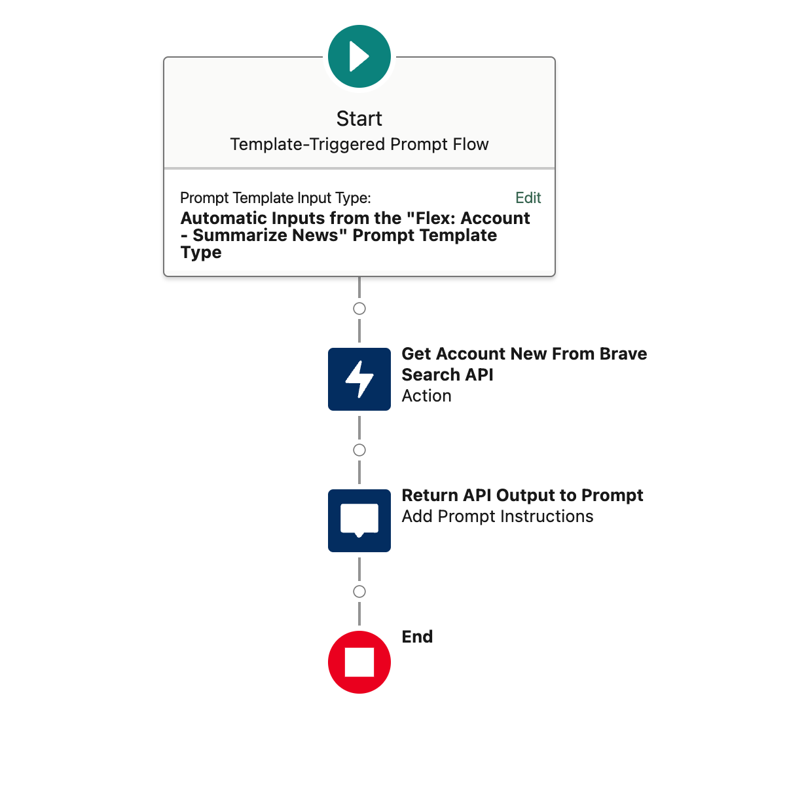

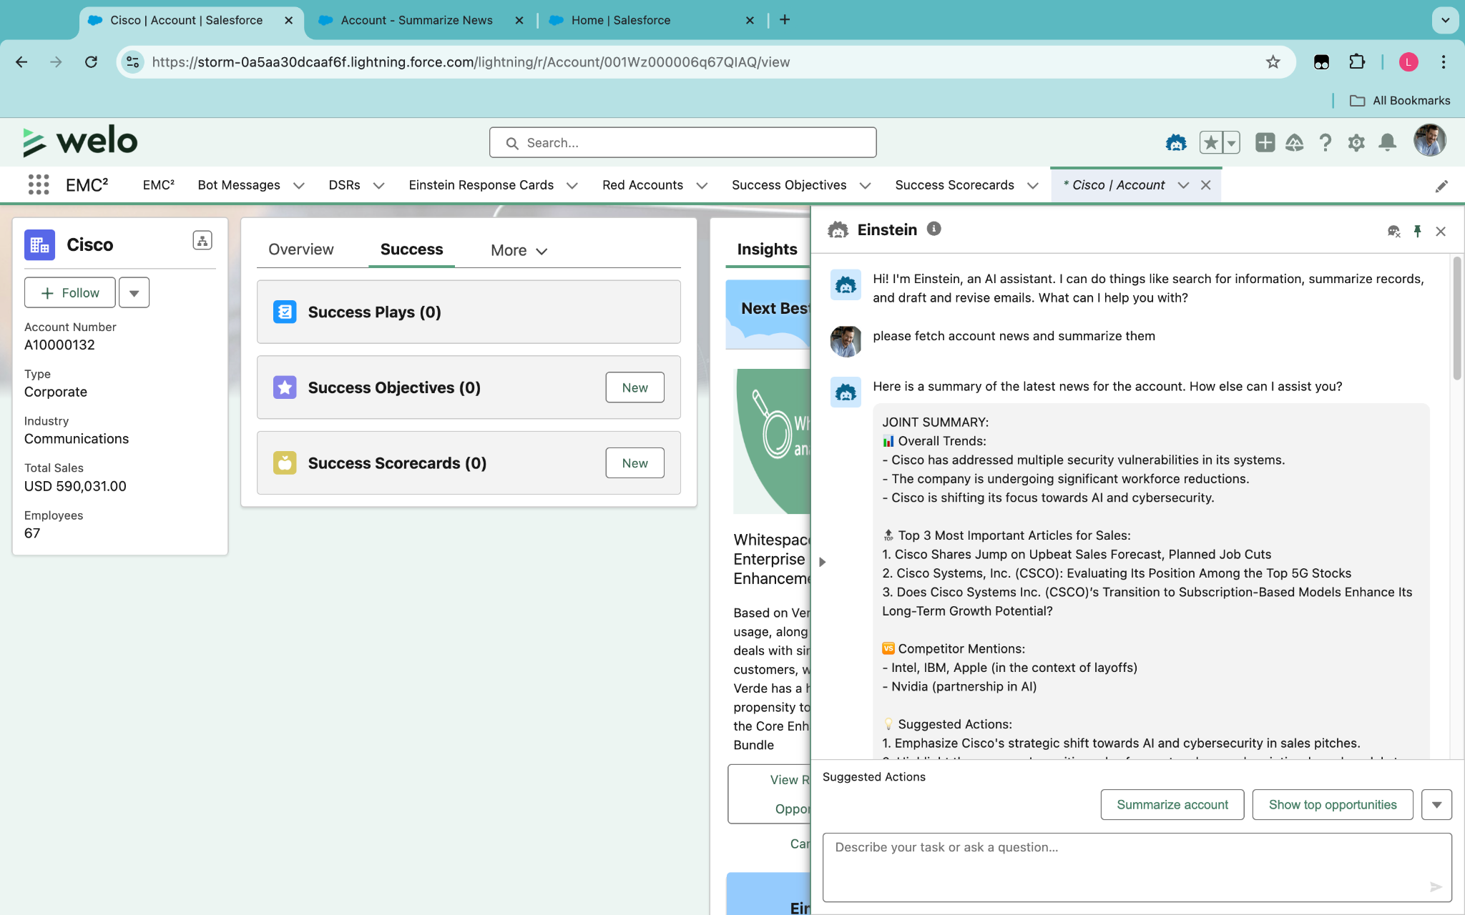
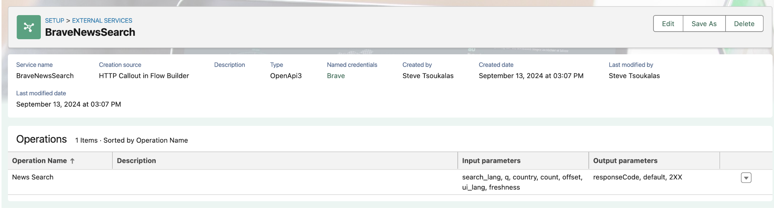
Account Research
Ansprechpartner: Sebastian Ohrmann, admin@salestechaiaug24.demo (salesforce1)
Short Description
Get data from external data provider Brave to show Sales relevant news articles for selected Account
AI mentions competitors and suggests actions
How to build it
Create Prompt (see notes)
Create Flow to retrieve data from provider Brave
Create External Service Provider
Create Agent Action
Overview
Notes:
You are an analyst working for the company {!$User.CompanyName}. Analyze the following news articles about {!$Input:Account.Name}. Provide a joint summary followed by individual summaries for sales-relevant articles only. Omit articles that are not relevant to sales.
JOINT SUMMARY:
📊 Overall Trends:
-
-
-
🔝 Top 3 Most Important Articles for Sales:
1.
2.
3.
🆚 Competitor Mentions:
💡 Suggested Actions:
1.
2.
🔮 Future Outlook:
〰️〰️〰️〰️〰️〰️〰️〰️〰️〰️〰️〰️〰️〰️〰️〰️〰️〰️〰️〰️
INDIVIDUAL ARTICLE SUMMARIES:
[For each sales-relevant article, use the following format:]
📰 [ARTICLE TITLE]
📅 [PUBLICATION DATE]
🗞️ [SOURCE]
🔗 [LINK - only add the link, no markdown]
Overall Tone: 😀 Positive | 😐 Neutral | 🙁 Negative
Sales Relevance: 🔥🔥🔥 (High) | 🔥🔥 (Medium) | 🔥 (Low)
Key Points:
-
-
-
#️⃣ Key Terms:
👤 Key Players:
🏷️ Related Products/Services:
〰️〰️〰️〰️〰️〰️〰️〰️〰️〰️〰️〰️〰️〰️〰️〰️〰️〰️〰️〰️
[Repeat the above format for each sales-relevant article]
Articles:
{!$Flow:Account_Get_News_from_Brave_Search_API.Prompt}

