Slide 1

Statistics

Slide 2

Statistics

Slide 3

Statistics

Slide 4
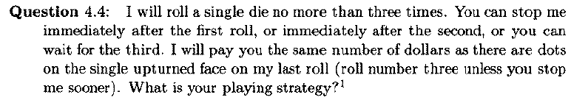
Statistics

Slide 5
Statistics

Slide 6
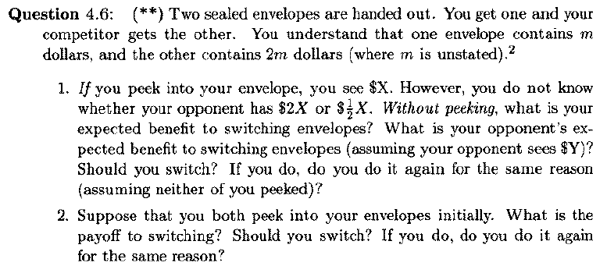
Statistics

Slide 7
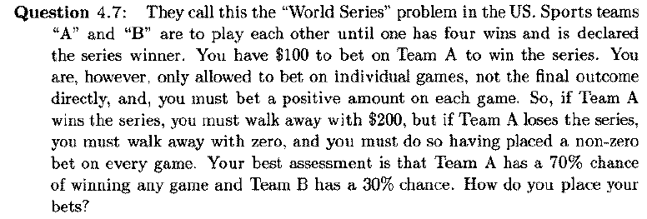
Statistics

Slide 8

Statistics

Slide 9
Statistics

Slide 10

Statistics

Slide 11
Statistics

Slide 12

Statistics

Slide 13
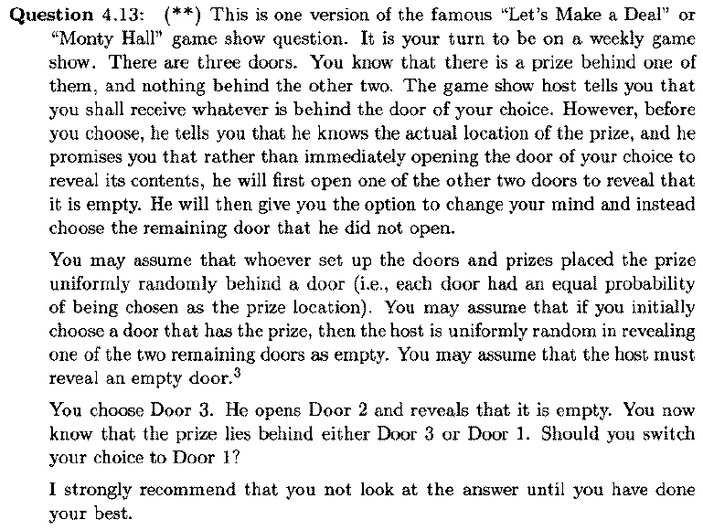
Statistics

Slide 14
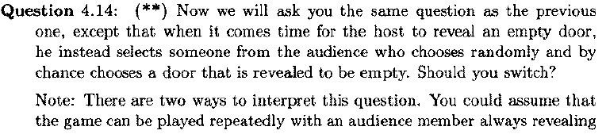

Statistics

Slide 15
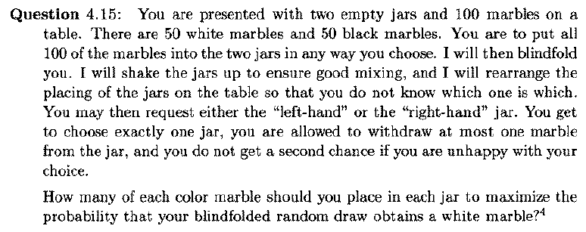
Statistics

Slide 16
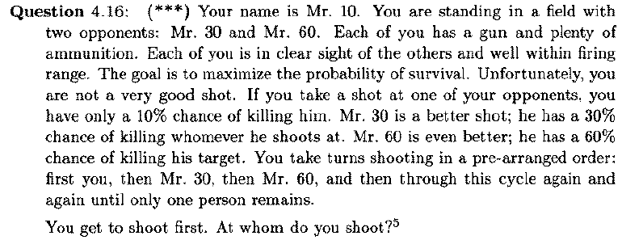
Statistics

Slide 17
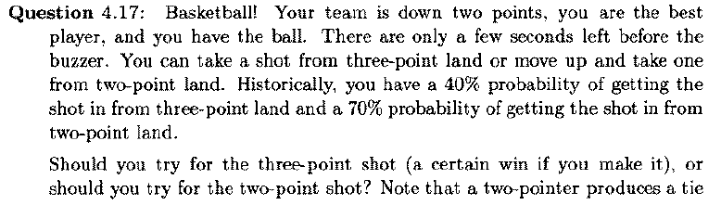
Statistics

Slide 18
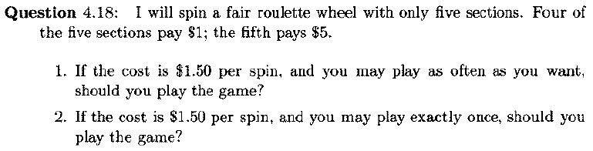
Statistics

Slide 19
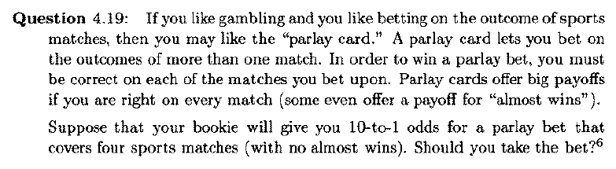
Statistics

Slide 20
Statistics

Slide 21
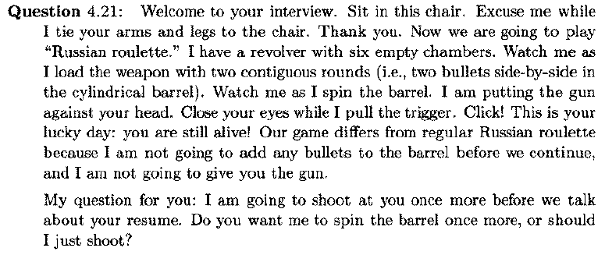
Statistics

Slide 22
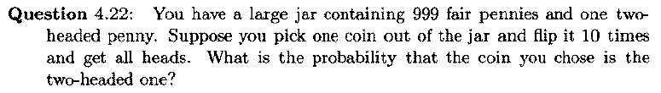
Statistics

Slide 23
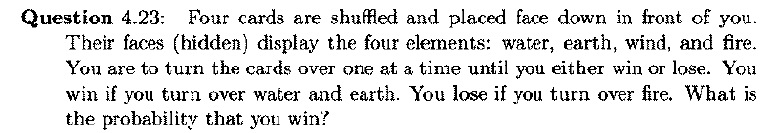
Statistics

Slide 24
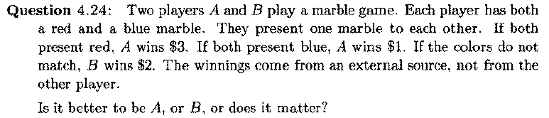
Statistics

Slide 25
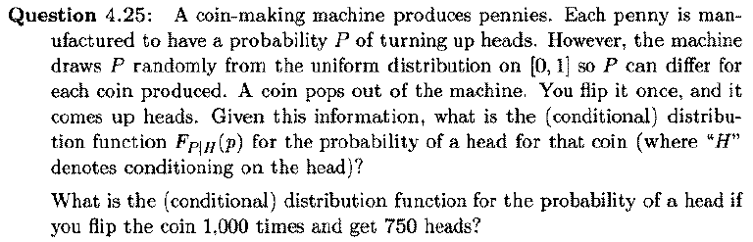
Statistics

Slide 26
Statistics

Slide 27
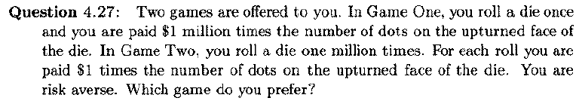
Statistics

Slide 28

Statistics

Slide 29

Statistics

Slide 30
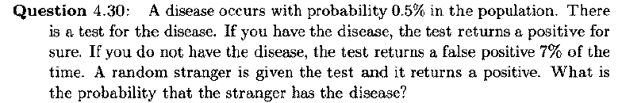
Statistics

Slide 31
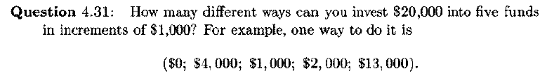
Statistics

Slide 32
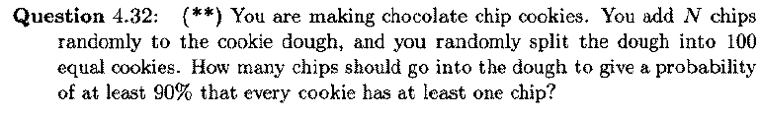
Statistics

Slide 33
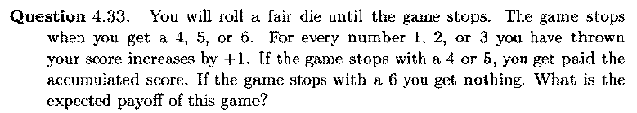
Statistics

Slide 34
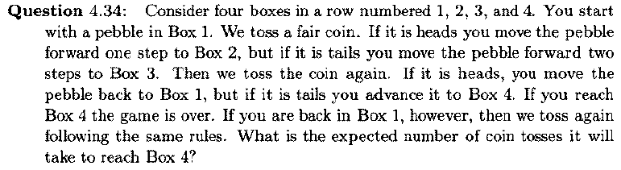
Statistics

Slide 35

Statistics

Slide 36
Statistics

Slide 37
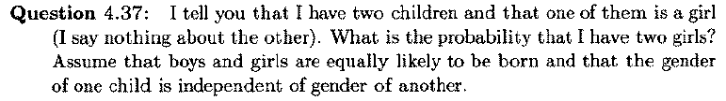
Statistics

Slide 38
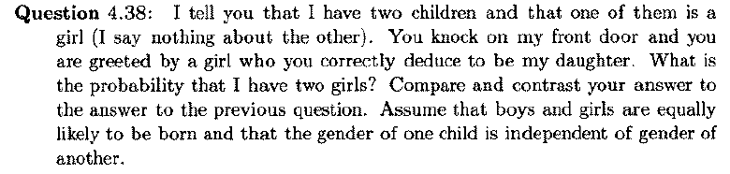
Statistics

Slide 39
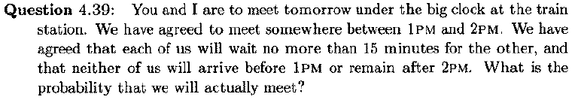
Statistics

Slide 40
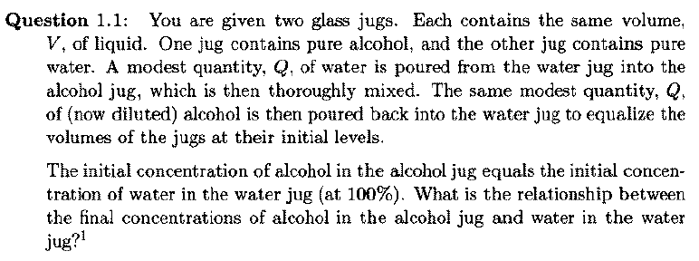
Purely Quantitative & Logic

Slide 41

Purely Quantitative & Logic

Slide 42
Purely Quantitative & Logic

Slide 43

Purely Quantitative & Logic

Slide 44
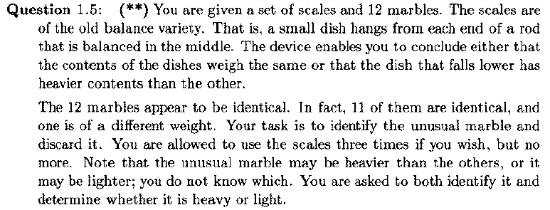
Purely Quantitative & Logic

Slide 45
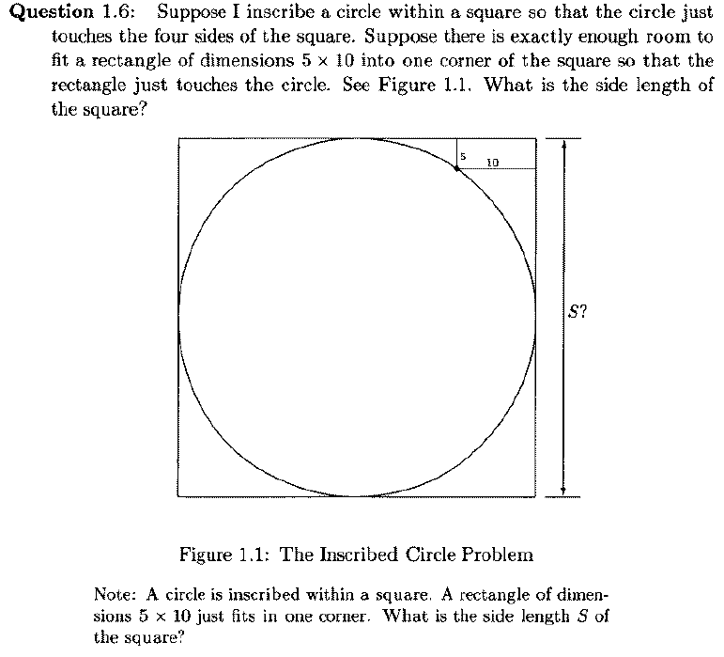
Purely Quantitative & Logic

Slide 46
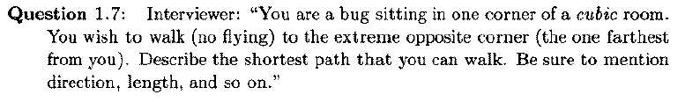
Purely Quantitative & Logic

Slide 47
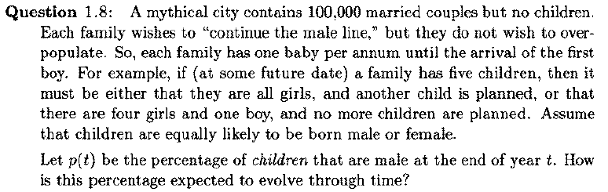
Purely Quantitative & Logic

Slide 48
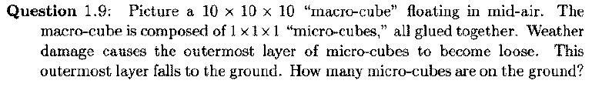
Purely Quantitative & Logic

Slide 49
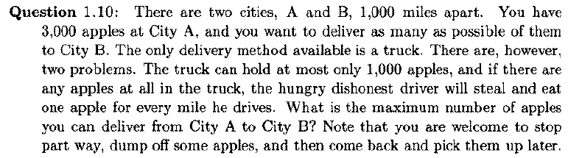
Purely Quantitative & Logic

Slide 50
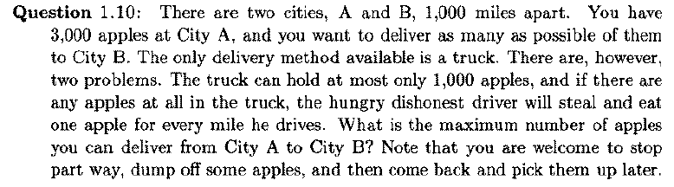
Purely Quantitative & Logic

Slide 51
Purely Quantitative & Logic

Slide 52
Purely Quantitative & Logic

Slide 53
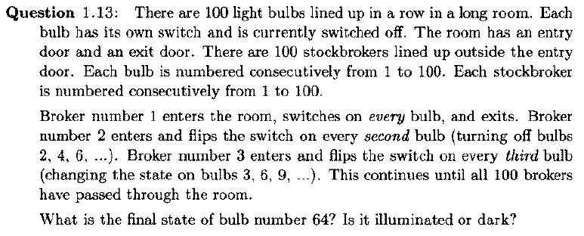
Purely Quantitative & Logic

Slide 54

Purely Quantitative & Logic

Slide 55
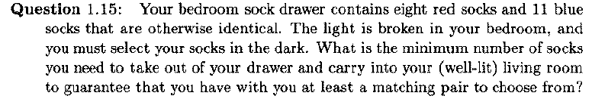
Purely Quantitative & Logic

Slide 56
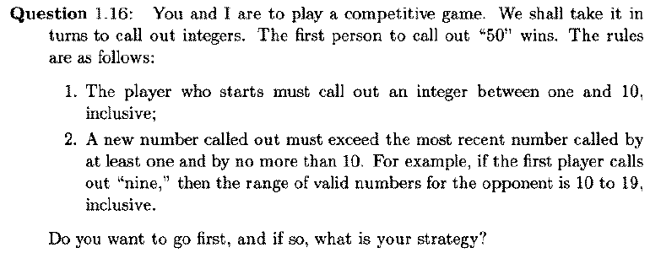
Purely Quantitative & Logic

Slide 57
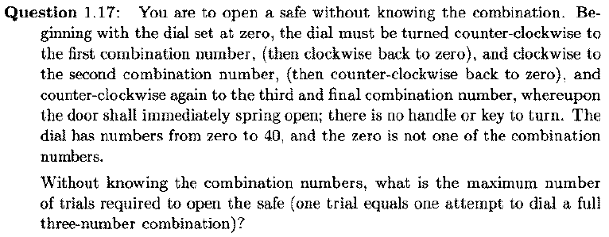
Purely Quantitative & Logic

Slide 58
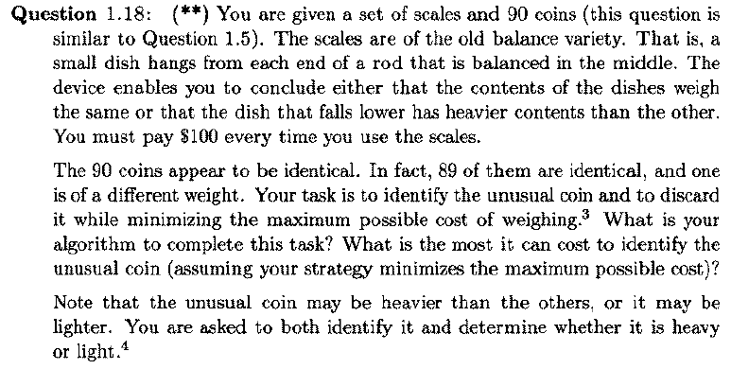
Purely Quantitative & Logic

Slide 59

Purely Quantitative & Logic

Slide 60
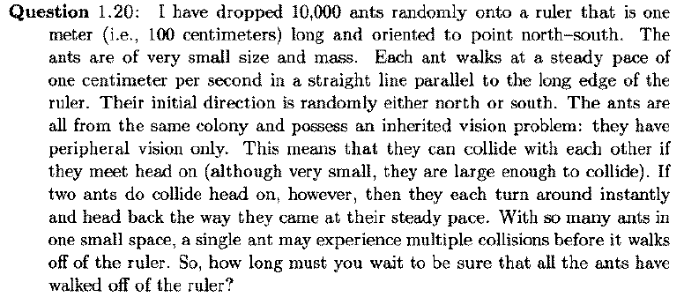
Purely Quantitative & Logic

Slide 61
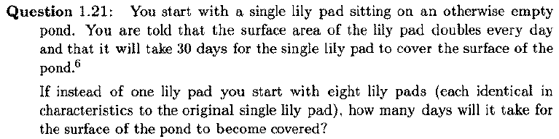
Purely Quantitative & Logic

Slide 62
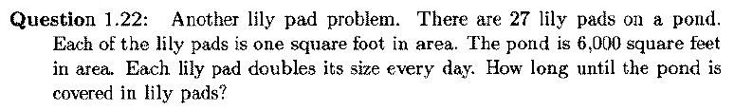
Purely Quantitative & Logic

Slide 63

Purely Quantitative & Logic

Slide 64

Purely Quantitative & Logic

Slide 65
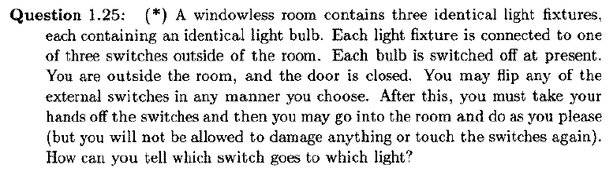
Purely Quantitative & Logic

Slide 66
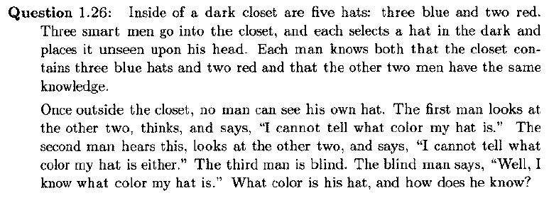
Purely Quantitative & Logic

Slide 67

Purely Quantitative & Logic

Slide 68
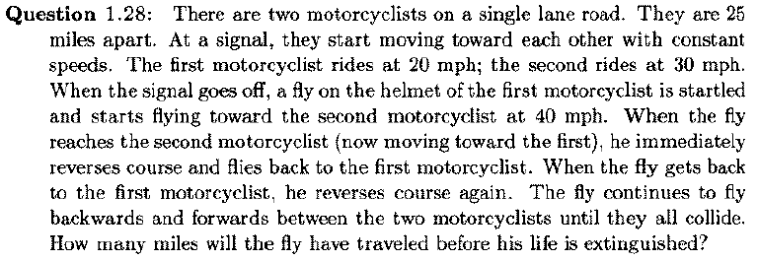
Purely Quantitative & Logic

Slide 69
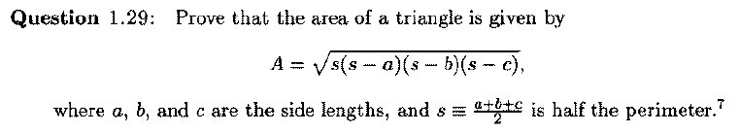
Purely Quantitative & Logic

Slide 70
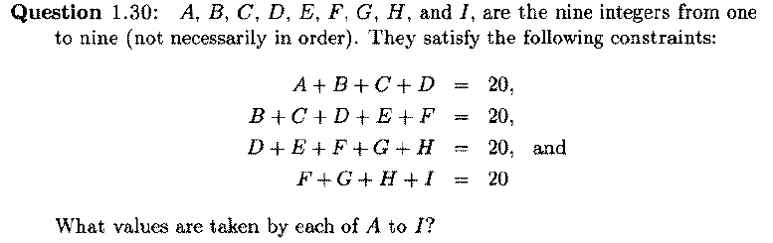
Purely Quantitative & Logic

Slide 71
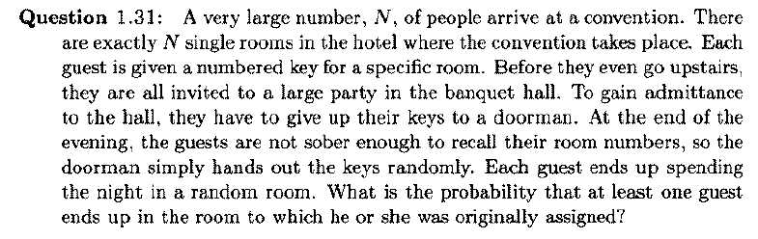
Purely Quantitative & Logic

Slide 72

Purely Quantitative & Logic

Slide 73
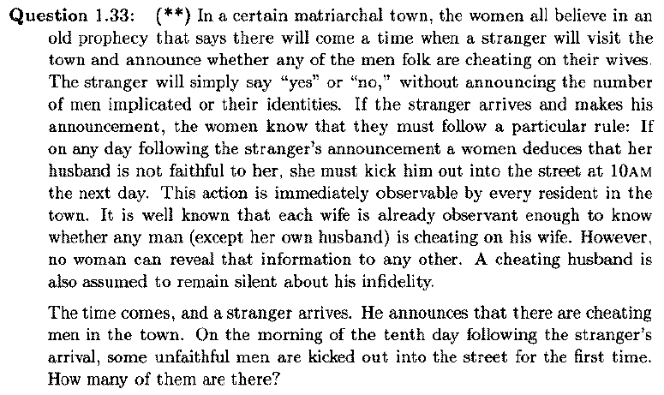
Purely Quantitative & Logic

Slide 74
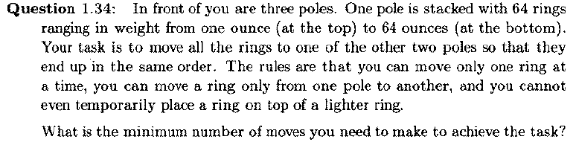
Purely Quantitative & Logic

Slide 75

Purely Quantitative & Logic

Slide 76
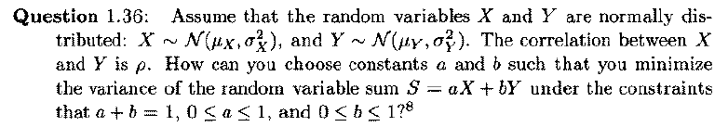
Purely Quantitative & Logic

Slide 77
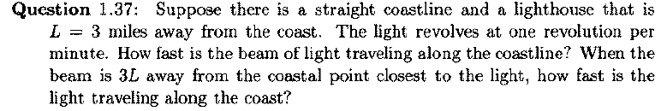
Purely Quantitative & Logic

Slide 78

Purely Quantitative & Logic

Slide 79

Purely Quantitative & Logic

Slide 80

Purely Quantitative & Logic

Slide 81
Purely Quantitative & Logic

Slide 82
Purely Quantitative & Logic

Slide 83

Purely Quantitative & Logic

Slide 84

Purely Quantitative & Logic

Slide 85
Purely Quantitative & Logic

Slide 86

Purely Quantitative & Logic

Slide 87

Purely Quantitative & Logic

Slide 88

Purely Quantitative & Logic

Slide 89

Purely Quantitative & Logic

Slide 90

Purely Quantitative & Logic

Slide 91

Purely Quantitative & Logic

Slide 92

Purely Quantitative & Logic

Slide 93

Purely Quantitative & Logic

Slide 94

Purely Quantitative & Logic

Slide 95

Purely Quantitative & Logic

Slide 96

Purely Quantitative & Logic

Slide 97

Purely Quantitative & Logic

Slide 98

Purely Quantitative & Logic

Slide 99

Purely Quantitative & Logic

Slide 100

Purely Quantitative & Logic

Slide 101
Purely Quantitative & Logic

Slide 102

Purely Quantitative & Logic

Slide 103
Purely Quantitative & Logic

Slide 104
Purely Quantitative & Logic

Slide 105
Purely Quantitative & Logic

Slide 106

Purely Quantitative & Logic

Slide 107
Purely Quantitative & Logic

Slide 108
Purely Quantitative & Logic

