Slide 1



AUTOMATION
WITH
ANSIBLE

Slide 2
ANSIBLE AUTOMATION
About Instructor
IT Industry Experience – 13 Years
Passion – Online Job Oriented Certified Courses
Teaching Over to 25000 Students
Shikhar Verma

Slide 3
Ansible Automation
Prerequisites
PC or Laptop with internet Connection
RHEL6,7,8 or CentOS, VMware Workstation & Oracle VirtualBox
Red Hat Certified System Administrator (RHCSA) Certification or equivalent experience.

Slide 4
Ansible Automation
Audience
Any Graduate, B.Tech or Students willing to start their career as Automation Engineer.

Slide 5
Ansible Automation
About Course Module
8-9 Hours of Video Contents
Theoretically Sessions covered with Practice Lab Sessions
30 days money back guarantee

Slide 6
Ansible Automation
Ansible is a simple IT automation platform that makes your applications and systems easier to deploy.
Ansible can help you with configuration management, application deployment & task automation as shown below:
Configuration of servers
Application deployment
Continuous testing of already install application
Provisioning
Orchestration
Automation of tasks
Introduction

Slide 7
Ansible Automation
Ansible is an open-source software provisioning, configuration management, and application-deployment tool. It runs on many Unix-like systems, and can configure both Unix-like systems as well as Microsoft Windows.
Ansible was originally written by Michael DeHaan, the creator of the Cobbler provisioning application. Ansible has been widely adopted, because it is simple to use for system administrators. Developers ease into using Ansible because it is built on Python.
Ansible is included as part of the Fedora distribution of Linux, owned by Red Hat, and is also available for Red Hat Enterprise Linux, CentOS, Debian, Scientific Linux, Oracle Linux via Extra Packages for Enterprise Linux (EPEL).
What is Ansible

Slide 8
Ansible Automation
Ansible's architecture is agentless. Work is pushed to remote hosts when Ansible executes. Modules are the programs that perform the actual work of the tasks of a play. Ansible is immediately useful because it comes with hundreds of core modules that perform useful system administrative work.
Instead of writing custom, individualized scripts, system administrators create high-level plays in Ansible. A play performs a series of tasks on the host, or group of hosts, specified in the play. A file that contains one or more plays is called a playbook.
What is Ansible

Slide 9
Ansible Automation
Ansible can add packages to an installation, but it does not perform the initial installation of the system. Every system can start with a minimal installation, either via Kickstart or a base cloud starter image, then use Ansible for further configuration.
Although Ansible can remediate configuration drift, it does not monitor for it.
Ansible does not track what changes are made to files on the system, nor does it track what user or process made those changes.
Ansible Limitations

Slide 10
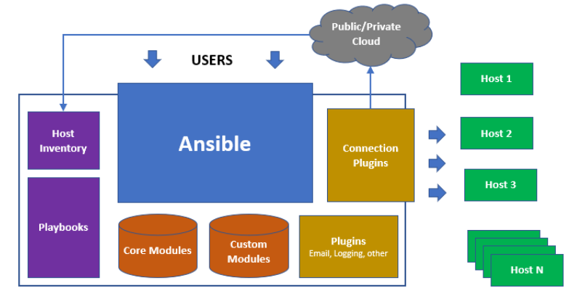
Ansible Automation

Slide 11
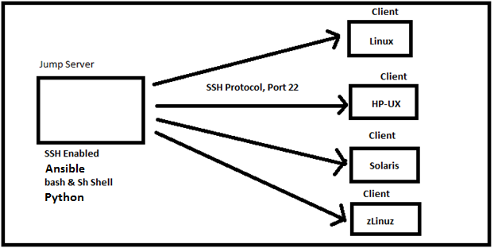
Ansible Automation

Slide 12
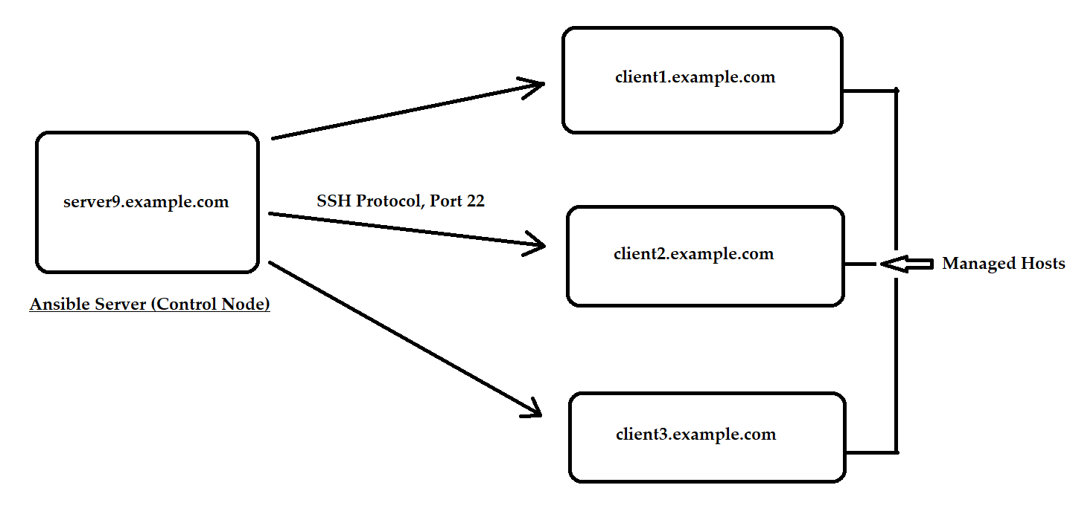
Ansible Automation
Linux, HP-UX,
Solaris, AIX,
zLinux, CentOS
Windows etc

Slide 13
Ansible Automation
It is a free open source software.
Agent-less – No need for agent installation.
Phython/yaml based.
Highly flexible and configuration management of systems.
Large number of ready to use modules for system management.
Custom modules can be added if needed.
Configuration roll-back in case of error .
Simple and human readable.
Implement Sudo passwd, so that normal needs password to elevate his privilege.
Important Points

Slide 14
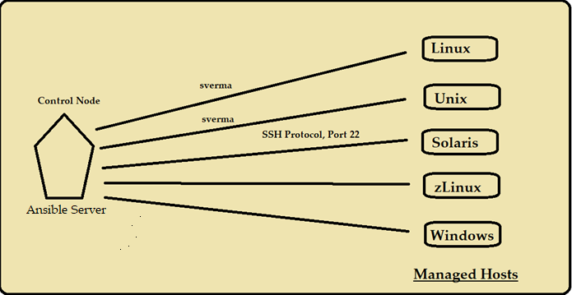
Ansible Automation
Ansible Server – ansibleser.example.com
Managed Hosts – client1, client2, client3

Slide 15
Ansible Automation
Ansible Components
Host
Inventory
Core Modules
Custom Modules
Ansible
Configuration
Playbooks
Connection
Plugins
Plugins

Slide 16
Ansible Automation
System administrators log in and initiate all Ansible operations from the control node. Ansible software is installed on the control node. Ansible configuration files are also maintained on the control node.
A machine acting as a control node must have Python 2.6 or 2.7 installed. This includes Linux, OS/X, and any BSD based Unix system. Windows is not supported for the control node at this time.
Role and requirements for the control node

Slide 17
Ansible Automation
A managed host is a system that Ansible logs into, installs modules, and executes remote commands to perform configuration tasks. Other names for a managed host include managed node and remote node.
Ansible uses SSH to communicate with managed hosts, so SSH must be installed and configured to allow incoming connections. Managed hosts must have Python 2.4 or later installed to run Ansible, which includes Red Hat Enterprise Linux 5, 6, and 7 hosts.
The python-simplejson package must also be installed on Red Hat Enterprise Linux 5 managed hosts. It is not required on Red Hat Enterprise Linux 6 and 7 managed hosts, since Python 2.5 (and newer versions) provide its functionality by default.
Role and requirements for the Managed Hosts

Slide 18
Ansible Automation
Host Inventory defines which hosts Ansible manages. Hosts may belong to groups which are typically used to identify the hosts' role in the datacenter. A host can be a member of more than one group.
[webservers]
localhost ansible_connection=local
web1.example.com
web2.example.com:1234 ansible_connection=ssh ansible_user=ftaylor
[db-servers]
web1.example.com
db1.example.com
Ansible Host Inventories

Slide 19
Ansible Automation
Customizing Ansible

Slide 20
Ansible Automation
Ansible Server – ansibleser.example.com
Managed Hosts – client1, client2, client3

Slide 21
Ansible Automation
The behavior of an Ansible installation can be customized by modifying settings housed in
ansible's configuration file (/etc/ansible/ansible.cfg).
privilege_escalation section in the ansible.cfg configuration file by adding the following entry.
[privilege_escalation]
Enable privilege escalation by adding the become setting and configuring it as True.
become=True
Customizing Ansible

Slide 22
Ansible Automation
Set the privilege escalation to use sudo by adding the become_method setting and configuring it as sudo.
become_method=sudo
Set the privilege escalation user by adding the become_user setting and configuring it as root.
become_user=root
Enable password prompting during privilege escalation by adding the become_ask_pass setting and configuring it as True.
become_ask_pass=True
Customizing Ansible

Slide 23
Ansible Automation
The command module allows administrators to quickly execute remote commands on managed hosts. These commands are not processed by the shell on the managed hosts. As such, they cannot access shell environment variables or perform shell operations such as redirection and piping.
For situations where commands require shell processing, administrators can use the shell module.
The following example illustrates the difference between the command and shell modules. If an attempt is made to execute the bash built-in, set, with these two modules, it will only succeed with the shell module.
Command & Shell Module

Slide 24
Ansible Automation
[student@demo ~]$ ansible localhost -m command -a set
localhost | FAILED | rc=2 >>
[Errno 2] No such file or directory
[student@demo ~]$ ansible localhost -m shell -a set
localhost | SUCCESS | rc=0 >>
BASH=/bin/sh
BASHOPTS=cmdhist:extquote:force_fignore:hostcomplete:interact
ive_comments:progcomp:promptvars:sourcepath
BASH_ALIASES=()
Command & Shell Module

Slide 25
Ansible Automation
Lab Session
Customizing Ansible

Slide 26
Ansible Automation
Goal: Write Ansible plays and execute a playbook.
Objective
Write YAML files.
Implement Ansible playbooks.
Write and execute a playbook.
Implementing Playbooks

Slide 27
Ansible Automation
Playbooks are the files where Ansible code is written. Playbooks are written in YAML format. Playbooks are one of the core features of Ansible and tell Ansible what to execute.
Ansible uses YAML syntax for expressing Ansible playbooks because it is very easy for humans to understand, read and write than other common data formats like XML or JSON.
Each playbook is an aggregation of one or more plays in it. Playbooks are structured using plays. There can be more than one play inside a playbook.
Implementing Playbooks

Slide 28
Ansible Automation
YAML SYNTAX
YAML files optionally begin with a three dash start of document marker and are optionally terminated with a three dot end of file marker.
---
...output omitted...
...
Implementing Playbooks

Slide 29
Ansible Automation
YAML SYNTAX
---
- hosts: dev
become: true
become_user: root
tasks:
- name: run the script
script: /home/sverma/ansible/scr.sh
when: ansible_distribution == "RedHat" and ansible_distribution_major_version == '7'
Implementing Playbooks

Slide 30
Ansible Automation
Modules are programs that Ansible uses to perform operations on managed hosts. They are ready-to-use tools designed to perform specific operations. Modules can be executed from the ansible command line or used in playbooks to execute tasks. When run, modules are copied to the managed host and executed there.
Ansible comes packaged with over 500 modules available for use. These prepackaged modules can be used to perform a wide range of tasks, such as cloud, user, package, and service management.
Introduction to modules

Slide 31
Ansible Automation
There are three types of Ansible modules:
Core modules are included with Ansible and are written and maintained by the Ansible development team. Core modules are the most important modules and are used for common administration tasks.
Extras modules are currently included with Ansible but may be promoted to core or shipped separately in the future. They are generally not maintained by the Ansible team but by the community. Typically, these modules implement features for managing newer technologies such as OpenStack.
Custom modules are modules developed by end users and not shipped by Ansible. If a module does not already exist for a task, an administrator can write a new module to implement it.
Introduction to modules

Slide 32
Ansible Automation
Core and Extras modules are always available. Ansible looks for custom modules on the control node in directories defined by the $ANSIBLE_LIBRARY environment variable
#library = /usr/share/my_modules/
On Red Hat Enterprise Linux 7,8 systems, modules are installed in the below location:
/usr/lib/pythonx.x/site-packages/ansible/modules directory.
Introduction to modules

Slide 33
Ansible Automation
Module categories
For better organization and management, Ansible modules are grouped into the following functional categories.
Module categories
• Cloud • Files • Notification
• Packaging • Source Control • System
• Utilities • Web Infrastructure • Windows
• Clustering • Inventory • Messaging • Monitoring
• Network • Commands • Database
Introduction to modules

Slide 34
Ansible Automation
Lab Session
Modules

Slide 35
Ansible Automation
Writing a playbook
If multiple tasks are desired, the same syntax is repeated for each task.
tasks:
- name: first task
service: name=httpd enabled=true
- name: second task
service: name=sshd enabled=true
...output omitted...
- name: last task
service: name=sshd enabled=true
Introduction to modules

Slide 36
Ansible Automation
Important
When possible, try to avoid the command, shell, and raw modules in playbooks because these take arbitrary commands, it is very easy to write non-idempotent playbooks with these modules.
For example, this task using the shell module is not idempotent. Every time the play is run, it will rewrite /etc/resolv.conf even if it already consists of the line "nameserver 192.0.2.1".
- name: Non-idempotent approach with shell module
shell: echo "nameserver 192.0.2.1" > /etc/resolv.conf
Writing a playbook

Slide 37
Ansible Automation
The following example will not rewrite the file /etc/resolv.conf if it already consists of the right content:
- name: Idempotent approach with copy module
copy:
dest: /etc/resolv.conf
content: "nameserver 192.0.2.1\n"
The copy module is special-purpose and can easily test to see if the state has already been met, and if it has will make no changes.
Idempotent playbooks can be run repeatedly to ensure systems are in a particular state without disrupting those systems if they already are.
Writing a playbook

Slide 38
Ansible Automation
If multiple tasks are desired, the same syntax is repeated for each task.
tasks:
- name: first task
service: name=httpd enabled=true
- name: second task
service: name=sshd enabled=true
...output omitted...
- name: last task
service: name=sshd enabled=true
Writing a playbook

Slide 39
Ansible Automation
Lab Session
Writing a playbook

Slide 40
Ansible Automation
Lab Session
Implementing Multi tasks in Playbook
Package Installation (Apache/FTP)
Mount OS Media Drive
Create local repository
Install required Packages
Enabled the service
Start the Service
Client1
Ansible Server
Client2

Slide 41
Ansible Automation
Ansible supports variables that can be used to store values that can be reused throughout files in an entire Ansible project.
Variables provide a convenient way to manage dynamic values for a given environment in your ansible project. Some examples of values that variables might contain include.
Users to create
Packages to install
Services to restart
Files to remove
Managing Variables

Slide 42
Ansible Automation
Naming variables
Variables have names which consist of a string that must start with a letter and can only contain letters, numbers, and underscores.
Defining variables
Variables can be defined in a variety of places in an Ansible project. However, this can be simplified to three basic scope levels:
• Global scope: Variables set from the command line or Ansible configuration
• Play scope: Variables set in the play and related structures
• Host scope: Variables set on host groups and individual hosts by the inventory, fact gathering, or registered tasks
Managing Variables

Slide 43
Ansible Automation
Variables in playbooks
When writing playbooks, administrators can use their own variables and call them in a task.
For example, a variable web_package can be defined with a value of httpd and called by the yum module in order to install the httpd package as shown in next slide.
Managing Variables

Slide 44
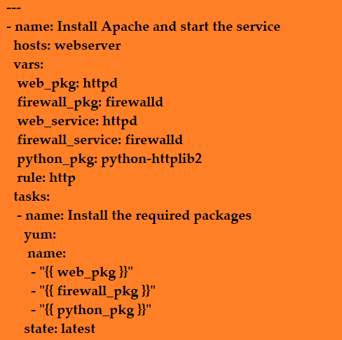
Ansible Automation
Managing Variables

Slide 45
Ansible Automation
Host Variables and Group Variables
Inventory variables that apply directly to hosts fall into two broad categories: host variables that apply to a specific host, and group variables that apply to all hosts in a host group or in a group of host groups. Host variables take precedence over group variables, but variables defined by a playbook take precedence over both.
This is a host variable, ansible_user, being defined for the host demo.example.com.
[servers]
demo.example.com ansible_user=joe
Managing Variables

Slide 46
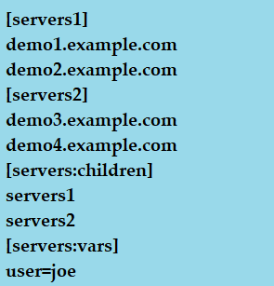
Ansible Automation
Host Variables and Group Variables
Managing Variables

Slide 47
Ansible Automation
Ansible facts are variables that are automatically discovered by Ansible from a managed host.
Facts are pulled by the setup module and contain useful information stored into variables that administrators can reuse. Ansible facts can be part of playbooks, in conditionals, loops, or any other dynamic statement that depends on a value for a managed host;
For example:
A server can be restarted depending on the current kernel version.
Users can be created depending on the host name.
Ansible facts

Slide 48
Ansible Automation
Ansible facts are a convenient way to retrieve the state of a managed node and decide which action to take based on its state. Facts provide information about
The host name
The kernel version
The network interfaces
The IP addresses
The version of the operating system
Various environment variables
The number of CPUs
The available or free memory
Ansible facts

Slide 49
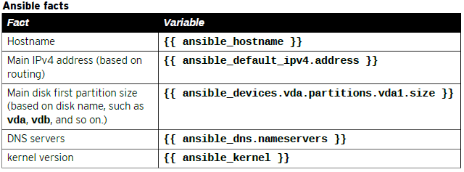
Ansible Automation
The following shows some of the facts Ansible gathered from a managed node:
[user@demo ~]$ ansible demo1.example.com -m setup
Ansible facts

Slide 50
Ansible Automation
Ansible can use conditionals to execute tasks or plays when certain conditions are met. For example, a conditional can be used to determine the available memory on a managed host before Ansible installs or configures a service.
The following examples illustrate some ways in which conditionals can be used by Ansible.
A hard limit can be defined in a variable (for example, min_memory) and compare it against the available memory on a managed host.
Ansible facts can be used to determine the managed host network configuration and decide which template file to send (for example, network bonding or trunking).
Conditionals

Slide 51
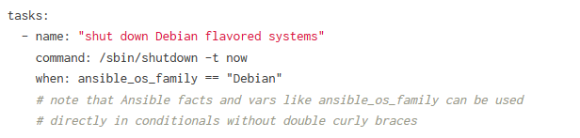
Ansible Automation
The When Statement
Sometimes you will want to skip a particular step on a particular host. This could be something as simple as not installing a certain package if the operating system is a particular version, or it could be something like performing some cleanup steps if a filesystem is getting full.
Conditionals

Slide 52
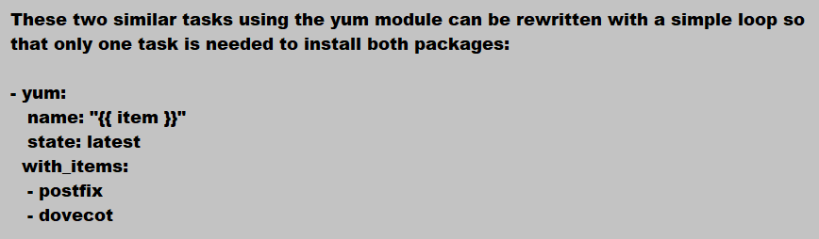
Ansible Automation
- yum:
name: postfix
state: latest
- yum:
name: dovecot
state: latest
Loops in Ansible

Slide 53
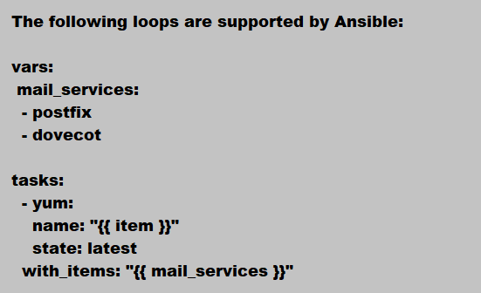
Ansible Automation
Loops in Ansible

Slide 54
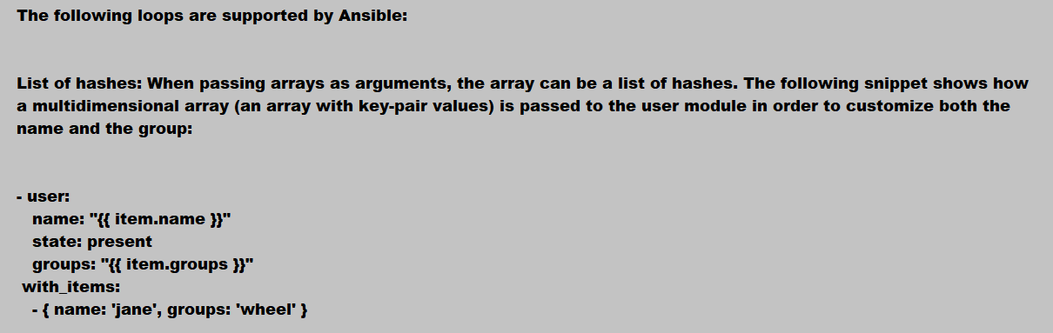
Ansible Automation
Loops in Ansible

Slide 55
Ansible Automation
Practice Lab Session
Loops in Ansible

Slide 56
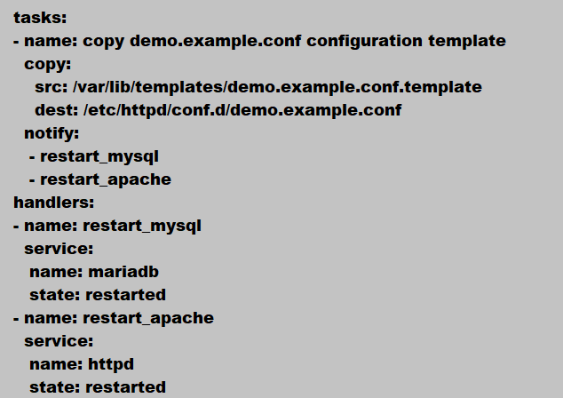
Ansible Automation
A Handler is exactly the same as a task, but it will run when called by another task. A Handler will take an action when called by an event it listens for.
Ansible Handlers

Slide 57
Ansible Automation

Slide 58
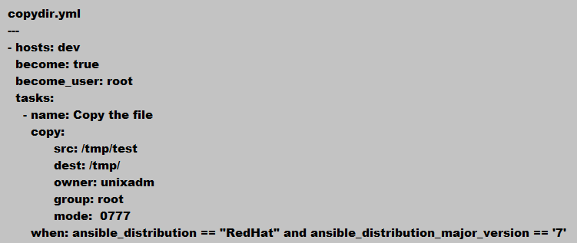
Ansible Automation
Conditionals

Slide 59
Ansible Automation
Verify the Application/Database processes are running or not.
Decision point to start patching.
Copy the required Repo file to the Managed host.
Upgrade the Kernel or Packages.
Check if reboot is required after kernel update.
Reboot the system.
Wait for few minutes, so that server should come up after reboot.
Debug a message with new kernel version
Patching On Linux Servers using Ansible
Patching

