Slide 2
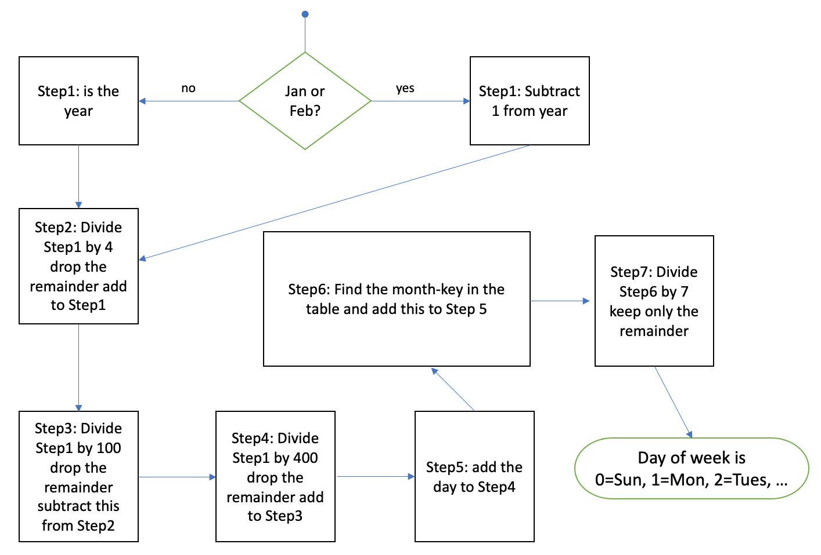
'January':0,
'February':3,
'March':2,
'April':5,
'May':0,
'June':3,
'July':5,
'August':1,
'September':4,
'October':6,
'November':2,
'December':4

Slide 3
Step1: is the year
Jan or Feb?
Step1: Subtract 1 from year
no
yes
Step2: Divide Step1 by 4 drop the remainder add to Step1
Step6: Find the month-key in the table and add this to Step 5
Step7: Divide Step6 by 7 keep only the remainder
Step3: Divide Step1 by 100 drop the remainder subtract this from Step2
Step4: Divide Step1 by 400 drop the remainder add to Step3
Step5: add the day to Step4
Day of week is
0=Sun, 1=Mon, 2=Tues, …

