Slide 1
ITM352
Dynamic Web Pages:
Server Side Processing with Node.js

Slide 2
Today's Class
What is Node.js and How is it used for server-side dynamic web pages?
Diving in head first!
  How Node.js enables server side dynamic web pages
  Starting to figure out what web application programming is about…
    It’s complicated with a lot of details but you will get it after working with it for a bit.
    Strive to understand what’s going on rather than just “getting it to work”

Slide 3
What is Node.js?
Node.js was created by Ryan Dahl starting in 2009, and its growth is sponsored by Joyent, his employer.
Javascript in an event-driven programming language very common for web applications
- All computers are directed by programs
- like very detailed recipes
written in languages that humans can understand and be processed by computers (unlike English)
Javascript is one among many hundreds of such languages… but currently is the most used

Slide 4
What's special about Node.js?
JavaScript used in client-side but node.js puts the JavaScript on server-side thus making communication between client and server will happen in same language
Servers are normally thread based but Node.JS is “Event” based. Node.JS serves each request in an Event loop that can able to handle simultaneous requests.
+99,000 packages and growing FAST
Used by nearly all major technology companies and a rapidly increasing adoption by non-technology companies

Slide 5
What can you do with Node ?
It is a command line tool. You download a tarball, compile and install the source.
It lets you “layer” on top of the TCP library as a HTTP and HTTPS client/server.
The JS executed by the V8 JavaScript engine (the ting that makes Google Chrome so fast)
Node provides a JavaScript API to access the network and file system.

Slide 6
WHAT CAN’T DO WITH NODE?
Node is a platform for writing JavaScript applications outside web browsers. This is not the JavaScript we are familiar with in web browsers. There is no DOM built into Node, nor any other browser capability.
Node can’t run on a GUI, but run on terminal or as a background process

Slide 7
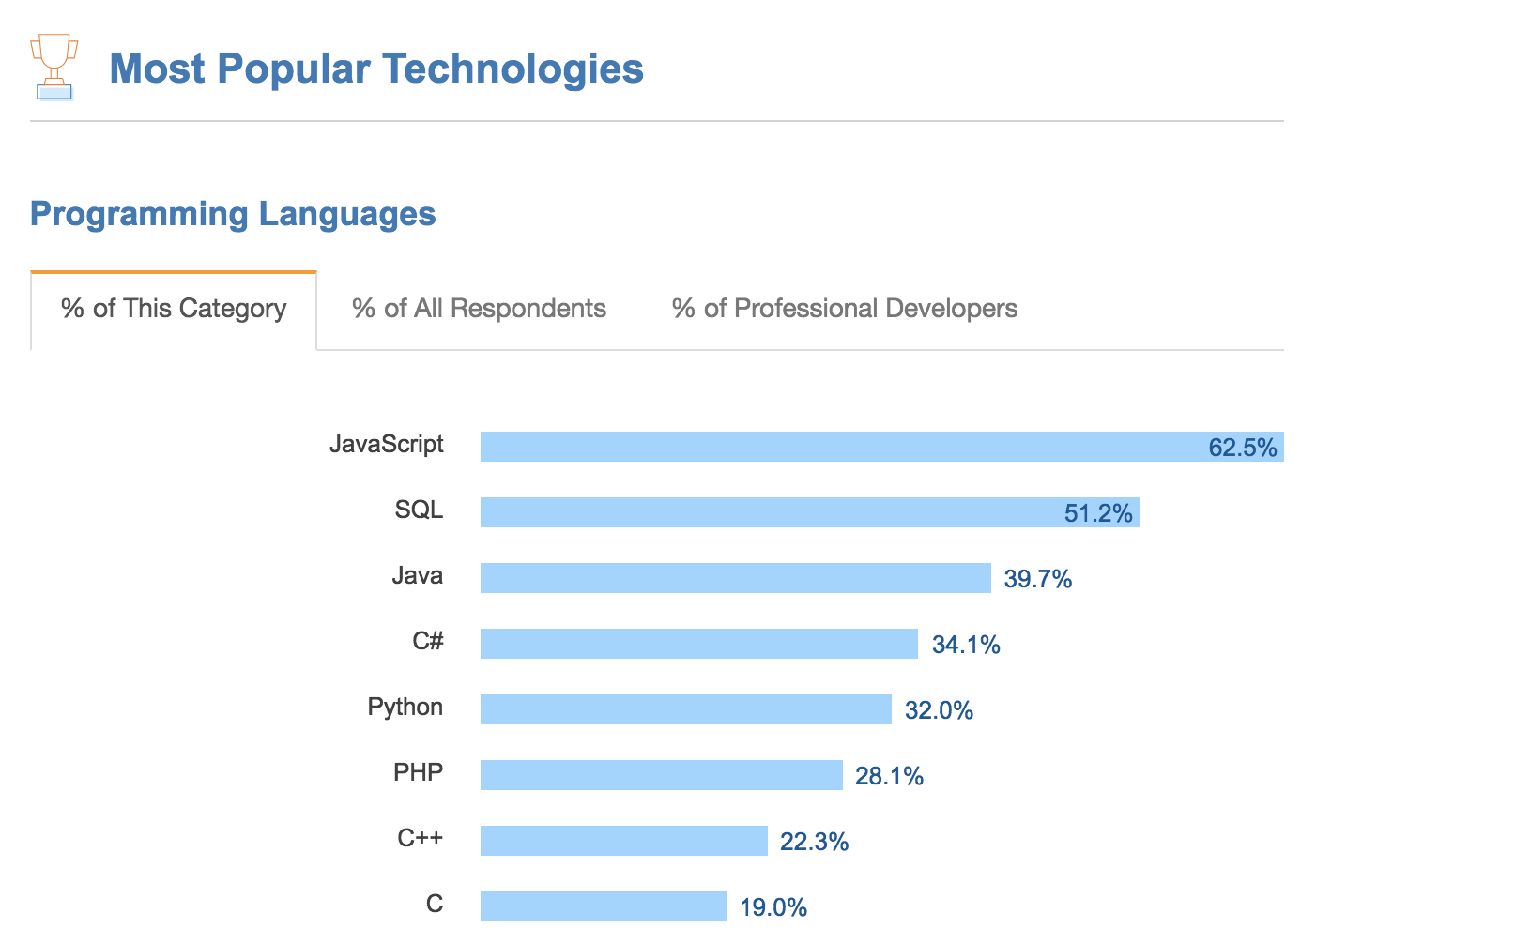
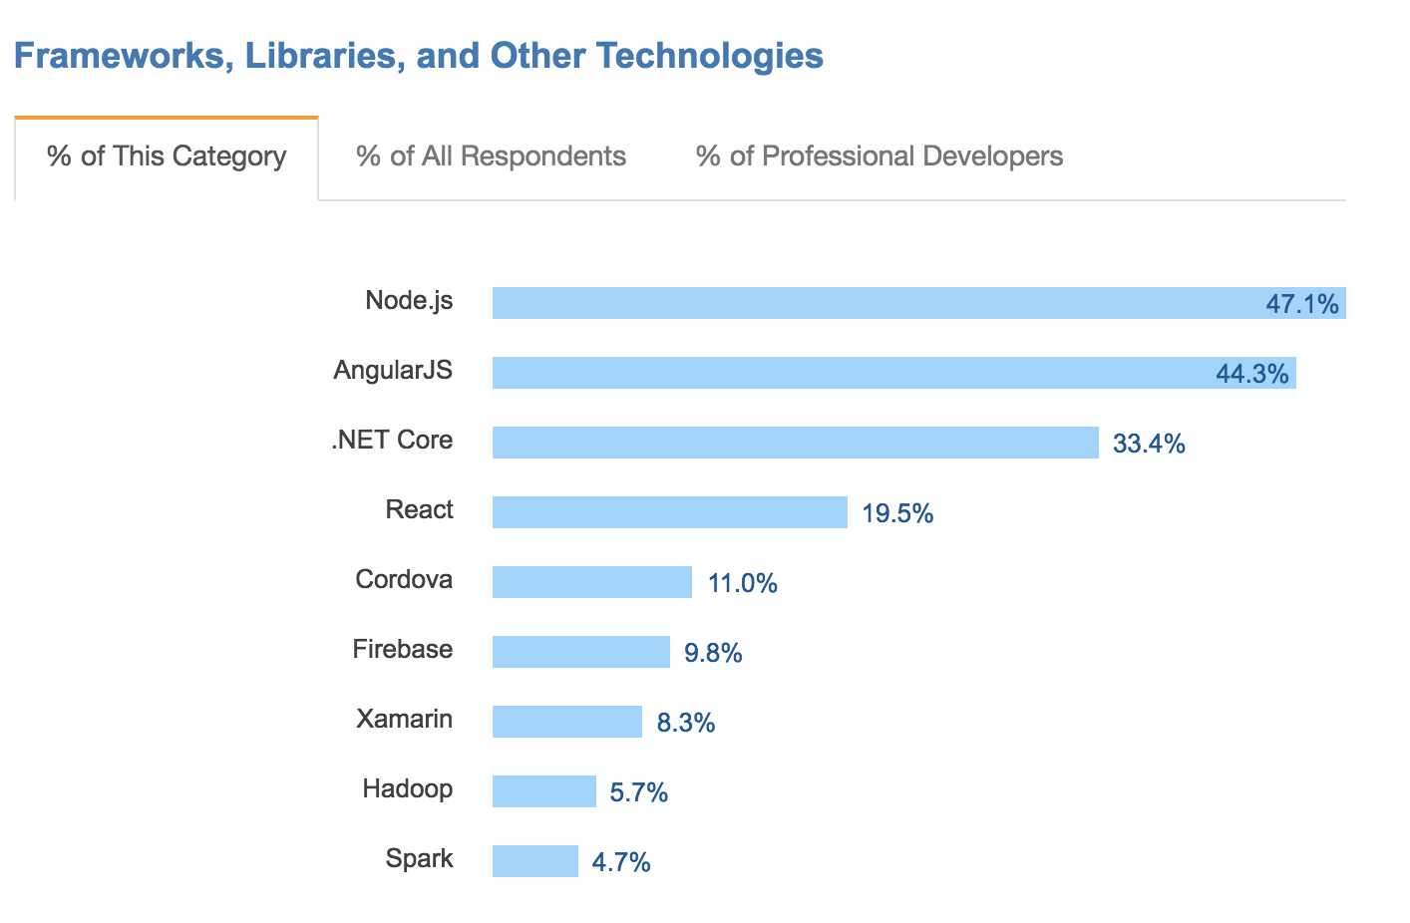
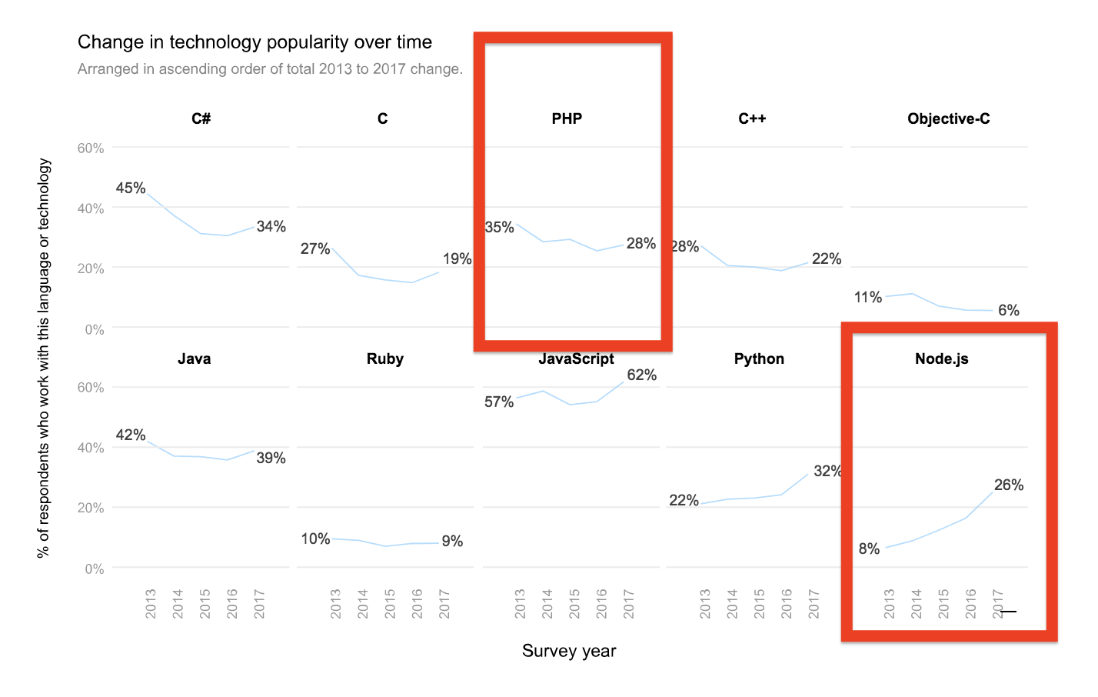
Node.js is the Now & Future
Source: https://medium.com/zerotomastery/want-to-be-a-web-developer-learn-node-js-not-php-dc298154fafd

Slide 8
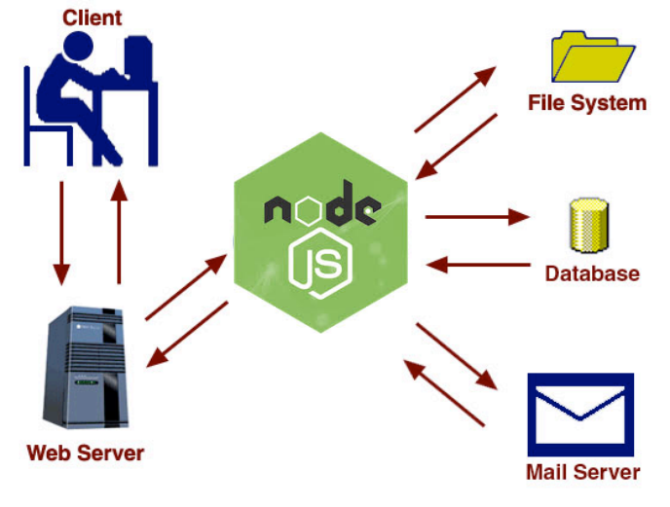
Node.js is the Gateway to Shared Services and Data

Slide 9
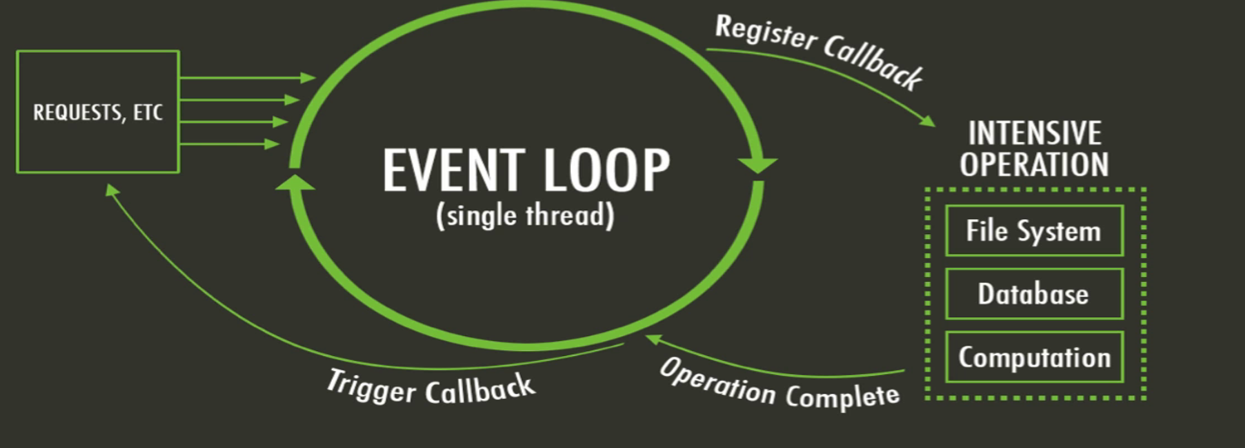
How Does Node.js Work?
Node.js is a program that performs executes Javascript
  It is a language interpreter that directly executes commands then ultimately outputs into HTML/HTTP (rather than a compiler which outputs translates commands into machine code for later execution)
Client (e.g. IE)
Node.js Server Application

Slide 10
Example Dynamic Web Page
Open VS Code and type
var http = require('http');
//create a server object:
http.createServer(function (req, res) {
console.log(req.headers); //output the request headers to the console
res.writeHead(200, {'Content-Type': 'text/html'}); // set MIME type to HTML
res.write('<h1>The date is: ' + Date.now() + '</h1>'); //write a response to the client
res.end(); //end the response
}).listen(8080); //the server object listens on port 8080
console.log('Hello world HTTP server listening on localhost port 8080');
Routing defines the way in which the client requests are handled by the application (server) endpoints. You define how HTTP requests are handled.
Questions
  Why is this a "dynamic" web page?
  Does the request matter? Where is the route handled?
  When you do a "view source" in the browser, where is the Javascript code?

Slide 11
Tour of a Node.js Simple Web App
Open VS Code and type
var http = require('http');
//create a server object:
http.createServer(function (req, res) {
console.log(req.headers); //output the request headers to the console
res.writeHead(200, {'Content-Type': 'text/html'}); // set MIME type to HTML
res.write('<h1>The date is:<script>document.write( Date.now() );</script></h1>'); //write a response to the client
res.end(); //end the response
}).listen(8080); //the server object listens on port 8080
console.log('Hello world HTTP server listening on localhost port 8080');
Why is this the same result as the previous dynamic web page example but fundamentally different?

Slide 12
Client vs. Server Side Processing
What’s the difference?
Client Side | Server Side
Can directly manipulate page objects | Can manipulate web server behavior e.g. page processing
No network communication needed | Secures data and actions away from users
Local user data from client only | User data can be shared for any client
Can “guard” data for validation before submission for quick recovery | Process data from clients
 | Can access shared data and services (files, databases, other servers, processes, etc.)

Slide 13
Libraries, Frameworks, Components, Services, Tools
Both Node.js and JavaScript have many useful freely available technologies to help you do just about anything!
Node.js:
Express, Koa, Restify, MySQL, EJS, …
Go to npmjs.org to see lots!
JavaScript:
REACT, JQuery, Angular, AJAX, COMET, DataTables, EJS, etc.

