Slide 1
ITM 352
Cookies

Slide 2
Problem…
How do you identify a particular user when they visit your site (or any page on your site) without always passing it back and forth in HTML forms?
What if they leave your site then come back later and you don't want to make them identify them again?
  E.g. username

Slide 3
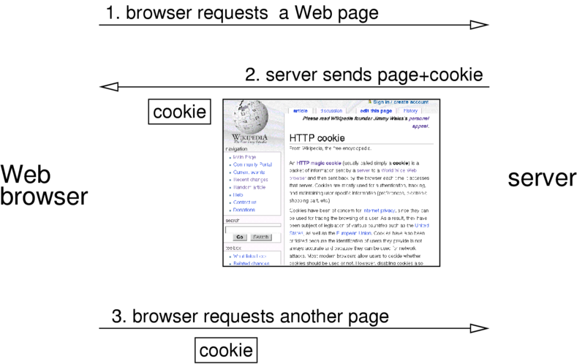
Use a Cookie!

Slide 4
What is a cookie?
A cookie is a particular piece of data combined with a unique id that the server sends to the browser to store
  Data is stored on the browser and can be requested by the server whenever the user visits
The data is set by you. Usually a user id, but sometimes other things.
  Generally one piece of info per cookie
Only the server that sent the cookie can request it from a user's browser (it's handled via the server's URL and can be specialized to particular directories or pages on that server)
The user's browser manages cookie data
  What is acceptable, where stored, when to send if requested, how long to keep
  The browser can set a suggested expiration time, but no guarantees!

Slide 5
Sending a Cookie
To send a cookie you MUST call the set_cookie() function before anything is output to your web browser (just like the header() function).
Otherwise you will get the error below:
  Warning: Cannot send session cookie - headers already sent by (output started at session_header_error/session_error.php:2) in session_header_error/session_error.php on line 3
  Warning: Cannot send session cache limiter - headers already sent (output started at session_header_error/session_error.php:2) in session_header_error/session_error.php on line 3

Slide 6
Sending a Cookie Examples
/* If cookie is not set, set the username as a cookie to identify the user
on the next visit. Make it expire in 1 hour */
$username = 'ITM352';
/* MUST BE DONE BEFORE ANY OUTPUT! */
if (!isset($_COOKIE["userid"]))
setcookie("userid", $username, time()+3600 );
/* set the expiration date to one hour ago with empty data to request
the browser to delete cookie */
setcookie ("userid", "", time() - 3600);
/* see if a cookie has been set and if so print it */
if (isset($_COOKIE["userid"]))
echo $_COOKIE["userid"];

Slide 7
Cookie Considerations
Limitations
  Users may delete cookies
  Users may disallow cookies
  Some browsers don't handle them well
  Only good for small bits of data (but you can use multiple cookies)
  Only identifies the browser the cookie sent to, not the actual user! (someone using another person's browser will be mistaken for that user)
    The only way to be sure the user is authentic is to have them log in with a username and password
Be careful!
  setcookie() will always send a new cookie to the browser. If you don't want to overwrite it, just check if it exists before writing.

Slide 8
ITM 352
Sessions

Slide 9
Problem…
How do you keep data about a particular user around when passing from page to page without always passing it back and forth in HTML forms? What if the user goes away from the site then comes back?
  E.g. You might want to keep: user authentication info, shopping cart items, user preferences.
(This is not a shared data problem as we have dealt with previously. The main problem is keeping and using individual data for multiple users.)

Slide 10
Answer: Use a Session!
session
data
server side
identify
identify
data
identify
data
browser side
page1
page3
page2

Slide 11
User Sessions
Start a session
  session_start();
Destroy the session when you're done
  session_destroy();
There are more sophisticated things you can do, e.g:
  Expire sessions, unregister particular variables, custom sessions storage, cookies, etc.

Slide 12
What is a Session?
A session is a particular set of data combined with a unique user id
  Data is stored on the server and connected to the user by the session id
The data is set by you
At least the user id is stored on the user's browser as a cookie or as a URL query string or browser header data
  Not great, but sometimes ok is to identify user by IP-address (and this is the default for sessions)
You must manage session data
  What, where, when, how-long

Slide 13
Starting Sessions
To start a session you MUST call the session_start() function before anything is output to your web browser (just like the header() function).
Otherwise you get the error below:
  Warning: Cannot send session cookie - headers already sent by (output started at session_header_error/session_error.php:2) in session_header_error/session_error.php on line 3
  Warning: Cannot send session cache limiter - headers already sent (output started at session_header_error/session_error.php:2) in session_header_error/session_error.php on line 3

Slide 14
Starting Sessions - 2
You must use session_start() on any page that you wish to use session variables EVEN IF YOU HAVE ALREADY CALLED IT PREVIOUSLY!!!!!
You must also be sure the location where the session data will be stored is accessible (e.g. writable)
  May have to specify with session_save_path();

Slide 15
Registering Session Variables
You access the session data via the $_SESSION array (which PHP manages for you)
To put a variable in the current session add it to the $_SESSION array:
  $_SESSION[‘product'] = ‘gumball';
  $_SESSION['size'] = 'small';
  All pages that call session_start() will have access to this array—it is shared data.

Slide 16
Registering Session Variables - 2
** Important **
Registered session variable values are static: they will only be set once when the corresponding variable is initialized.
If you want them to change dynamically along with changes to the variable, you must assign them a reference to the session variable (note the '&' in the code below):
$aVarIdent = &$_SESSION['aVarIdent'];

Slide 17
Accessing Session Variables
Session variables are generally not automatically set in a page. You usually must access them from the $_SESSION array
  $aVarIdent = $_SESSION['aVarIdent'];
  $aVarIdent is local to the page only. To store it back in the session, you must use $_SESSION['aVarIdent'] = $aVarIdent;
If you want to directly affect changes, use references (create an alias)
  $aVarIdent = &$_SESSION['aVarIdent'];

Slide 18
Example: User Page Hits
<?
session_save_path('.'); // You may need to change this
session_start(); // No output before this!
if (!isset($_SESSION['hitcount'])) $_SESSION['hitcount'] = 1;
$hits = &$_SESSION['hitcount'];
$hits++;
/* Un-comment the line below if you want to remove the
comment and clear the registered variables. */
// session_destroy();
?>
<html>
You've hit this page <?= $hits ?> times. <br><br>
<A href="<?php echo $_SERVER['PHP_SELF'] ?>"> Hit this page again</A>
</html>

Slide 19
A Useful Bit of Code…
foreach ($_SESSION as $sessVar => $value)
$$sessVar = &$_SESSION[$sessVar];
Converts all session values to variables (that are aliased to session values)
Note that you can register ANY data type for a session and PHP will automatically encode and decode it in a session for you!
  $myArray = array(1,2,3,4);
  session_register('myArray');

Slide 20
What's A Shopping Cart Anyway?
Any information that keeps track of what a particular user wants from page to page, e.g.
  Quantities array corresponding to products array
  A single Orders array with functions to add, remove, get individual orders
  …
Being tied to a specific user, this cries out for sessions!

Slide 21
So What's a Shopping Cart?
A shopping cart holds information about a particular user's choices and preferences
  Must be able to uniquely identify user while the choices are being made and manipulated
  Must tie a particular user’s data to a unique id
    E.g. BSimpson chooses:
2 large gumballs
0 medium gumballs
5 small gumballs

Slide 22
Shopping Cart Designs
Need to maintain the following data for each unique user's purchase:
  Quantity of large gumballs
  Quantity of medium gumballs
  Quantity of small gumballs
First, choose a data structure to store each users data. Some examples
  Associative arrays:
array('large'=>2, 'med'=>0, 'small'=>5);
  indexed arrays (implicitly assumes an order of gumball sizes):
array(2, 0, 5);
  Array Orders:
$anOrder[] = array('large' => 2);
$anOrder[] = array('med' => 0);
$anOrder[] = array('small' => 5);
  Strings:
'large:2, med:0, small:5'

Slide 23
Shopping Cart Designs (cont.)
Now need to tie the data to each user’s choices.
  First, must have unique IDs for choices. Many ways to do this:
    Use a unique user id
    Use the IP address of the contacting system
    Create a unique ID and pass it to the user's system as a cookie
  Second, must tie a unique ID to the data structures and make this data persistent, e.g.
    Associative arrays, keys are IDs
    Individual file with name as ID

Slide 24
Using Cookies for Login and Session ID
// got a userid cookie? If so, get the userid
if(isset($_COOKIE["userid"])) {
$username = $_COOKIE["userid"];
}
// no userid cookie, so ask the user to login and send a cookie
else {
// define this function to ask for username and
// pass and return username when valid
$username = get_valid_login();
// send a cookie with username that expires in an hour
setcookie("userid", $username, time()+3600 );
}
// ok, logged in so start a session for username
// use the unique username to identify this users session
if ($username != '') session_id($username);
session_start();
$_SESSION['logged_in'] = true;
Be careful not to output
anything after getting login!

