Slide 1
ITM 352
Algorithms

Slide 2
A Brief Tour of Programming Logic and Algorithms
We'll go into greater depth on this later. Today we will just see and play with some simple examples

Slide 3
What’s An Algorithm?
Let’s start with an example:
  Everyone knows how to make change
  When given an amount of change, we will all do exactly the same thing
  There is a process (i.e. series of steps) and set of rules you follow to solve this problem using your given capabilities
Let’s try it:
  Q: if you owe someone 73 cents and have a drawer full of pennies, nickels, dimes, and quarters, how many of each will you give?

Slide 4
Example: Making Change - 2
A: 2 quarters, 2 dimes, 3 pennies
  Did anyone get a different answer?
  Why not?
Because we are all using the same algorithm!
  What are the “rules” you followed?
  What was the process?
  How did you know it would solve the problem?
You know how to do it; the problem is writing it down unambiguously.
  This is the main challenge of programming, especially given the computer only understands the commands you give it!
Do Lab Exercises #1

Slide 5
Thinking Algorithmically
What’s programming?
  Directs (specifies) the computer's actions in detail
  Uses a language that humans can deal with and translates it into something the computer can process.
  Builds a software representation of something (a model) that people value in some way (e.g. solves a problem).

Slide 6
What is an Algorithm?
Computers not only have the ability to model (represent concepts) things, they can also exercise those models.
  In the model we can set up problems to be solved and program a process and rules to be followed that solve those problems
  An algorithm is the series of steps (i.e. programming statements) to solve a given problem
    Think about the “model” and series of steps you used to make change …

Slide 7
Thinking Algorithmically: Programming a Robot
Problem: Say that we want to create a software representation of the Roomba Robot vacuum
Why would we want this?
Important note: Before you can implement an algorithm, you must first determine exactly what is wanted, then how it will do what is wanted

Slide 8
Preparing to Program a Robot
So how do we get started? Start by asking some fundamental "what" questions like:
What is a Robot?
  What can they do? What do we want from them?
What is our intent for a Robot?
  How do we expect it be used?
What do we need in this for a Robot Vacuum?
  What things about a Robot are relevant, which are not?

Slide 9
Possible Robot Capabilities
A robot vacuum can:
  move
  detect things
  pick up stuff

Slide 10
Elaborate Robot Capabilities
move
  Forward: move()
  rotate left, right: turn('right'), turn('left')
detect things
  "feel" obstacle: {true, false} is_obstacle()
pick up stuff
  Vacuum and brush
live in a "world" (environment)

Slide 11
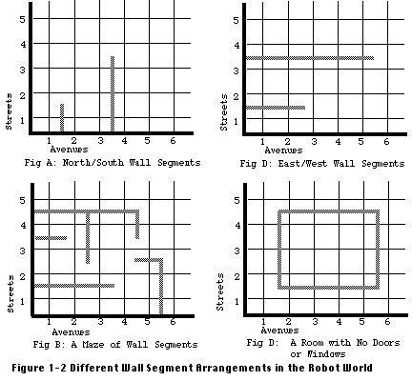
Indirect Considerations:
Robot World
Robots can not move past walls
Robots have limited energy supply
Robots can only move one unit at a time
A robots movement is restricted by its size and weight
These are environmental
constraints

Slide 12
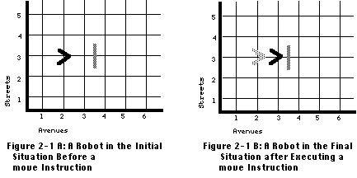
Programming: Moving a Robot
  roomba.move(); // lets take our first step
Direct studebot to pick up prize

Slide 13
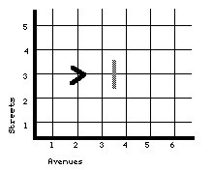
Programming:
Moving around a wall
// move around wall
  roomba.move();
  roomba.turnRight();
  roomba.move();
  roomba.move();
  roomba.turnLeft();
  roomba.move();
Direct studebot to pick up prize
Could have "programed" studebot to pick up prize (use chalkboard)

Slide 14
Programmatic Problems
Put up blind, move prize and walls, program studebot to pick up prize
// move around wall
  roomba.move();
  roomba.turnRight();
  roomba.move();
  roomba.move();
  roomba.turnLeft();
  roomba.move();
?
  May not work!!!
General solution requires an algorithm that uses decision making and repetition

Slide 15
Algorithms:
Solving Programmatic Problems
Turn right;
If facing a wall? then
turn left and if facing a wall? then
turn left and if facing a wall? Then
turn left and if facing a wall? Then
…
If not facing wall, move forward
The above describes a solution in pseudo-code

Slide 16
Algorithm in JS
roomba.turnRight();
if ( roomba.isFacingWall() ) {
roomba.turnLeft();
if ( roomba.isFacingWall() ) {
roomba.turnLeft();
if ( roomba.isFacingWall() ) {
…
Question: Where do we stop? What if walls were allowed to be diagonal? Can only write a finite number of lines of code!

Slide 17
Algorithm Compactness
roomba.turnRight();
while( roomba.isFacingWall() ) {
roomba.turnLeft();
}
roomba.move();
What is the potential problem with this code?

Slide 18
Algorithm Completion
num_turns_to_360 = 4; // four turns to 360
roomba.turnRight();
turns = 0;
while( roomba.isFacingWall() &&
turns++ < num_turns_to_360) {
roomba.turnLeft();
}
roomba.move();

Slide 19
Qualities of Algorithms
An algorithm must:
Be unambiguous
Executable (compact)
Terminate (complete)
Programs are just a series of algorithms!
Do Lab Exercises #2, #3

