Slide 1
ITM 352
HTML Forms,
Basic Javascript Form Processing

Slide 2
Some Inspiration!
We are essentially done with basic programming concepts!
  The tough stuff is putting it to use …
  From here on you will frequently have to do a lot of self-learning and experimentation. There is is rarely a single correct way.
  Fortunately there are tons of good references and examples online! But use for inspiration. Searching for a solution is often tedious and fruitless.
Some advice moving forward:
  Perseverance: never giving up, persistence
  Indomitable Spirit: never wanting to give up,
  Formula for success
    var Success = Perseverance + Indomitable_Spirit;
Indomitable Spirit
  “Get to your limit and see what’s on the other side” - Yoga
  "Try not. Do, or do not. There is no try." - Yoda
  “Suffering is optional” – Yoghurt
  “If you’re brain is hurting it just means you’re learning” – P²

Slide 3
What We Will Cover Today
Today we will explore HTML forms in some detail:
  Input types
  Compound types
  Details on <FORM>
  Some tips for processing HTML form elements

Slide 4
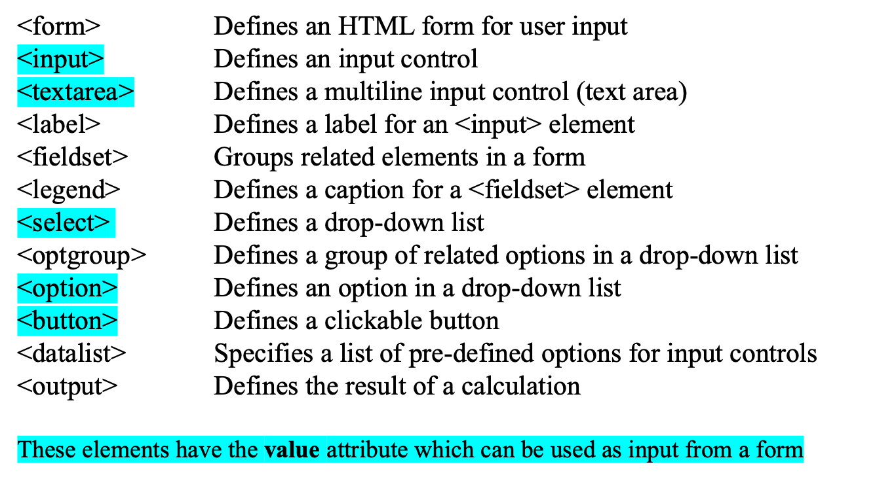
HTML Form Elements

Slide 5
HTML Form Elements
A form element is a page object that enables input or output in a browser page.
  Become DOM objects and can be manipulated with JS
  Form processing is how you respond to form element events such as onclick, onsubmit, onkeyup, etc.
Any <input> element will have a value attribute
Typically will have a name attribute. Like id but used to label form elements and does not have to be unique.
The most common form element is the input element:
<input type = 'type'
name = '<the name of this element>'
value = '<the value of the input>'
>

Slide 6
HTML input types
Here are the HTML form element input types you can use
<input type="button">
<input type="checkbox">
<input type="color">
<input type="date">
<input type="datetime-local">
<input type="email">
<input type="file">
<input type="hidden">
<input type="image">
<input type="month">
<input type="number">
<input type="password">
<input type="radio">
<input type="range">
<input type="reset">
<input type="search">
<input type="submit">
<input type="tel">
<input type="text">
<input type="time">
<input type="url">
<input type="week">

Slide 7
Compound Types
<select></select>
<textarea></textarea>
Compound types enable multiple inputs and/or outputs
Unlike input types, compound types always use a begin and end tag
  <textarea name='a_textarea’>
  Blah blab gab
  </textarea>

Slide 8
Text Area
Text Area provide a region of size row X cols to display and input text.
  Value is whatever is in the area when the submit button is pressed
<TEXTAREA name="a_test_area" rows="20" cols="40">
This is some text in the text area.
</TEXTAREA>

Slide 9
Select Boxes
Select boxes provide a drop down set of options for the user to choose from.
  Value is whatever the user chooses when the submit button is pressed
  If no value parameter is set, the value defaults to the label
<SELECT name="a_select_box">
<OPTION value="value_of_thing1">thing1</OPTION>
<OPTION value="value_of_thing2">thing2</OPTION>
<OPTION value="value_of_thing3">thing3</OPTION>
</SELECT>

Slide 10
Tips and Hints
Use single ' ' on the inside, " " around the outside or vice versa to avoid conflicting delimiters
Take advantage of JS by using for/while/foreach to generate multiple form elements and compound types
Quotes must be used around anything with spaces

Slide 11
Login No Server Example
<script>
function checkLogin() {
passwords = { "dport": "spaz", "kazman": "geek" };
var username = document.getElementsByName("username_textbox")[0].value;
var password = document.getElementsByName("password_textbox")[0].value;
if (passwords[username] == password) {
// window.location.href = "file:logged_in.html";
document.write(`Thank you ${username} for loggin in!`);
}
else { alert('incorrect login!'); }
}
</script>
<body>
<label for="username_textbox">Username:</label><input type='text' name='username_textbox'>
<br>
<label for="password_textbox">Password:</label><input type='password' name='password_textbox'>
<br>
<input type='button' name='submit_button' value='Login' onclick="checkLogin();">
</body>
Do Lab #1, #2

Slide 12
Form Parts
<form action = 'xxx' method = 'yyy’>
… <form elements> …
</form>
Used mainly to pass data to a server to access shared resources e.g. other web applications, files, data, operations, processing, etc.
  Browser can only access resources in the browser or from a server e.g. cannot load a file to generate an invoice from a file that enables users to select products. Everything would have to be done in
action is a URI to call on form submit
  If omitted or empty – current href
  ‘.’ – current href path, ‘..’ – parent of current path
method should be either POST or GET
  Determines the actions HTTP request of GET or POST
  If omitted or empty - GET

Slide 13
Action
An action is the form processor to use when the form is submitted
  Could by any URI (e.g. a protocol and path), usually a URL, e.g. http://www.somewebserver.com/myfile.html)
  Could be javascript: doThis();
  There are a variety of shorthand things e.g. 'myfile.html' is same as “current page’s document.location except myfile.html at end of path
Example if URL of current page is http://www.somewebserver.com/myfile.html
<form action = 'invoice.html'>
…
</form>
This will make an HHTP request to www.somewebserver.com with the path /invoice.html
The action only occurs when the form is submitted. This usually is done by adding a submit button to the form and the user presses it.
Note: You should always use quotes around the action in case it has special characters or spaces.

Slide 14
Method
The method can be either 'POST' or 'GET’.
  Data from the form will be packaged in the action as a GET or POST HTTP request
    The GET method will put the form data in a query string with the GET request
    POST method will put data in POST variables with the POST request
Must have a server process an POST HTTP request!
The npm Express package makes server processing a lot easier.

Slide 15
Submit Button
Usually you need to have a submit button to invoke a form's action, e.g.:
<input type = 'SUBMIT'
name = 'the name you want to appear in the POST/GET array'
value = 'the label in the button '
>

Slide 16
Login: Form Data No Server
<script>
function checkLogin() {
passwords = { "dport": "spaz", "kazman": "geek" };
var username = login_form["username_textbox"].value;
var password = login_form["password_textbox"].value;
if (passwords[username] == password) {
document.write(`Thank you ${username} for loggin in!`);
}
else { alert('incorrect login!'); }
}
</script>
<form action="javascript:checkLogin();" name='login_form'>
<label for="username_textbox">Username:</label><input type='text' name='username_textbox'>
<br>
<label for="password_textbox">Password:</label><input type='password' name='password_textbox'>
<br>
<input type='SUBMIT' name='submit_button' value='Login'>
</form>
Do Lab #3

Slide 17
GET method
<form method = 'GET'> … </form>
GET will package named form elements into a query string as part of the URL in the action request.
  On form submit creates an URL from the action which is a GET HTTP request is that URL is a server
  Good tool for error checking
  However, it is not secure because users can see the full contents of the request.
  Pages can be cached. Stored in history.
  Length restrictions. Data will be URI encoded (e.g. no spaces)
  Good for passing data between different servers or between pages without using a server
Notes:
Stored in history,

Slide 18
POST method
<form method = 'POST'> … </form>
POST will package named form elements into the body of an HTTP POST request
  POST will hide information being passed between pages in the address bar.
  More secure than GET
  Pages won't be cached. Not stored in history.
  No restrictions on size
  HINT: use GET for error checking; change to POST later when everything works

Slide 19
Login Self-Processing Page
<script>
let params = (new URL(document.location)).searchParams;
GET = {};
params.forEach(function (value, key) { GET[key] = value });
if(typeof GET['submit_button'] != 'undefined') {checkLogin();}
function checkLogin() {
passwords = { "dport": "spaz", "kazman": "geek" };
var username = GET["username_textbox"];
var password = GET["password_textbox"];
if (passwords[username] == password) {
location.href = './loggedin.html';
}
else { alert('incorrect login!'); }
}
</script>
<body>
<form action="" name='login_form' method="GET">
<label for="username_textbox">Username:</label><input type='text' name='username_textbox'>
<script> if(typeof GET['submit_button'] != 'undefined') {
login_form['username_textbox'].value = GET['submit_button'];} </script>
<br>
<label for="password_textbox">Password:</label><input type='password' name='password_textbox'>
<br>
<input type='SUBMIT' name='submit_button' value='Login'>
</form>
</body>
Do Lab #4

