Slide 1
ITM 352
Server Side Web Application Processing

Slide 2
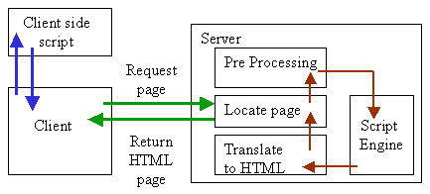
Recall: Dynamic Web Pages
Basic web pages are “static”
  They are set in advance, not created or modified at request time
Dynamic web pages are processed (at least partially) at request time by scripting code to create the output
  Allows changes at request time
  There are two opportunities for this
    on the client after request
      internal to Browser (API, plugin, etc.)
    (2) on the server after the file received
      Though a “gateway” (CGI) or the server itself (micro services)
(1)
(2)

Slide 3
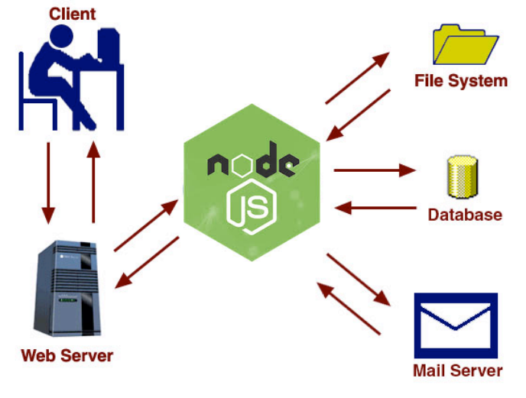
Server Side Processing – Why?
We understand that a Web Server is useful for enabling shared access to centrally maintained applications
  Applications can be accessed from anywhere through a browser
  Applications can be updated in a single location
  “Static file serving” - When the web server is used just to deliver requested files (HTML, images, CSS, JS, JSON, etc.)
We can easily process form data in the browser , but sometimes the application needs to access shared data or services
  The client (browser) cannot or should not have access
    Transactions in an order management system database
    Passwords for identifying and verifying a user before access
    Keeping track of a customers order or interests

Slide 4
Server Side Processing - How?
In a previous lab we made a simple server to respond to any web server request with the date
var http = require('http');
//create a server object:
http.createServer(function (req, res) {
console.log(req.headers); //output the request headers to the console
res.writeHead(200, {'Content-Type': 'text/html'}); // set MIME type to HTML
res.write('<h1>The date is:<script>document.write( Date.now() );</script></h1>'); //write a response to the client
res.end(); //end the response
}).listen(8080); //the server object listens on port 8080
console.log('Hello world HTTP server listening on localhost port 8080’);
Now we wish to do less simple things like serve a file and respond based on the kind of request (like a POST vs a GET).
This can get complicated so Node.js has a useful module called Express (see express.com) that makes this stuff easier

Slide 5
Lightning Introduction To Express
Must download express and run on server with Node.js
var express = require('express');
var app = express();
app.all('*', function (req, res, next) {
console.log(req.method);
next();
})
app.listen(8080);
Load the express module code
Initialize (start) express and get express object
Response to all HTTP request methods
Execute this function when there is a match (callback function)
* means match with “any” path in the HTTP request
Start the server and accept HTTP requests on port 8080

Slide 6
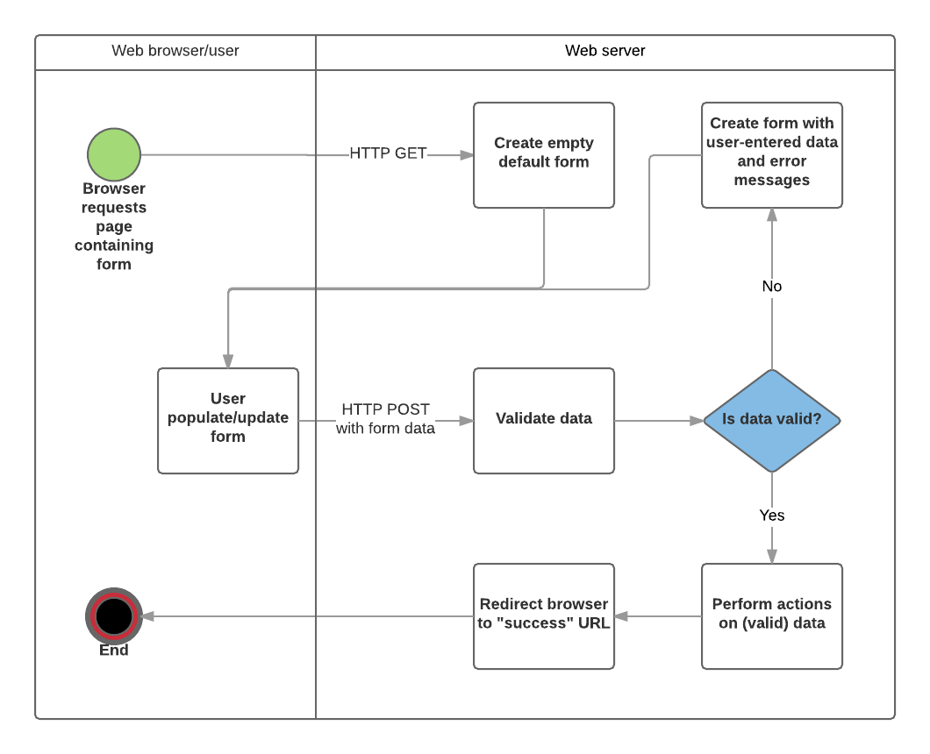
Server Side Form Processing

Slide 7
Server Side Processing – Why?
A common design for server side dynamic web pages is Model-View-Controller
  Model is data part.
  View is User Interface part.
  Controller is request-response handler.

Slide 8
Processing On Sever (POST or GET)
info_process_server.js must run on server with Node.js
var express = require('express');
var myParser = require("body-parser");
var fs = require('fs');
var app = express();
app.use(myParser.urlencoded({ extended: true }));
app.post("/process_name", function (request, response) {
// response.send(request.body);
let POST = request.body;
var contents = fs.readFileSync('./Views/display_login_template.html', 'utf8');
response.send(eval('`' + contents + '`')); // render template string
});
app.use(express.static(‘./public'));
app.listen(8080);
./Views/display_name_template.view
<body>
<div style="text-align:center">
Nice to meet you ${POST["firstname"]}
</div>
</body>
The Controller
The Model
./public/get_name.html
<form action="process_name" method=“POST”>
<input type=TEXT name="firstname">
<input type=SUBMIT>
</form>
The View

