Slide 1
ITM 352
Debugging

Slide 2
Debugging
Debugging is a “black art”.
What we will discuss:
  relation to testing
  why debugging is hard
  types of bugs
  process
  techniques
  tools
  avoiding bugs

Slide 3
Debugging and Testing
Testing and debugging go together like peas in a pod:
  Testing finds errors; debugging repairs them.
  Together these form the "testing/debugging cycle": we test, then debug, then repeat.
  Any debugging should be followed by a reapplication of all relevant tests, particularly regression tests. This helps avoid the introduction of new bugs.
  Testing and debugging need not be done by the same people (and often should not be).

Slide 4
Why Debugging is Hard
There may be no obvious relationship between the external manifestation(s) of an error and its internal cause(s)!! ☹
Cause and symptom may be in remote parts of the program. ☹
Changes (new features, bug fixes) in program may mask (or modify) bugs. ☹
Symptom may be due to a human mistake or misunderstanding that is difficult to trace. ☹
Bug may be triggered by rare or difficult to reproduce input sequence, program timing or other external causes.
☹ ☹ ☹ ☹ ☹ ☹ ☹ ☹ ☹ ☹ ☹ ☹ ☹ ☹ ☹ ☹ ☹ ☹ ☹ ☹ ☹ ☹

Slide 5
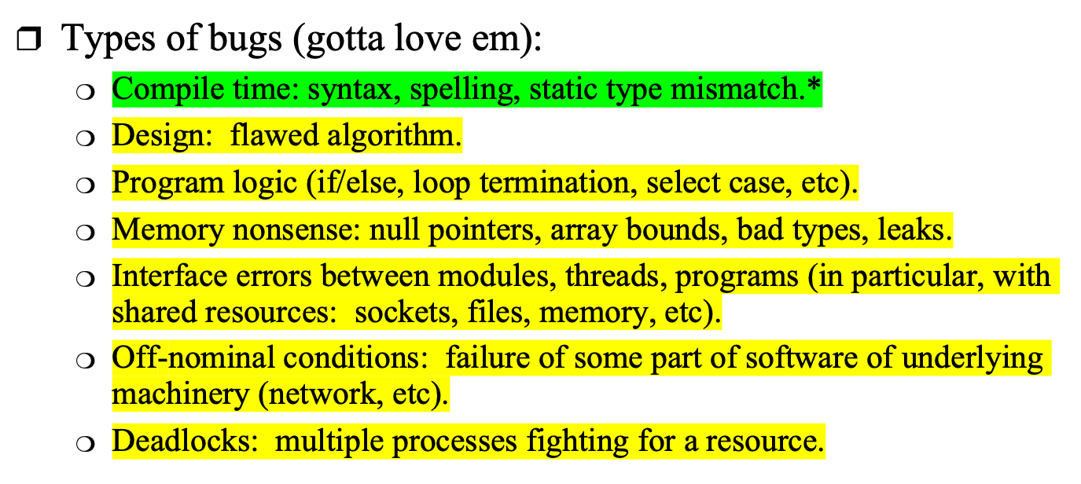
Types of Bugs

Slide 6
The Ideal Debugging Process
Identify test case(s) that reliably show existence of fault (when possible)
Isolate problem to small fragment(s) of program
Correlate incorrect behavior with program logic
Change the program (and check for other parts of program where same or similar program logic may also occur)
Regression test to verify that the error has really been removed - without inserting new errors
Update documentation when appropriate
Not all these steps need be done by the same person!

Slide 7

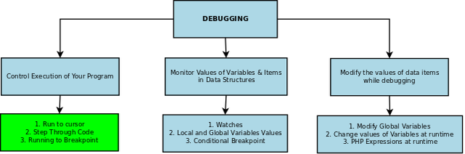
Debugging Techniques

Slide 8
Debugging Techniques, 1
Execution tracing
  running the program,
    look at error output to identify what and area of problem
    Look for stupid stuff first (e.g. missing }’s )
  print
  trace utilities
  single stepping in debugger
  hand simulation/walkthroughs
Avoiding bugs
  Comment as you code
  Programming conventions, format your code often!
  Reuse of known good code
  Modularization
  Test small pieces before combining them

Slide 9
Debugging Techniques, 2
Create test cases first
  Think through how things are supposed to work and establish a range of inputs and expected outputs
Interface checking
  check procedure parameter number/type (if not enforced by compiler) and value
  defensive programming: check inputs/results from other modules
  documents assumptions about caller/callee relationships in modules, communication protocols, etc
Assertions: include range constraints or other information with data.
Skipping code: comment out suspect code, then check if error remains.

Slide 10
Debugging with Print
How debugging with console.log() can be made more useful:
  print variables other than just those you think suspect
  print informative statements (e.g. `var x is ${x}` not just "hi!").
  use process.exit() (or window.stop) to concentrate on a part of a program.
  move print through a through program to track down a bug.
  You can comment/uncomment debugging statements as needed
  Set values of variables to test particular cases

Slide 11
Avoiding Bugs in the First Place
Coding style: use clear, consistent style and useful naming standards.
Document everything that is non-obvious, from architecture and interface specification documents to comments on code lines.
Hold code reviews.
Program defensively.
Use/implement exception handling liberally; think constantly about anomalous conditions.
Be suspicious of cut/paste.

Slide 12
Code Reviews
Primary programmer(s) for some piece of code presents and explains that code, line by line.
Audience of programmers experienced in language, code's general domain. Audience may also contain designers, testers, customers and others less versed in code but concerned with quality and consistency.
Review is a dialogue: audience pushes presenters to reevaluate and rationalize their implementation decisions.
Extremely useful: reviews often turn up errors, inconsistencies, inefficiencies and unconsidered exceptional conditions.
Also useful in familiarizing a project team with a member's code.

Slide 13
Exercise: Debug the Following
product = {name:'small gumball', price:'$0.34’};
tax_rate = 0.045;
total = product.price + product.price * tax_rate;
console.log(`A ${product.name} costs ${total}`);

Slide 14
Exercise 2: Debug the Following
prices = [5.95, 3.00, 12.50];
total_price = 0;
tax_rate = 1.08; // 8% tax
for (price of prices) {
total_price = price * tax_rate;
}
console.log(`Total price (with tax): ${total_price.toFixed(2)}`);

Slide 15
Exercise 3: Debug the Following
<script>
const urlParams = new URLSearchParams(window.location.search);
if (urlParams.has('Submit')) {
var value = "";
for(value of urlParams.values()) {
if (value = "Tyler") document.write("Found him!");
}
window.stop();
}
</script>
<form method="GET">
Name: <input name="name"><br>
Email: <input name="email" size="25"><br>
<input name="Submit" type="submit" value="Send GET Request">
</form>

