Slide 1
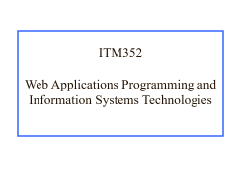
ITM352 Web Applications Programming and Information Systems Technologies

Slide 2
Welcome to MIS!
Information systems are not singular applications. They are:
Networked
Built on common frameworks
Integration of components
Integrated with other systems
End-user development
Non-centrally managed
MIS specialists are now “Business Technologists” who are expected to have skills in:
Determine application of technology to meet business needs
Maintain and enhance systems in use
Learn technologies quickly
Tactical and strategic management of technology

Slide 3
Welcome to ITM352
This course is about
Acquiring basic programming skills in an business context
Understanding why you need and can use basic programming skills and knowledge
Gaining hands-on experience in developing actual business relevant software applications
Experiencing real technology problems and solutions
Experiencing technology development issues
Gaining confidence in rapid self-learning of IS/IT technologies for addressing business technology problems

Slide 4
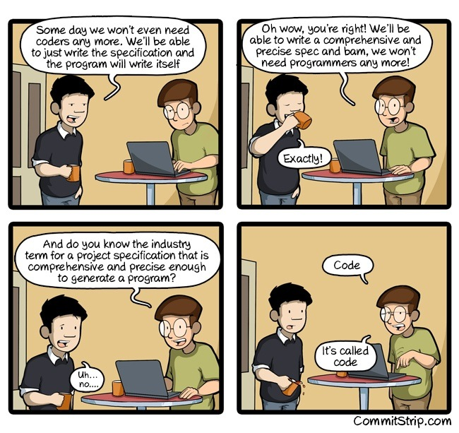
What, Me Code?

Slide 5
Misconceptions about ITM352
Only about programming
It’s a big part, but there's system admin, project mgmt, collaboration, ...
Understanding how software systems work
You must have a prior programming experience
The course is designed for those with no programming experience.
Doesn't require a serious and sustained time investment
Expect 9 hrs per week effort outside class
It's hard to get a good grade
Do all the work, on-time, without shortcuts
The Professor isn't willing to help when you have trouble
I enjoy most working 1-1 with you! Even by Discord/email

Slide 6
MIS and Programming
New students can sometimes be intimidated by the MIS major because they think it involves too much programming
“Will I have to program at this job?” “Programming is not for me.” “After this class, I will never code again.”
We stress having an understanding of programming because you will be acquiring, adapting, and implementing software technologies and will need to understand the technologies you will be working with, but you do not have to be an expert programmer to succeed in MIS!
You may not want to be a programmer. But programing skills are needed for many MIS tasks:
Database administration, management and reporting (Ex. SQL, Crystal Reports)
Networking (Ex. Firewall configuration)
End User Computing (Ex. VBA for Excel, SAS, R) – create a reporting spreadsheet, use of analytics packages
Web (Ex. Websites, Web apps) – create a reporting dashboard, customer data ingest page, custom UI widget, access control)
Data Management (Ex. Automated conversion/formatting, cleaning, checking, import/export, data security)
Test (Ex. Test scripts, security analysis)
Systems Tools / System maintenance / Cloud services
Data reporting (data analytics, data dashboards, data self-service)
Self-service information systems (intranet/extranet applications, HR services)
Discussion: Try asking ChatGPT “Why would an MIS major need to learn programming?” and
“Is it important for an MIS major to learn how to program?” and ”

Slide 7
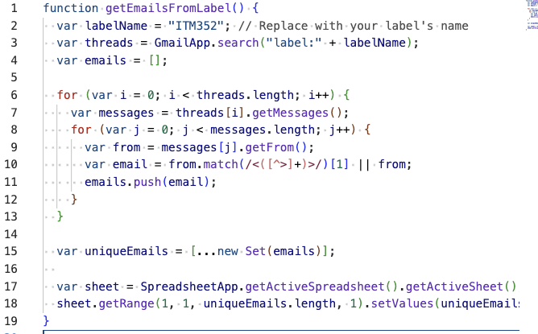
Examples
Problem: Need to get all unique email addresses in a Gmail for emails with a given label
Solution: Write a Google Apps Script (in Javascript) to scrape email addresses into a Google Sheet
Problem: Users mistakenly capitalize their user name when logging in to our website
Solution: Add Javascript to the HTML input in the login to automatically convert input to lowercase
Username: <input type="text" onkeyup="this.value=this.value.toLowerCase()" />
Go to https://texteditor.com/html and try this!
Discussion: Try asking ChatGPT “Give some examples of MIS oriented programming tasks”

Slide 8
The Programming Advantage
Programming skill will help you think more logically and effectively about technology and give you an advantage and more options in addressing technology issues.
You will have a deeper understanding of technology and ability to apply technology to solving business problems.
You will enjoy building something from “just a concept” and having the ability to construct an application or utility when needed.
You will be a technology leader better equipped to consult on work with technology acquisition and maintenance e.g. buy versus build, upgrade decisions, components and framework use, legacy versus replacement
Be able to make advanced use of the many application building tools
Wordpress, Facebook, BuildFire (and many other mobile app development tools), WIX, Weebly, etc.

Slide 9
The MIS Core
ITM 352
System Technology
ITM 353
Systems Management
ITM 354
Systems Information
Programming for business applications and services
Technical considerations of using and building systems
Development process
Inner workings of software
Mainly computer perspective
Bridging gap between people and technology
Technical thinking and problem solving
“Technology leadership”
Organizational considerations in building systems
Team technology leadership
Information management
Bridging gap between information and systems
Mainly developer perspective
Development management
Mainly organization perspective
Database systems
Solving data access and sharing problems

Slide 10
No kidding! Learning to Program is TOUGH!
Programming (coding) is a skill. You cannot “study” to obtain it. Mastery requires “training” and a lot of practice. As a skill, it is something that will always be incomplete and that you can always improve. It will be hard to see your improvement.
Training can be painful
Practice can be tedious
If you don’t practice, your skill will decay
You will often hit walls and be frustrated with your seeming lack of progress.
You have to learn to learn as you will never learn everything and technology is always rapidly changing and evolving
You have to learn persistence and not let mistakes and gaps in your knowledge hold you back or cause a melt down
BUT once you obtain basic competence, you will enjoy it and it’s valuable.
Discussion: Ask ChatGPT “Why is learning to program so hard?”

Slide 11
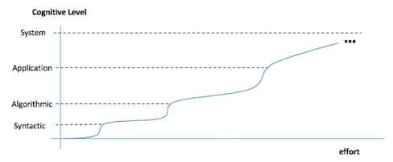

Stages of Programming Skill
Your programming skill will increase with the effort you put in
It will not be quick
It will not be “linear”
You will hit walls and plateaus
It will rarely feel easy, you will always feel you need to know more
You will go from not-able to able without even realizing it

Slide 12
What Will We Do?
You will work very hard to obtain programming web application competency in an MIS context (not ICS).
Constructing web applications such as e-commerce systems
Only an example of MIS programming that is compatible with your business focus
Front-end applications “client-side” development with HTML, CSS, Javascript
Back-end services “server-side” dev with Javascript and Node.js
All good stuff, but the focus is on MIS programming skill and technology management
The aim is to get you on a path as a “technologist”, particular technologies, frameworks, programming languages, etc. are just tools to help achieve business IS goals and capability
We will frequently discuss technology issues beyond programming such as good/poor system design, buy or build?, requirements management, etc.

Slide 13
Is 352 Still Relevant?
Why Web application development?
Most applications are web applications
Business rely on web applications for internal and external IS
Try asking ChatGPT “Why would an MIS major need to learn web application development?” and “Why is it valuable for an MIS major to learn web application development?”
Why Javascript and Node.js?
The leading edge of web application technologies
10,000’s of available components, frameworks, and microservices!
You can build totally awesome things!
https://blog.teamtreehouse.com/7-awesome-things-can-build-node-js
Try asking ChatGPT “What technologies are most prevalent in web applications?”

Slide 14
This is Education, not “Training”
This is not a follow-the-steps or memorize this stuff course.
You strive for fundamental understanding and insight
We are trying to build your technical problem-solving skills.
Not ”how-to” recipes. You rarely see the same problem twice
You will never know enough. There’s always something you will now know and things change fast.
Learn how to learn technical stuff fast
A ton of self-teaching
You will always be challenged.
Confidence is critical
Technical problem solving is a skill that you get good at only through practice
Everyone will hit a wall (or many walls) at some point. Realise these are opportunities, not obstacles
Ask ChatGPT “What's the difference between education and training?”

Slide 15
Class Objectives
Become familiar with basic programming
Note: you must demonstrate by the end of the course that you have acquired rudimentary programming skills to be successful in ITM352
Understand basic systems development concepts, technology solutions, development management
You will learn more on this in ITM 353
Getting “under the hood” of web applications
Not just programming, but networks, client-server architectures, components, frameworks, configuration, security, user interface design, database, system quality, match to use, testing, maintenance, …
You will go into depth for many of these topics in later MIS courses (database - ITM 354, security - ITM 481)

Slide 16
Not-Brief Syllabus
See the course website:
https://dport96.github.io/ITM352/schedule/#
In particular, pay attention to:
https://dport96.github.io/ITM352/modules/

Slide 17
Requirements
Textbooks:
No required book, but some references you will want to use are
https://dport96.github.io/ITM352/morea/010.introduction/reading-references.html
Software needed:
Web browser (Chrome preferred but Firefox or Safari are ok)
VS Code (free from Microsoft)
Node.js (free from OpenJS Foundation)
Cyberduck (free from https://cyberduck.io/)
Other misc. tools, components, and packages as needed and desired
Reasonable computer to use
See the laptop requirements on the course web-site
Mac’s are fine, but some things may appear a bit different than what you see in class and in the instructions

Slide 18
Assignments
Three (3) major programming assignments
See class schedule for approximate locations in class
Work first individually, and later in the semester in groups
Groups will be randomly assigned or perhaps self-selected
Confidential evaluation of team members (including yourself) required for group assignment
Always must be “deployed” on class server (I will explain this later). Code available in GitHub repository, screencast demo and explanation of code.
Workouts of the Day (WODs)
There will be a number of small programming assignments to build your skill. You get out what you put in to these!
You are expected to record a screencast and time yourself and rework until you can complete before the DNF time.
These are an important self-check on your skill development. We do not assess your work. You get credit for just doing them. You only cheat yourself from needed skills if you skimp on these.

Slide 19
Exams
None!
The labs and assignments are hard enough
However you will be expected to work on the lab after (or during) a screencast to be sure you are prepared for class
The labs will be checked and graded
You will not be able to follow along in class if you have not started work on the lab
Labs must be completed and submitted on time. No late labs will be accepted.

Slide 20
Grades
See the course web-site for the grade breakdown
Approximate scale:
>= 90% A
>= 80% B
>= 70% C
Anyone can get an "A”
But you need to earn it. Get help early and often when you need it.
Do all the work, do not try to take short cuts
Your progress will be continuously posted on the class web site.
Do not expect me or the TA to know if you are having trouble.
Get help before something is a major problem. It will not be possible to “catch up” or “make up” at end of the semester
If you are not doing as well as you would like, there are always opportunities for extra credit.

Slide 21
Class Flow
Lectures are generally available on the class web page and are viewed at home prior to class
Skipping lectures will make the in-class labs very difficult to follow
* Do not expect to be able to learn and apply the concepts during class *
Readings are mandatory and to be done at home prior to class
These will be important reference materials for you!
There will usually be a quiz on the readings due before class
Most classes will be “follow along” labs with the professor (mini-lecture with lab exercises) , class exercises, or major assignment “workshops”
You will get little “lecture” (except this class of course!)

Slide 22
How to do Well in ITM352
Attend class, ask lots of questions, get help when you need as soon as possible
Do all assignments early (especially WODs!!!)
Best advice (thanks mom!):
Go to class and pay attention
Always ask questions when they occur to you
Explore; don’t be afraid to play; share your insights with others
Get help when you are stuck. Don’t worry about “holding the class up”
Find something interesting about the material
Go above and beyond what is asked for (get creative!)
Always take advantage of "extra credit" opportunities
Have (or fake) confidence, ditch "worry"
And (duh) do what is asked of you without trying to shortcut
Don’t try to have a full-time job this semester
Dedicate at least 9 hours per week just for ITM 352

Slide 23
Course Policies
Lateness
Programming assignments and labs will not normally be accepted late unless arrangements are made in advance of due date.
This is because subsequent material invariably builds on previous material
e.g. a lab exercise may refer to a previous lab, WOD, or assignment so you will need to have these done in order to do the exercise

Slide 24
Course Policies
Cheating
It’s always ok to get help. But turning in someone else's work as your own is robbing you of the experience you need to be successful.
There is often a lot of confusion about using code from labs, the class website, or online resources. This is generally OK so long as you make CLEAR reference to where this code came from and you indicate you understand what you are using (usually by lots of comments in the code)
In general it is NOT OK to use another student's code, an entire project or system, or have someone write code for you.
On programming assignments: zero on first offence, notice sent to deans office
Second offence (of any kind): "F" in course, action by Dean’s office
Bottom line: Don't do it! It's never worth it. Since you are building a skill here you only end up cheating yourself. There also really is never any need. We will help you achieve success if you put in a honest effort.

Slide 25
Use of Generative AI
You will be tempted to use generative AI such as ChatGPT, Bard, and CoPilot to help you in this class
Our policy on this is “go for it” and we encourage you to find and use these excellent tools!
We only ask that you be “smart” about use of these tools to assist your learning and not to avoid learning difficult things
Use to get ideas on what code to use or examples of how to do something
Use to help communicate or refine your answers to lab questions
Use to help debug or find problems in your code
Use to help document/comment your code
Use to explain concepts you may be confused about
Blind copy and paste of answers from generative AI is strongly discouraged and will often result in poor quality answers
The tools do not know the context of what you are trying to address. Trying to add this in is often more effort than just addressing the issue on your own
Be careful that these tools often provide incorrect or not contextually aware answers. Frequently answers are total fabrications and wrong!
If you use something to answer a lab question, read and edit the answer carefully and make sure you fully verify the correctness and completeness of the answer.
If you use something from ChatGPT (or similar thing), always provide a note of what you used and how you used it
Ex. “Used ChatGPT “write Javascriopt to convert HTML input to lowercase on keypress”
This will not only help you, but will also help us understand how best to make use of these tools and what their limitations are and better enable us to help you “live”
Avoid embarrassing yourself by not acknowledging use of AI. It’s very easy to tell when AI was used.

Slide 26
How to Fail ITM352
Some examples of things that will make you sad:
Submitting someone else's work
Copying someone else’s work
Not submitting work
Acquiring sample assignment/quiz solutions beforehand
Not providing sufficient referencing for use of others code or generative AI
Enabling/encouraging anyone to do the above
Any form of cheating will not be tolerated
It's simply not worth it.
If you are struggling, I will help you
I am a "softie" when I see honest effort; but laziness, apathy, irresponsibility, or cheating really upset me ☹

Slide 27
How Class Will Work
WODs
Mandatory! Must be submitted to Laulima and GitHub
To receive WOD credit you must complete it before the DNF (Did Not Finish time) and before the due date
You record your work and finish time, but it’s still credit/no-credit. No judgment on quality ☺
During class you will work on lab exercises and assignments
We may not complete all material in scheduled class time
Whatever is not completed will be covered in the next class session (we go at the natural pace of the class) OR give as an assignment to be worked on at home.
Labs generally are due only after they are completed in class.

Slide 28
How Class Will Work (cont.)
In-class labs
You must do the readings and view the lecture screencasts before class
You will take a short quiz to ensure you are ready for the lab in class.
Your interaction during class is critical. I will periodically bug people with questions. Your answers do not have to be correct. I use this to see how the class is doing and set the pace, not to test you!
After a lab is completed (or you are asked to complete it at home) it must be submitted before the next class.
Late labs receive no credit.
There are no “make up” labs. If you miss class, you must do the lab on your own before it is due.

Slide 29
Jobs and Getting Help
Your job
Attend class
Work all the assignments on Laulima on time
Work together with your classmates and help each other out. But do this with integrity. Make sure everyone is learning
Be respectful and have high integrity for everything you do in 352
Instructor job
Educate (not train) you in programming and web application development, software technology
Be responsive to your needs and help you through problems
Provide opportunities for your learning and advancement
TA
Primarily grading, not teaching
Help structure and manage course logistics
We want to see each and everyone of you succeed in ITM352 and to enjoy the experience. But this is entirely up to you!
Please come see me or a TA right away when you need help.
DM in Discord (best), Phone/Zoom, Office hours, After class, By appointment
We will make time to help you!!! Always!!!
But you have to ask. I will not monitor you.
Use Discord over email as your primary means of communication and getting/giving help. Let’s all signup now!

Slide 30
Keep in Mind
The ITMA club and I are here to help you succeed in ITM352 (meeting the class objectives)
Please come see me, the TA, or an ITMA club member right away when you need help.
Phone
Office hours
After class
By appointment
We will make time to help you!!! Always!!!
But you have to ask. I will not monitor you.
Avoid getting help from previous 352 students, friends, or anyone outside our class. They do not know exactly what we are doing or how best to help you
We encourage you to work together and help each other out
But do this with integrity. Make sure everyone is learning.
We want to see each and everyone of you succeed in ITM352 and to enjoy the experience. But this is entirely up to you

Slide 31
Final Words…
Programming is not a memorization subject. You must immerse yourself in it until you know the fundamental process.
Practice, practice, practice, is what WORKS
You will continually be challenged and be frustrated with your lack of progress
Ask questions, practice, get help until you fully comprehend each concept, then you assuredly will do very well.

Slide 32
More Final Words…
You do not have to be a stellar programmer to do well in this course, you simply need to be proficient in the fundamental practice of programming.
ITM352 will take up significantly more time than other classes. You will be well rewarded for the effort, but you must plan for this effort.

Slide 33
Bottom Line!
You want to have competent and confident programming skills and become a technology leader?
Do a whole lot of programming!

Slide 34
Next Class…
Always bring your laptop to class!!!!
Go through the WADT module (lets take a look now)
We will cover the experiential learnings in class so you do not need to do these at home (but you can preview these if you wish)
The readings are critical for these and will ask you to download and try to install VS Code and Node.js
Work on E0

Slide 35
E0: Create an MIS Portfolio
To get you started with web application development you will build a Professional MIS Portfolio
You will use this to introduce yourself to the class and start building your MIS professional for your future!
There are a lot of technical details and new things to learn about. This is to help jump start you on this. You are not expected know everything. Expect to be baffled and lost!
You will write a number of short essays about your experience in 352 and your assignments.
These are expected to be personal BLOG entries linked to your portfolio

Slide 36
E0 Technologies
GitHub, GitHub pages
- Get an account, understand repositories, GitHub as a web server
JSON
- Notation to organize information as objects and lists
YAML
- Configuration notation
Markdown
- Simplified page markup that translates into HTML
Techfolios
- Template for portfolio page
Let’s get started on E0 together. You will need to complete this at home.

