Slide 1
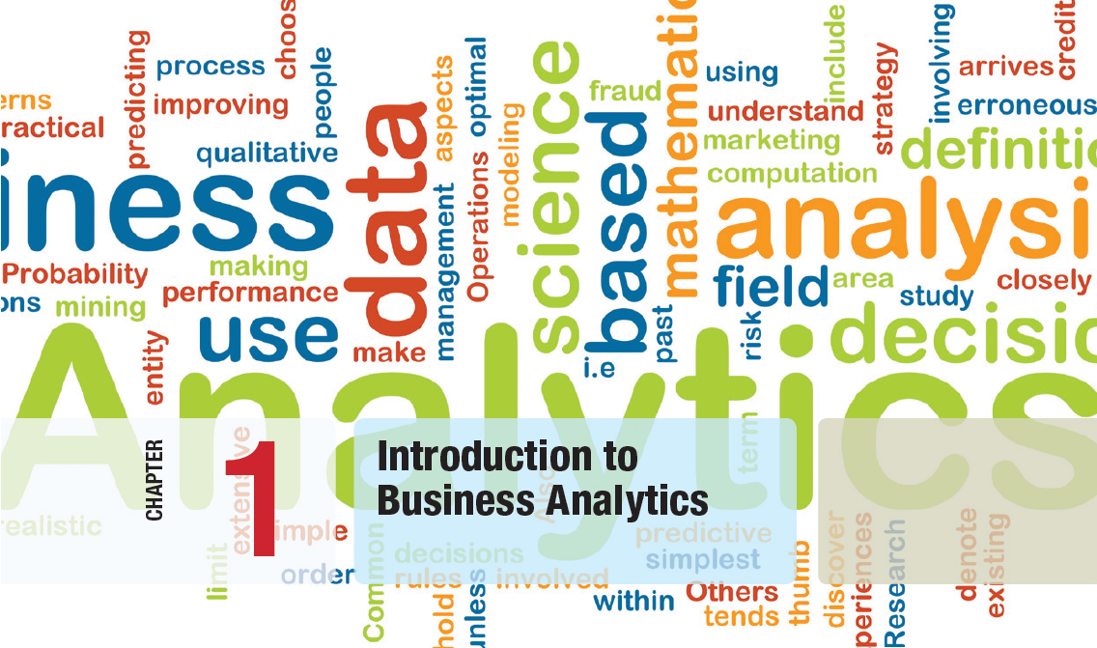

Slide 2
Introduction Topics
Class Logistics
What is Business Analytics?
Evolution of Business Analytics
Scope of Business Analytics
Data for Business Analytics
Decision Models
Problem Solving and Decision Making
Fun with Analytics – Stats Review Case Studies
Homework!

Slide 3
Class Logistics
Grading breakdown:
Exercises: 20%
Case Study Reports: 30%
Final Project: 30%
Class participation: 15%
Contemporary business analytics report: 5%
This is not a data science or engineering course. It is hands-on, applied data analytics.
Very little theory or development will be presented. We will make heavy use of tools to perform our analytics.
It is not a training course for the latest and greatest tools (e.g. Radoop, Microsft BI, Tablau). However this course should prepare you to quickly learn and make use of such tools.
We will
Review and learn basic concepts needed to perform data analytics
Study data analytics for a variety of business cases
Utilize data analytics on a real business problem (from work, a ”client”, or a problem of interest to you)

Slide 4
What We Will Do
No textbook or course syllabus coherently captures DA
Vast area with rapidly increasing and evolving methods, tools, applications.
Can’t learn it all! Need to learn how identify what you need, quickly learn, and confidently apply
You will research what is currently most important or useful
Cases and exercises will be business focused in a variety of areas of Finance, Accounting, Marketing, MIS, and Management
First some fundamentals
Review of needed statistics
Data types, quality and integrity, data presentation
Descriptive statistics – distributions, summary stats, summary tables, basic visualization
Inferential stats – theoretical distributions, confidence intervals, hypothesis testing, linear regression
Basic decision theory
Modeling and model analysis – descriptive, predictive, prescriptive
Statistical learning problems, basic methods, performance assessment
Let’s take a look at the draft schedule!

Slide 5
Stuff
In class:
Class exercises
Case studies
Current Topics Presentations
Tool Tutorials
Outside class
Read about methods and tools
Work on project
Case study exercises
Case study prepararion

Slide 6
Tools Needed for Now
Excel or other suitable spreadsheet (e.g. Google Sheets)
https://www.thebalance.com/free-spreadsheet-programs-1356337
R Statistical Processing
https://cran.cnr.berkeley.edu/
We will install some useful R packages such as Rattle which may require some additional software such as XQuartz
R-Studio
https://www.rstudio.com/products/RStudio/#Desktop
Optional, may be useful
Rexcel
http://rcom.univie.ac.at/
Megastat, PHStat

Slide 7
Why Excel and R?
There are many excellent tools for data analytics.
We don’t have time too look at them all, even the most popular ones.
Despite the marketing hype, there is no “one” tool that magically makes data analytics easy and accessible.
R is very mature, highly used, and supports everything we might want to do this semester
Basically, R and Python are “staples” for business data analytics. Both are hugely popular, well-supported (and free!)
Python is more popular in data engineering/science and operations while R is more popular with research and reporting. Both areas are utilized heavily in business!
R is good foundation
If you are good with R people believe you can pick up other tools easily (even Python analytics).

Slide 8
Business Analytics?
Business Analytics is the use of:
data,
information technology,
statistical analysis,
quantitative methods, and
mathematical or computer-based models
to help managers gain improved insight about their business operations and
make better, fact-based decisions.

Slide 9
Data Analytics What?
A very “noisy” area currently
So many terms – Business Intelligence (BI), Big Data, Machine Learning, Data Science, Data Mining, Business Analytics, …
Our task is to cut though this noise and find out what is useful
Data Analytics is a loosely defined discipline consisting of:
Data “Wrangling”
Data Modeling
Statistics
Statistical (”Machine”) Learning
We will discuss all of these areas today

Slide 10
What is Business Analytics?
Business Analytics Applications
Management of customer relationships
Financial and marketing activities
Supply chain management
Human resource planning and management
Pricing decisions
Sport team game strategies
Market research
Consumer behavior/profiling
Business operations management and optimization

Slide 11
What is Business Analytics?
Importance of Business Analytics
There is a strong relationship of BA with:
- profitability of businesses
- revenue of businesses
- shareholder return
BA enhances understanding of data
BA is vital for businesses to remain competitive
BA enables creation of informative reports

Slide 12
Evolution of Business Analytics
Operations research
Management science
Business intelligence
Decision support systems
Desktop computer software “desktop analytics”
“Cloud” analytics*
AI analytics**
*rapidly emerging area
** immature and not established in business but great interest

Slide 13
Scope of Business Analytics
Descriptive analytics
- uses data to understand past and present
Predictive analytics
- analyzes past performance
Prescriptive analytics
- uses optimization techniques
These perspectives are not “orthogonal” and highly interdependent. Typically, analytics will be a mix of these.
The purpose of identifying these is that different techniques and methods tend to apply

Slide 14
Scope of Business Analytics
Example 1.1 Retail Markdown Decisions
Most department stores clear seasonal inventory by reducing prices.
The question is:
When to reduce the price and by how much?
Descriptive analytics: examine historical data for similar products (prices, units sold, advertising, …)
Predictive analytics: predict sales based on price
Prescriptive analytics: find the best sets of pricing and advertising to maximize profit

Slide 15
Scope of Business Analytics
Analytics in Practice: Harrah’s Entertainment
Harrah’s owns numerous hotels and casinos
Uses analytics to:
- forecast demand for rooms
- segment customers by gaming activities
Uses prescriptive models to:
- set room rates
- allocate rooms
- offer perks and rewards to customers

Slide 16
Business Analytics Process
1. Business understanding
2. Data understanding 3. Data preparation 4. Modeling
5. Evaluation
6. Deployment
* People often use different terms and different breakdowns, but the fundamental process is the same

Slide 17
Data for Business Analytics
DATA
- “raw” collected facts and figures
DATABASE
- “source” or repository of data. Usually, a collection of computer files possibly managed by a CMS or DBMS
INFORMATION
- comes from analyzing data, “processed data”

Slide 18
Data for Business Analytics
Examples of using DATA in business:
Annual reports
Accounting audits
Financial profitability analysis
Economic trends
Marketing research reports
Operations management performance
Human resource measurements

Slide 19
Data for Business Analytics
Metrics are used to quantify performance or quality.
Measures are numerical values of metrics.
Discrete metrics involve counting
- ex. Categorical variable {“on time”, “not on time”}
- Metric: number or proportion of on time deliveries
Continuous metrics are measured on a continuum
Examples:
- delivery time
- package weight
- purchase price

Slide 20
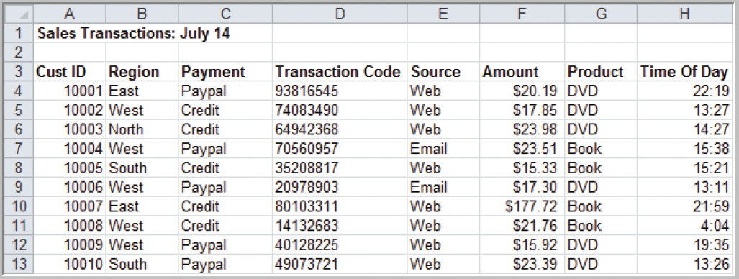
Data for Business Analytics
Example 1.2 A Sales Transaction Database File
Records
Figure 1.1
Entities
Fields or Attributes
“Standard Tabular Format” – “Data Frame”

Slide 21
Data for Business Analytics
Four Types Data Based on Measurement Scale:
Categorical (nominal) data
Ordinal data
Interval data
Ratio data
You know these! But we will review anyway.
We type the data to help ensure quality and fitness of use for particular analytics
E.g. Don’t use mean to summarize CT for ordinal data (such as Likert scale and number of starts product ratings)

Slide 22
Data for Business Analytics
Categorical (nominal) Data
Data placed in categories according to a specified characteristic
Categories bear no quantitative relationship to one another
Examples:
- customer’s location (America, Europe, Asia)
- employee classification (manager, supervisor,
associate)

Slide 23
Data for Business Analytics
Ordinal Data
Data that is ranked or ordered according to some relationship with one another
No fixed units of measurement
Examples:
- college football rankings
- survey responses
(poor, average, good, very good, excellent)

Slide 24
Data for Business Analytics
Interval Data
Ordinal data but with constant differences between observations
No true zero point
Ratios are not meaningful
Examples:
- temperature readings
- SAT scores

Slide 25
Data for Business Analytics
Ratio Data
Continuous values and have a natural zero point
Ratios are meaningful
Examples:
- monthly sales
- delivery times

Slide 26
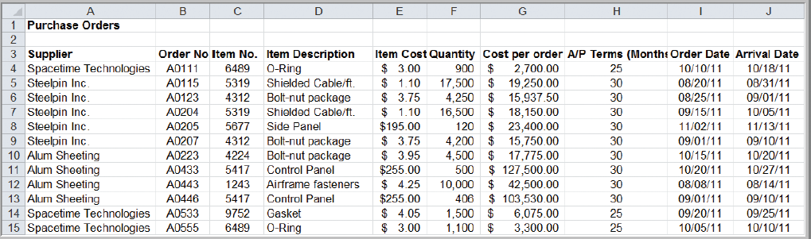
Data for Business Analytics
Example 1.3
Classifying Data Elements in a Purchasing Database
Figure 1.2

Slide 27
Data for Business Analytics
Example 1.3 (continued)
Classifying Data Elements in a Purchasing Database
Figure 1.2
Ratio
Ratio
Ratio
Ratio
Categorical
Categorical
Categorical
Interval
Interval
Categorical

Slide 28
Decision Models
Model:
An abstraction or representation of a real system, idea, or object based on simplifying assumptions
Captures the most important features
Can be a written or verbal description, a visual display, a mathematical formula, or a spreadsheet representation
"Essentially, all models are wrong, but some are useful."
--- Box, George E. P.

Slide 29
Hierarchy of Modeling Skills
Learning “modeling” versus learning “about models”
You
Business analytics (mgt science) tools and applications
Advanced modeling skills
Basic modeling skills
Numeracy and logical skills

Slide 30
Models provide a bridge
Simplified abstraction of reality
Capture essence of problem
Model
Problem
Excel Workbook
(calculations)
Interpretation
Decisions
“Real”
World
Analysts
World
From Monahan, G., “Management Decision Making”, Cambridge University Press, 2000

Slide 31
Characteristics of Models
Models are usually simplified versions of the things they represent
A valid model faithfully represents the relevant characteristics of the object or decision being studied
"Essentially, all models are wrong, but some[times] are useful."
--- Box, George E. P.

Slide 32
Benefits of Modeling
Economy - It is often less costly to analyze decision problems using models.
Timeliness - Models often deliver needed information more quickly than their real-world counterparts.
Feasibility - Models can be used to do things that would be impossible.
Models give us insight & understanding that improves decision making.
They are not magic and are only as good as the assumptions they re based on are valid

Slide 33
The Modeling Approach to Decision Making
A model is representation of a concept built on (usually simplifying) assumptions
Everyone uses models to make decisions.
Models are as valid as their assumptions and to the degree they are useful
“All models are wrong, but some are useful.” - George Box
Types of models:
Mental (arranging furniture)
Visual (blueprints, road maps)
Physical/Scale (aerodynamics, buildings)
Mathematical (what we’ll be studying)

Slide 34
The Psychology of Decision Making
Models can be used for structurable aspects of decision problems.
Other aspects cannot be structured easily, requiring intuition and judgment.
Caution: Human judgment and intuition is not always rational and rarely unbiased!
Let’s take a look at how decisions may be biased.

Slide 35
Why do we model for decision making?
Building model forces detailed examination and thought about a problem
structures our thinking
must articulate our assumptions, preconceived notions
Model building may illuminate solution without actually using the model
Searching for general insights
form of relationship between key variables involved in decision
importance of various parameters on decisions
Looking for specific numeric answers to a decision making problem
If we add 1 lab tech between 7a-3p, how much reduction can we expect in test turnaround time?
Find the best way to do something
What price for our product will maximize profit?
Notes:
To build a model of a system, you really need to dig into the system from multiple angles and really understand it.

Slide 36
Good Decisions vs. Good Outcomes
Good decisions do not always lead to good outcomes...
A structured, modeling approach to decision making helps us make good decisions and reduce bias, but can’t guarantee good outcomes.

Slide 37
Decisions & Outcomes
 |  | Outcome Quality
 |  | Good | Bad
Decision Quality | Good | Deserved Success | Bad Luck
 | Bad | Dumb Luck | Poetic Justice
Decision Risk: The potential loss from a bad quality decision
The loss is the difference between the outcome of the best good quality decision and the outcome of the bad quality decision
@ What is the main problem with bad quality decisions we are trying to avoid by using models?

Slide 38
Decision Models
Example 1.4 Three Forms of a Model
The sales of a new produce, such as a first-
generation iPad or 3D television, often follow a
common pattern.
Sales might grow at an increasing rate over time
as positive customer feedback spreads.
(See the S-shaped curve on the following slide.)
A mathematical model of the S-curve can be
identified; for example, S = ae^{bect}, where S is
sales, t is time, e is the base of natural logarithms,
and a, b and c are constants.
1-23

Slide 39
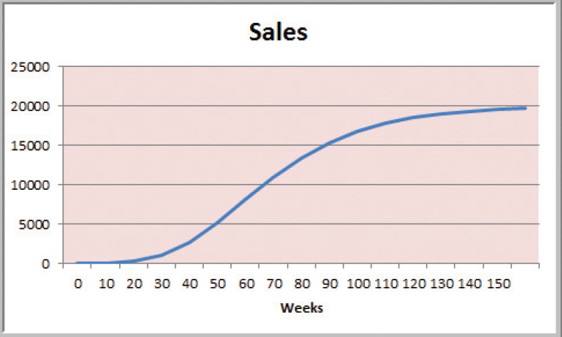
Decision Models
Figure 1.3

Slide 40
Decision Models
A decision model is a model used to understand, analyze, or facilitate decision making.
Types of model input
- data
- uncontrollable variables
- decision variables (controllable)
Types of model output
- performance measures
- behavioral measures

Slide 41
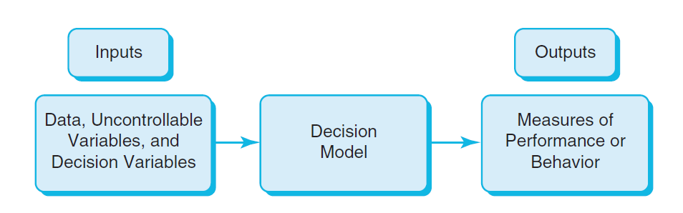
Decision Models
Nature of Decision Models
Figure 1.4

Slide 42
Decision Models
Example 1.5 A Sales-Promotion Model
In the grocery industry, managers typically need to know how best to use pricing, coupons and advertising strategies to influence sales.
Using Business Analytics, a grocer can develop a model that predicts sales using price, coupons and advertising.

Slide 43
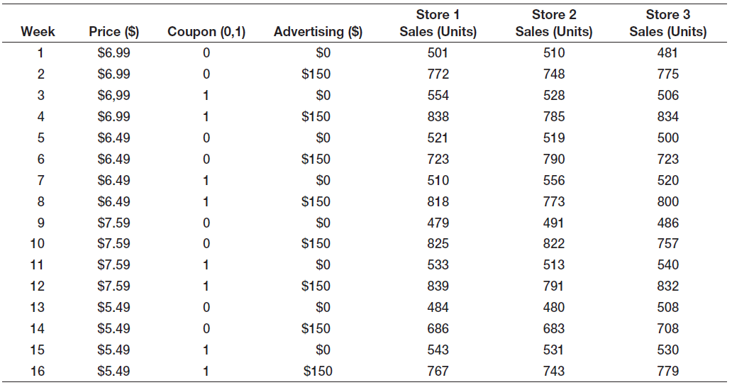
Decision Models
Sales = 500 – 0.05(price) + 30(coupons)
+0.08(advertising) + 0.25(price)(advertising)

Slide 44
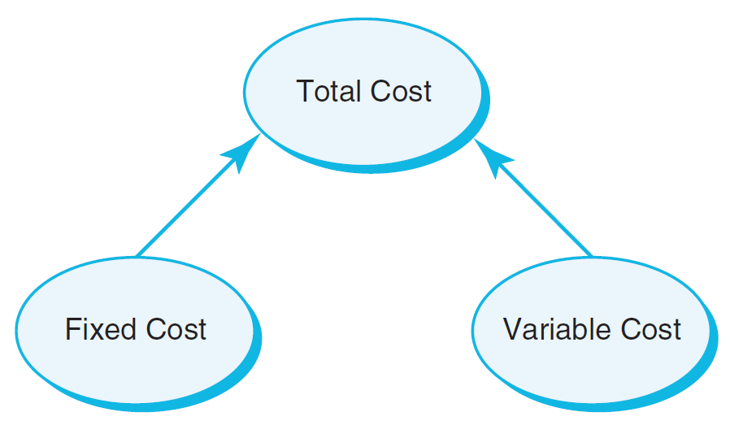
Decision Models
Descriptive Decision Models
Simply tell “what is” and describe relationships
Do not tell managers what to do
Example 1.6 An Influence Diagram for Total Cost
Influence Diagrams visually show how various model elements relate to one another.
Figure 1.5

Slide 45
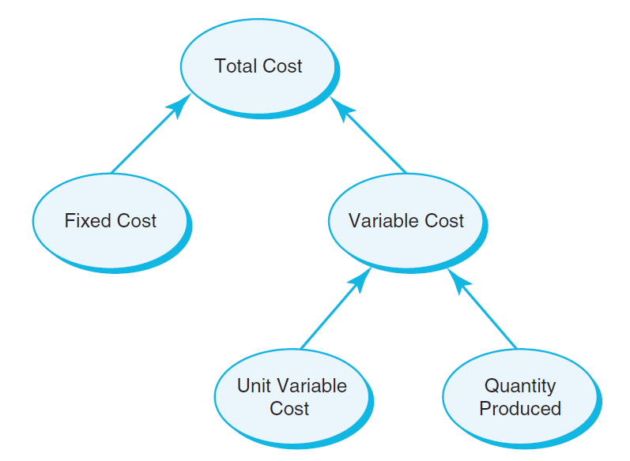
Decision Models
Example 1.7 A Mathematical Model for Total Cost
TC = F +VQ
TC is Total Cost
F is Fixed cost
V is Variable unit cost
Q is Quantity produced
Figure 1.6

Slide 46
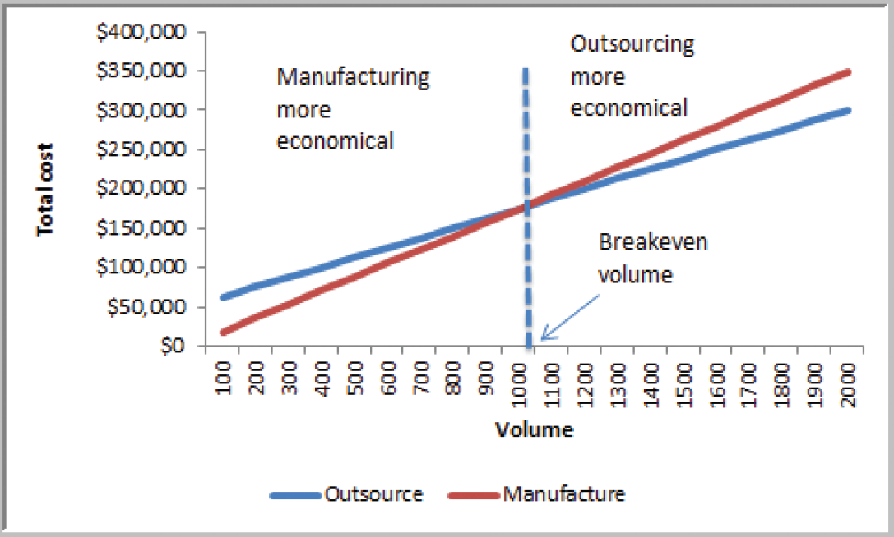
Decision Models
Example 1.8 A Break-even Decision Model
TC(manufacturing) = $50,000 + $125*Q
TC(outsourcing) = $175*Q
Breakeven Point:
Set TC(manufacturing)
= TC(outsourcing)
Solve for Q = 1000 units
Figure 1.7

Slide 47
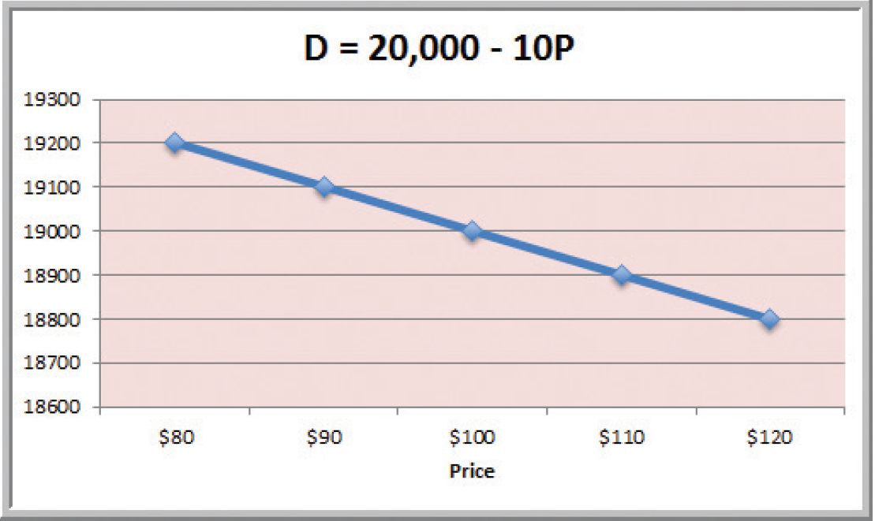
Decision Models
Example 1.9 A Linear Demand Prediction Model
As price increases, demand falls.
Figure 1.8

Slide 48
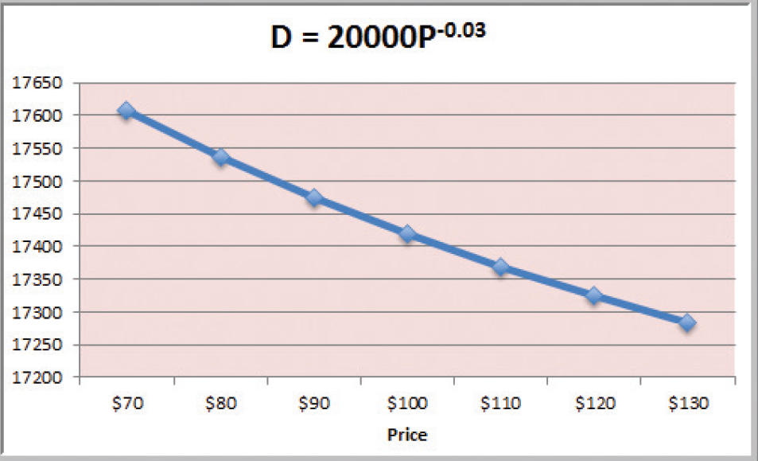
Decision Models
Example 1.10 A Nonlinear Demand Prediction Model
Assumes price elasticity (constant ratio of % change in demand to % change in price)
Figure 1.9

Slide 49
Decision Models
Predictive Decision Models often incorporate uncertainty to help managers analyze risk.
Aim to predict what will happen in the future.
Uncertainty is imperfect knowledge of what will happen in the future.
Risk is associated with the consequences of what actually happens.

Slide 50
Decision Models
Prescriptive Decision Models help decision makers identify the best solution.
Optimization - finding values of decision variables that minimize (or maximize) something such as cost (or profit).
Objective function - the equation that minimizes (or maximizes) the quantity of interest.
Constraints - limitations or restrictions.
Optimal solution - values of the decision variables at the minimum (or maximum) point.

Slide 51
Decision Models
Example 1.11 A Pricing Model
A firm wishes to determine the best pricing for one of its products in order to maximize revenue.
Analysts determined the following model:
Sales = -2.9485(price) + 3240.9
Total revenue = (price)(sales)
Identify the price that maximizes total revenue, subject to any constraints that might exist.

Slide 52
Decision Models
Deterministic prescriptive models have inputs that are known with certainty.
Stochastic prescriptive models have one or more inputs that are not known with certainty.
Algorithms are systematic procedures used to find optimal solutions to decision models.
Search algorithms are used for complex problems to find a good solution without guaranteeing an optimal solution.

Slide 53
Problem Solving and Decision Making
BA represents only a portion of the overall problem solving and decision making process.
Six steps in the problem solving process
1. Recognizing the problem
2. Defining the problem
3. Structuring the problem
4. Analyzing the problem
5. Interpreting results and making a decision
6. Implementing the solution

Slide 54
Problem Solving and Decision Making
1. Recognizing the Problem
Problems exist when there is a gap between what is happening and what we think should be happening.
For example, costs are too high compared with competitors.

Slide 55
Problem Solving and Decision Making
2. Defining the Problem
Clearly defining the problem is not a trivial task.
Complexity increases when the following occur:
- large number of courses of action
- several competing objectives
- external groups are affected
- problem owner and problem solver are not the
same person
- time constraints exist

Slide 56
Problem Solving and Decision Making
3. Structuring the Problem
Stating goals and objectives
Characterizing the possible decisions
Identifying any constraints or restrictions

Slide 57
Problem Solving and Decision Making
4. Analyzing the Problem
Identifying and applying appropriate Business Analytics techniques
Typically involves experimentation, statistical analysis, or a solution process
Much of this course is devoted to learning BA techniques for use in Step 4.

Slide 58
Problem Solving and Decision Making
5. Interpreting Results and Making a Decision
Managers interpret the results from the analysis phase.
Incorporate subjective judgment as needed.
Understand limitations and model assumptions.
Make a decision utilizing the above information.

Slide 59
Problem Solving and Decision Making
6. Implementing the Solution
Translate the results of the model back to the real world.
Make the solution work in the organization by providing adequate training and resources.

Slide 60
Statistics Review Case Studies
YMCA Hallowine Silent Auction
Detecting expense fraud
FSA Account Benefit
Late Night Happy Hour
Challenger O-Ring and Temperature Launch Risk

Slide 61
The Decision Situation
The decision maker can control which decision alternative (row) is selected but cannot determine which state of nature (column) will occur.
The decision alternative is selected prior to knowing the state of nature.

Slide 62
An Example
Problem 19.34: A ski resort operator must decide before the winter season whether he will lease a snow-making machine. If he has no machine, he will make $20,000 if the winter is mild, $30,000 if it is typical, and $50,000 if the winter is severe. If he decides to lease the machine, his profits for these conditions will be $30,000, $35,000, and $40,000, respectively. The probability of a mild winter is 0.3, with a 0.5 chance of a typical winter and a 0.2 chance of a severe winter. If the operater wants to maximize his expected profit, should he lease the machine? What is the most he should be willing to pay for a perfect forecast?

Slide 63
The Decision Situation: An Example
The decision alternatives are:
The operator does not lease the snow-making machine.
The operator does lease the snow-making machine.
The states of nature are:
The winter is mild.
The winter is typical.
The winter is severe.

Slide 64
The Payoff Table: An Example

Slide 65
The Decision Tree
Decision Alternatives State of Nature Payoff
p₁ State 1 Occurs v₁₁
p₂ State 2 Occurs v₁₂
p₃ State 3 Occurs v₁₃
Select Alternative 1
p₁ State 1 Occurs v₂₁
p₂ State 2 Occurs v₂₂
p₃ State 3 Occurs v₂₃
Select Alternative 2
p₁ State 1 Occurs v₃₁
p₂ State 2 Occurs v₃₂
p₃ State 3 Occurs v₃₃
Select Alternative 3

Slide 66
The Decision Tree: An Example
Does not lease snow-
making machine
0.3 Winter mild $20,000
0.5 Winter typical $30,000
0.2 Winter severe $50,000
Does lease snow-
making machine
0.3 Winter mild $30,000
0.5 Winter typical $35,000
0.2 Winter severe $40,000

Slide 67
Non-Bayesian Decision Theory: Strategies Without Probabilities
Maximin Strategy - Select the alternative with the least unfavorable possible outcome.
Maximax Strategy - Select the alternative with the best possible outcome.
Minimax Regret - Select the alternative that minimizes the regret the decision maker will experience after the state of nature is known.

Slide 68
Non-Bayesian Decision Theory: An Example
Maximin Strategy:
Decide to lease the snow-making machine because the minimum payoff for that alternative is $30,000, which beats the minimum payoff of $20,000 for the alternative to not lease the snow-making machine.
Maximax Strategy:
Decide to not lease the snow-making machine because the maximum payoff for that alternative is $50,000, which beats the maximum payoff of $40,000 for the alternative to lease the snow-making machine.

Slide 69
Bayesian Decision Theory: Strategies With Probabilities
Expected Payoff (or Expected Monetary Value) Criterion: Select the alternative where the expected value for the payoff is the best.
Expected Opportunity Loss Criterion: Select the decision alternative with the minimum expected regret value.

Slide 70
Expected Value: An Example
Does not lease snow-
making machine
0.3 Winter mild $20,000
0.5 Winter typical $30,000
0.2 Winter severe $50,000
0.3($20,000) + 0.5($30,000) + 0.2($50,000) = $31,000
Does lease snow-
making machine
0.3 Winter mild $30,000
0.5 Winter typical $35,000
0.2 Winter severe $40,000
0.3($30,000) + 0.5($35,000) + 0.2($40,000) = $34,500

Slide 71
Expected Value: An Example
In the long run, the operator will expect to earn $34,500 if he does lease the snow-making machine compared to $31,000 if he does not lease the snow-making machine.
Best Decision: Lease the snow-making machine.

Slide 72
A Fun Application of Decision Modeling
The Monte Hall problem is a classic decision problem where bias and questionable modeling assumptions lead to poor decision making. “Suppose you're on a game show, and you're given the choice of three doors: Behind one door is a car; behind the others, goats. You pick a door, say No. 1, and the host, who knows what's behind the doors, opens another door, say No. 3, which has a goat. He then says to you, "Do you want to pick door No. 2?"
a. What do you believe is the best decision? Explain why.
b. Create a payoff matrix for the decision to keep door 1 or switch to door 2. Assume the goat has zero value and the car has some large positive value.
c. Determine from the decision model what the best decision is and explain why.

Slide 73
Homework!
Use the draft schedule as a guide to research what kinds of data analytics are important for business
Collect data:
What is the method or tool?
What does it apply to
How important is it?
What is the source for this (job posting, blog, etc.)?

