Slide 1
Decision Modeling

Slide 2
Introduction Topics
Decision Models
Problem Solving and Decision Making
Fun with Analytics – Stats Review Case Studies
Homework!

Slide 3
Decision Models
Model:
An abstraction or representation of a real system, idea, or object based on simplifying assumptions
Captures the most important features
Can be a written or verbal description, a visual display, a mathematical formula, or a spreadsheet representation
"Essentially, all models are wrong, but some are useful."
--- Box, George E. P.

Slide 4
Hierarchy of Modeling Skills
Learning “modeling” versus learning “about models”
You
Business analytics (mgt science) tools and applications
Advanced modeling skills
Basic modeling skills
Numeracy and logical skills

Slide 5
Models provide a bridge
Simplified abstraction of reality
Capture essence of problem
Model
Problem
Excel Workbook
(calculations)
Interpretation
Decisions
“Real”
World
Analysts
World
From Monahan, G., “Management Decision Making”, Cambridge University Press, 2000

Slide 6
Characteristics of Models
Models are usually simplified versions of the things they represent
A valid model faithfully represents the relevant characteristics of the object or decision being studied
"Essentially, all models are wrong, but some[times] are useful."
--- Box, George E. P.

Slide 7
Benefits of Modeling
Economy - It is often less costly to analyze decision problems using models.
Timeliness - Models often deliver needed information more quickly than their real-world counterparts.
Feasibility - Models can be used to do things that would be impossible.
Models give us insight & understanding that improves decision making.
They are not magic and are only as good as the assumptions they re based on are valid

Slide 8
The Modeling Approach to Decision Making
A model is representation of a concept built on (usually simplifying) assumptions
Everyone uses models to make decisions.
Models are as valid as their assumptions and to the degree they are useful
“All models are wrong, but some are useful.” - George Box
Types of models:
Mental (arranging furniture)
Visual (blueprints, road maps)
Physical/Scale (aerodynamics, buildings)
Mathematical (what we’ll be studying)

Slide 9
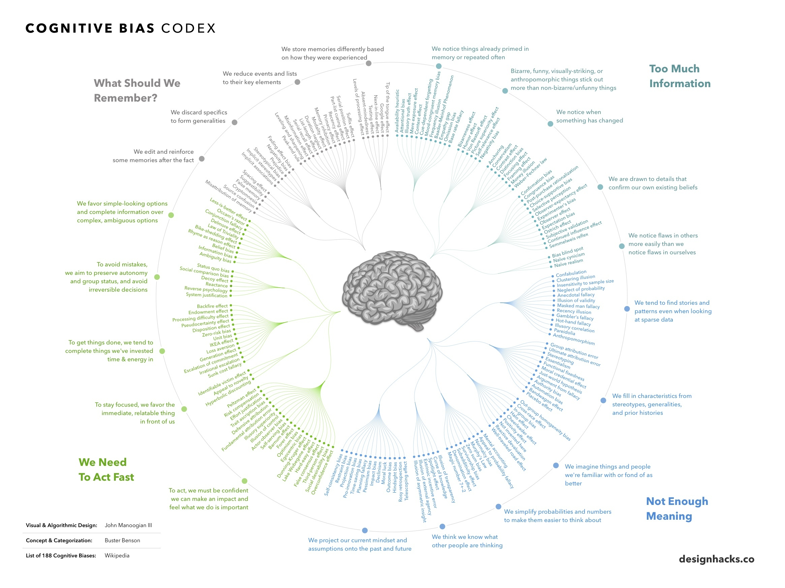
The Psychology of Decision Making
Models can be used for structurable aspects of decision problems.
Other aspects cannot be structured easily, requiring intuition and judgment.
Caution: Human judgment and intuition is not always rational and rarely unbiased!
Let’s take a look at how decisions may be biased.

Slide 10
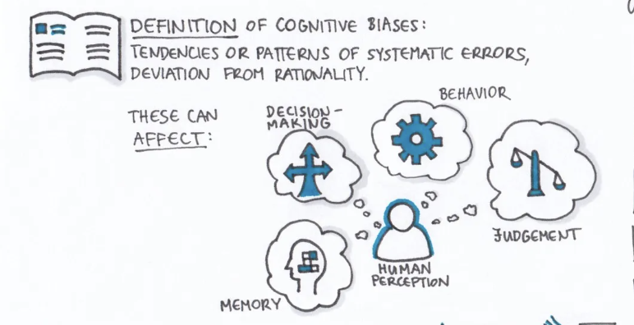
What are Cognitive Biases?
First coined in the 1970s by Israeli Psychologists, Amos Tversky and Daniel Kahneman, cognitive biases are considered to be errors in thinking that can lead to a misinterpretation of information from the world around us, affecting the accuracy of our decisions and the rationality of our judgements. Biases are generally an automatic process formulated by our brains as an attempt to make decision-making more efficient by simplifying information processing to help us make sense of the world and reach decisions faster.
A cognitive bias can be conscious or subconscious and be caused by several factors such as emotions, social pressures and mental shortcuts (i.e., heuristics).

Slide 11
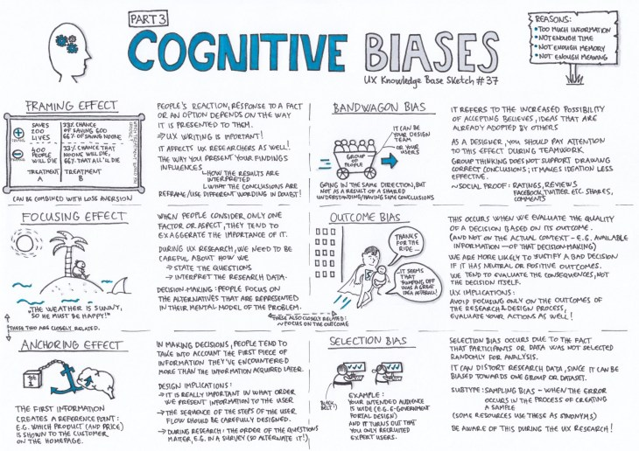

Slide 12
Why do we model for decision making?
Building model forces detailed examination and thought about a problem
structures our thinking
must articulate our assumptions, preconceived notions
Model building may illuminate solution without actually using the model
Searching for general insights
form of relationship between key variables involved in decision
importance of various parameters on decisions
Looking for specific numeric answers to a decision making problem
If we add 1 lab tech between 7a-3p, how much reduction can we expect in test turnaround time?
Find the best way to do something
What price for our product will maximize profit?
Notes:
To build a model of a system, you really need to dig into the system from multiple angles and really understand it.

Slide 13
Good Decisions vs. Good Outcomes
Good decisions do not always lead to good outcomes...
A structured, modeling approach to decision making helps us make good decisions and reduce bias, but can’t guarantee good outcomes.

Slide 14
Decisions & Outcomes
 |  | Outcome Quality
 |  | Good | Bad
Decision Quality | Good | Deserved Success | Bad Luck
 | Bad | Dumb Luck | Poetic Justice
Decision Risk: The potential loss from a bad quality decision
The loss is the difference between the outcome of the best good quality decision and the outcome of the bad quality decision
@ What is the main problem with bad quality decisions we are trying to avoid by using models?

Slide 15
Decision Models
Example 1.4 Three Forms of a Model
The sales of a new produce, such as a first-
generation iPad or 3D television, often follow a
common pattern.
Sales might grow at an increasing rate over time
as positive customer feedback spreads.
(See the S-shaped curve on the following slide.)
A mathematical model of the S-curve can be
identified; for example, S = ae^{bect}, where S is
sales, t is time, e is the base of natural logarithms,
and a, b and c are constants.
1-23

Slide 16
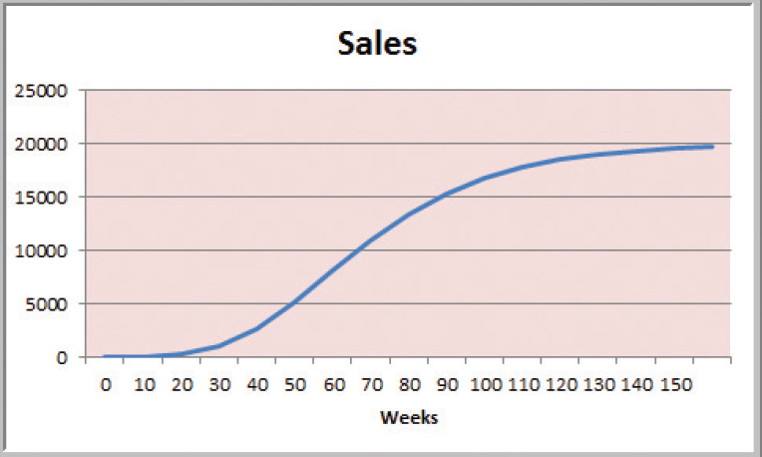
Decision Models
Figure 1.3

Slide 17
Decision Models
A decision model is a model used to understand, analyze, or facilitate decision making.
Types of model input
- data
- uncontrollable variables
- decision variables (controllable)
Types of model output
- performance measures
- behavioral measures

Slide 18
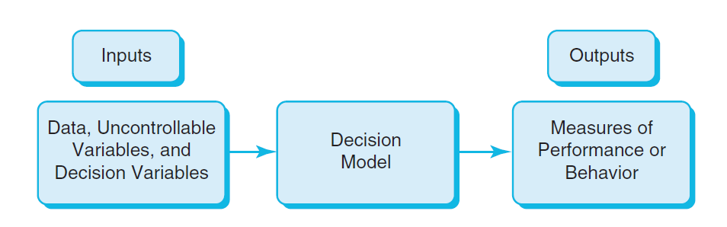
Decision Models
Nature of Decision Models
Figure 1.4

Slide 19
Decision Models
Example 1.5 A Sales-Promotion Model
In the grocery industry, managers typically need to know how best to use pricing, coupons and advertising strategies to influence sales.
Using Business Analytics, a grocer can develop a model that predicts sales using price, coupons and advertising.

Slide 20
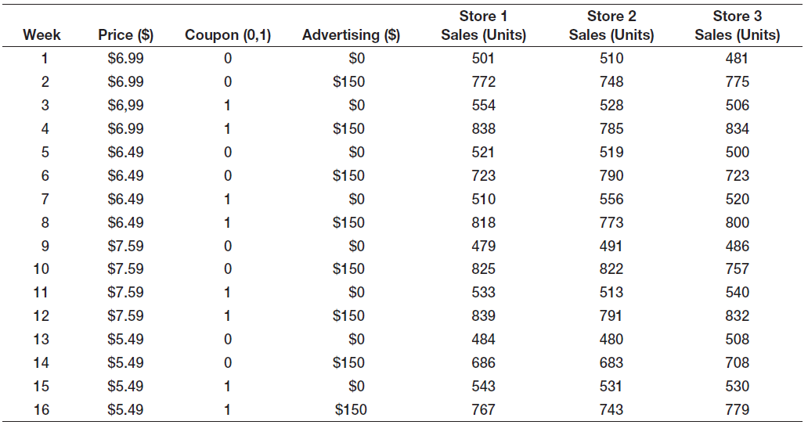
Decision Models
Sales = 500 – 0.05(price) + 30(coupons)
+0.08(advertising) + 0.25(price)(advertising)

Slide 21
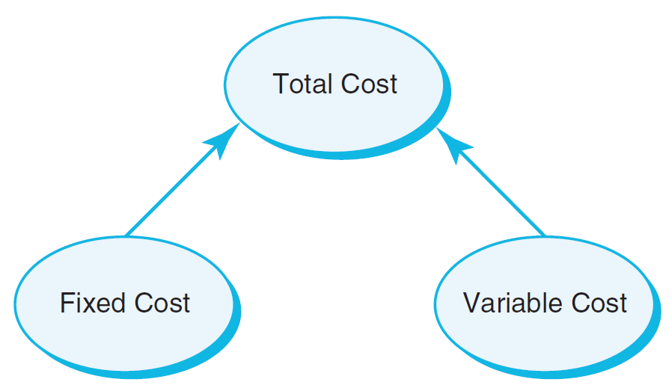
Decision Models
Descriptive Decision Models
Simply tell “what is” and describe relationships
Do not tell managers what to do
Example 1.6 An Influence Diagram for Total Cost
Influence Diagrams visually show how various model elements relate to one another.
Figure 1.5

Slide 22
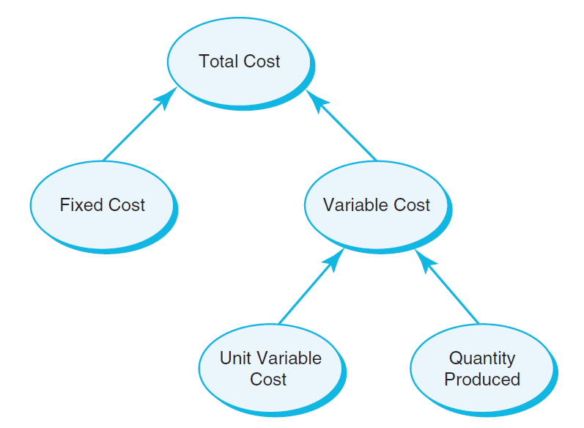
Decision Models
Example 1.7 A Mathematical Model for Total Cost
TC = F +VQ
TC is Total Cost
F is Fixed cost
V is Variable unit cost
Q is Quantity produced
Figure 1.6

Slide 23
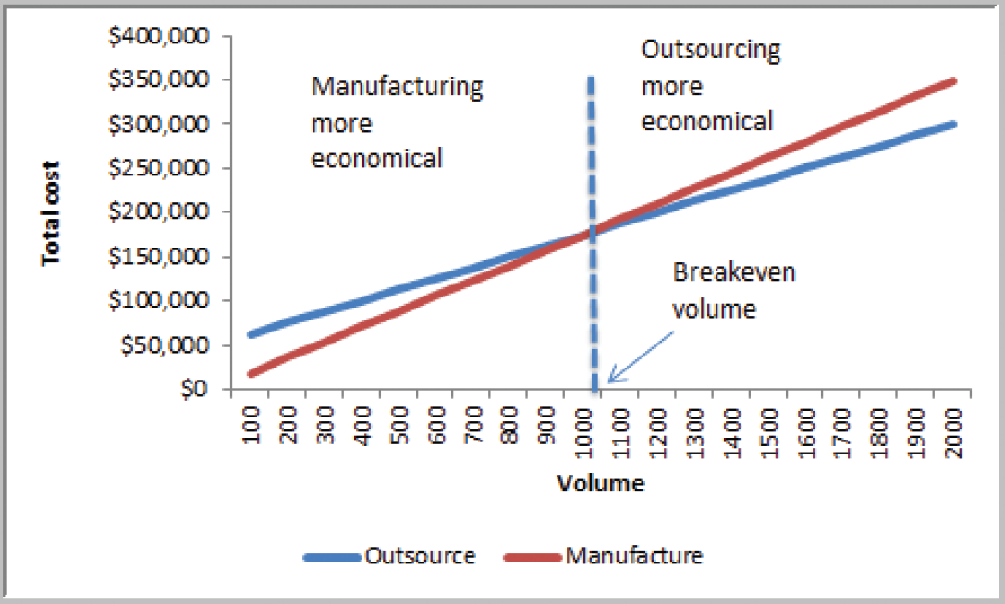
Decision Models
Example 1.8 A Break-even Decision Model
TC(manufacturing) = $50,000 + $125*Q
TC(outsourcing) = $175*Q
Breakeven Point:
Set TC(manufacturing)
= TC(outsourcing)
Solve for Q = 1000 units
Figure 1.7

Slide 24
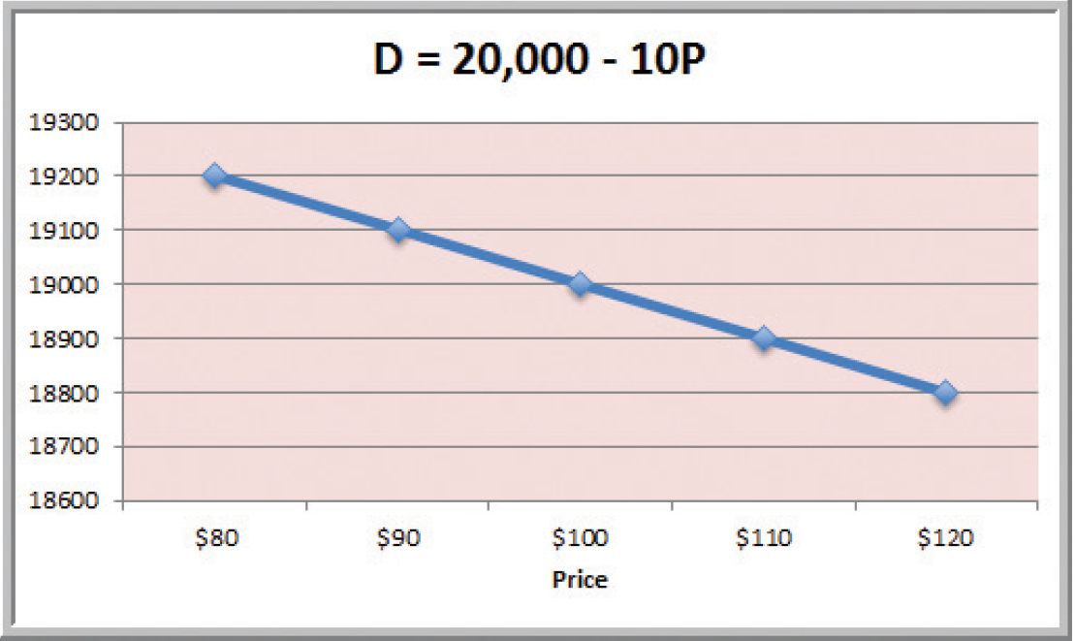
Decision Models
Example 1.9 A Linear Demand Prediction Model
As price increases, demand falls.
Figure 1.8

Slide 25
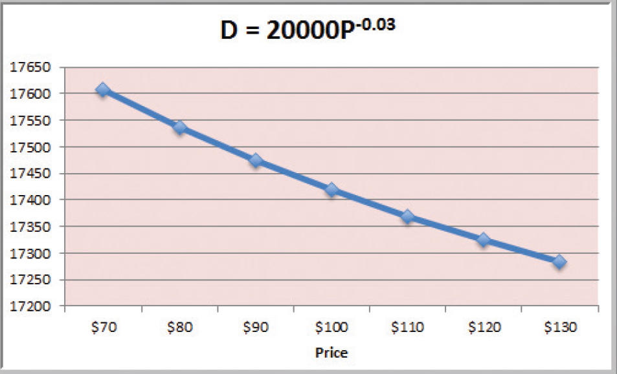
Decision Models
Example 1.10 A Nonlinear Demand Prediction Model
Assumes price elasticity (constant ratio of % change in demand to % change in price)
Figure 1.9

Slide 26
Decision Models
Predictive Decision Models often incorporate uncertainty to help managers analyze risk.
Aim to predict what will happen in the future.
Uncertainty is imperfect knowledge of what will happen in the future.
Risk is associated with the consequences of what actually happens.

Slide 27
Decision Models
Prescriptive Decision Models help decision makers identify the best solution.
Optimization - finding values of decision variables that minimize (or maximize) something such as cost (or profit).
Objective function - the equation that minimizes (or maximizes) the quantity of interest.
Constraints - limitations or restrictions.
Optimal solution - values of the decision variables at the minimum (or maximum) point.

Slide 28
Decision Models
Example 1.11 A Pricing Model
A firm wishes to determine the best pricing for one of its products in order to maximize revenue.
Analysts determined the following model:
Sales = -2.9485(price) + 3240.9
Total revenue = (price)(sales)
Identify the price that maximizes total revenue, subject to any constraints that might exist.

Slide 29
Decision Models
Deterministic prescriptive models have inputs that are known with certainty.
Stochastic prescriptive models have one or more inputs that are not known with certainty.
Algorithms are systematic procedures used to find optimal solutions to decision models.
Search algorithms are used for complex problems to find a good solution without guaranteeing an optimal solution.

Slide 30
Problem Solving and Decision Making
BA represents only a portion of the overall problem solving and decision making process.
Six steps in the problem solving process
1. Recognizing the problem
2. Defining the problem
3. Structuring the problem
4. Analyzing the problem
5. Interpreting results and making a decision
6. Implementing the solution

Slide 31
Problem Solving and Decision Making
1. Recognizing the Problem
Problems exist when there is a gap between what is happening and what we think should be happening.
For example, costs are too high compared with competitors.

Slide 32
Problem Solving and Decision Making
2. Defining the Problem
Clearly defining the problem is not a trivial task.
Complexity increases when the following occur:
- large number of courses of action
- several competing objectives
- external groups are affected
- problem owner and problem solver are not the
same person
- time constraints exist

Slide 33
Problem Solving and Decision Making
3. Structuring the Problem
Stating goals and objectives
Characterizing the possible decisions
Identifying any constraints or restrictions

Slide 34
Problem Solving and Decision Making
4. Analyzing the Problem
Identifying and applying appropriate Business Analytics techniques
Typically involves experimentation, statistical analysis, or a solution process
Much of this course is devoted to learning BA techniques for use in Step 4.

Slide 35
Problem Solving and Decision Making
5. Interpreting Results and Making a Decision
Managers interpret the results from the analysis phase.
Incorporate subjective judgment as needed.
Understand limitations and model assumptions.
Make a decision utilizing the above information.

Slide 36
Problem Solving and Decision Making
6. Implementing the Solution
Translate the results of the model back to the real world.
Make the solution work in the organization by providing adequate training and resources.

Slide 37
Statistics Review Case Studies
YMCA Hallowine Silent Auction
Detecting expense fraud
FSA Account Benefit
Late Night Happy Hour
Challenger O-Ring and Temperature Launch Risk

Slide 38
The Decision Situation
The decision maker can control which decision alternative (row) is selected but cannot determine which state of nature (column) will occur.
The decision alternative is selected prior to knowing the state of nature.

Slide 39
An Example
Problem 19.34: A ski resort operator must decide before the winter season whether he will lease a snow-making machine. If he has no machine, he will make $20,000 if the winter is mild, $30,000 if it is typical, and $50,000 if the winter is severe. If he decides to lease the machine, his profits for these conditions will be $30,000, $35,000, and $40,000, respectively. The probability of a mild winter is 0.3, with a 0.5 chance of a typical winter and a 0.2 chance of a severe winter. If the operater wants to maximize his expected profit, should he lease the machine? What is the most he should be willing to pay for a perfect forecast?

Slide 40
The Decision Situation: An Example
The decision alternatives are:
The operator does not lease the snow-making machine.
The operator does lease the snow-making machine.
The states of nature are:
The winter is mild.
The winter is typical.
The winter is severe.

Slide 41
The Payoff Table: An Example

Slide 42
The Decision Tree
Decision Alternatives State of Nature Payoff
p₁ State 1 Occurs v₁₁
p₂ State 2 Occurs v₁₂
p₃ State 3 Occurs v₁₃
Select Alternative 1
p₁ State 1 Occurs v₂₁
p₂ State 2 Occurs v₂₂
p₃ State 3 Occurs v₂₃
Select Alternative 2
p₁ State 1 Occurs v₃₁
p₂ State 2 Occurs v₃₂
p₃ State 3 Occurs v₃₃
Select Alternative 3

Slide 43
The Decision Tree: An Example
Does not lease snow-
making machine
0.3 Winter mild $20,000
0.5 Winter typical $30,000
0.2 Winter severe $50,000
Does lease snow-
making machine
0.3 Winter mild $30,000
0.5 Winter typical $35,000
0.2 Winter severe $40,000

Slide 44
Non-Bayesian Decision Theory: Strategies Without Probabilities
Maximin Strategy - Select the alternative with the least unfavorable possible outcome.
Maximax Strategy - Select the alternative with the best possible outcome.
Minimax Regret - Select the alternative that minimizes the regret the decision maker will experience after the state of nature is known.

Slide 45
Non-Bayesian Decision Theory: An Example
Maximin Strategy:
Decide to lease the snow-making machine because the minimum payoff for that alternative is $30,000, which beats the minimum payoff of $20,000 for the alternative to not lease the snow-making machine.
Maximax Strategy:
Decide to not lease the snow-making machine because the maximum payoff for that alternative is $50,000, which beats the maximum payoff of $40,000 for the alternative to lease the snow-making machine.

Slide 46
Bayesian Decision Theory: Strategies With Probabilities
Expected Payoff (or Expected Monetary Value) Criterion: Select the alternative where the expected value for the payoff is the best.
Expected Opportunity Loss Criterion: Select the decision alternative with the minimum expected regret value.

Slide 47
Expected Value: An Example
Does not lease snow-
making machine
0.3 Winter mild $20,000
0.5 Winter typical $30,000
0.2 Winter severe $50,000
0.3($20,000) + 0.5($30,000) + 0.2($50,000) = $31,000
Does lease snow-
making machine
0.3 Winter mild $30,000
0.5 Winter typical $35,000
0.2 Winter severe $40,000
0.3($30,000) + 0.5($35,000) + 0.2($40,000) = $34,500

Slide 48
Expected Value: An Example
In the long run, the operator will expect to earn $34,500 if he does lease the snow-making machine compared to $31,000 if he does not lease the snow-making machine.
Best Decision: Lease the snow-making machine.

Slide 49
Exercise: Decision Modeling for YMCA Hallowine
xxx.

