Slide 1
Data and Decisions

Slide 2
Learning Objectives
Understand the role of data and modeling in decision making
Express a decision situation in terms of decision alternatives, states of nature, and payoffs.
Differentiate between non-Bayesian and Bayesian decision criteria.
Determine the expected payoff for a decision alternative.
Calculate and interpret the expected value of perfect information.
Express and analyze the decision situation in terms of opportunity loss and expected opportunity loss.

Slide 3
Key Terms
Levels of doubt
Risk
Uncertainty
Ignorance
Decision situation
Decision alternatives
States of nature
Probabilities
Expected payoff
Maximin criteria
Maximax criteria
Minimax regret
Expected value of perfect information
Expected opportunity loss
Decision risk

Slide 4
Introduction
We face numerous decisions in life & business.
We can analyze data and the potential outcomes of decision alternatives to determine “best” options.
Decision modeling is the tool of choice for today’s managers when faced with complex decisions especially with uncertainty and risk.
The field of decision analysis provides a framework for making important decisions.

Slide 5
The Modeling Approach to Decision Making
A model is representation of a concept built on (usually simplifying) assumptions
Everyone uses models to make decisions.
Models are as valid as much as their assumptions and to the degree they are useful
“All models are wrong, but some are useful.” - George Box
Types of models:
Mental (arranging furniture)
Visual (blueprints, road maps)
Physical/Scale (aerodynamics, buildings)
Mathematical (what we’ll be studying)

Slide 6
The Psychology of Decision Making
Models can be used for structural aspects of decision problems.
Models are always required to make use of data objectively in decision making.
Other aspects cannot be structured easily, requiring intuition and judgment.
Caution: Human judgment and intuition is not always rational and rarely unbiased even in highly structured decision problems!
Let’s take a look at how decisions may be biased.

Slide 7
Anchoring Effects
Arise when trivial factors influence initial thinking about a problem.
Decision-makers usually under-adjust from their initial “anchor”.
Exercise:
Go to the following website and make a quick estimating for a large multiplication problem
http://itm-vm.shidler.hawaii.edu/itm660/Anchoring/
After everyone gives an estimate, grab the data and do the following analysis:
Compare the distributions of the two estimate groups. Is what you observe what you expected?
Compare the proportion of under-estimates for the two groups to a hypothesized value and then between the two,
Is there evidence of bias in the estimates? If so what is the bias and what may be the cause?
How does bias effect decision making?

Slide 8
Framing Effects
Refers to how decision-makers view a problem from a win-loss perspective.
The way a problem is framed often influences choices in irrational ways…
Another exercise (next two slides)

Slide 9
Framing Effects (Exercise Part 1)
Suppose you’ve been given $1000 and must choose between:
A. Receive $500 more immediately
B. Flip a coin and receive $1000 more if heads occurs or $0 more if tails occurs
Write down your choice (A or B)
What is the “value” of each choice?

Slide 10
Framing Effects (Exercise Part 2)
Now suppose you’ve been given $2000 and must choose between:
A. Give back $500 immediately
B. Flip a coin and give back $0 if heads occurs or give back $1000 if tails occurs
Write down your choice (A or B)
What is the “value” of each choice?

Slide 11
Framing Effects Exercise Part 3
Explain the difference between choice A and choice B
If you did not pick the same choice for both situations (i.e. both A or both B) explain why.
What does this say about “risk” assessment in decision making?

Slide 12
Good Decisions vs. Good Outcomes
While good quality decisions do not always lead to good outcomes...
A structured, modeling approach to decision making helps us make good quality decisions and reduce bias, but can’t guarantee good outcomes.
But poor quality decisions add risk leading to less reliable outcomes.

Slide 13
Decisions & Outcomes
 |  | Outcome Quality
 |  | Good | Bad
Decision Quality | Good | Deserved Success | Bad Luck
 | Bad | Dumb Luck | Poetic Justice
Decision Risk: The potential loss from a bad quality decision
The loss is the difference between the outcome of the best good quality decision and the outcome of the bad quality decision
@ What is the main problem with bad quality decisions we are trying to avoid by using models?

Slide 14
Modeling a Decision Situation
One basic model is the payoff matrix/table
The decision maker can control which decision alternative (row) is selected but cannot determine which state of nature (column) will occur.
The decision alternative is assumed selected prior to knowing the state of nature.
The table entries contain the benefit for each decision alternative under each state of nature
State of Nature
Decision Alternative | State 1 | State 2
A | Payoff A-1 | Payoff A-2
B | Payoff B-1 | Payoff B-2

Slide 15
An Example
A ski resort operator must decide before the winter season whether he will lease a snow-making machine. If he has no machine, he will make $20,000 if the winter is mild, $30,000 if it is typical, and $50,000 if the winter is severe. If he decides to lease the machine, his profits for these conditions will be $30,000, $35,000, and $40,000, respectively.
The probability of a mild winter is 0.3, with a 0.5 chance of a typical winter and a 0.2 chance of a severe winter. If the operator wants to maximize his expected profit, should he lease the machine? What is the most he should be willing to pay for a perfect forecast?

Slide 16
The Decision Situation: An Example
The decision alternatives are:
The operator does not lease the snow-making machine.
The operator does lease the snow-making machine.
The states of nature are:
The winter is mild.
The winter is typical.
The winter is severe.

Slide 17
The Payoff Table: An Example

Slide 18
The Decision Tree
An alternative basic model is the decision tree
Decision Alternatives State of Nature Payoff
p₁ State 1 Occurs v₁₁
p₂ State 2 Occurs v₁₂
p₃ State 3 Occurs v₁₃
Select Alternative 1
p₁ State 1 Occurs v₂₁
p₂ State 2 Occurs v₂₂
p₃ State 3 Occurs v₂₃
Select Alternative 2
p₁ State 1 Occurs v₃₁
p₂ State 2 Occurs v₃₂
p₃ State 3 Occurs v₃₃
Select Alternative 3

Slide 19
The Decision Tree: An Example
Does not lease snow- making machine
0.3 Winter mild $20,000
0.5 Winter typical $30,000
0.2 Winter severe $50,000
Does lease snow-
making machine
0.3 Winter mild $30,000
0.5 Winter typical $35,000
0.2 Winter severe $40,000

Slide 20
Decision Making Criteria
Classifying decision-making criteria
Decision making under certainty.
The future state-of-nature is assumed known.
Decision making under risk.
There is some knowledge of the probability of the states of nature occurring.
Decision making under uncertainty.
There is no knowledge about the probability of the states of nature occurring.

Slide 21
Non-Bayesian Decision Theory: Strategies Without Probabilities
Maximin Strategy - Select the alternative with the least unfavorable possible outcome.
Maximax Strategy - Select the alternative with the best possible outcome.
Minimax Regret - Select the alternative that minimizes the regret the decision maker will experience after the state of nature is known.

Slide 22
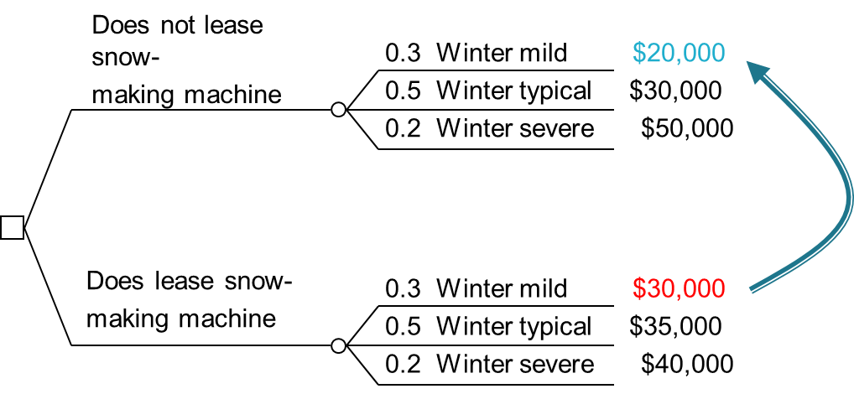
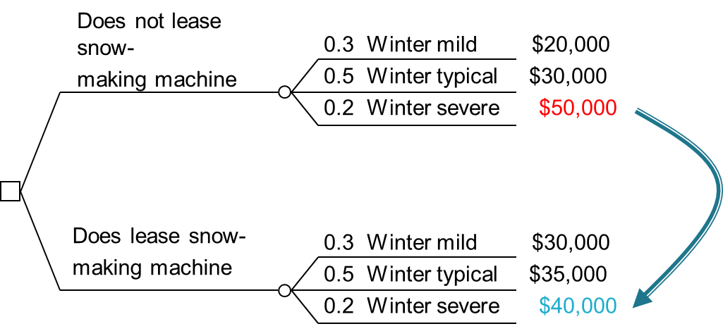
Non-Bayesian Decision Theory: An Example
Maximin Strategy:
Decide to lease the snow-making machine because the minimum payoff for that alternative is $30,000, which beats the minimum payoff of $20,000 for the alternative to not lease the snow-making machine. Pessimistic? Risk averse?
Maximax Strategy:
Decide to not lease the snow-making machine because the maximum payoff for that alternative is $50,000, which beats the maximum payoff of $40,000 for the alternative to lease the snow-making machine. Optimistic? Risk seeking?

Slide 23
The Minimax Regret Criterion
The Minimax Regret Criterion
This criterion fits both a pessimistic and a risk averse decision maker approach.
The payoff table is based on “lost opportunity,” or “regret.”
The decision maker incurs regret by failing to choose the “best” decision.

Slide 24
The Minimax Regret Criterion
The Minimax Regret Criterion
To find an optimal decision, for each state of nature:
Determine the best payoff over all decisions.
Calculate the regret for each decision alternative as the difference between its payoff value and this best payoff value.
For each decision find the maximum regret over all states of nature.
Select the decision alternative that has the minimum of these “maximum regrets.”

Slide 25
Regret Table (Opportunity Loss)
State of Nature
Decision Alternative | Mild | Typical | Severe | Max
No Lease | $30,000 | $20,000 | 0 | $30,000
Lease | $10,000 | $5,000 | 0 | $10,000
Difference from best outcome
This is a “loss” not a benefit so lower is better
Minimax Regret
Decide to lease the snow-making machine because the Maximum regret for that alternative is $10,000, which beats the maximum regret of $30,000 for the alternative to not lease the snow-making machine.

Slide 26
Bayesian Decision Theory: Strategies With Probabilities
Expected Payoff
Expected Opportunity Loss Criterion (EOL): Select the decision alternative with the minimum expected regret value.
Expected Payoff = Σ(Probability)(Payoff)
Expected Regret = Σ(Probability)(Regret)

Slide 27
Bayesian Decision Theory: Strategies With Probabilities
Expected Payoff (or Expected Monetary Value - EMV) Criterion: Select the alternative where the expected value for the payoff is the best.
Expected Opportunity Loss Criterion (EOL): Select the decision alternative with the minimum expected regret value.
It can be shown that these two criteria are equivalent!

Slide 28
Expected Value: An Example
Does not lease snow-
making machine
0.3 Winter mild $20,000
0.5 Winter typical $30,000
0.2 Winter severe $50,000
0.3($20,000) + 0.5($30,000) + 0.2($50,000) = $31,000
Does lease snow-
making machine
0.3 Winter mild $30,000
0.5 Winter typical $35,000
0.2 Winter severe $40,000
0.3($30,000) + 0.5($35,000) + 0.2($40,000) = $34,500
Choose to lease because its EMV highest

Slide 29
Regret Table (Opportunity Loss)
State of Nature
Decision Alternative | Mild 0.3 | Typical 0.5 | Severe 0.2 | EOL
No Lease | $30,000 | $20,000 | 0 | $10,900
Lease | $10,000 | $5,000 | 0 | $5,500
Choose to Lease because its EOL is lowest

Slide 30
Expected Value: An Example
In the long run, the operator will expect to earn $34,500 if he does lease the snow-making machine compared to $31,000 if he does not lease the snow-making machine.
Best Decision: Lease the snow-making machine.
The expected value criterion is useful generally in two cases:
Long run planning is appropriate, and decision situations repeat themselves.
The decision maker is risk neutral.

Slide 31
Decision Modeling Exercise
The Monte Hall problem is a classic decision problem where bias and questionable modeling assumptions lead to poor decision making. “Suppose you're on a game show, and you're given the choice of three doors: Behind one door is a car; behind the others, goats. You pick a door, say No. 1, and the host, who knows what's behind the doors, opens another door, say No. 3, which has a goat. He then says to you, "Do you want to pick door No. 2?"
a. What do you believe is the best decision? Explain why.
b. Create a payoff matrix for the decision to keep door 1 or switch to door 2. Assume the goat has zero value and the car has value of 1. Hint: Note that the states of nature are that your initial door choice was a winner and initial choice was not a winner (it is not door 1,2,3)
c. Determine from the decision model what the best decision is and explain why.

