Slide 1

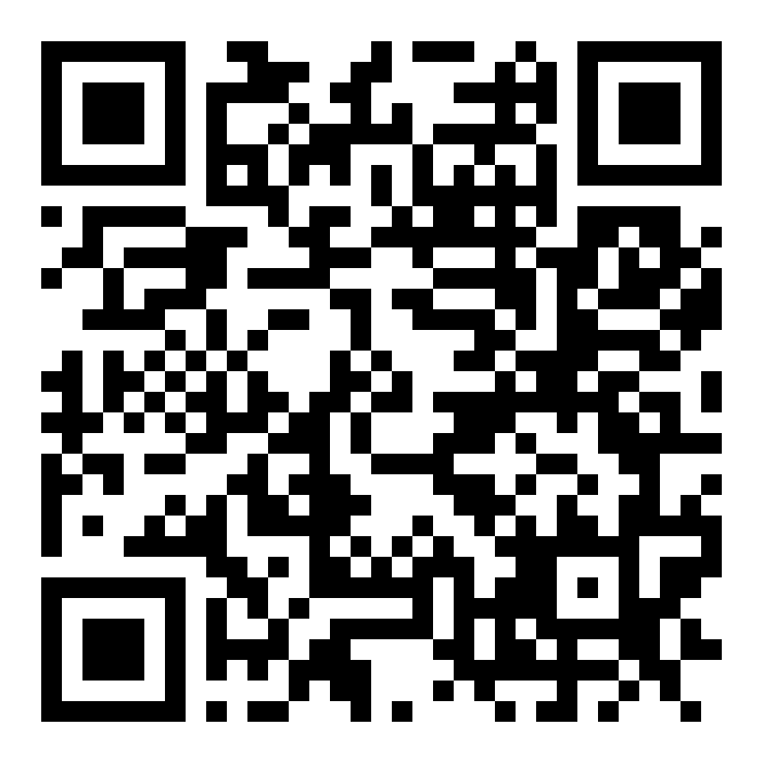
SYDNEY 2026 · CROWD VOTE
Vote for your favourite band
1 Scan the QR code with your phone camera
2 Pick your favourite band and submit
3 One vote per person — make it count
In the running
Bandlassian · Canvanauts · Amakazaam! · V2 Voyagers
The crowd vote is 20% of the final score.
battleofthetechbands.com/vote/crowd/sydney-2026

Slide 2
Tonight's run order
7:15
ShipReX
Rex Software · special guests (not competing)
7:50
Bandlassian
Atlassian
8:25
Canvanauts
Canva
9:00
Amakazaam!
Amazon
9:35
V2 Voyagers
V2 AI
Crowd voting: battleofthetechbands.com/vote/crowd/sydney-2026

