Slide 1
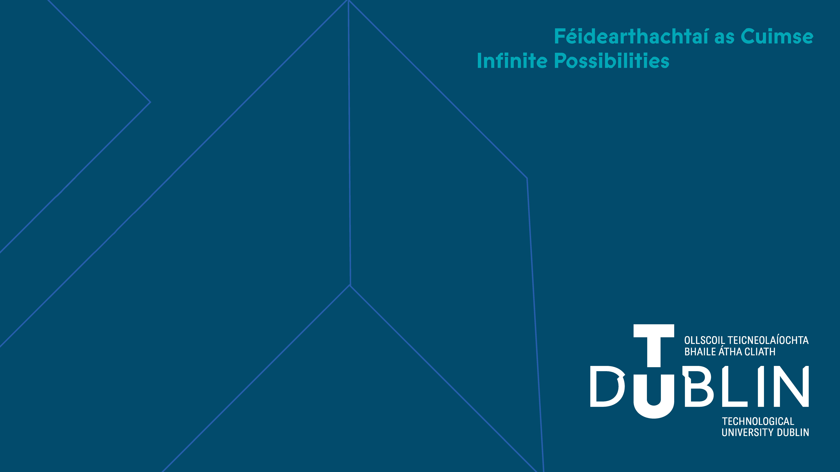
David Powell (tPOT research group)
Understanding pedestrian activity using Graph Databases
20 September 2022

Slide 2
Background
David Powell (tPOT TU Dublin)
Developed hardware (ESP32 based) which was used by Ahlam Al Anbouri as part of a pedestrian walking study around the new TU Dublin Grangegorman campus (2021)
Large volume of data was collected as part of the Pedestrian Walking Study by Ahlam Al Anbouri, this work builds on top of that.
This rich data gives us interesting problem on how to extract information and knowledge from it
Data
Information
Knowledge

Slide 3
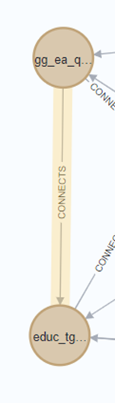
Overview
Building Graphs to represent connected information such as topologies and Journeys
Supplement topology information with walking distances / times from the likes of open street map
Querying Graphs to identify similarity of Journeys or if a Journey is possible for a given topology
Graph Algorithms (shortest path, Dijkstra )
All data / scripts used are available at GitHub for people to try
https://github.com/dpowelltu/walk21

Slide 4
Objectives of this work
Explore how the graph data model can be used to help with current and future pedestrian studies
Learn about storing / querying connected data in Graph form
Learn about Neo4J (AuraDB) and the Cypher query language
Explore built in data types, including native storage of gps locations
Not write lots of complex python code to pre-process information, for example loading of data using built in methods.
Explore how graph databases can give us better insights into large amounts of data collected as part of the pedestrian walking study
How can graph data model can enable us to quickly understand the topology and activities for pedestrian studies
Efficiently validate Journeys are valid, based on the graph representation of the topology

Slide 5
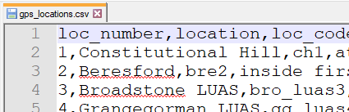


Previous Approaches
CSV (Comma Separated Variable) files historically used to store data in flat file format (good for exchanging information)
Database management systems (DBMS) were developed to allow data to be stored and queried.
Relational Databases:
First proposed in the 1960s
Store data in tables, designed based on a schema
SQL query language developed in the 1970s
Are widely used and taught across the world
Data tables need to be well structured (normal forms)
Data tables are typically optimised to reduce storage size, but not necessarily optimised for queries / computation. Computation is expensive!
Can be used to link data together (primary / foreign key relations), this causes computational over-head for queries

Slide 6
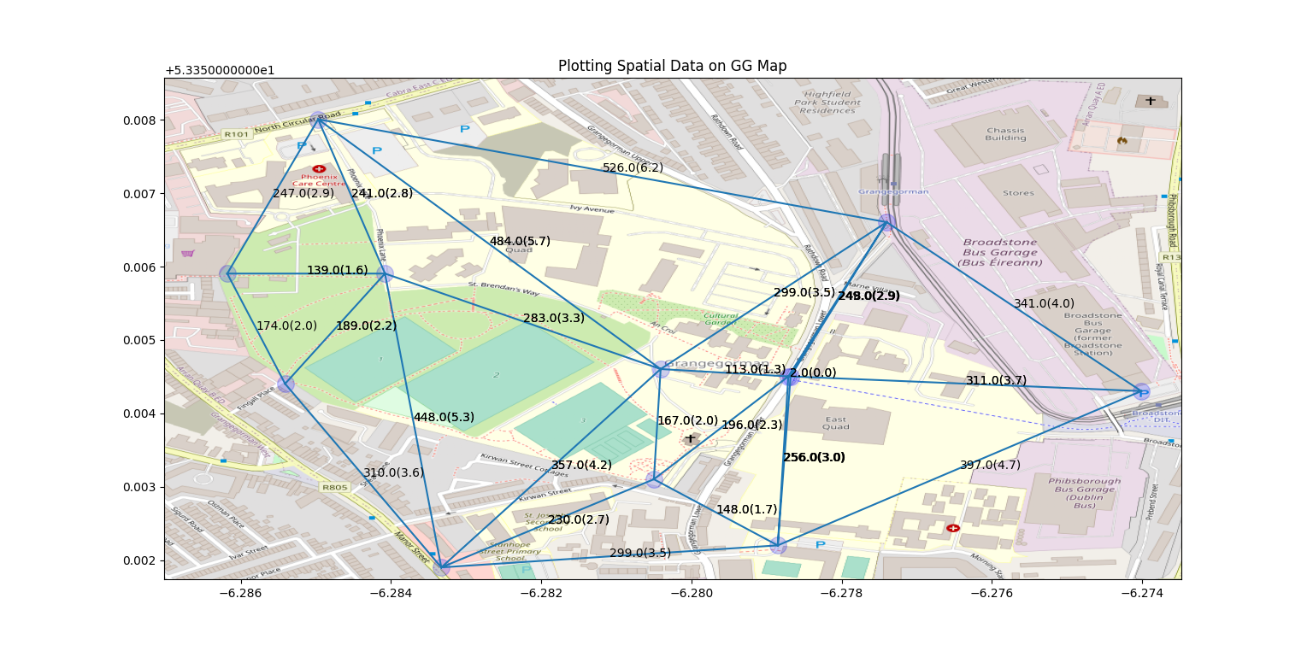
Graph Data Model

Slide 7
Graph Approach (Theory)
Graph is constructed of nodes and relations
Both nodes and relations can have a specific “type”, used to filter data
Both nodes and relations can have attributes (store information)
Specific Algorithms to efficiently:
Calculate paths across the graph based on different metrics
Compare graphs for similarity
Highly optimised for connected information
Most Graph databases do not require a schema

Slide 8
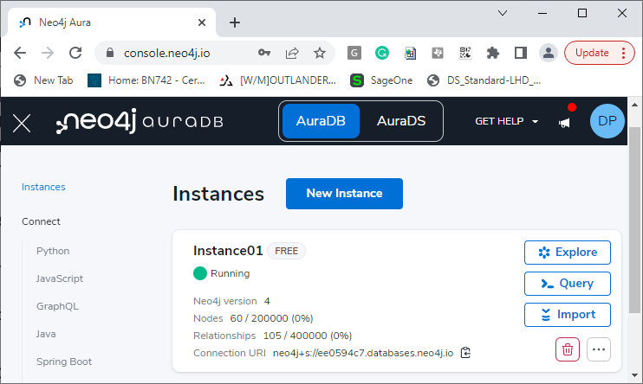
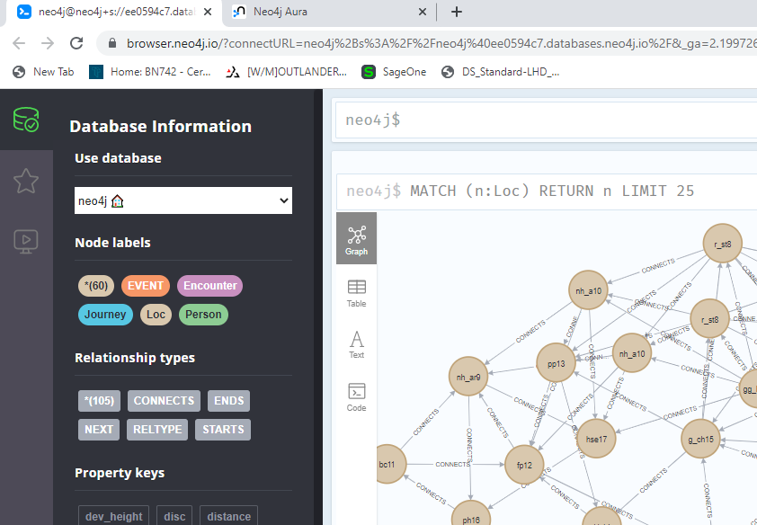
Graph Approach (Practical)
What is Neo4J
Widely used Graph Database Management System (DBMS)
Natively supports connected information
Supports a variety of built in datatypes including spatial / GPS coordinates
Supports querying of graphs to gain insights into the data using various algorithms
Tools used
Neo4J cloud based Aura DB online (free version, up to 200k nodes 400k relations)
Neo4J cloud based Aura DB Console in the browser
Local Python Scripting
Data Loading
Neo4J Aura DB can load from a local file (csv), but as Aura DB is cloud based, a local file can’t be used, although a http interface can be used. Solution, CSV file stored on github / dropbox / google drive and a link shared.

Slide 9
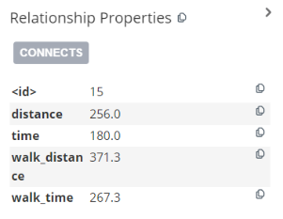
Graph Approach (Practical)
Importing the Topology information:-
Import Node data from CSV file into neo4j, this will give the basic nodes within the topology, but not the links between them.
In python, work out relationships (triangulation) and potential routes,
Query open street map for walking times and export routes between nodes as routes.CSV
Import route data from routes.CSV file into neo4j, this links the nodes together and provides attributes for those links
Validate topology graph, compare gps locations at nodes v’s relations generated supplemented with open street map information. Query in neo4j!
256.2839908431127
Import locations as nodes to neo4j (gps_locations.csv)
Using python import locations generate triangulation (gps_locations.csv)
Query Open street map for each route (output routes.csv)
Import routes to neo4j (import routes.csv)
Validate Topology generated
load_locations.txt
load_relations.txt
generate_relations_from_gps.py

Slide 10
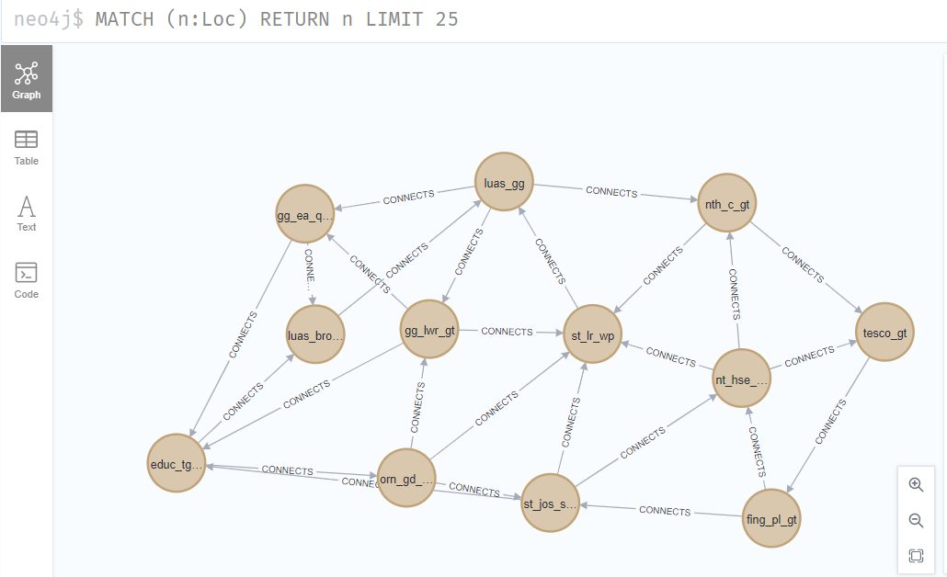
Graph Approach (Practical)
Full topology with relations is shown below
Nodes are colour coded based on type and allocated an identifier based on some attribute.
Relations are given an identifier based on their type
Graph can be manually navigated or queried to extract information

Slide 11
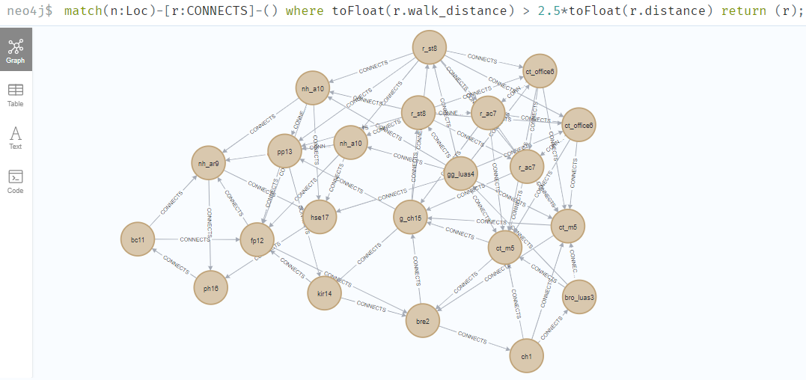
Graph Approach (Practical)
Question: Are all walking routes optimal?
{"distance":"194.0","walk_distance":"547.3","walk_time":"394.0","time":"138.0"}
{"distance":"56.0","walk_distance":"741.9","walk_time":"534.1","time":"42.0"}
{"distance":"145.0","walk_distance":"595.4","walk_time":"428.7","time":"102.0"}
{"distance":"194.0","walk_distance":"547.3","walk_time":"394.0","time":"138.0"}

Slide 12
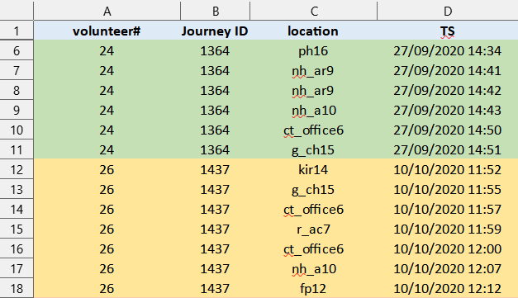
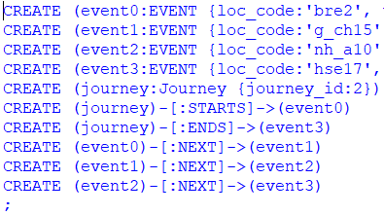
Graph Approach (Journeys)
The basis the 2020 pedestrian walking study was that the events were captured and stored locally in CSV format. These events could then be combined to form discrete journeys.
Different approach from the topology was taken to generate the Journey graphs, python was used to process the CSV data and generate the required nodes and relations as cypher queries, which could then be loaded into neo4j.
Journey information (sample_journey.csv) imported into python script
Using python, identify journeys, start/end nodes and events
Create Cypher Queries to generate Journey and event nodes with relations
Bring cypher queries into Neo4j
create_journeys_from_csv.py

Slide 13
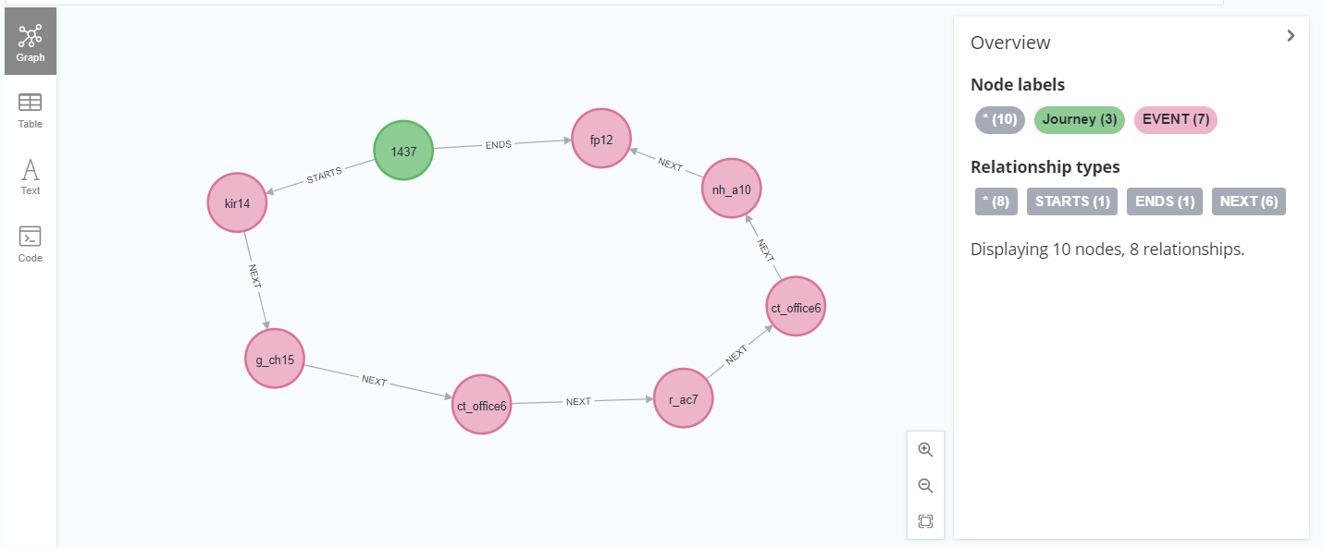
Graph Approach (Journeys)

Slide 14
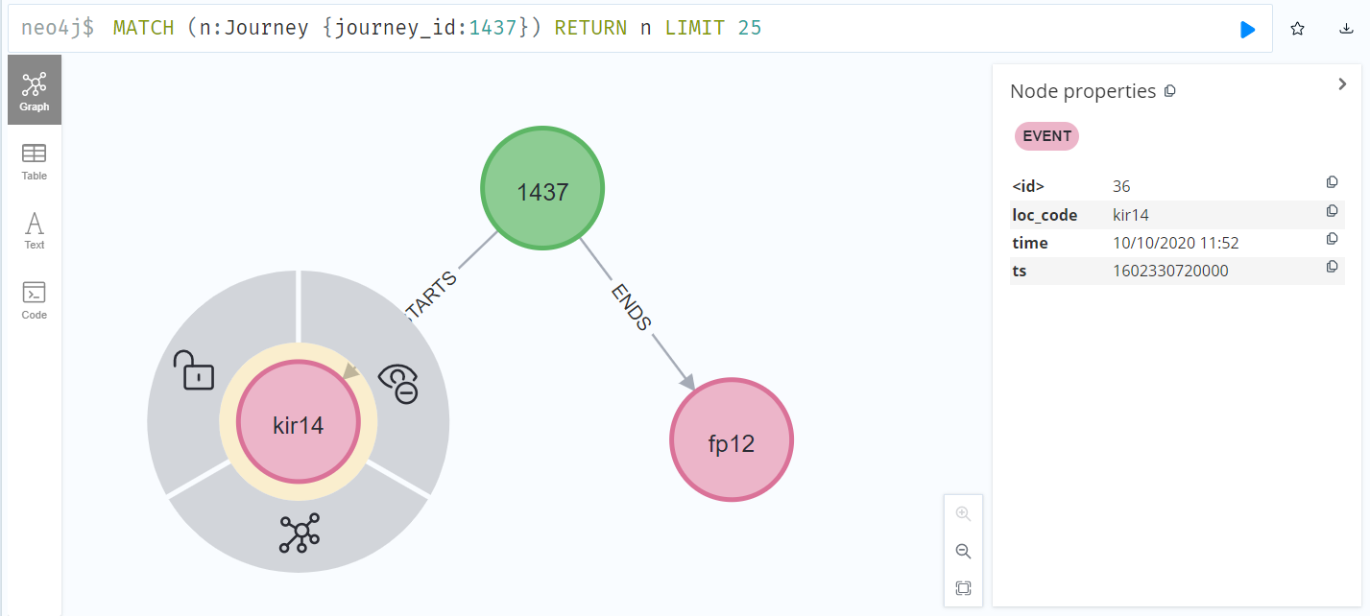
Graph Approach (Journeys)

Slide 15
Demonstration

Slide 16
Questions?
https://github.com/dpowelltu/walk21

