Slide 1
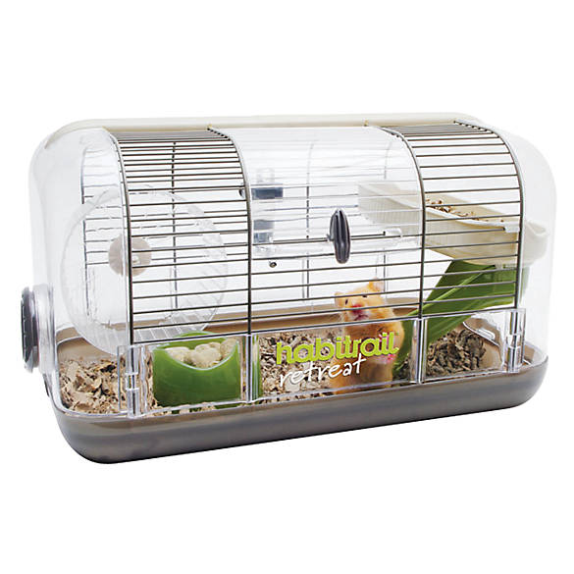

SMART HAMSTER CAGE!
+
=

Slide 2
Idea
The complete solution for the parents whose kids wants to have own pet, but they always forget about taking care of him.
How to do it? The most important word is CARING!
* Caring for the state of the water
* Caring for the state of the food
* Caring for the right temperature of our pet
How to do it from the engineer’s point of view?
* Electronic board
* Water pump / Stepper motor
* Fan

Slide 3
Specification
Electronic components
System outputs
uC - ATMEGA32
Thermometer - DS1621+
Stepper Motor - L297 + L298
OLED - SSD1306
5V input - LM2596
Shottky diodes - 1N5822
Transistors NPN – BC639
LEDs – 5mm
External 12V/2A – power with fuse
Water pump 12V/0.3A
Stepper motor bipolar, 12V/0.4A, 0.25Nm
Fan 12V/0.3A
KANDA – programming in ISP
LEDs for each output + debug led called CTRL_LED

Slide 4
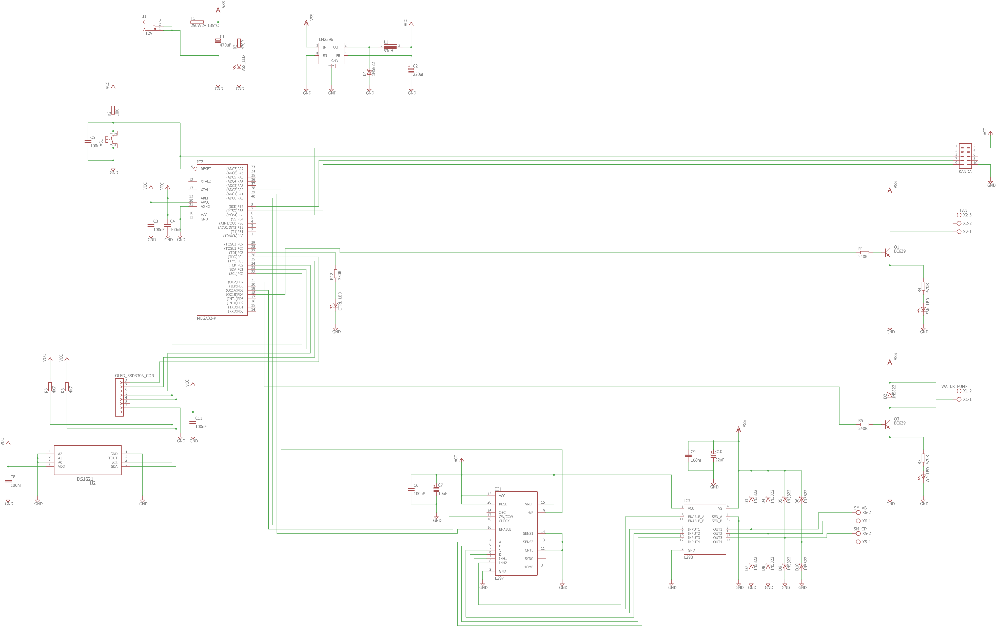
Electronic scheme

Slide 5
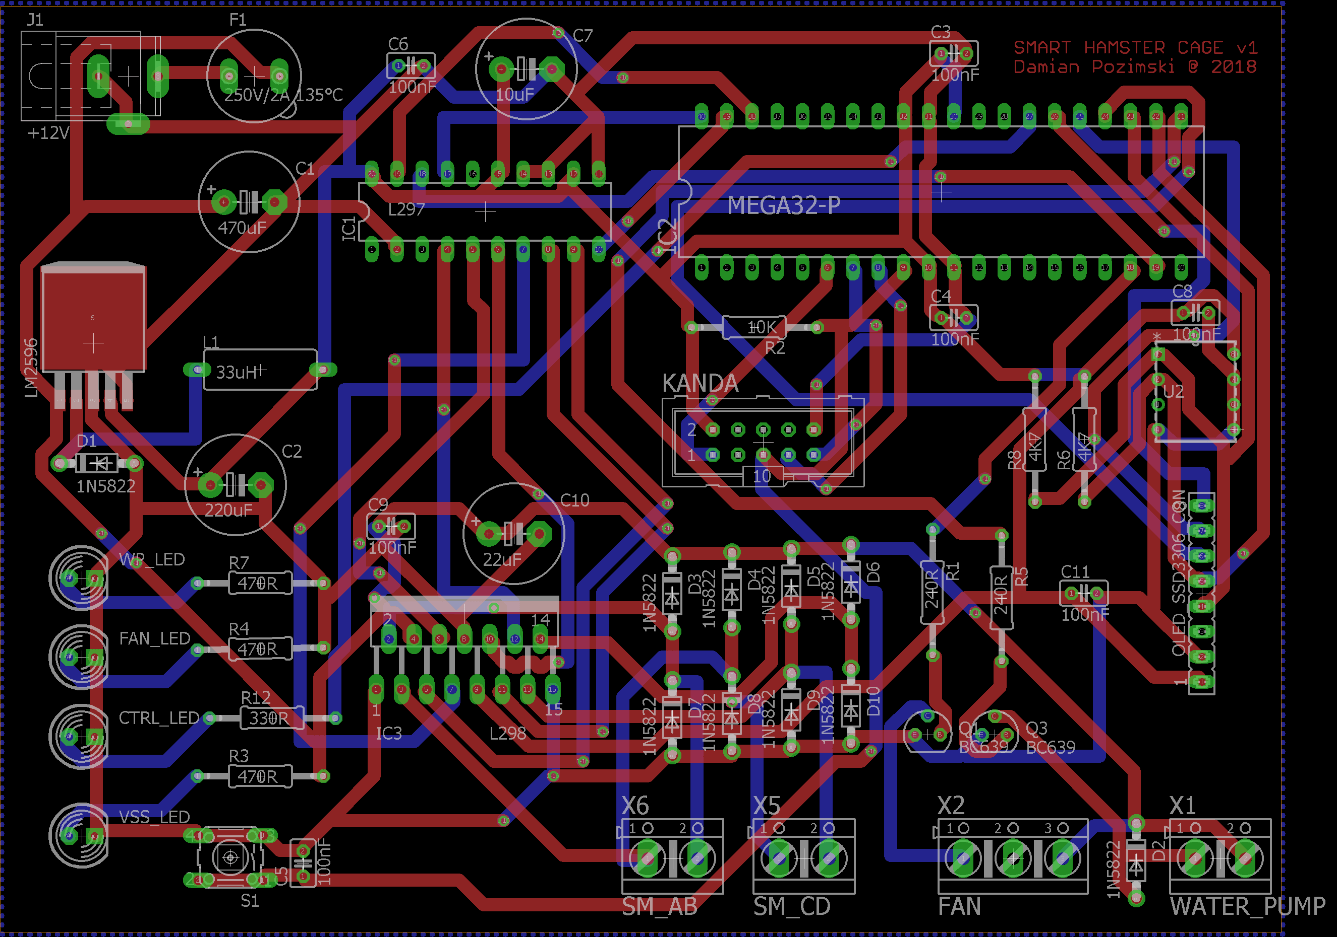
PCB design

Slide 6
Thanks for the attention!
Created by:
Damian Pozimski

