Slide 1
FABRICATION OF FOUR WHEEL STEERING SYSTEM
PARUL UNIVERSITY, LIMDA

Slide 2
PROJECT MEMBERS
JAYRAJ KHATRA
DIXIT KUKADIYA
NIMESH KATARIYA
PROJECT GUIDE
Asst.Prof. Shivani desai

Slide 3
CONTENTS
INTRODUCTION
FOUR WHEEL STEERING SYSTEM
MODES IN 4WS SYSTEM
VEHICLE DYNAMICS AND STEERING
FABRICATION OF FOUR WHEEL STEERING SYSTEM
BENEFITS OF THE 4WS MODEL
RESULT AND DISCUSSION
CONCLUSIONS AND SCOPE OF FUTURE WORK

Slide 4
INTRODUCTION
The front-to-rear wheel alignment plays a significant role in the directional stability of a vehicle.
Often the lack of stability causes a dangerous drive.
Up to the mid-1950s the majority of cars suffered from over-steer, mainly due to the uncontrolled movement of the rear axle caused by spring deflection which is initiated by body roll.

Slide 5
INTRODUCTION Cont..,
To improve stability, most cars nowadays are designed to exhibit under-steer characteristic when driven at high speeds.
Although under-steer condition improves stability of the vehicle, it increases the driver's steering effort. Also since a vehicle handling changes with road speed, the response to a steering movement, both in time and direction, is difficult to predict.
These disadvantages can be overcome to a great extent by using four wheel steering (4WS).

Slide 6
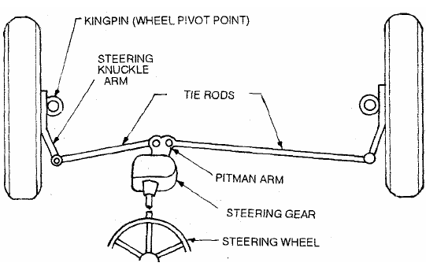
STEERING SYSTEM

Slide 7
MODES IN FOUR WHEEL STEERING SYSTEM
TWO MODES ARE GENERALLY USED IN THESE 4WS MODEL
Slow Speeds - Rear Steer Mode:
High speeds – Crab Mode.

Slide 8
VEHICLE DYNAMICS AND STEERING
Understeer:
Understeer is so called because when the slip angle of front wheels is greater than slip angle of rear wheels.
Oversteer:
Over steer is defined when the slip angle of front wheels lesser than the slip angle of rear wheels.
Neutral steer or counter steering:
Counter-steering can defined as when the slip angle of front wheels is equal to slip angle of rear wheels

Slide 9
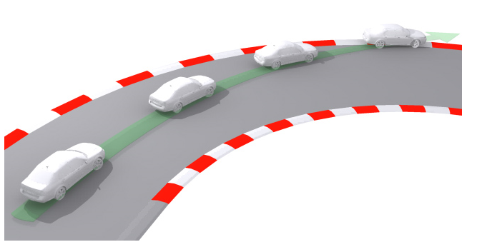
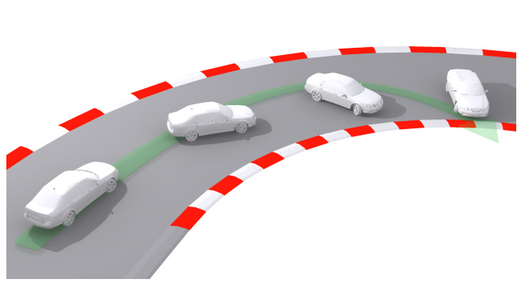
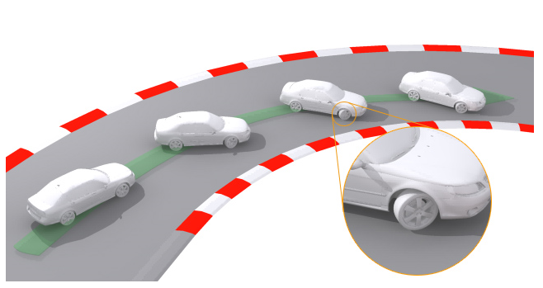
Understeer
Oversteer
Neutral steer or
counter steering

Slide 10
FABRICATION OF FOUR WHEEL STEERING SYSTEM
Here, the rear wheels turn in a direction opposite to the front wheels so that to reduce the turning circle radius at low speeds. This would be very useful in city traffic conditions
The main objective of our project is to fabricate the Four Wheel steering, (REAR STEER MODE).

Slide 11
METHODOLOGY
Modification was made in the rear wheel assembly and addition of one more rack and pinion steering gear box for steering the rear wheels.
Then a transfer rod is placed in between the front and rear steering gear box to transfer the motion to rear steering gear box.

Slide 12
WORKING PRINCIPLE
When the steering is steered the power is transferred to the front steering gear box, and a bevel gear arrangement is made to transfer the power to the rear steering gear box.
Bevel gear is used to transmit the rotary motion perpendicularly, so the one bevel gear is introduced in the front steering rod. Other bevel gear is connected to the transfer rod.
Two supports are used to support the transfer rod. Transfer rod is connected to the rear steering gear box. Rear steering gear box is fixed to the car body by bolts and nuts and the ends of the steering box are connected to the rear wheel hub where the tyres are mounted.
As the steering is steered the rear wheels also turn by the arrangements made and the rear wheel turn in the opposite direction.

Slide 13
BENEFITS OF THE 4WS MODEL
In conjunction with rear steer mode, four-wheel steering can significantly improve the vehicle handling at both high and low speeds.
Due to the better handling and easier steering capability, driver fatigue can be reduced even over long drives.
Stability of the vehicle increases.
Turning radius of the vehicle can be decreased to a greater extent by rear steer mode.

Slide 14
RESULT AND DISCUSSION
The use of four-wheel steering in wheelchairs introduces a dilemma for the control of that vehicle. Optimum performance is likely attained when the wheels can be left at arbitrary, but known, steering angles while the chair is idle.
The range of options available are to power both rear wheels, power both front wheels, and power one rear and one front wheel on opposite sides of the vehicle. Powering all wheels gives maximum performance, and, since each wheel on the same side of the vehicle travels at the same velocity, four completely independent channels of control are not necessary.

Slide 15
CONCLUSIONS AND SCOPE OF FUTURE WORK
An innovative feature of this steering linkage design and its ability to drive all four (or two) wheels using a single steering actuator. Its successful implementation will allow for the development of a four-wheel, steered power base with maximum maneuverability, uncompromised static stability, front- and rear-wheel tracking, and optimum obstacle climbing capability.

Slide 16
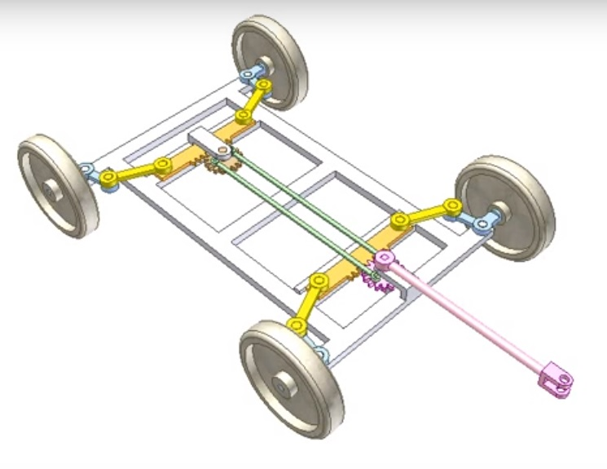
COMPONENTS USED
Chassis = 1
Wheels= 4
Gears= 2
Rack= 2
Arm= 4
Steering Rod= 1

Slide 17
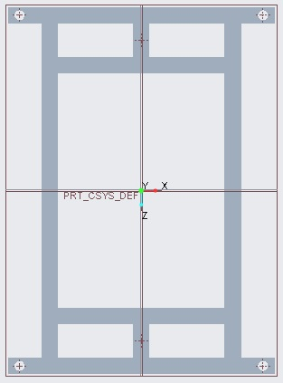
DIMENSION OF MODEL
Chassis
Length = 500 mm
Width = 250 mm
Wheel base = 500 mm
Wheel Track = 270 mm

Slide 18
DIMENSION OF MODEL
Wheel
Diameter = 100 mm
Thickness = 30 mm
Gear
Outer Diameter = 50 mm
Inner Diameter = 45 mm
No. of teeth = 80

Slide 19
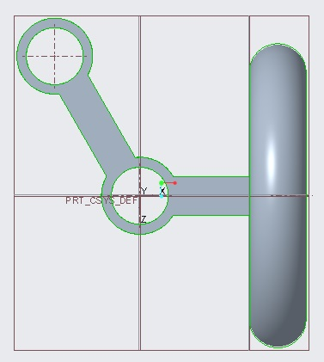
DIMENSION OF MODEL
Rack
Length = 300 mm
Width = 20 mm
No. of teeth = 40
Arm
Length1 = 50 mm
Length2 = 50 mm
Angle = 120 degree

Slide 20
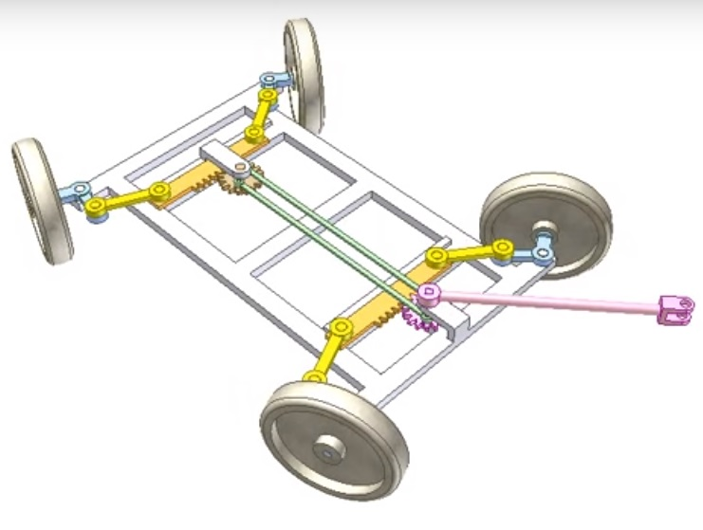
TURNING RADIUS
Turning Radius (FWS)
= 3000 mm
Turning Radius (4WS)
= 2100 mm

Slide 21
THANK YOU

