Slide 1
H₂O₂ 與植物荷爾蒙之差異性表現基因關聯性探討
生物資訊學導論-期末報告
Proposal Defense
組別：第九組
組員：吳晉宇 (d01623001)
謝誌紘 (r06b42001)
曾柏舜 (r07b42006)
劉宗晏 (r07b42009)
報告日期：2018.12.07

Slide 2









Overview of phytohormone crosstalk
Phytohormone | 植物荷爾蒙
ABA (Abscisic acid) | 離層酸
GA (Gibberellin) | 吉貝素
Auxin | 生長素
CK (Cytokinin) | 細胞分裂素
Ethylene | 乙烯
SA (salicylic acid) | 水楊酸
JA (Jasmonate) | 茉莉酸
BR (Brassinosteroid) | 蕓苔素
SL (Strigolactone) | 獨腳金內酯
Cell expansion
Root growth
Seed germination, stem elongation, meristem size
Cell elongation, plant growth
Shoot and root
elongation
Cell expansion,
root growth
Senescence, stresses
Environmental
stresses
Abiotic stress, seed dormancy
Secondary growth, stresses
Secondary growth,
bud growth
Wounding response
Biotic stresses
Biotic and abiotic stresses
Environmental
stresses
Biotic and abiotic stresses
Seif EI-Yazal et al. (2015) Curr. Protein Pept. Sci.

Slide 3
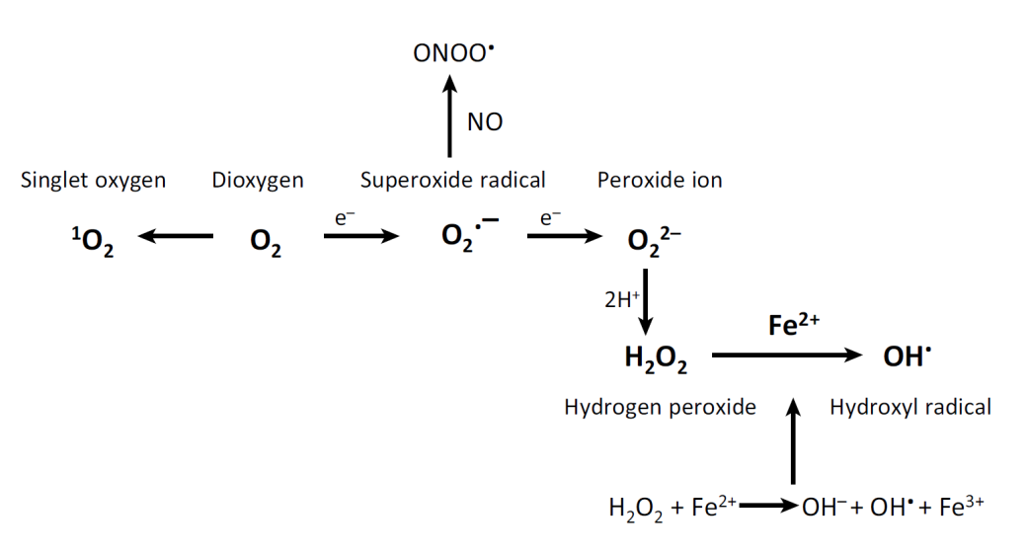
ROS and redox biology in plant cells
Mittler (2017) Trends Plant Sci.

Slide 4
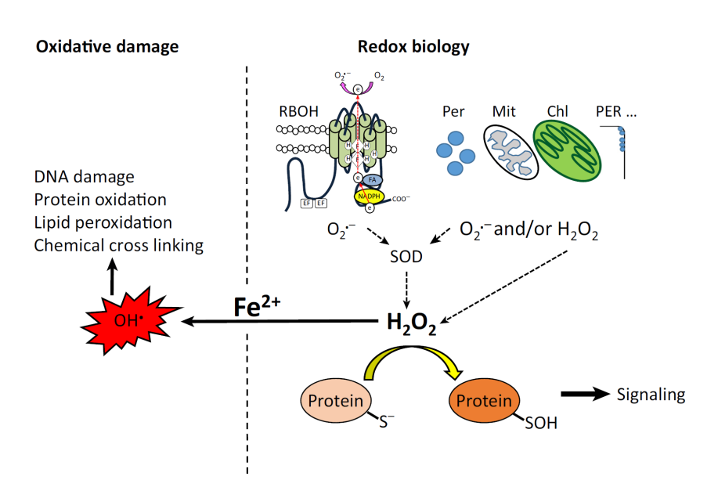
ROS and redox biology in plant cells
Mittler (2017) Trends Plant Sci.

Slide 5
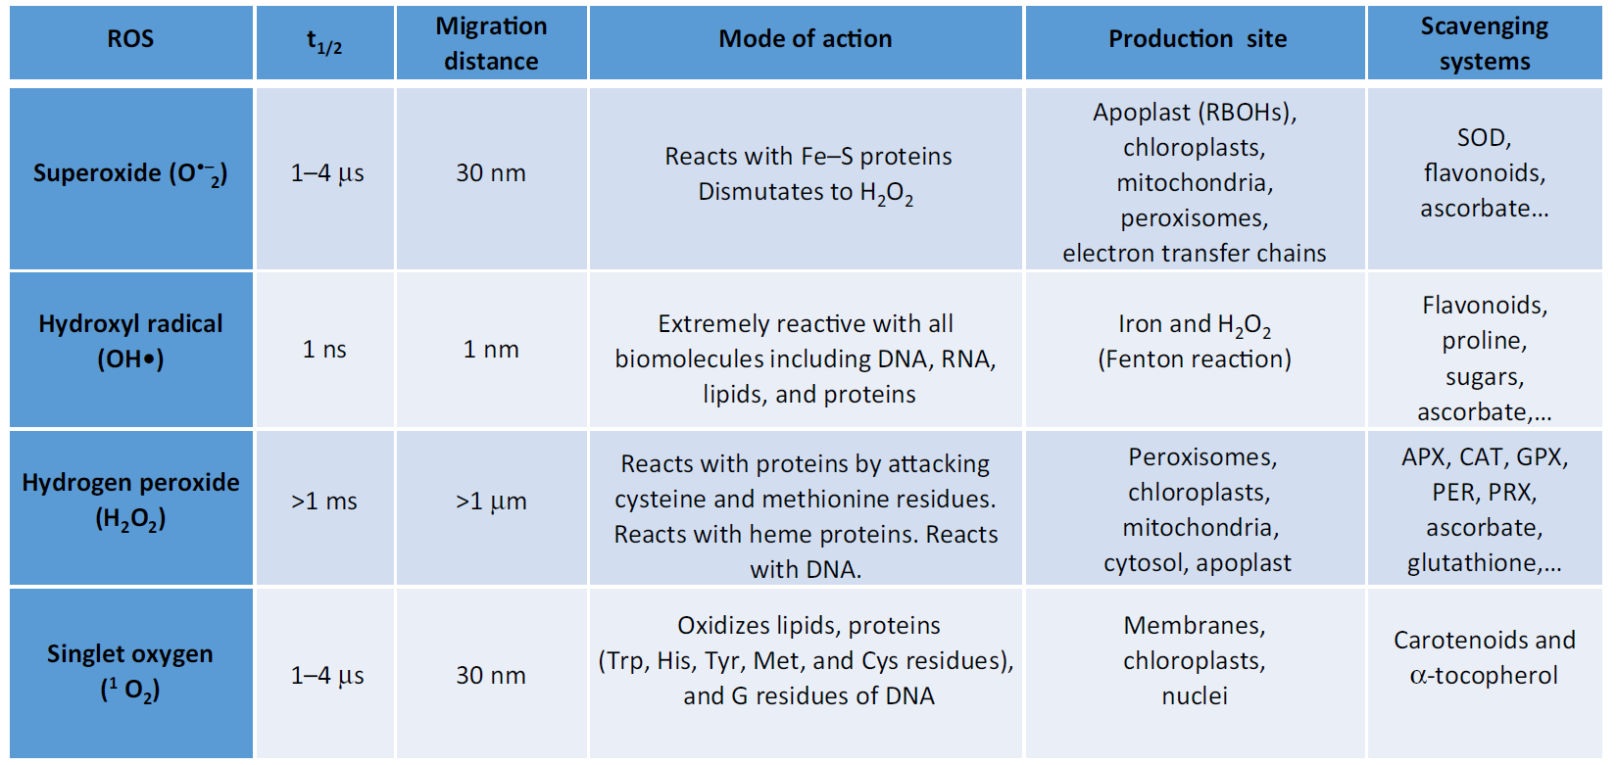
ROS and redox biology in plant cells
Mittler (2017) Trends Plant Sci.

Slide 6
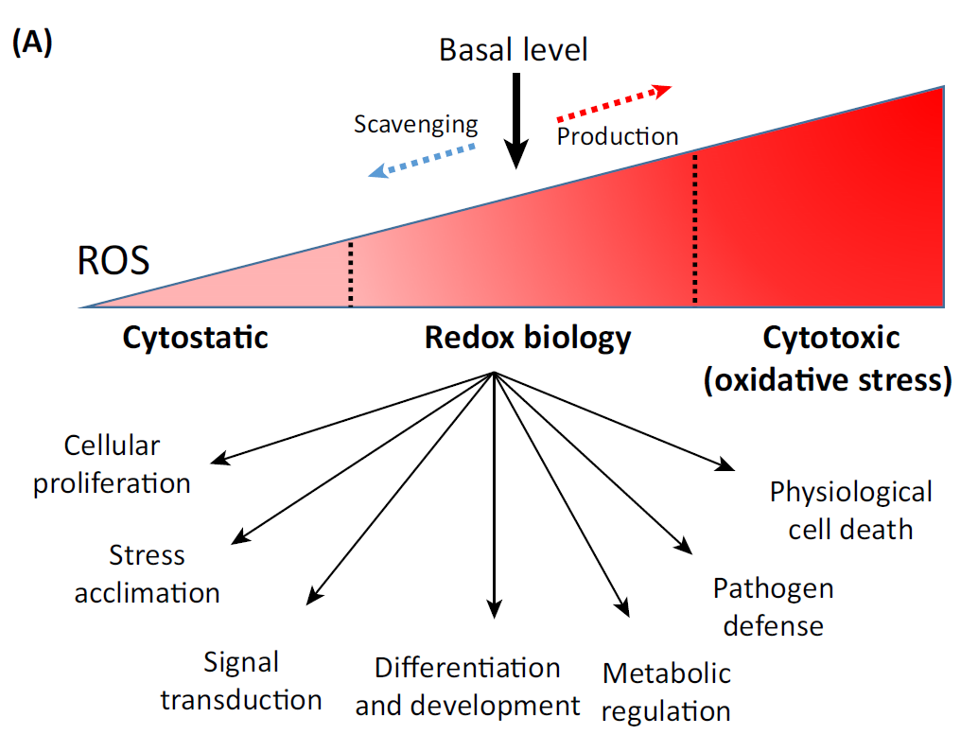
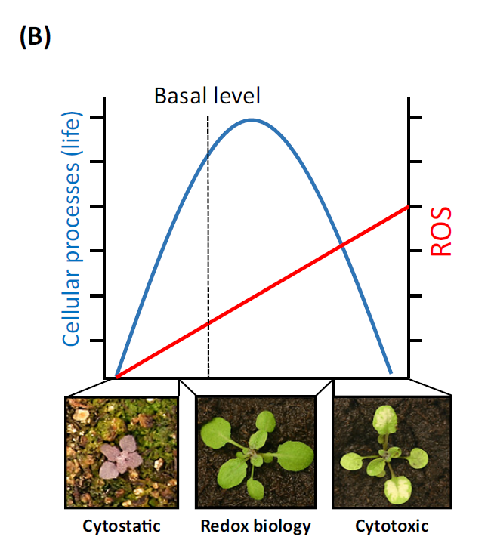
A general model of systemic signalling between ROS and phytohormone
Mittler (2017) Trends Plant Sci.

Slide 7
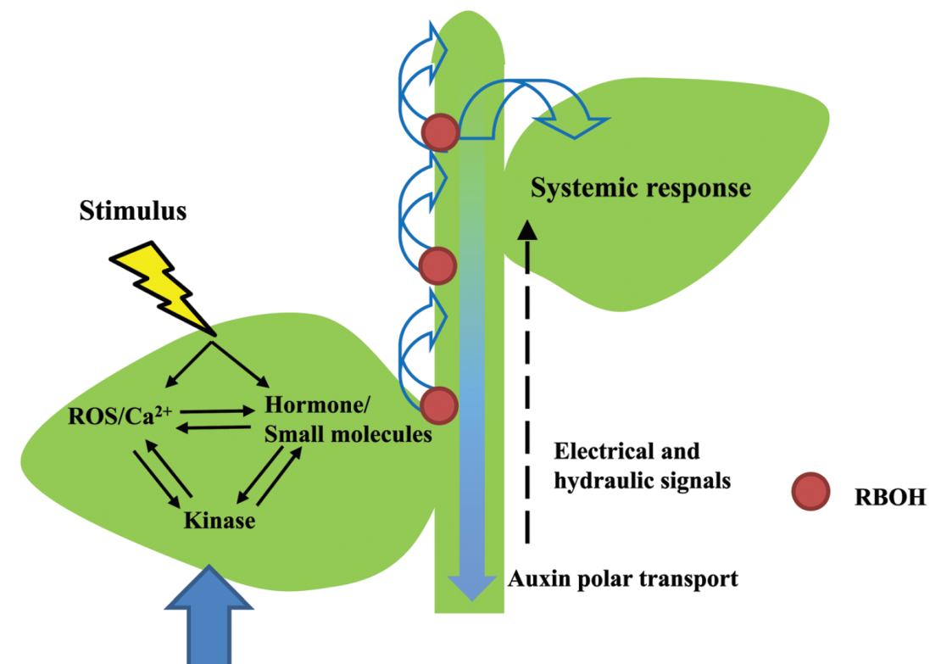
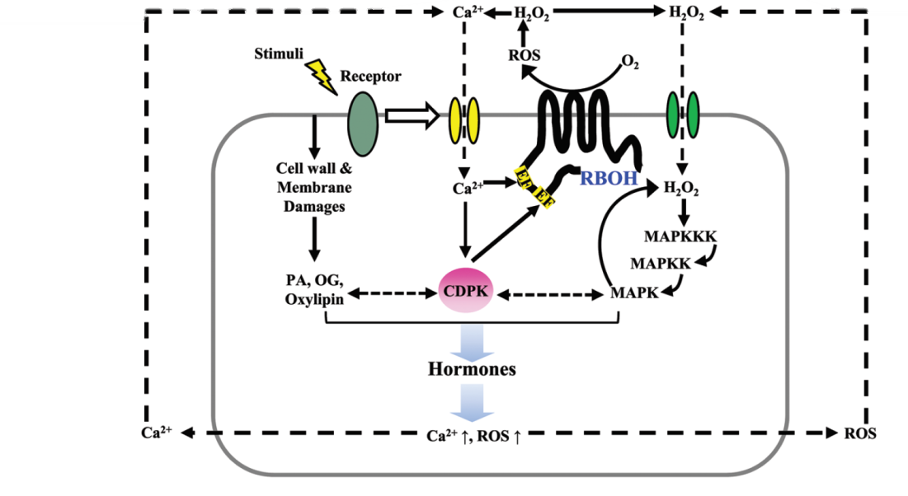
A general model of systemic signalling between ROS and phytohormone
Xia et al. (2015) J. Exp. Bot

Slide 8
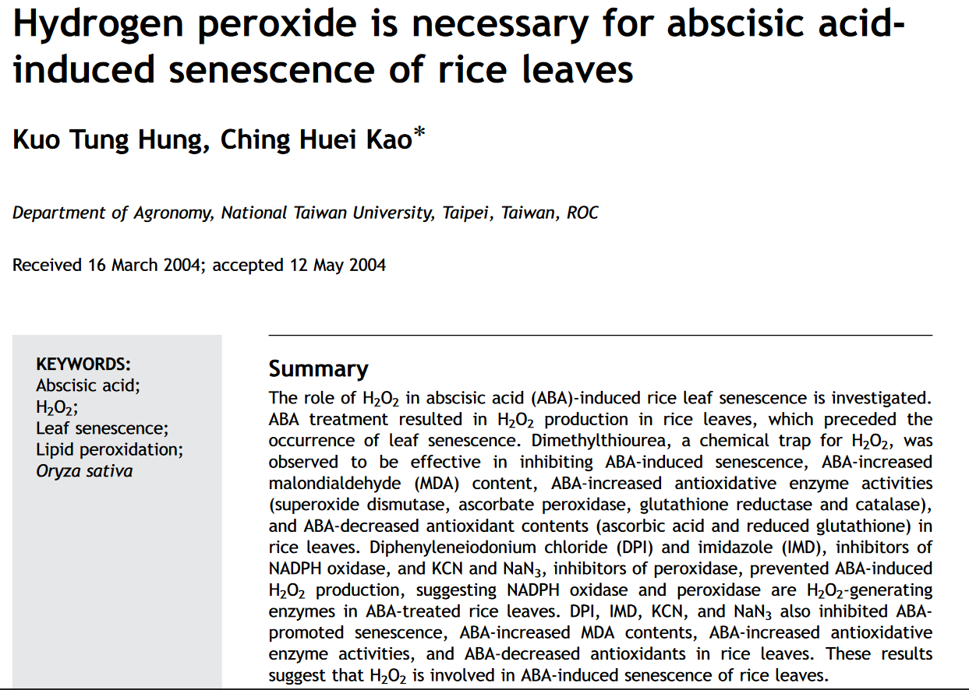

Slide 9
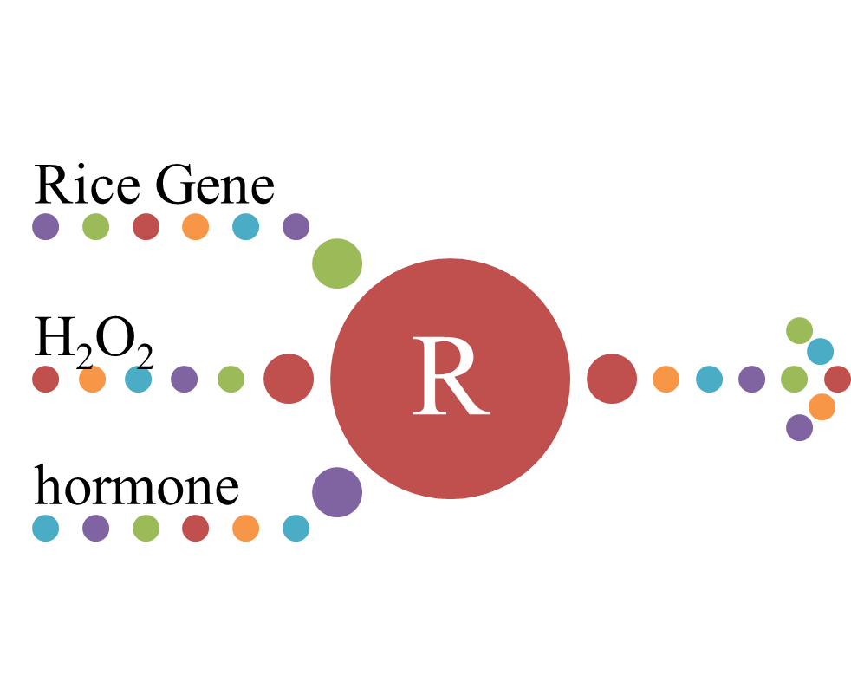
What we are going to do
Gene expression analysis

Slide 10


Database
H₂O₂ from GEO
Rice hormone from RiceXPro

Slide 11
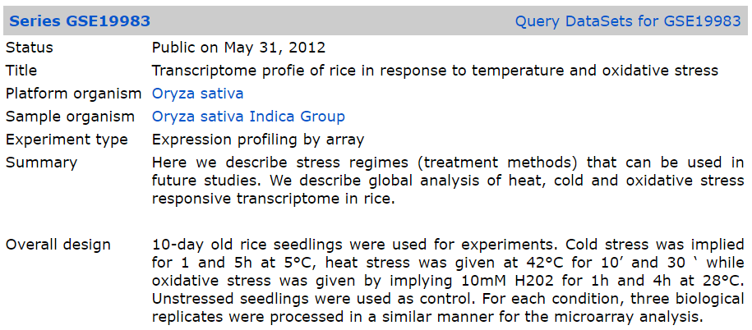
NCBI GEO_GSE19983

Slide 12
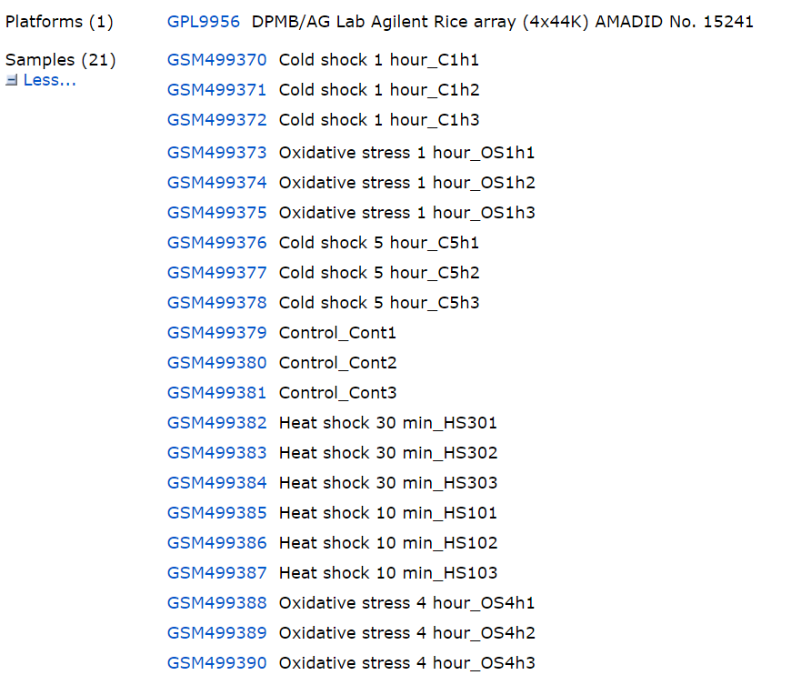
NCBI GEO_GSE19983

Slide 13
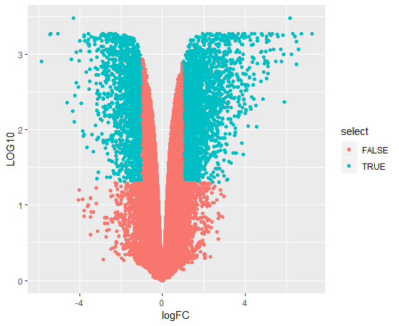
Volcano plot_H₂O₂
Bioconductor - limma
4062 genes
Log₂Fold Change >1 || < -1
p.Adj < 0.05
42417 genes

Slide 14

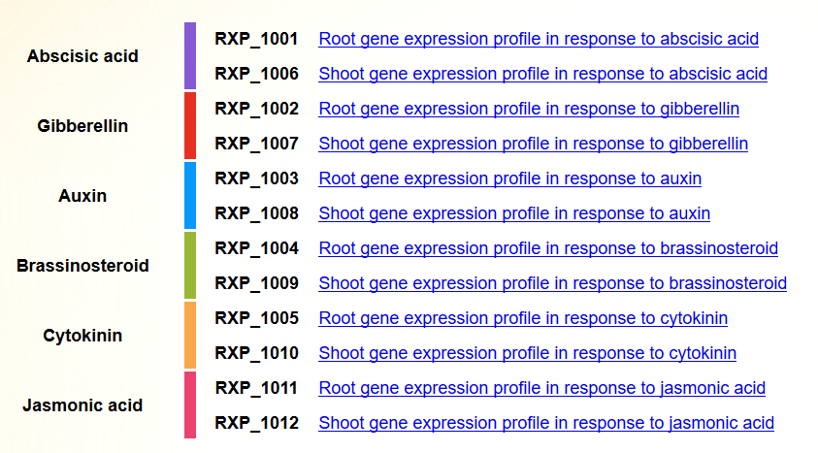

Slide 15

Data we choose
Separate root and shoot.
Seven-day old seedlings were transferred in culture solution with treatment for 1 hour.
Compare with control (mock treatment).

Slide 16
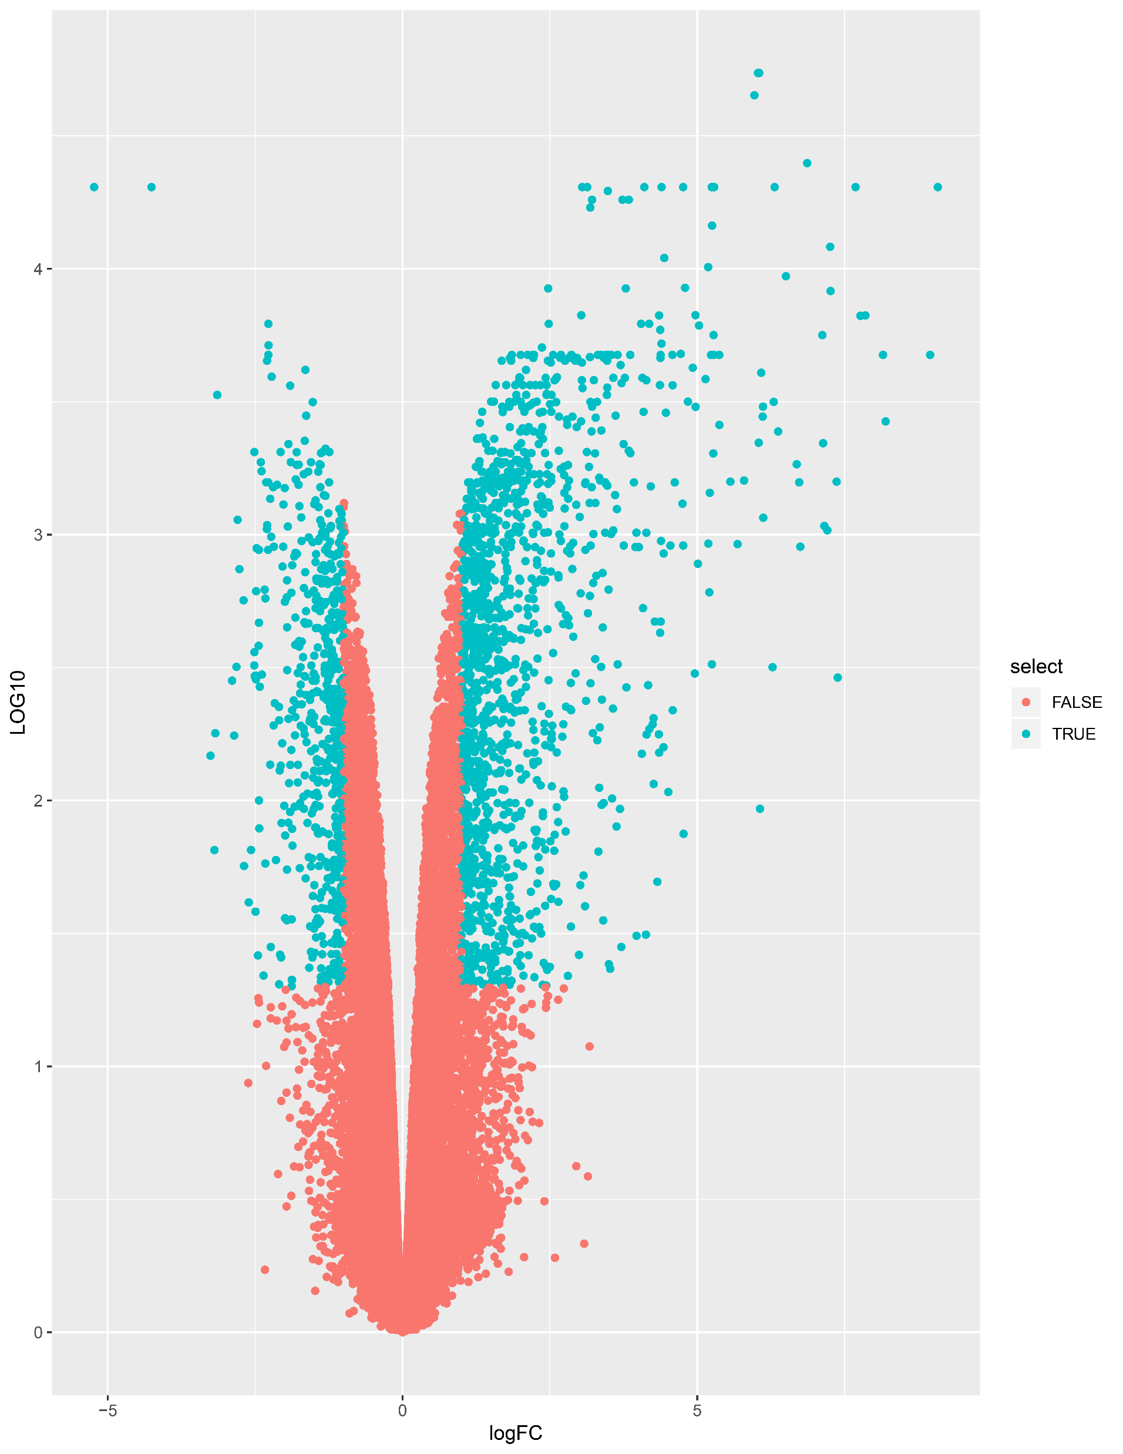
Abscisic acid (ABA)
1995 gene
Log₂Fold Change >1 || < -1
p.Adj < 0.05
45150 genes

Slide 17
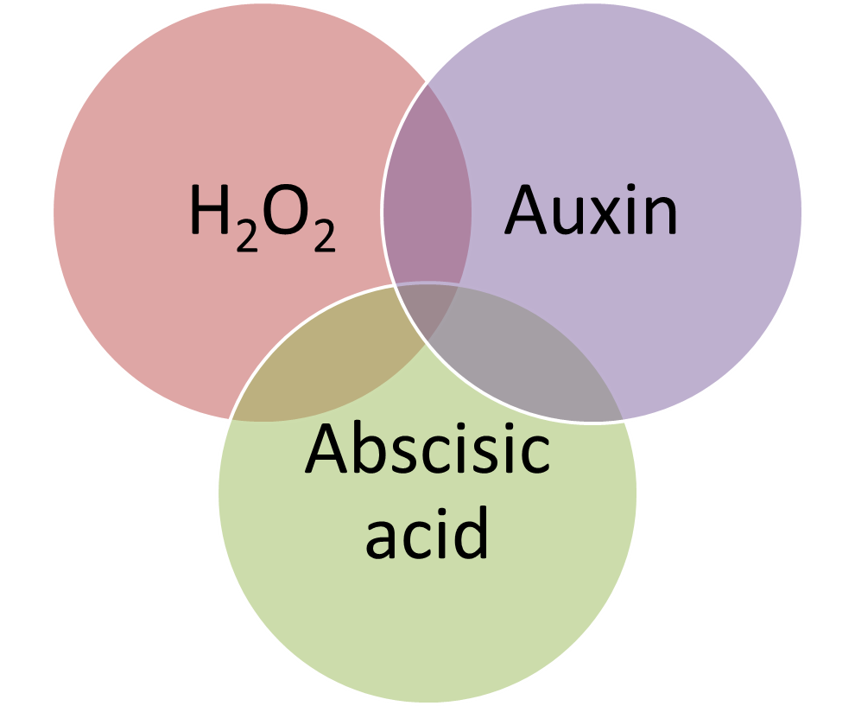
vennDiagram
Gene Ontology (GO)
將基因做系統性地注釋

Slide 18
THANKS FOR YOUR PARTICIPATION.
Q&A

