Slide 1

BDM CapStone Project
Enhancing Operational Efficiency and Cost Savings through Process Optimization at Prajwal Steel and Thibak Agency
Dhairyasheel Patil
21f1006987

Slide 2
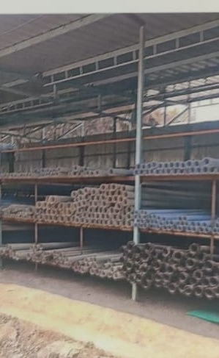
ABOUT
Operates as an authorized B2B distributor for Shree TNB Polymers Limited.
Manages inventory and maintains supply chain for affiliate dealers.
Holds third position in market share for distribution of drip irrigation, sprinkler, and PVC products locally.
Currently operates from a 3000 sq ft warehouse in Kameri, Maharashtra.
Plans to expand storage capacity to 7000 sq ft and grow turnover from 55 lakhs to 1 crore by 2024

Slide 3
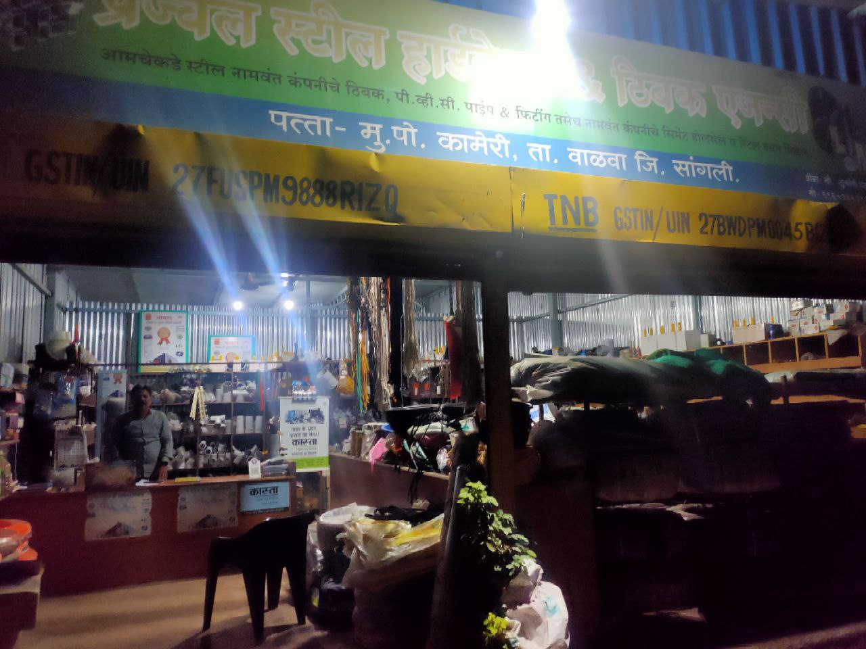
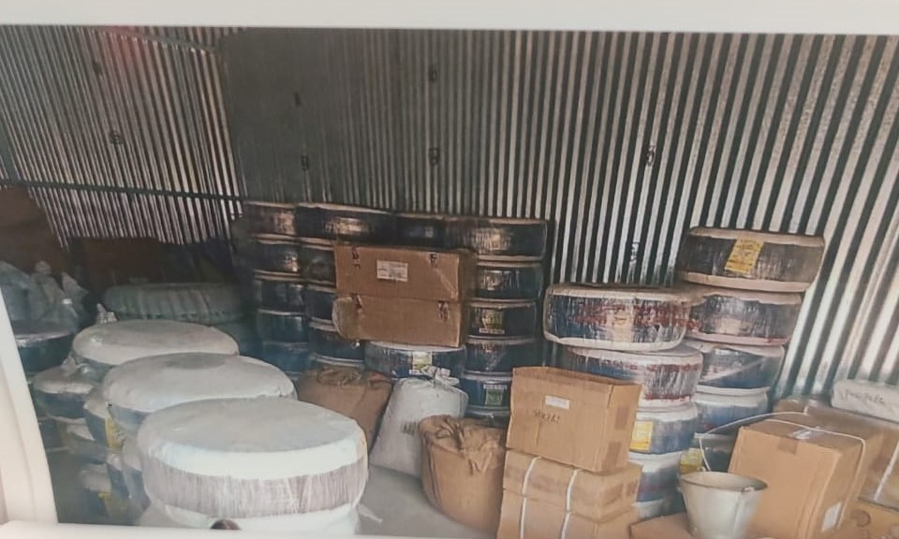
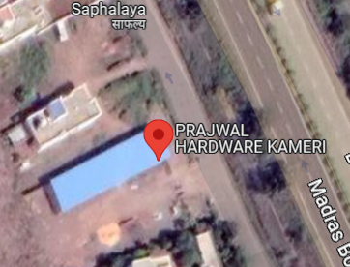

Slide 4
CHALLENGES
Complex credit systems
Price instability
Logistics issues
Sales seasonality
Supply shortages
Demand unpredictability
Inventory optimization challenges
Customer-product mismatches

Slide 5
DATA & COLLECTION
Sales transactions from Jan 2022 - Aug 2023
Shipment details of items received from Mar 2022 - Feb 2023
Credit extended to dealers from Jun 2022 - Feb 2023
Inventory levels of all products
Dealer information - name, location, revenue
Geographical coordinates of dealer locations
Stock received vs sold over time
Monthly aggregated sales data

Slide 6
ANALYSIS PROCESS
Exploratory Data Analysis
Volume Analysis
Sales Analysis
Trend Analysis
Credit Analysis
Stock Analysis
Geographical Analysis
Predictive Analytics
SARIMA Modeling

Slide 7

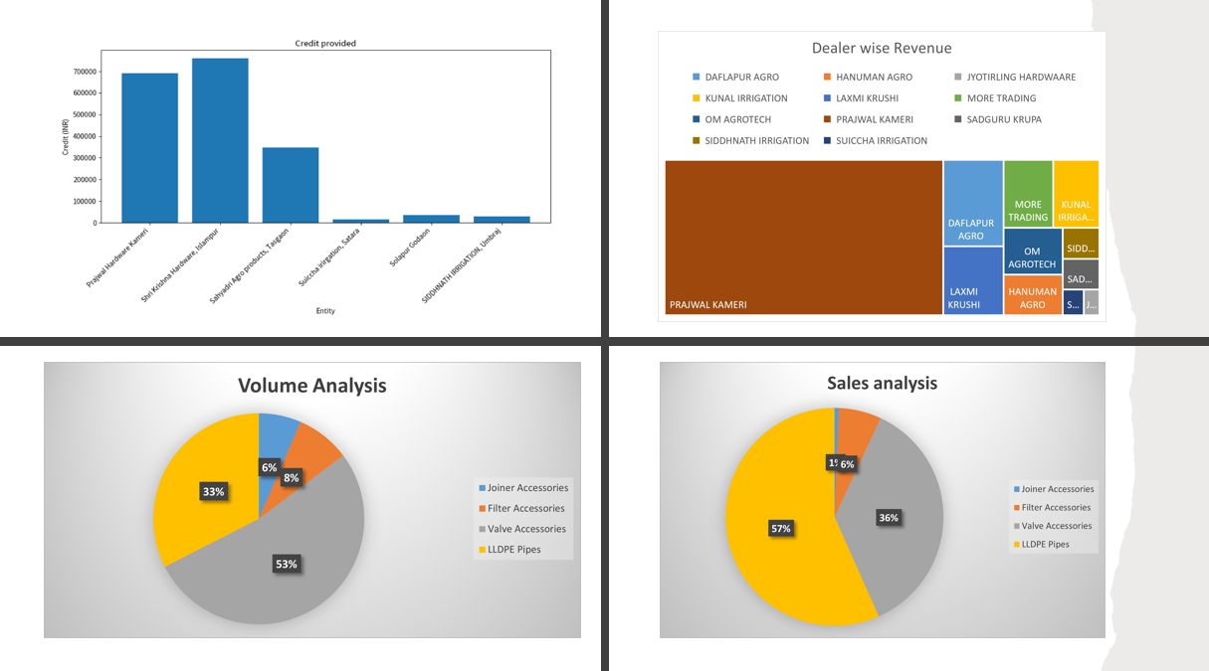
EDA

Slide 8
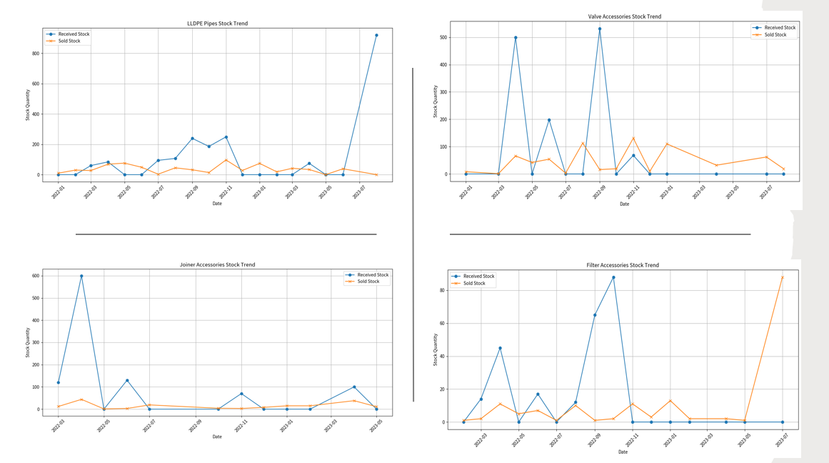
STOCK ANALYSIS

Slide 9
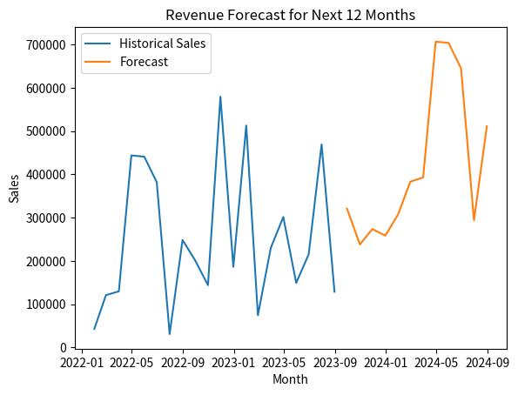
Revenue & Prediction

Slide 10
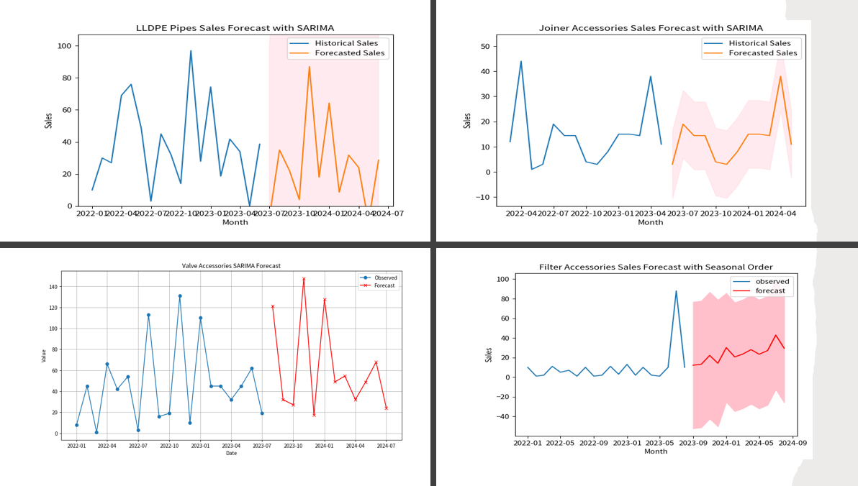
SALES & PREDICTION

Slide 11
Key Findings
RECOMMENDATIONS
Base stock orders on sales predictions
Increase stock orders during high-demand months
Stop procuring negligible selling products
Expand dealer network southwards
Relocate distribution center if constraints persist
Introduce incentives for purchasing diverse products
Expand credit offerings to more dealers
LLDPE pipes lead revenue, Valve accessories lead volume
Excess inventory accumulation
Sales spike in Q1, variability across quarters
Skewed product sales
Northern dealer concentration
Limited credit offering
Receipt-sales gaps

