Slide 1
Student Profile
Management System
Fundamentals of Data Science | UFCFK1-15-0
Module Tutor: Saurav Gautam | Year: 2025/2026
Submitted by: Shahjida Khatun, Shivani Giri, Aayushna Chapagain, Praptee Dewan

Slide 2
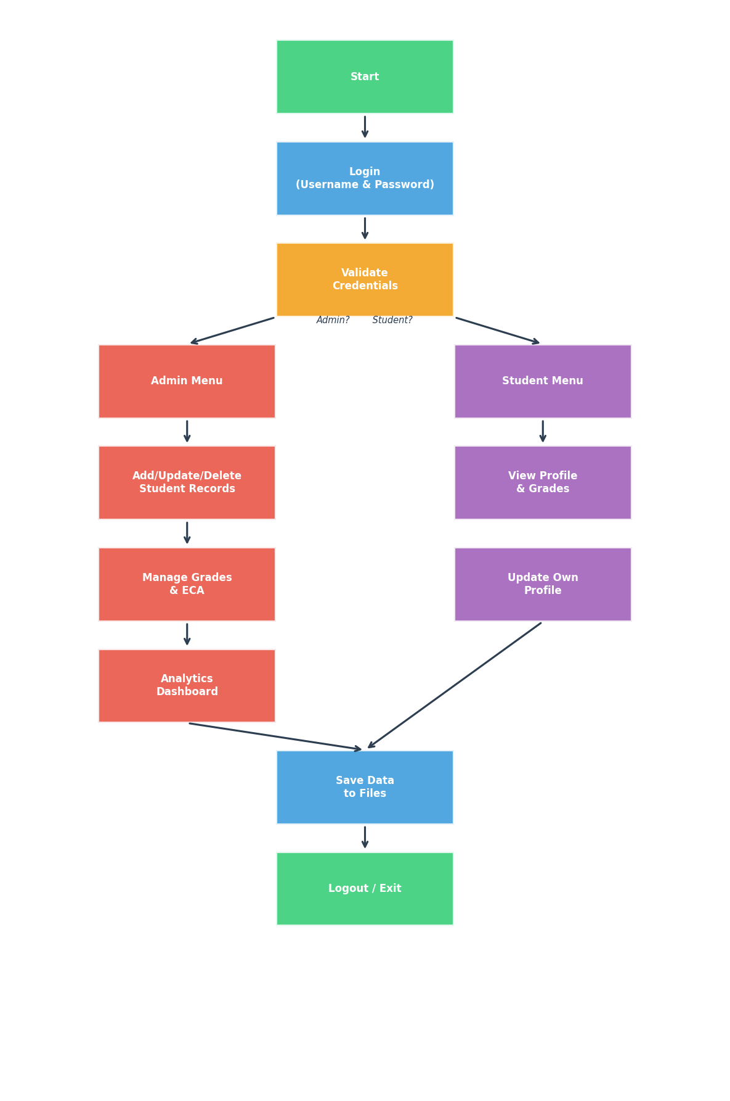
Project Overview
A Python-based Student Profile Management System that handles:
Student personal information management
Examination data (5 subjects per student)
Extracurricular activities (ECA) tracking
Role-based access (Admin / Student)
Performance Analytics Dashboard with charts

Slide 3
System Design & OOP
Person (Base)
Student
Admin
ID, Name, Age, Address, Phone
Inherits Person + Grades, ECA
Inherits Person + Full Access
DataManager
AnalyticsEngine
FileHandler
Load/Save files, Authentication
Charts & Insights (matplotlib)
Read/Write/Append with exceptions

Slide 4
Data Storage (Text Files)
File | Format
users.txt | ID, Name, Age, Address, Phone, Role
grades.txt | ID, Math, Physics, Programming, English, DS, Semester
eca.txt | ID, Activity1; Activity2; Activity3
passwords.txt | Username, Password

Slide 5
Key Features
Admin Features
Student Features
Add/Update/Delete students
Manage grades & ECA records
View all students summary
Analytics Dashboard (6 charts)
Performance alerts & ranking
View personal profile
Update own information
View exam grades & average
View ECA participation

Slide 6
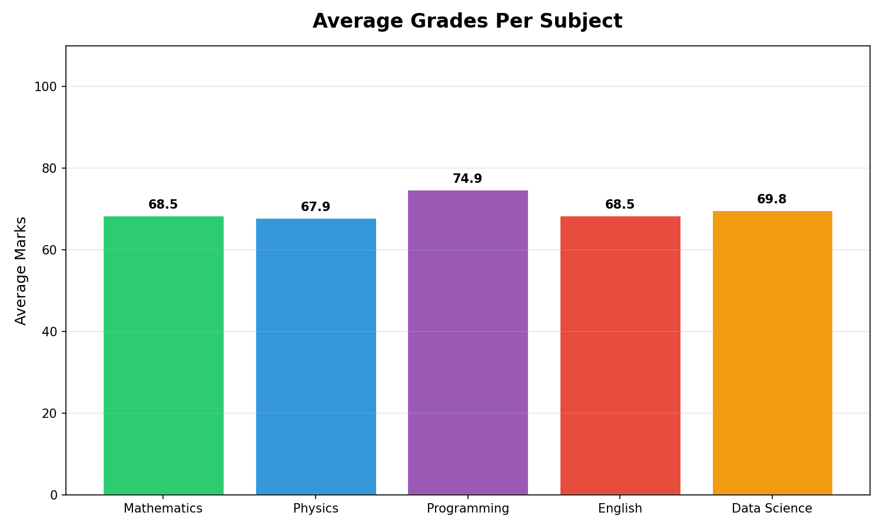
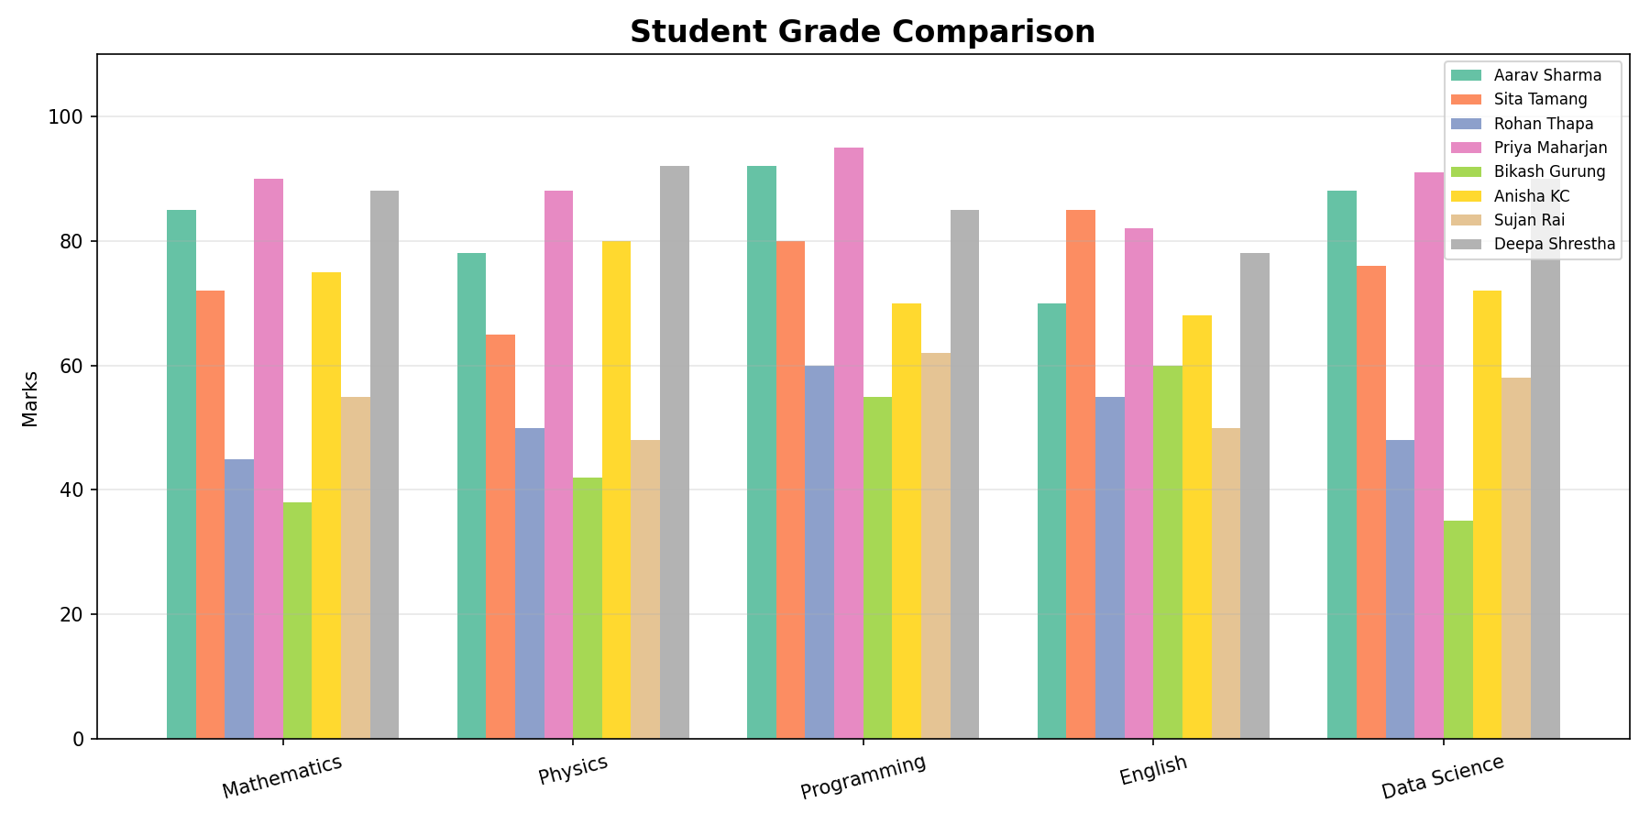
Analytics: Subject Averages
Bar chart showing average marks per subject across all students.
Key Insights:
Programming has the highest average
Physics has the lowest average
Generated with matplotlib

Slide 7
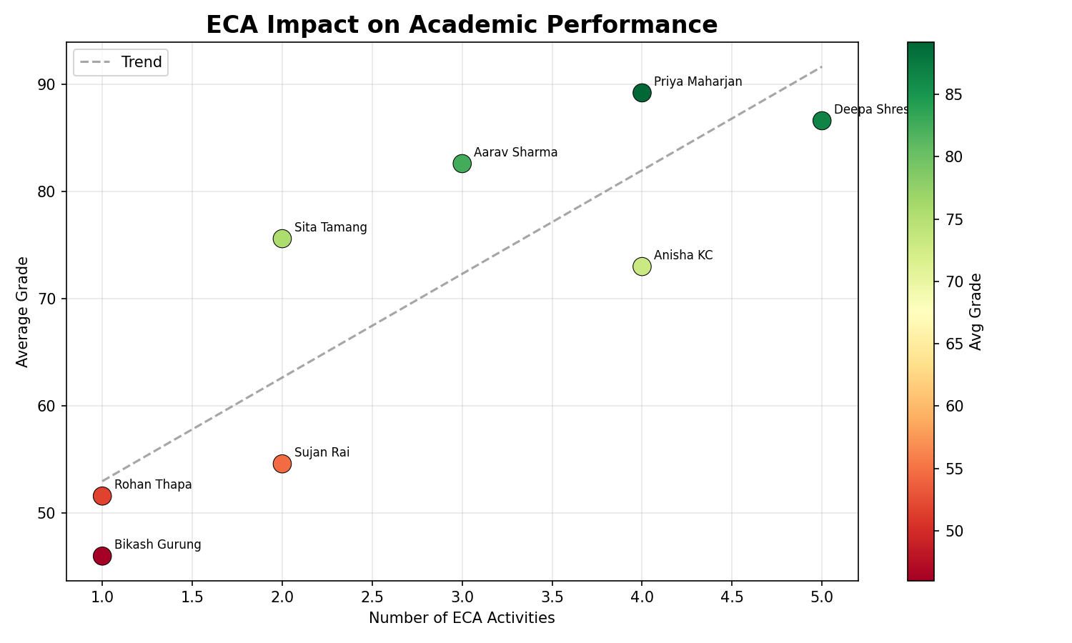
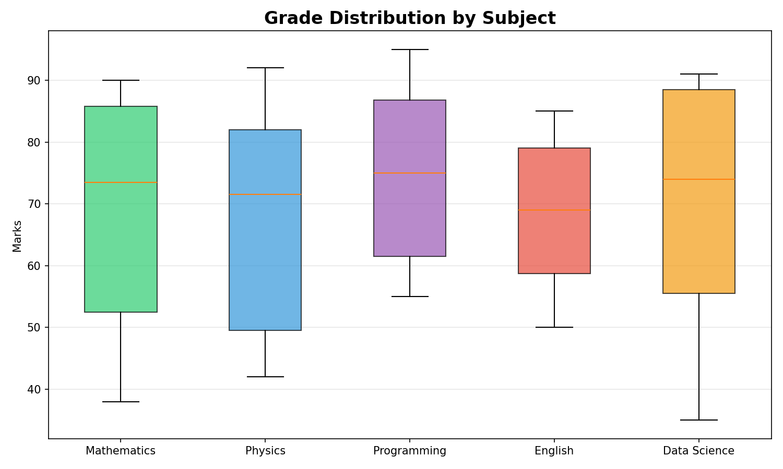
Analytics: ECA Impact & Distribution
Scatter plot with trend line shows correlation between ECA involvement and academic performance. Box plot reveals grade distribution spread per subject.

Slide 8
Technical Implementation
Python 3
Core programming language
OOP
Classes, Inheritance, Encapsulation, Polymorphism
File Handling
Read/Write to .txt files with exception handling
matplotlib
6 chart types for analytics dashboard
numpy
Statistical calculations and data processing
Exception Handling
Try-except throughout for robustness

Slide 9
Thank You!
Questions?
UFCFK1-15-0 | Fundamentals of Data Science | 2025/2026

