Slide 1


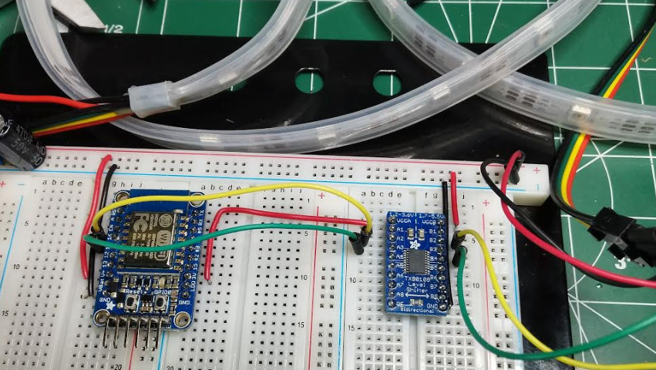
Intro to esp8266
Creating a secure web api server using ESP8266

Slide 2
agenda
SSL fundamentals
LED Strip setup
SSL Server and simple request routing
GET and POST requests using Json
Save/Load configuration to Flash
Add authentication to your api

Slide 3







SSL explained
3.
2.
Load website
4. Requesting Secure SSL
Connection from Website Host
Query DNS for IP address
5. Host responds with SSL certificate
1.
01101000 01110100 01 110000 01110011
User requests a secure site
In browser
6. Secure connection is now established
Transferred data is encrypted
This Photo by Unknown Author is licensed under CC BY-NC

Slide 4
Demo
Let’s write some code…

Slide 5
Parts used in this demo
ESP8266 Breakout
https://www.adafruit.com/product/2471
TXB0104 Bi-Directional Level Shifter - TXB0104/TXB0108
https://www.adafruit.com/product/1875
https://www.adafruit.com/product/395
DotStar LED Strip – White 30/60
https://www.adafruit.com/product/2240
https://www.adafruit.com/product/2238

Slide 6
References
ESP8266 Arduino Core’s documentation
https://arduino-esp8266.readthedocs.io/en/latest/
ArduinoJson
https://arduinojson.org/
Adafruit DotStar
https://learn.adafruit.com/adafruit-dotstar-leds/overview

