Slide 1


SPAtop Update
Sweep verdict · bigger training set · first four-top results
Daniel Primosch · UC San Diego · 13 August 2026

Slide 2


Overview
Sweep decided: pairwise attention, at 4× fewer parameters
Class reweighting and the legacy config: both negative
Bigger dataset: fully-resolved tops correctly assigned, 26% → 55%
New 15M four-top sample: pairwise wins decisively
SPAtop Update · 13 Aug 2026
1

Slide 3
Pairwise attention wins the sweep at a quarter of the model size
sweep | winner ID | params | best val_avg_jet_acc
vanilla | g2vc1w2g | 21.2 M | 0.4124
pairwise | gs8pex8v | 5.3 M | 0.4293
Winner is the smallest model in the pool
Ranking robust to metric choice (ρ ≥ 0.97)
v1 sweeps optimised a metric that was structurally NaN
Random search: not a like-for-like comparison
SPAtop Update · 13 Aug 2026
2

Slide 4
Class reweighting and the legacy config both hurt
arm (fixed data, same test set) | FR | SRqq | FB | event purity
pairwise winner config | 26.0 | 71.3 | 99.7 | 37.2
+ balance_particles | 1.6 | 44.2 | 99.7 | 15.2
legacy SPANet-paper config | 5.1 | 36.6 | 96.2 | 14.6
FB is already ~100% findable, so nothing to gain
Downweighted FR classes (67% of events) collapse
LEGACY DIFFERS ON EVERY REGULARISATION KNOB
 | best vanilla (g2vc1w2g) | legacy (SPANet paper)
learning rate | 4.7e-4 | 1.5e-3
dropout | 0.24 | 0
gradient clip | 10 | 0
balance_particles | off | on
SPAtop Update · 13 Aug 2026
3

Slide 5
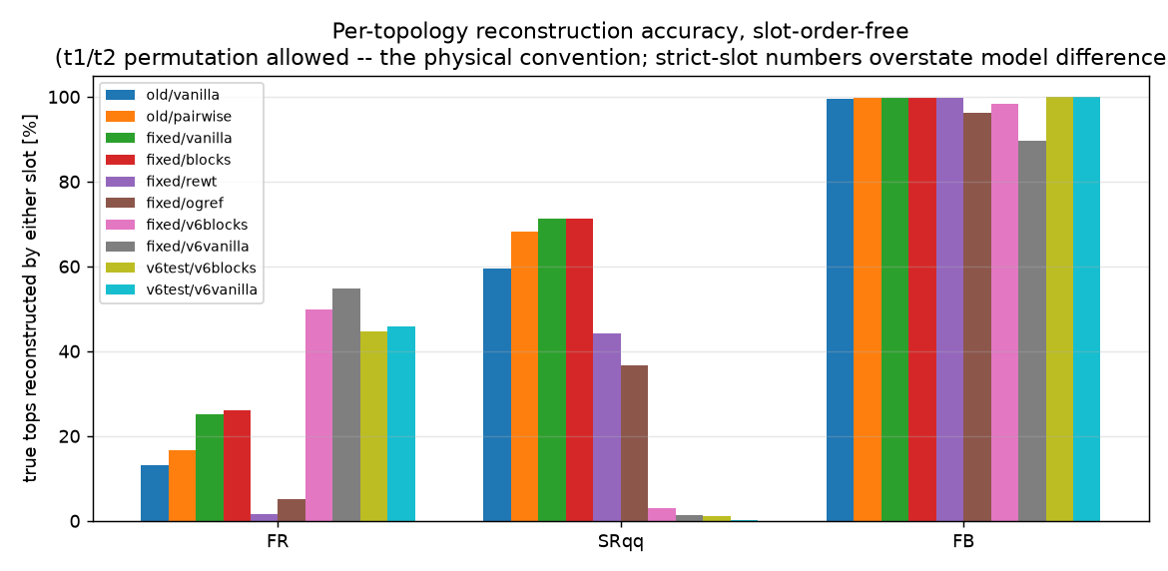
Correction: our earlier per-topology numbers were slot-ordered
FB is ~99.7% reconstructed, not the 50% we showed
SRqq 71.3% for both architectures
FR 26.0 vs 25.0: the “2× FR” claim was slot ordering
SPAtop Update · 13 Aug 2026
4

Slide 6
The bigger training set nearly doubles fully-resolved reconstruction
model (evaluated on the trusted fixed test set) | FR | SRqq | FB
pairwise, fixed data, 864 k events | 26.0 | 71.3 | 99.7
pairwise, delphes v6, 15.4 M events | 49.8 | 3.0 * | 98.3
vanilla, delphes v6, 15.4 M events | 54.8 | 1.3 * | 89.6
Group curves: +10 pts resolved purity above 150 GeV
3 to 6× the high-pT efficiency (0.6 vs 0.05 at 300 GeV)
* SRqq needs a fix, see next slide
SPAtop Update · 13 Aug 2026
5

Slide 7
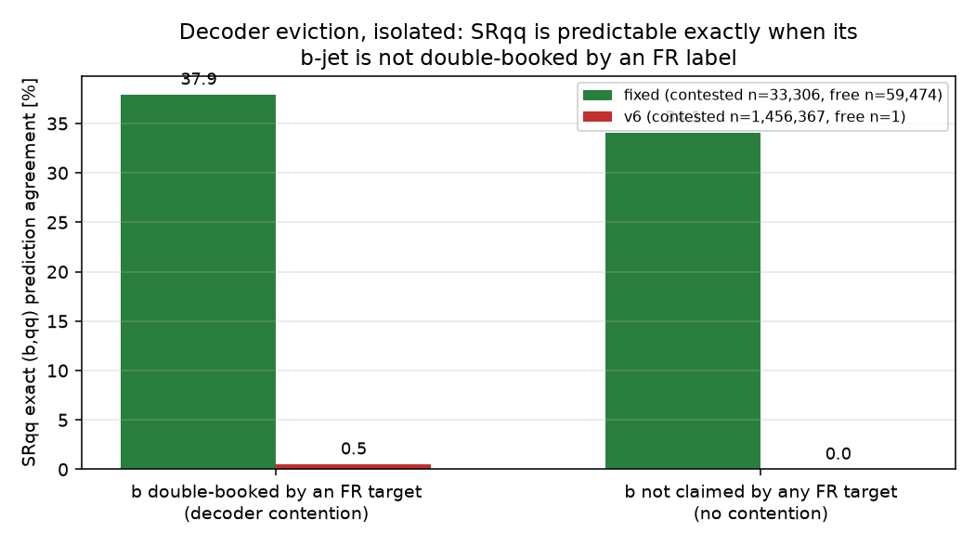
v6's SRqq failure is decoder eviction, not bad labels
v6 SRqq labels are ~89% physically correct
But the b-jet is double-booked with FR in ~100% of targets
SPANet's decoder is globally exclusive, so SRqq is evicted
Same effect costs 17.4% on our current fixed data
SPAtop Update · 13 Aug 2026
6

Slide 8
In t̄t the attention bias is a sample-efficiency device
FR reconstruction, slot-order-free | 864 k events | 15.4 M events
vanilla | 25.0 | 54.8
pairwise | 26.0 | 49.8
Pairwise leads narrowly at small data, 4× parameter efficiency
Vanilla wins at 15.4 M events
Standard analysis: architectures equivalent at scale
SPAtop Update · 13 Aug 2026
7

Slide 9
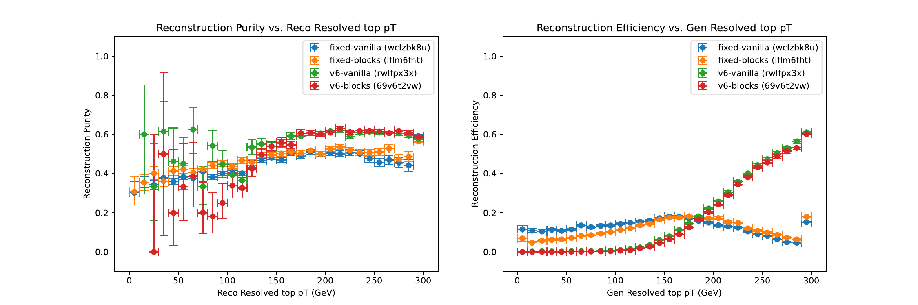
After the standard selection the two t̄t architectures are equivalent
Resolved tops. Left: purity vs reconstructed pT. Right: efficiency vs generated pT.
SPAtop Update · 13 Aug 2026
8

Slide 10
In four tops, pairwise wins decisively
tttt, 1.63 M training events | FR | SRqq | FB | event | val
vanilla | 15.4 | 43.6 | 99.8 | 29.0 | 0.4046
pairwise | 28.4 | 52.9 | 99.8 | 35.2 | 0.4558
SRqq +9.3, event-level +6.2
Group's own metric agrees: ~2× purity and 2 to 3× efficiency
FR +13.0 points, an 84% relative improvement.
SPAtop Update · 13 Aug 2026
9

Slide 11
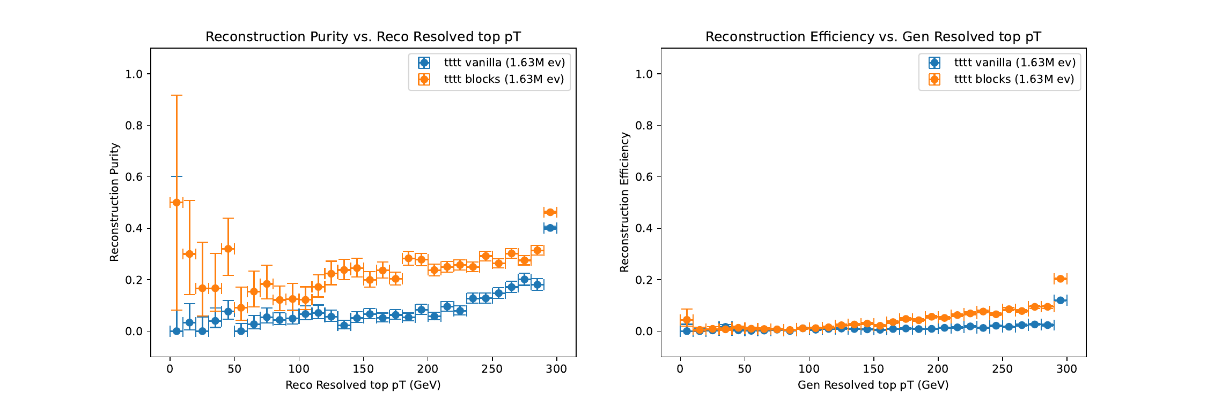
Standard selection confirms it: pairwise doubles resolved purity
Four-top resolved tops, 100 k-event test subsample.
SPAtop Update · 13 Aug 2026
10

Slide 12
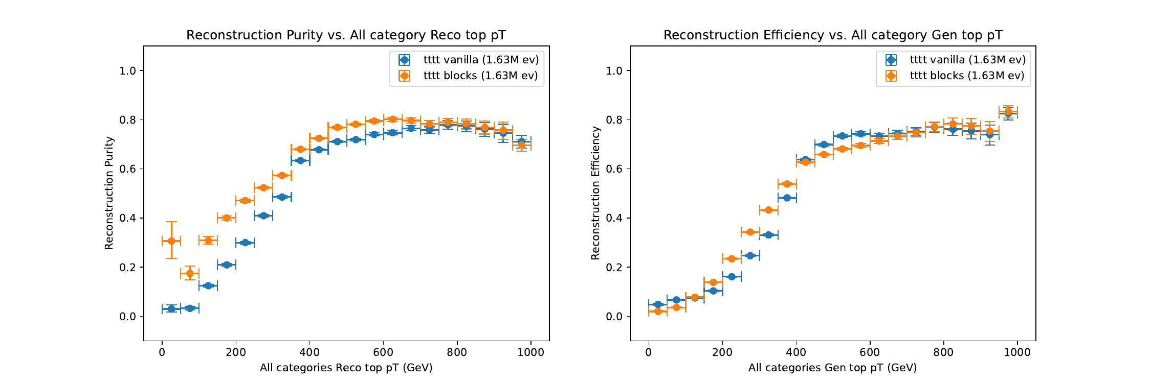
The advantage holds across all four-top categories
All categories combined, four tops.
SPAtop Update · 13 Aug 2026
11

Slide 13
And the advantage grows with data, the opposite of t̄t
FR gap, pairwise − vanilla | t̄t | tttt
small data | +1.0 (864 k) | +3.3 (10.9 k)
large data | −5.0 (15.4 M) | +13.0 (1.63 M)
H_{T}(N) = N! / [ (N−3T)! · 2^{T} · T! ] → 1.9×10⁴ (t̄t) · 2.3×10⁹ (tttt)
label symmetry T! = 2 (t̄t) · 24 (tttt) · 720 (t̄tt̄tt̄t)
SPAtop Update · 13 Aug 2026
12

Slide 14
Recommendation: vanilla SPAtop for t̄t, pairwise for multi-top
t̄t: vanilla SPAtop
t̄tt̄t, t̄tt̄tt̄t: pairwise attention SPAtop
First order improvements: data for t̄t, architecture for tttt
SPAtop Update · 13 Aug 2026
13

Slide 15
What we need from this meeting
1
v6 SRqq relabel: regenerate targets under the fixed-era rule (Thomas)
2
Group-aware decoding: recovers 17.4% on our *current* data too
3
The ≥3n-jet cut: 13.6% acceptance dominates four-top event economy
4
Selection variable: switch pipeline from detection to marginal probability
5
tttt next step: dedicated sweep, more statistics, or both?
SPAtop Update · 13 Aug 2026
14

Slide 16
Backup

Slide 17
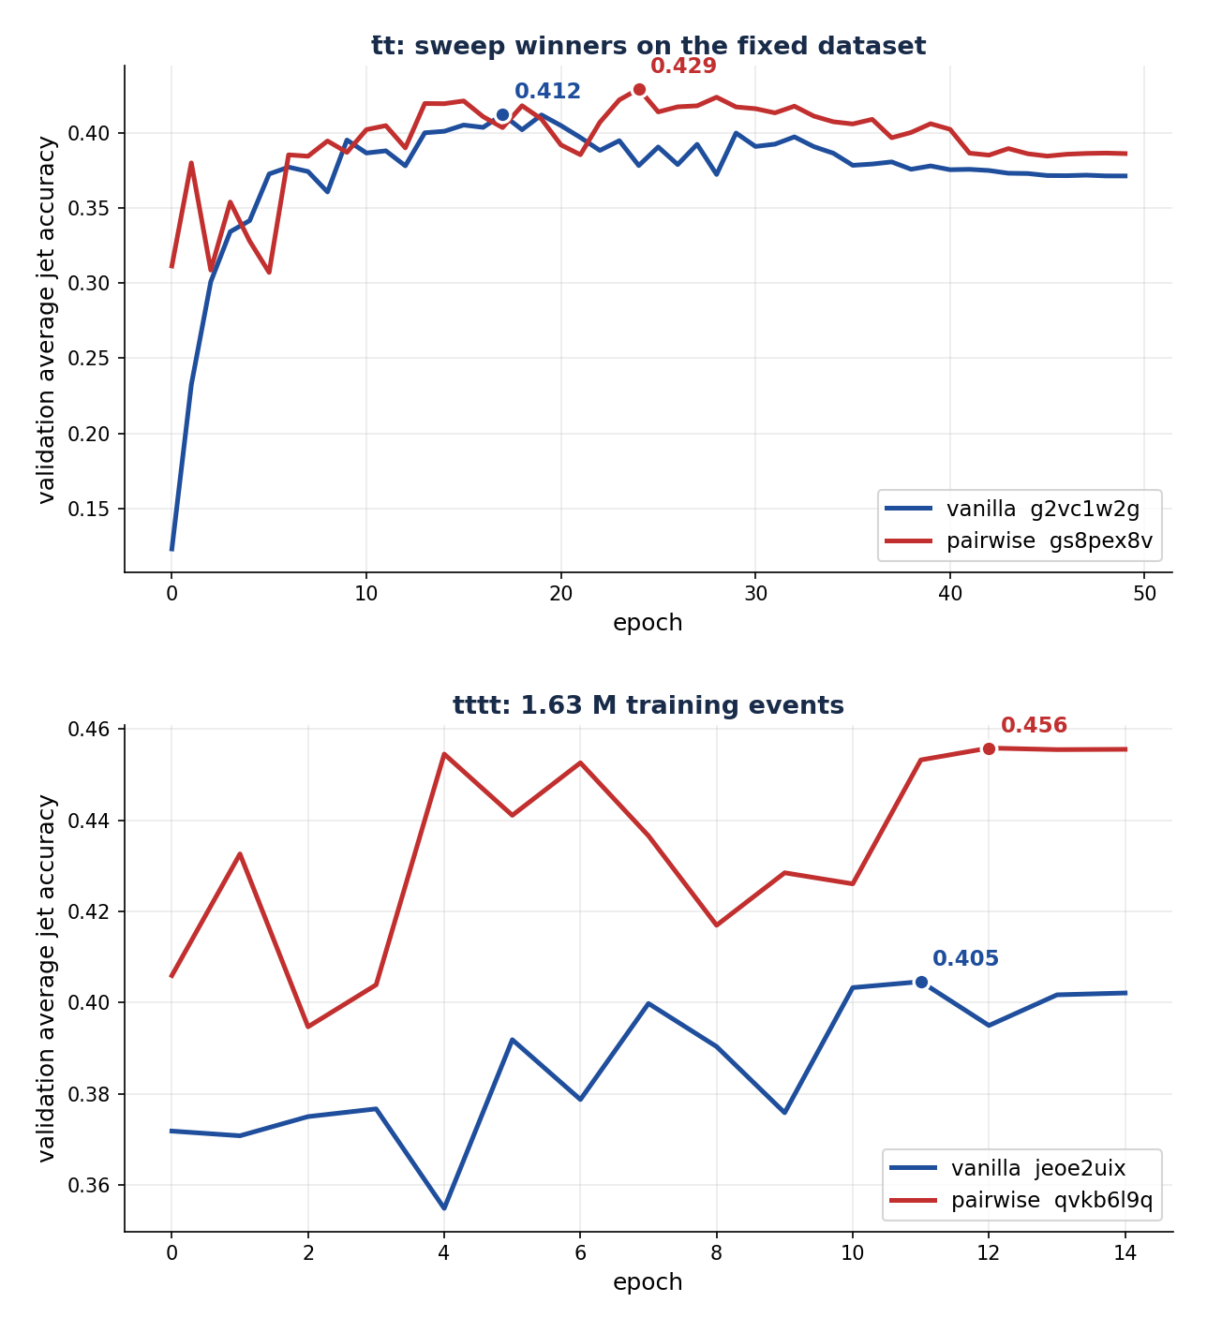
Training curves: a higher plateau, not a faster one
Top: t̄t sweep winners. Bottom: four tops at 1.63 M events.
SPAtop Update · 13 Aug 2026
15

Slide 18
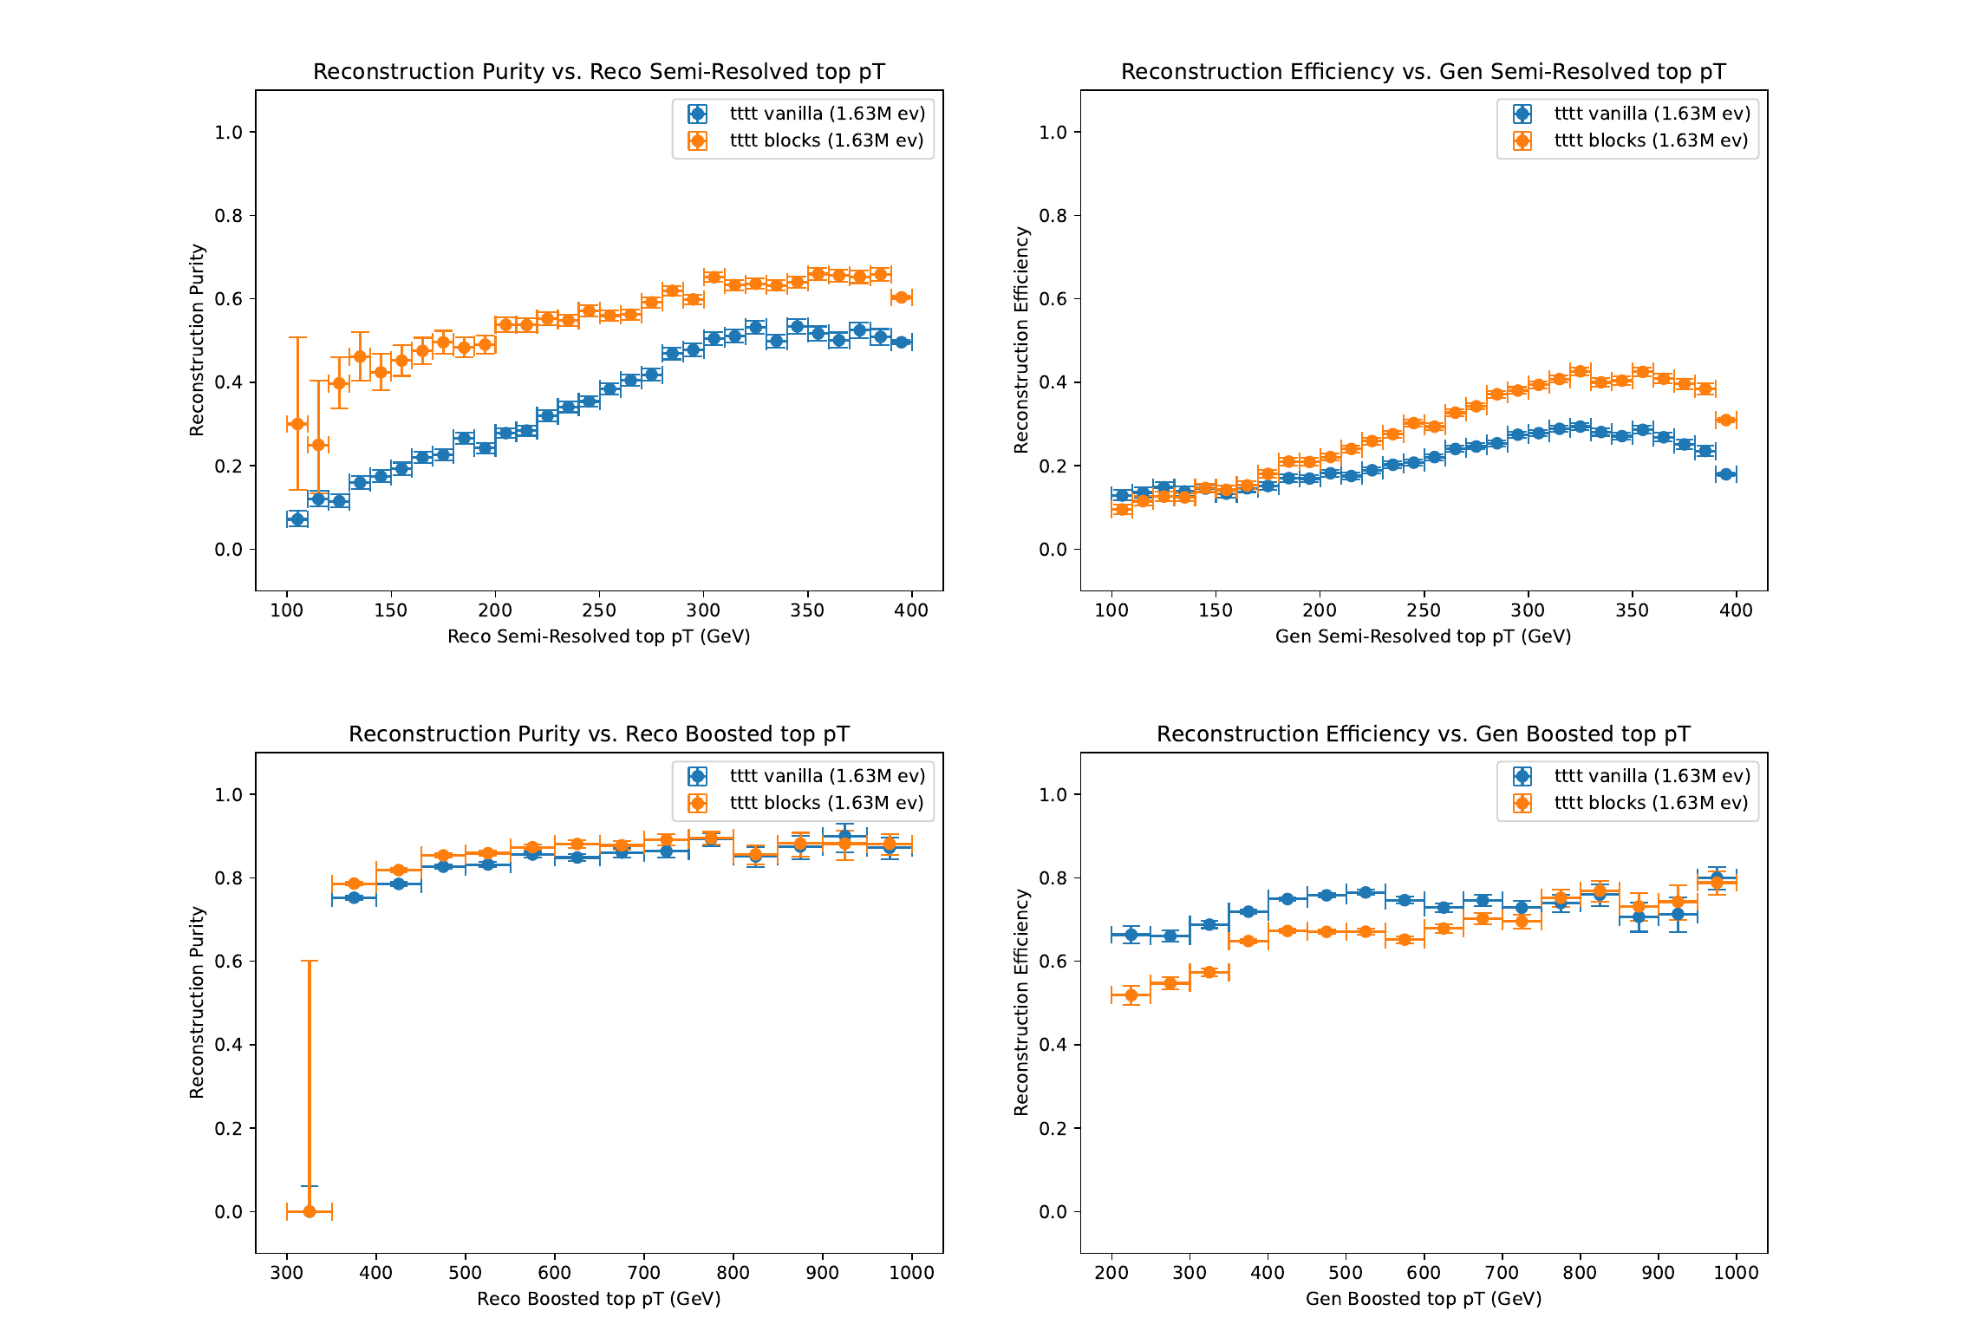
Four-top semi-resolved and boosted categories
Top: semi-resolved qq. Bottom: boosted.
SPAtop Update · 13 Aug 2026
16

Slide 19
How we built the four-top sample
Card → MadGraph → Delphes → converter → gate → SPANet
Group converter used unmodified at --n-tops 4
15 M events generated: 750 shards, zero failures, ~6 h
1.63 M train / 408 k test, label gate PASS
Check physics of the four-top simulations (Tommy?)
SPAtop Update · 13 Aug 2026
17

Slide 20
Caveats, stated up front
One run per arm everywhere, no seed variance
tttt used t̄t-derived hyperparameters, 15 epochs
tttt group curves on a 100 k-event subsample
Delphes level throughout, no pile-up or detector realism claims
SPAtop Update · 13 Aug 2026
18

Slide 21
Pipeline defects found this cycle
v6 deltaRfj written with the pre-cleaning row count
One structurally invalid SRqqt2 target, killed five runs
Train/test split keyed on a filename substring
Pythia card has no trailing newline, appends silently lost
SPAtop Update · 13 Aug 2026
19

Slide 22
Where everything lives
Data: /data/spatop/{tttt_15M, delphes_v6, tttt_pilot}/
Code, jobs, figures: branch claude/great-curie-12c321
Forensics: reports/v6_srqq_bug_report.md
Generation recipe: simulation/tttt/README.md
SPAtop Update · 13 Aug 2026
20

