Slide 1
QUINTILE
-Niharika Srivastava
(Analyst Programmer)

Slide 2
CONTENT
Introduction
Input and Output
Programs Needed
Methodology
Differences
Languages Used
Quintile Document with Explaination
Q and A session

Slide 3
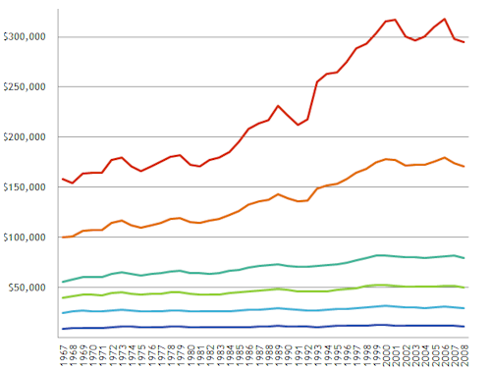
INTRODUCTION
Quintile is a statistical value of a data set that represents 20% of a given population.
i.e. first quintile represents the lowest fifth of the data(1-20)%

Slide 4
INPUT | OUTPUT
TCS_DATA(data.csv) | Report.xlsx
KEY FILE (final key) | Remark.xlsx
PARAMETER FILE :- Header Project Name and Id Test Boundary Test Name 5. First option id 6. Number of Candidates 7. Responses(4/5/6) | Plot_items.xlsx

Slide 5
Programs Needed
Response Generation
Quintile Reports
response.sh
generate_resp.py
quintile.py
remarks.py
plot.py

Slide 6
METHODOLOGY
OLD | NEW
Input:- data.csv, key file, parameter file | Input:- data.csv, key file, parameter file
Create OMR file using data file and key file (which contains responses) | Directly generate responses without OMR
Reports are generated for 4 Forms although only 1 is needed | Forms which are not needed are excluded.
Quintile Report contains Double Marking | Double Marking excluded from Quintile Report
Lots of scripts are run manually at each step. | It contains 5 programs/scripts which can be run via single program.
Four files are generated in output | Three files are generated as output

Slide 7
DIFFERENCES
OLD | NEW

Slide 8
LANGUAGE USED
1. Python
2. Shell Scripting

Slide 9
Explaination of Quintile Report
Detailed Explaination of values provided in Quintile Report.

Slide 10

QUERIES ????

