Slide 1

Agile in (less than) an Hour
Gail E. Harris
Web Development Manager & Architect
Derived from a Presentation by
Joe Bergin & Fred Grossman
Pace University

Slide 2
Introduction
Agile Software Development is a high discipline and very iterative development method
It avoids early commitment and early infrastructure development to achieve:
  Low cost of change and
  Easy retargeting of a project
Notes:
Agile started with eXtreme Programming, in late 1990’s
Chrysler C3 project
Main idea, take good practices and dial them up to 10
If testing is good, test everything and test before you start (TDD)
If code review is good, then do it 100% of the time (pair programming)
If incremental/spiral development is good, then deliver working code every few weeks (iteration)
In 2000’s adoption grew rapidly
Why? Because many software projects still failing

Slide 3
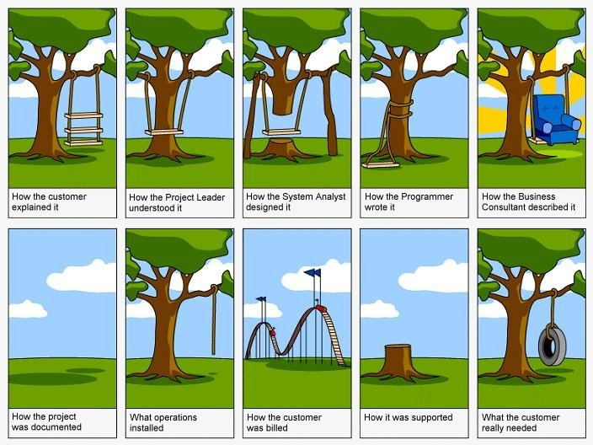
Why Projects Fail
Notes:
Trying to over-control the dimensions
Features
Cost
Schedule
Quality
In reality you can only control 3 of these
In response, and with the success of C3 and other collaborations,
a group of thought leaders gathered in Oregon in 2001.

Slide 4
Agile Manifesto
We Value:
  Individuals and interactions over
  processes and tools
  Working software over
  comprehensive documentation
  Customer collaboration over
  contract negotiation
  Responding to change over
  following a plan
Notes:
Careful phrasing of these four values, to say one thing is valued over another means that both are valued, but one is is valued more.
Applying these values takes:
Courage
Communication
Simplicity
Feedback
Respect
Signs and symptoms of losing sight of values:
Cubicles, loneliness
Lying
Coercion (“... by Friday”, or “You can’t have that”)
Late testing, too little testing
Working from inadequate documentation
High cost of change, inflexible design
Parts OK, but don’t fit together

Slide 5
Agile Sweet Spot
Reasonable Size
Uncertainty on Features…
Change Likely
Standard process likely to fail
If you can’t plan, then build on a tight feedback loop
Notes:
Structured development best when:
Few unknowns
Built something similar before
And with the same technology
Human safety issues
But even there I am hearing stories about applying Agile successfully for air traffic control and other similar projects
For the PMP trained, think of Agile as rolling wave planning and/or time boxed projects.

Slide 6
Many Flavours
Scrum -- overall management process
XP -- day to day practices
Crystal -- scaling, flexibility
…
Being agile, not just doing agile.

Slide 7
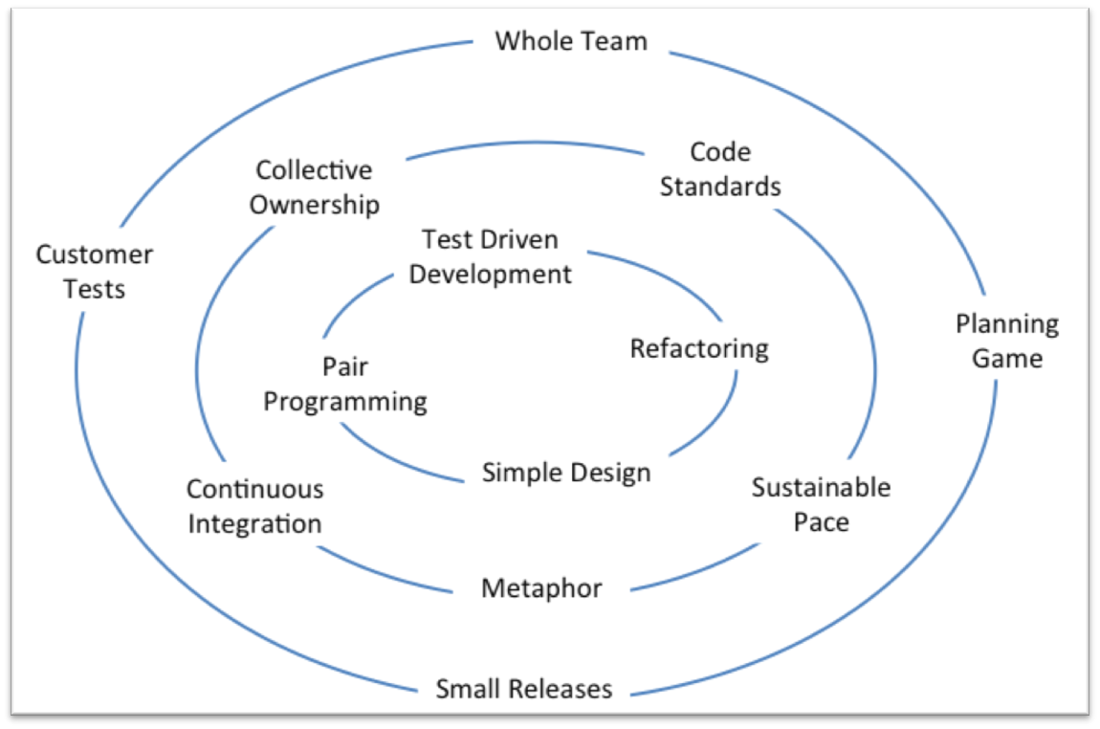
Key Ideas
Notes:
Set of practices drive behavior:
Outer circle are process practices
Middle circle are team practices
Inner circle are coding practices
Practices are synergistic & support each other
Based on observation that Communication Distance is expensive
Have a goal that Schedules never slip (time-box)
Balance between rights & responsibilities
Set of practices is humane
Requires:
Discipline
Commitment
Honesty
Courage

Slide 8
What is missing?
Upfront requirements gathering and sign-off -- hence no need to commit early
Upfront design documents -- hence easy to retarget
Early costs amortized over life of project
-- hence lower cost of change
Intimidation: schedule, cost, or value
Notes:
You may have noticed agile is missing BDUF
The first computer programmers were engineers and mathematicians
Their skills and practices, and the (relatively) slow turnaround time from program writing to execution (hours or even days) naturally led these pioneers to do a lot of upfront requirements and design.
The metaphor of software development to engineering (construction) maintained this practice
Today, computers are fast, humans are slow. Its time for a new metaphor with new processes.
Let’s dive deeper, who are the players in this new approach?

Slide 9
Agile Roles
Customer, Product Owner, Stakeholder
Developer
Tester -- all developers do this
Coach -- responsible for process and guidance
  ScrumMaster (super coach plus downfield blocker)
Others (tracker, documentation, …)
Notes:
<identify who in the room has each role: ask customers to raise hand, etc.>
Peter is investigating taking a two-day CSM course

Slide 10
Customer/ Product Owner
Write short “story cards” describing features
Answer questions throughout to add specificity to the stories (just in time requirements)
Write/specify acceptance tests to verify stories
Make all business decisions: function, priority, feature value, acceptance
Obtains consensus/consent among stakeholders to guide development
Notes:
Understands the domain well by working in that domain
and also by understanding how it works (not always the same thing)
Can understand, with development’s help, how software can provide business value in the domain
Is determined to deliver value regularly
and is not afraid to deliver too little rather than nothing
Can make decisions about what’s needed now and what’s needed later
Is willing to accept ultimate responsibility for the success or failure of the project. [Beck & Fowler]

Slide 11

Sample Story
The system will correctly classify triangles: right triangles, equilateral, etc.
Story 3

Slide 12
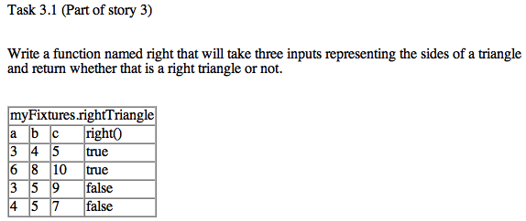
Sample Acceptance Test
These are created in Excel or HTML, but are executable

Slide 13
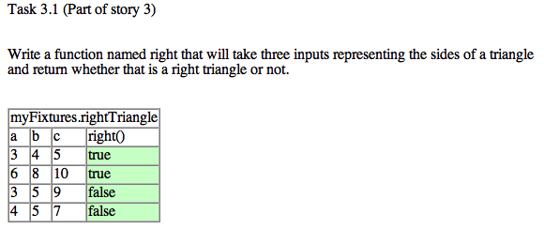
After Execution
Failed tests show up in red.

Slide 14
Developer
Estimate stories
Break stories into tasks
Build tasks -- with customer feedback
Write unit tests (all tests always succeed)
Do continuous integration
Notes:
Shared goal to maximize value while minimizing cost
The customers define what is needed
Developers estimate effort
Customer sets priorities
Collaborate to find alternative solutions that meet customer goal in a different way
Customer feedback points: when working on a story, at demonstration at end of iteration

Slide 15
Other
Tracker (keep everyone aware of progress)
Coach (conscience of the team)
Big-Boss (management and shelter)
Tester (write/run unit tests...)
Consultant (extra knowledge as needed)
  Concept: Pigs v Chickens
Notes:
Chickens are committed
Pigs have skin in the game

Slide 16
Contract
For best effort and full communication, NOT for deliverables on a given date
Customer/Product Owner may terminate project at any time
Short release cycles (6 - 12 weeks) ensure constant delivery of customer value
Schedule never slips, though features may be dropped from an iteration (1-3 weeks)

Slide 17
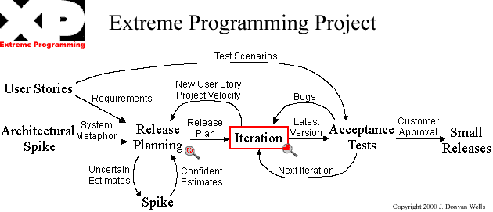
Overview of Cycle
Notes:
<Review diagram>
Scrum includes a Demonstration and Retrospective practice for every iteration.

Slide 18
QUESTIONS
Notes:
<after questions have our first Demonstration, one of the feedback points>

Slide 19
Practices
XP has a dozen or so key (daily) practices. The most important overall are
  Onsite Customer
  Whole Team
Notes:
Whole Team:
Include on the team people with all the skills and perspectives necessary for the project to succeed
Ready availability of all resources needed
Avoid fractional people
Onsite Customer:
In ideal circumstance a business representative of the customer sits with the developers.

Slide 20
Practices-- Customer
The most important practices for the customer are:
  Onsite customer - available customer
  Planning Game
  Customer Written Acceptance Tests

Slide 21
Onsite Customer
Customer is needed on site because
  Developers should not make business decisions but
    no upfront requirements
    no upfront design documents
A story is a contract to talk in the future
  actual requirement is captured just-in-time

Slide 22
Whole Team
In addition to the customer, the “whole team” includes all personnel with key skills needed to develop the system
  Software developers
  Designers - architects - analysts
  Information architects
  Graphic artists
  Integrators
  Others as appropriate - testers, documentation specialists …
BUT it favors generalists over specialists
AND it is SELF-ORGANIZING

Slide 23
Key Ideas
Everyone has responsibility for the project
  Not just for their little piece
Just in Time - Just Enough
  Lack of anticipation and scaffolding
Strict time-boxing of iterations

Slide 24
Whole Team
The customers write stories and prioritize them
The other members task out the stories and estimate them
Members with appropriate skills estimate and perform tasks
Tasks support the stories

Slide 25
Planning Game 1
This is a periodic task (every 1-3 weeks) in which the customer chooses the high value features (stories) for the next release or iteration
Based on cost estimates from the developers
Estimates are not a contract, so re-steering is required throughout the iteration.
Notes:
Build the high value features first -- controlled by customer
Make expensive decisions as late as possible
When the cost and value curves cross - quit!
We have chosen 3 weeks as the sweet spot

Slide 26
Planning Game 2
Customer writes stories
Developers estimate stories
Customer prioritizes stories
Developers give the “velocity”
Customer chooses stories up to velocity
Notes:
Issues that might arise:
Vague story
Overly constrained story
Difficulty in providing an estimate
Estimates are too long relative to the iteration length
Common resolutions:
Refine the description
Discussion about what is hard and what is easy
Replacing a story or task with a different one with a similar business outcome
Split a story or task into two or more new ones

Slide 27
Planning Game 3
Developers/Customer discuss stories
Developers divide stories up into tasks
Individual developer with appropriate skills chooses a task and estimates it
If sum of task times > velocity then back to planning, otherwise build, test, & integrate

Slide 28
Staying Happy
Customer steers like a bicycle
If something is not “right” then write a new story and prioritize it like any other (no guilt, no blame)
Developers build only the stories in the current iteration and always do the simplest thing that could possibly work
Stories are fine-grained to enable short iterations

Slide 29
Build Phase
Tracker keeps track of everyone’s progress
If all tasks/stories can’t be completed on time some are dropped. Customer chooses which
At end of each task, all tests pass. Customer verifies - accepts or rejects
If the customer still isn’t happy, write a new story - no time wasted on assigning blame

Slide 30
Build Phase (cont.)
If developers finish early, go back to customer for more work. Customer chooses
Developers give a new “mini velocity”
Next iteration velocity is adjusted based on what we complete this iteration
Concept: Done = built, thoroughly tested, integrated, documented, accepted

Slide 31
Practices--Developer
Standup Meeting
Sustainable Pace - energized work
Test Driven Development
  No code without a failing test
Small Releases - 2 or 3 iterations
Collective Code Ownership
Coding Standard

Slide 32
Practices--Developer
Pair Programming
Constant Refactoring
Continuous Integration
Simple Design
Metaphor
Retrospectives

Slide 33
New Practices
The above practices may not all be appropriate as stated for an integrated team
Practices are built on principles to give benefits
Need to discover and implement appropriate practices for THIS team on THIS project to achieve desired goals (so, hold Retrospectives)

Slide 34
Agile Synonyms
XP
Scrum
Iteration
Customer
Coach
Big Boss (sheltering mgr)
Project Stories
Iteration Stories
Stand up meeting
Planning Game
Sprint
Product Owner
Scrum Master
Scrum Master
Product Backlog
Sprint Backlog
Daily Scrum Meeting
Sprint Planning Meeting

Slide 35
References
Books
  eXtreme Programming Explained, Kent Beck
  User Stories Applied, Mike Cohn
  Agile Estimating and Planning, Mike Cohn
Internet
  Agilemanifesto.org
  Extremeprogramming.org
  Xprogramming.com
  Agilealliance.org

