Slide 1
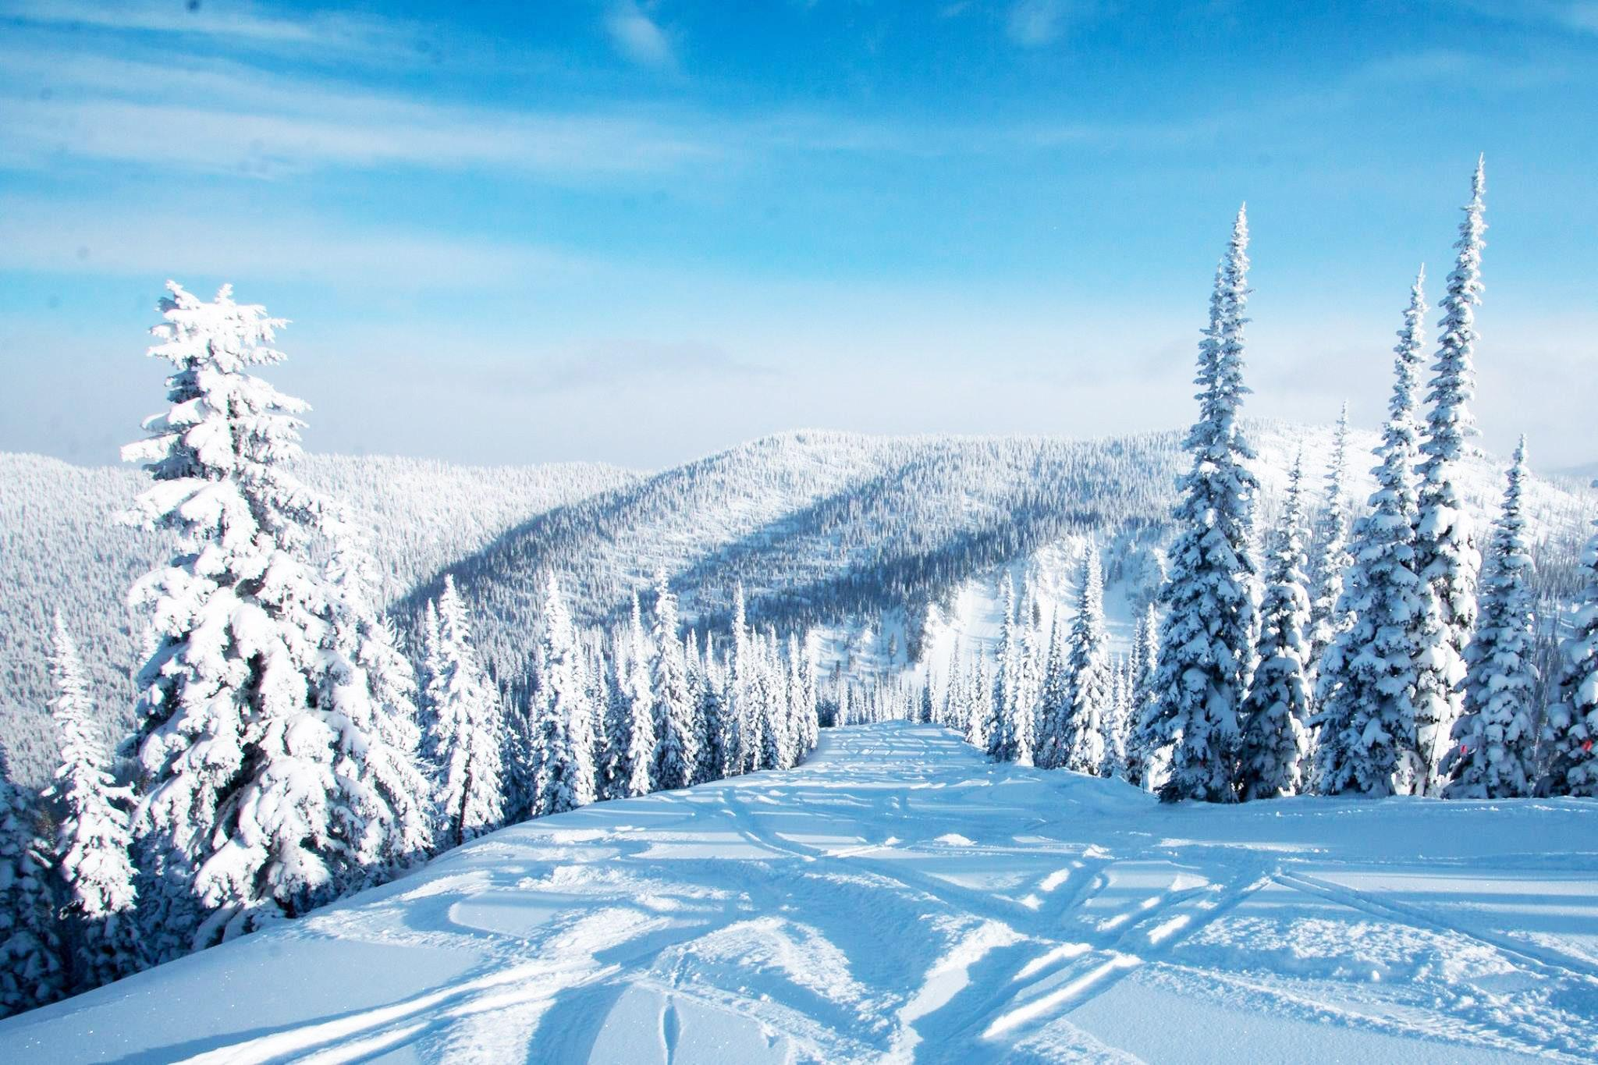
Big Mountain Ski Resort
Guided Capstone | Danielle Santiago
Image source: www.cntraveler.com

Slide 2
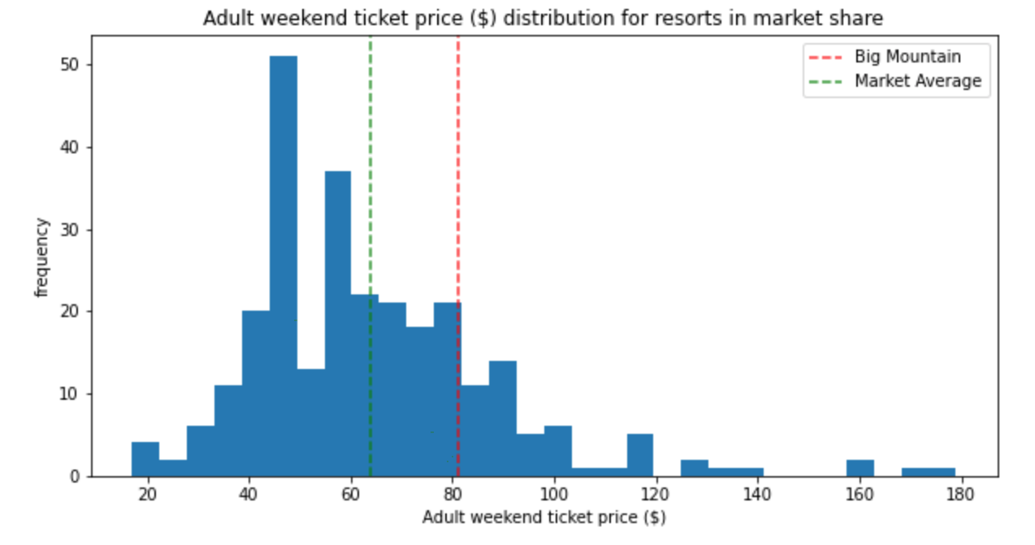
Problem Identification
Big Mountain resort has been charging a premium (~$17) over the market average ticket price ($63.81).
Can the resort charge an even higher premium and increase revenue?
What facilities should be the focus of future investments?

Slide 3
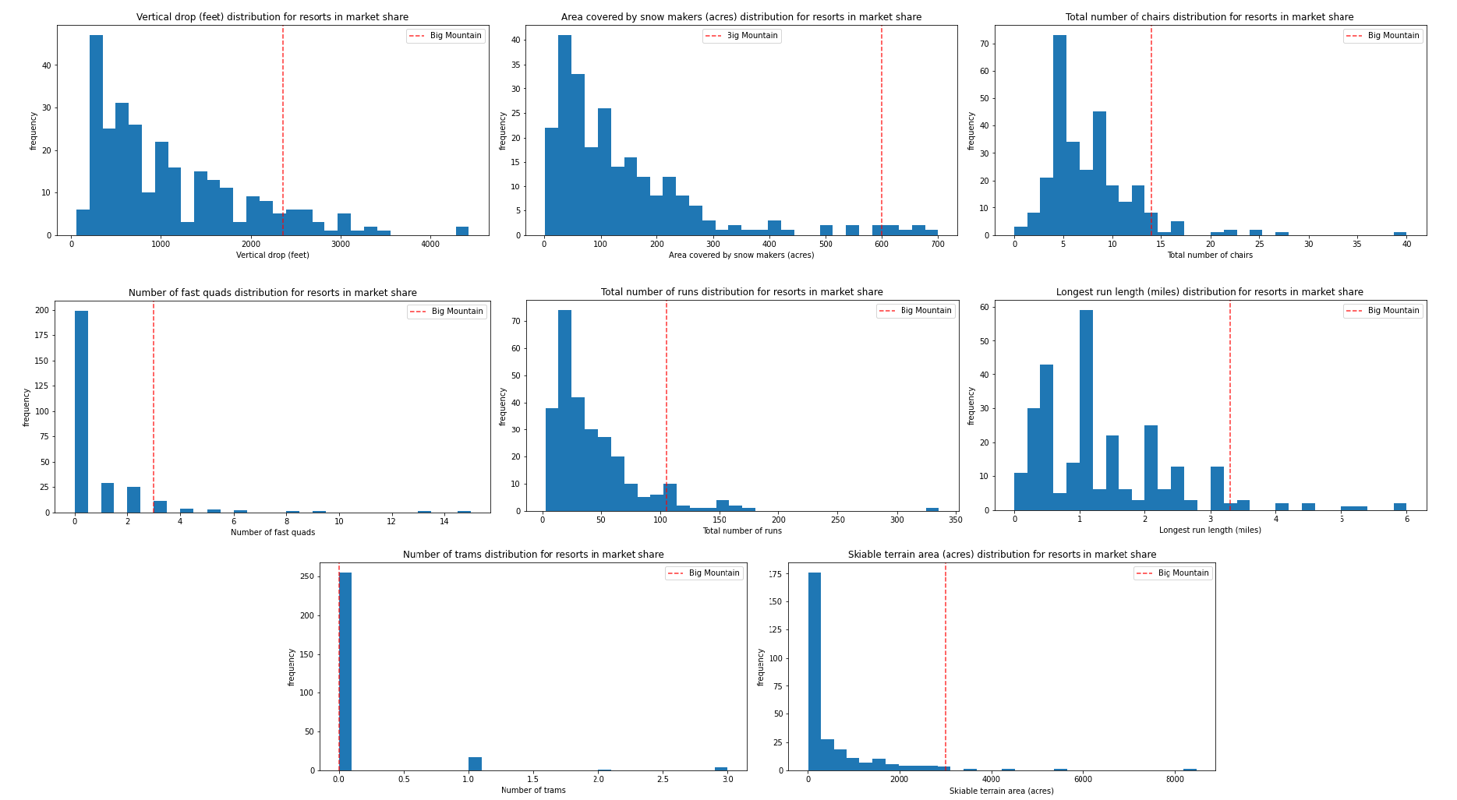
Modeling Results and Analysis

Slide 4
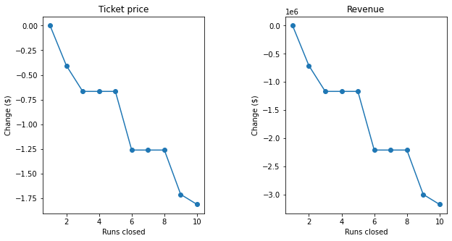
Modeling Results and Analysis
Given current offered facilities, the best available model ($10.39 error) suggests a ticket price of $95.87. However, improvements in facilities may allow for even higher prices.
Model scenario 1: Closing down up to 10 runs
Result:
no change in prices or up to $1.75 decrease

Slide 5
Modeling Results and Analysis
Model scenario 2: Increase vertical drop by 150 ft (add one run & one chair)
Result: $8.61 increase in price and additional revenue of $15,065,471
Model scenario 3: Increase vertical drop (+150 ft) & snow coverage (+2 acres)
Result: $9.90 increase in price and additional revenue of $17,322,717
Model scenario 4: Increase longest run (+0.2 mi) & snow coverage (4 acres)
Result: no change in price

Slide 6
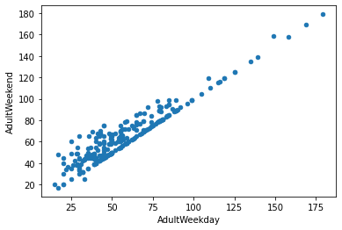
Recommendations and findings
1. Without making any changes to current offered facilities, model results suggest ticket prices can be increased to $95.87, almost $15 above current price.
2. For even higher ticket prices ($104.48), I recommend (1) closing one run & (2) opening a new run at a higher elevation, therefore increasing the vertical drop (most important feature likely controlling market prices). This scenario will require the addition of one chair lift.
3. Weekday prices can be the same as weekend prices, following market trend for tickets above $100.

Slide 7
Summary and Conclusion
Big Mountain has a strong standing in the ski resort market. Current ticket prices are low and can be increased by ~$15 w/out additional investment.
For even higher prices, we recommend increasing the vertical drop by opening a new run and adding a chair lift. Costs incurred can be offset by closing one of the current runs (which one will require further consideration).
A more complete revenue analysis would benefit from additional information on the cost side of the business.

