Slide 1

Title
Project Name: VitaSakhi
Tagline: AI-powered maternal risk screening for rural ASHA workers
Team Name: Byte.exe - DevCraft
Event: DevCraft: Simon’s Command Line (or your event name)
Date: 6th and 7th April 2026
Domain: Healthcare + AI

Slide 2
Problem Statement
In India, a maternal death occurs approximately every fifteen minutes, with 97% of these tragedies happening in rural areas. While 1.05 million ASHA workers conduct home visits, they lack real-time decision support. Conditions like pre-eclampsia, gestational diabetes, and anemia can be detected early, yet they are often missed. Referral delays currently span two to three weeks, but with VitaSakhi, we aim to reduce this to under 48 hours.

Slide 3
Target Audience
Primary: 1.05 million ASHA workers conducting antenatal visits in rural India
Secondary: PHC doctors receiving unstructured or delayed referrals
Scale: 8.8 crore pregnancies annually passing through the ASHA care pathway

Slide 4
Existing Solutions
Paper ANC checklists: record vitals only, no risk analysis or guidance
EMR systems (Bahmni, OpenMRS): require clinics, staff, and internet
Government apps (RCH, NISHCHAY): data entry only, no decision support
Commercial apps (Practo, PharmEasy): urban-focused, not ASHA-friendly
None provide instant risk assessment with actionable guidance at point of care

Slide 5
Gaps & Opportunities
Gaps:
No real-time risk scoring at point of care
No referral decision logic
Lack of explainability → limited trust
Opportunities:
Lightweight AI tool for field use
Converts 6 vitals → risk level → top 3 reasons → referral action in <30 seconds
Usable without clinical training

Slide 6
Your Solution
AI-powered maternal risk screener for ASHA workers
Enter 6 vitals → receive risk, top 3 reasons, and referral guidance in <30 seconds
Key attributes:
1. AI-powered: XGBoost model (AUC 0.82–0.90)
2. Explainable: SHAP-based top 3 reasons in plain English
3. Actionable: Green / Amber / Red referral guidance
4. Local-first: Runs fully offline, no cloud dependency
Our model predicts risk level, explains which vital is the problem, tells the ASHA worker exactly what to say to the patient, flags dangerous readings visually, and tells her when to come back — all in under 30 seconds.

Slide 7
Key Features
6-Input Risk Form: simple, validated input for field use
Risk Badge: instant visual output — Low / Mid / High
SHAP Explainability Panel: top 3 reasons in plain language
Referral Card + History: clear action and last 5 patient records

Slide 8
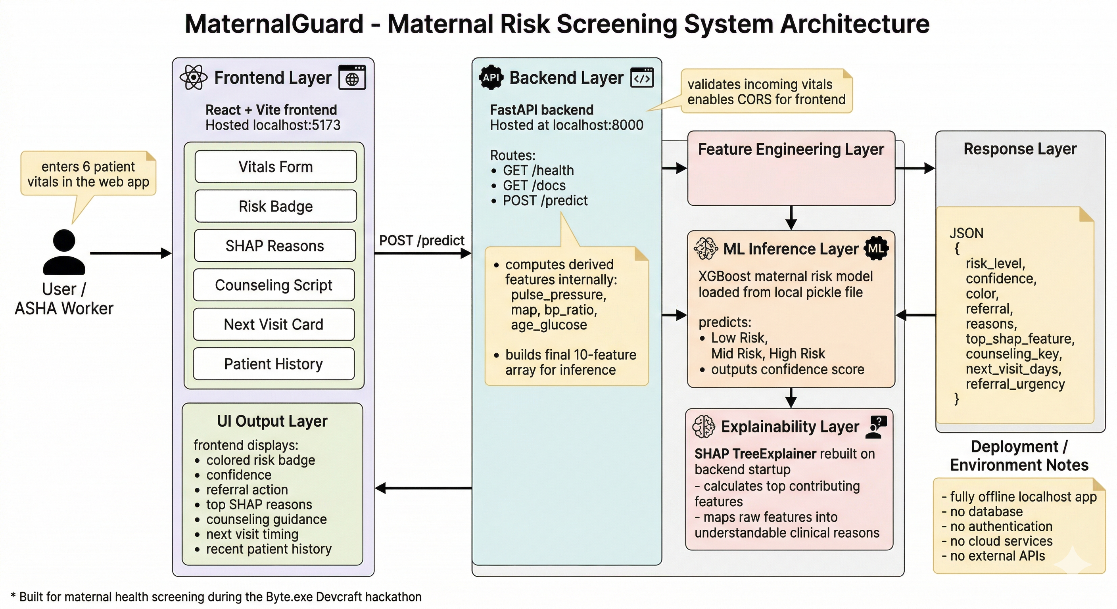
System Architecture

Slide 9
Tech Stack
Backend:
Python 3.11, FastAPI, XGBoost, SHAP (TreeExplainer), scikit-learn
pandas, numpy, pydantic, uvicorn
Frontend:
React 18 (Vite), Fetch API, CSS
Dataset:
UCI Maternal Health Risk Dataset
1,014 rows → 452 cleaned
3 classes: Low / Mid / High
Model Performance:
Accuracy: 72–80%
AUC: 0.82–0.90
F1 Score: 0.58–0.68

Slide 10
Workflow
ASHA worker opens app during home visit
Enters 6 vitals and hits submit
Backend processes data in <2 seconds
Risk badge + top 3 reasons displayed
ASHA follows referral action

Slide 11
Impact
1.05 MILLION ASHA workers enabled
8.8 CRORE pregnancies annually reached
2–3 WEEKS → <48 HOURS referral delay reduction
Early detection of pre-eclampsia, gestational diabetes, and anemia can prevent most maternal deaths at the community level

Slide 12
Future Scope
Offline-first model: run entirely in-browser (ONNX / TF.js)
Regional language UI: Hindi, Kannada, Tamil support
NRHM data integration: train on India-specific maternal datasets

Slide 13
Team Info
Member 1: Dhruv Patel - ML Engineer + Backend
Member 2: Tanuj Jain - Frontend + API Integration
Member 3: Shailaja Sharma - UI/UX + Presentation

