Slide 1
Discussion of Section 2.4 of Machine Learning in Asset Pricing by Stefan Nagel Prateek Mahajan Feburary 3, 2022

Slide 2
Many Choices
ML requires us to make many choices
Which model to use
If penalized regression (i.e., ridge or lasso), what penalty function
Hyperparameters
Scaling
Etc.
Could let the data speak by trying CV on each choice
But run into the no-free lunch problem (Wolpert 1996): no one ML algo can be universally best for all DGPs
Instead, we should use prior knowledge about the objective and the data
This section introduces a Bayesian interpretation of this
Prior knowledge is expressed probabilistically in terms of prior distributions

Slide 3
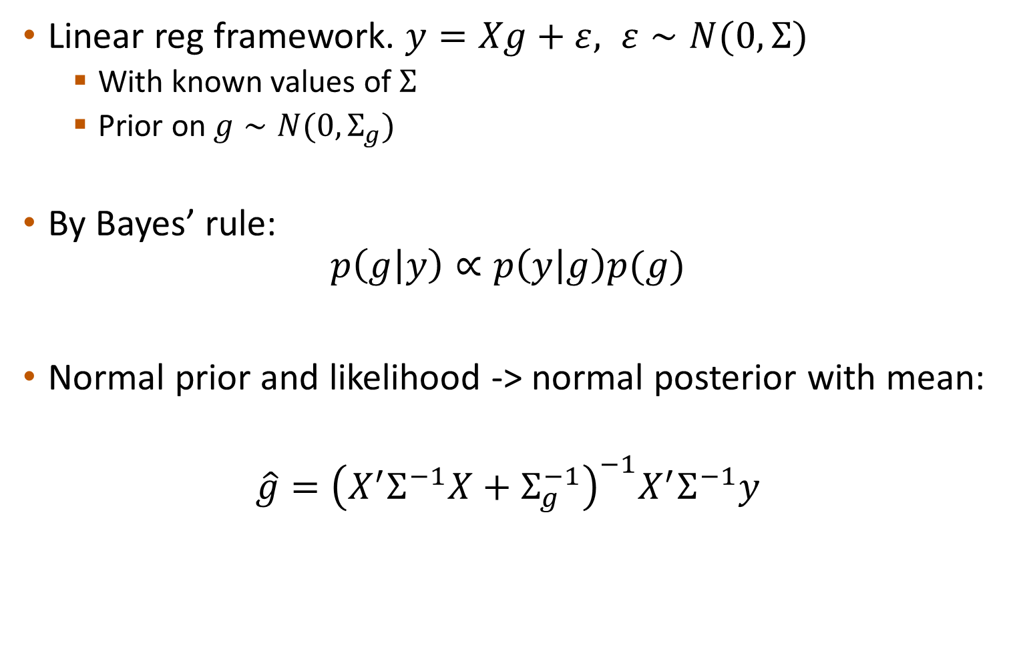

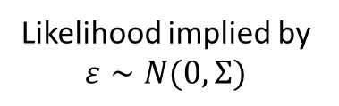
Ridge Example
Linear reg framework. $y=Xg+ε, ε∼N(0, Σ)$
With known values of $Σ$
Prior on $g∼N(0, Σ_{g})$
By Bayes’ rule:
$$p\left(g | y\right)∝p\left(y | g\right)p(g)$$
Normal prior and likelihood -> normal posterior with mean:
$$\hat{g}={\left(X^{′}Σ^{−1}X+Σ_{g}^{−1}\right)}^{−1}X^{′}Σ^{−1}y$$
Likelihood implied by
$ε∼N(0, Σ)$
Prior on $g$
Induces shrinkage towards prior
GLS

Slide 4
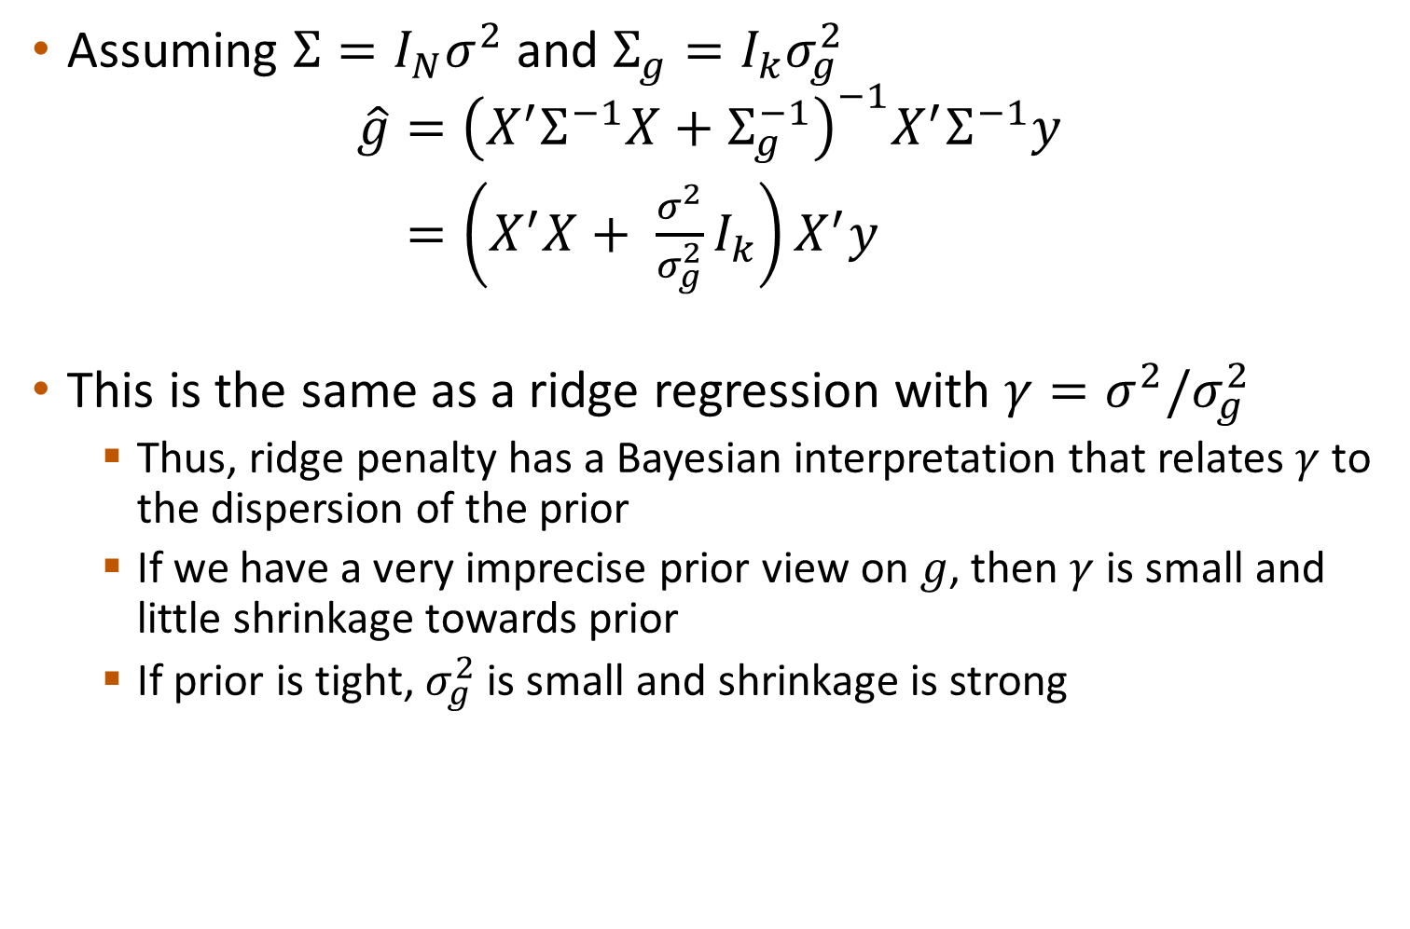
Ridge Example
Assuming $Σ=I_{N}σ^{2}$ and $Σ_{g}=I_{k}σ_{g}^{2}$
$$\hat{g}={\left(X^{′}Σ^{−1}X+Σ_{g}^{−1}\right)}^{−1}X^{′}Σ^{−1}y$$ $=\left(X^{′}X+ \frac{σ^{2}}{σ_{g}^{2}}I_{k}\right)X^{′}y$
This is the same as a ridge regression with $γ=σ^{2}/σ_{g}^{2}$
Thus, ridge penalty has a Bayesian interpretation that relates $γ$ to the dispersion of the prior
If we have a very imprecise prior view on $g$, then $γ$ is small and little shrinkage towards prior
If prior is tight, $σ_{g}^{2}$is small and shrinkage is strong

Slide 5
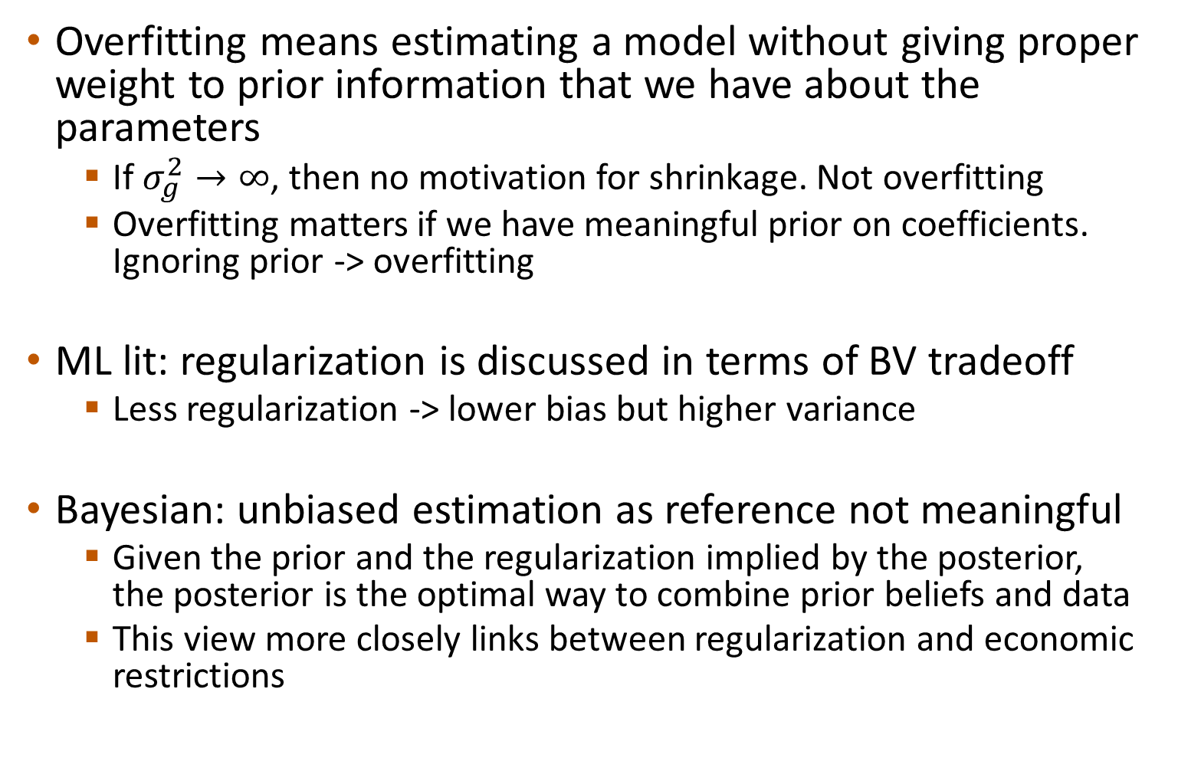
Overfitting and BV Tradeoff
Overfitting means estimating a model without giving proper weight to prior information that we have about the parameters
If $σ_{g}^{2}→∞$, then no motivation for shrinkage. Not overfitting
Overfitting matters if we have meaningful prior on coefficients. Ignoring prior -> overfitting
ML lit: regularization is discussed in terms of BV tradeoff
Less regularization -> lower bias but higher variance
Bayesian: unbiased estimation as reference not meaningful
Given the prior and the regularization implied by the posterior, the posterior is the optimal way to combine prior beliefs and data
This view more closely links between regularization and economic restrictions

Slide 6
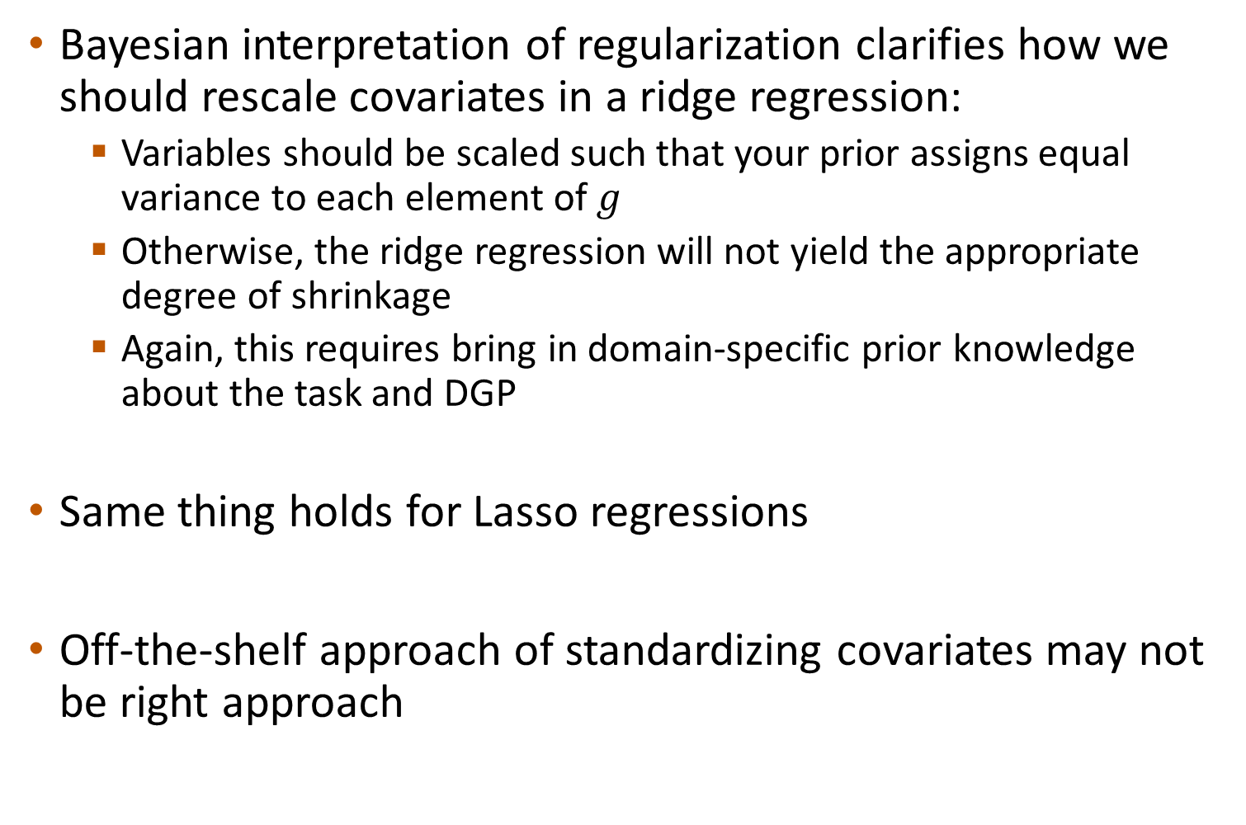
Rescaling
Bayesian interpretation of regularization clarifies how we should rescale covariates in a ridge regression:
Variables should be scaled such that your prior assigns equal variance to each element of $g$
Otherwise, the ridge regression will not yield the appropriate degree of shrinkage
Again, this requires bring in domain-specific prior knowledge about the task and DGP
Same thing holds for Lasso regressions
Off-the-shelf approach of standardizing covariates may not be right approach

Slide 7
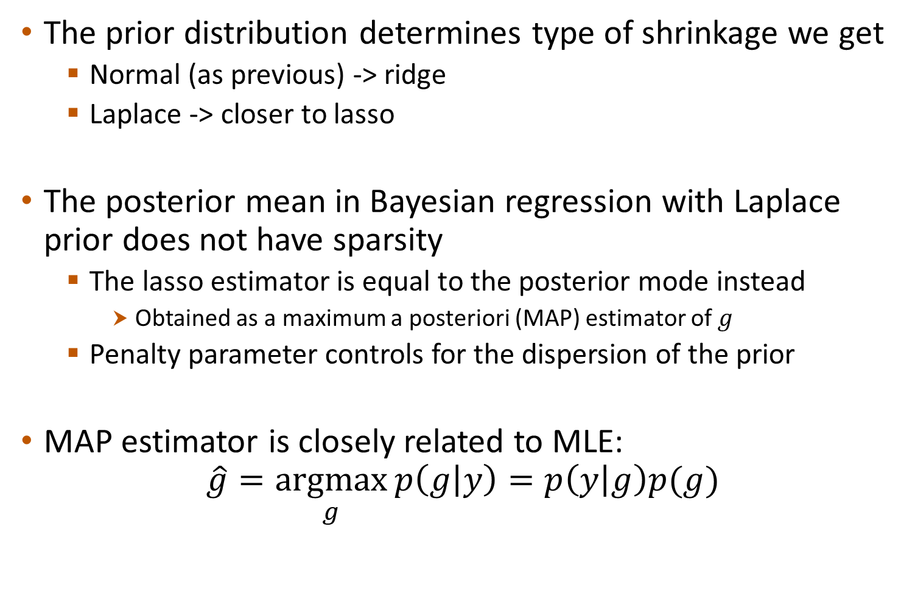

Lasso
The prior distribution determines type of shrinkage we get
Normal (as previous) -> ridge
Laplace -> closer to lasso
The posterior mean in Bayesian regression with Laplace prior does not have sparsity
The lasso estimator is equal to the posterior mode instead
Obtained as a maximum a posteriori (MAP) estimator of $g$
Penalty parameter controls for the dispersion of the prior
MAP estimator is closely related to MLE:
$$\hat{g}=\underset{g}{argmax}{p\left(g | y\right)=p\left(y | g\right)p(g)}$$
Prior on $g$
Likelihood,
what MLE maximizes

Slide 8
Cross-Validation
Essentially a way to estimate the prior dispersion from the data
In the empirical Bayes approach, the prior parameters are estimated empirically by taking a uniformed hyperprior and looking for prior parameters that maximize the posterior probability
Thus, we can think of CV as approximating an empirical Bayes approach in which we estimate prior parameters from the data

Slide 9
Summary
Regularization has a Bayesian interpretation as the expression of prior knowledge about model parameters
Preprocessing of data (e.g., scaling) or specification of penalties (e.g., norm and parameters) express prior views
In general, Bayes interpretations provide a useful guide for bring in domain-specific knowledge into the learning process

