Slide 1
Discussion of Sections 5.1 and 5.2 of Machine Learning in Asset Pricing by Stefan Nagel Prateek Mahajan March 31, 2022

Slide 2
Belief Formation
Previously, have taken the POV of a statistician studying historical data ex post and using ML to extract forecasts.
If the statistician is confronted with a high-dimensional problem, investors whose trading generated the data likely faced one too.
Yet, most AP models do not incorporate this complexity.
Most assume rational expectations, i.e., investors know the model and its parameters. Thus, the problem of learning the predictive relationship between observables and future returns is assumed away.
Even in the models where agents learn from observed data, the learning problem is low-dimensional.
Could the abnormalities in investor forecasts/decisions be a consequence of oversimplifying the learning process?
This chapter discusses how we can use ML tools to let investors in a model learn about the world and price assets.

Slide 3
High-level View of Model
Investors face a high-dimensional learning problem
Simplified version of Martin and Nagel (2019)
Investors estimate functional relationship between covariates and future cash flow based on observed data. Then, use forecasted cash flows to price stocks
This learning has effects on properties of asset prices, especially when # covariates large relative to # stocks
This is an oversimplification of real-world learning process
Set of predictor variables is known
Data generating process of fundamentals is time-invariant
No frictions in information processing
Use Bayesian regression tools

Slide 4
High-level View of Model
All assumptions together make belief formation statistically optimal -> minimizing the estimation errors investors make
Model has no risk premia or behavioral bias… but returns will appear to be predictable in ways that resemble risk premia and behavioral bias
High dimensionality also changes the equilibrium properties of asset prices
When learning problem is low-dimensional, returns close to marginable differences from econometrician's POV… but when high-dimensional, no longer true

Slide 5
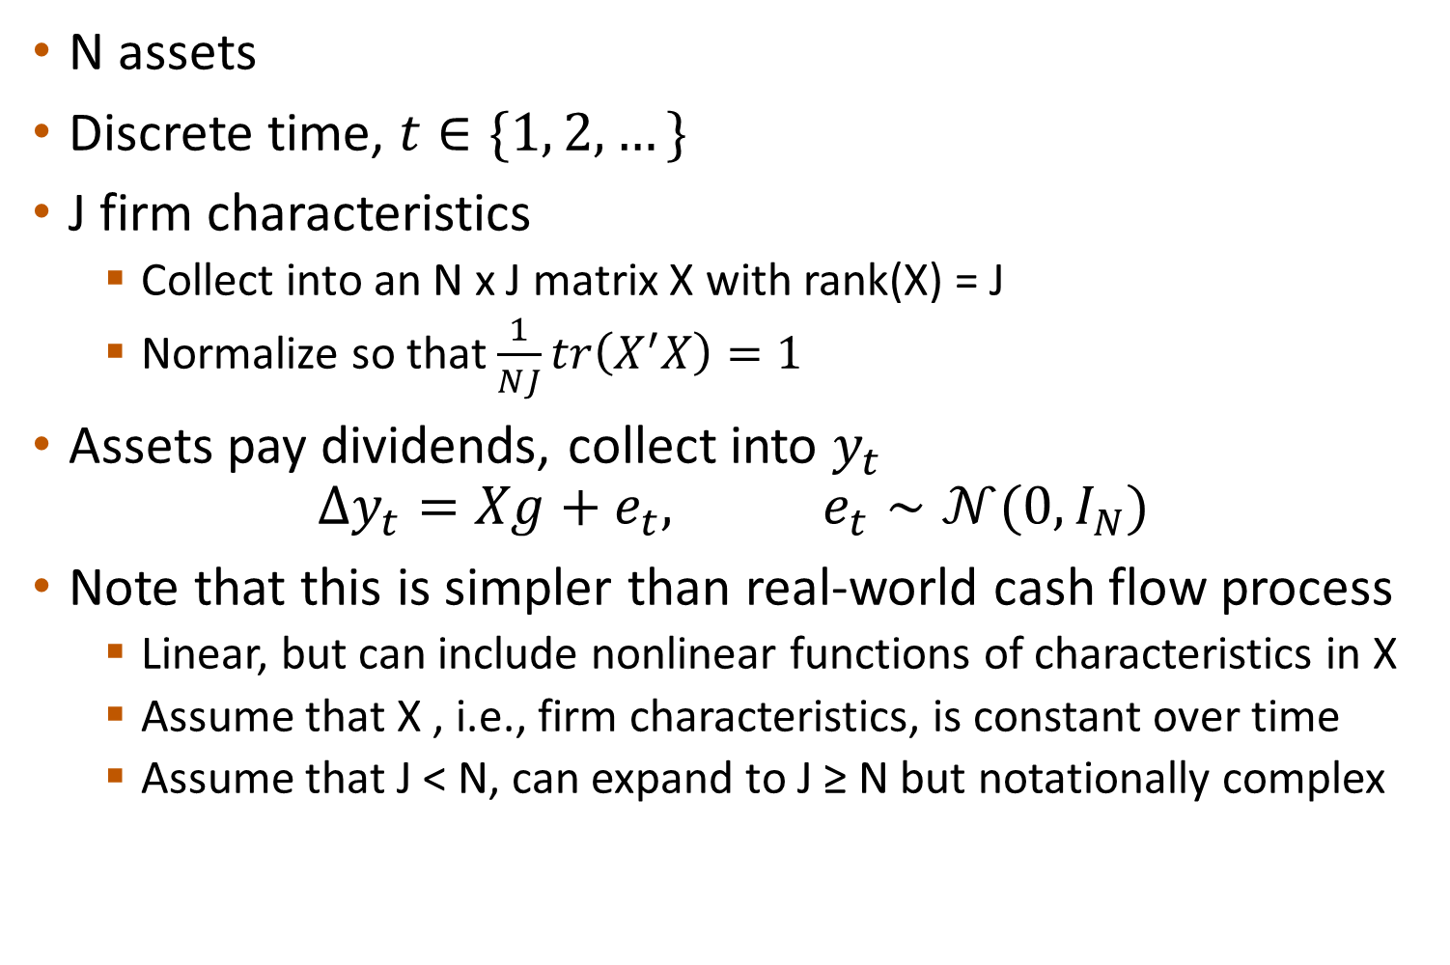
The Asset Market
N assets
Discrete time, $t∈\{1, 2, …\}$
J firm characteristics
Collect into an N x J matrix X with rank(X) = J
Normalize so that $\frac{1}{NJ}tr\left(X^{′}X\right)=1$
Assets pay dividends, collect into $y_{t}$
$$Δy_{t}=Xg+e_{t}, e_{t}∼𝒩(0,I_{N})$$
Note that this is simpler than real-world cash flow process
Linear, but can include nonlinear functions of characteristics in X
Assume that X , i.e., firm characteristics, is constant over time
Assume that J < N, can expand to J ≥ N but notationally complex

Slide 6
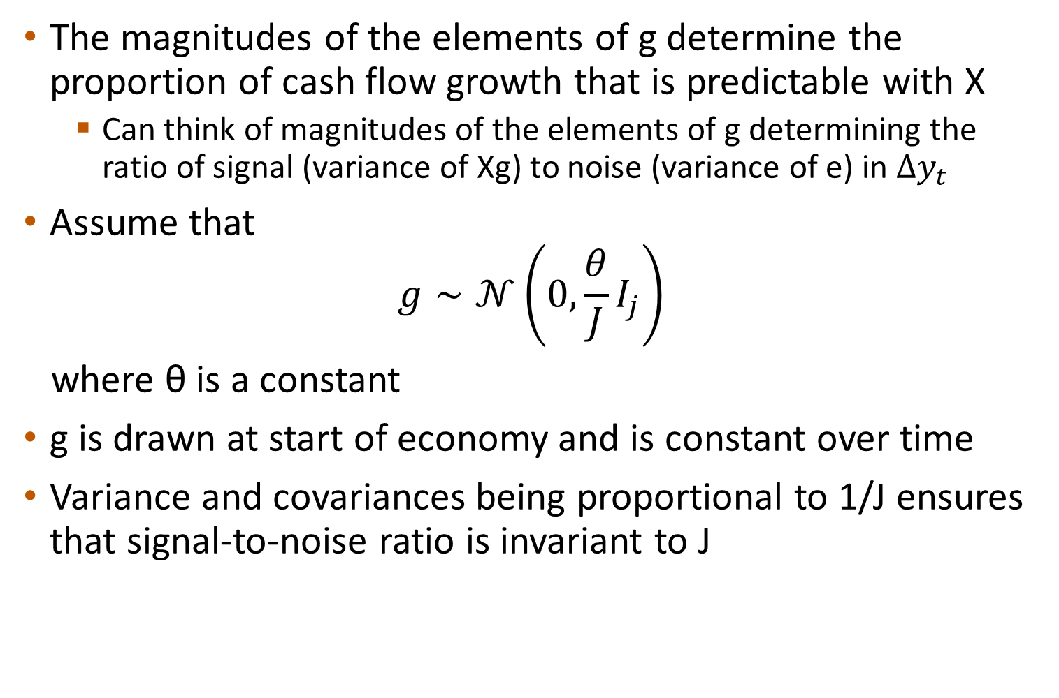
The Asset Market
The magnitudes of the elements of g determine the proportion of cash flow growth that is predictable with X
Can think of magnitudes of the elements of g determining the ratio of signal (variance of Xg) to noise (variance of e) in $Δy_{t}$
Assume that
$$g∼𝒩\left(0,\frac{θ}{J}I_{j}\right)$$
where θ is a constant
g is drawn at start of economy and is constant over time
Variance and covariances being proportional to 1/J ensures that signal-to-noise ratio is invariant to J

Slide 7
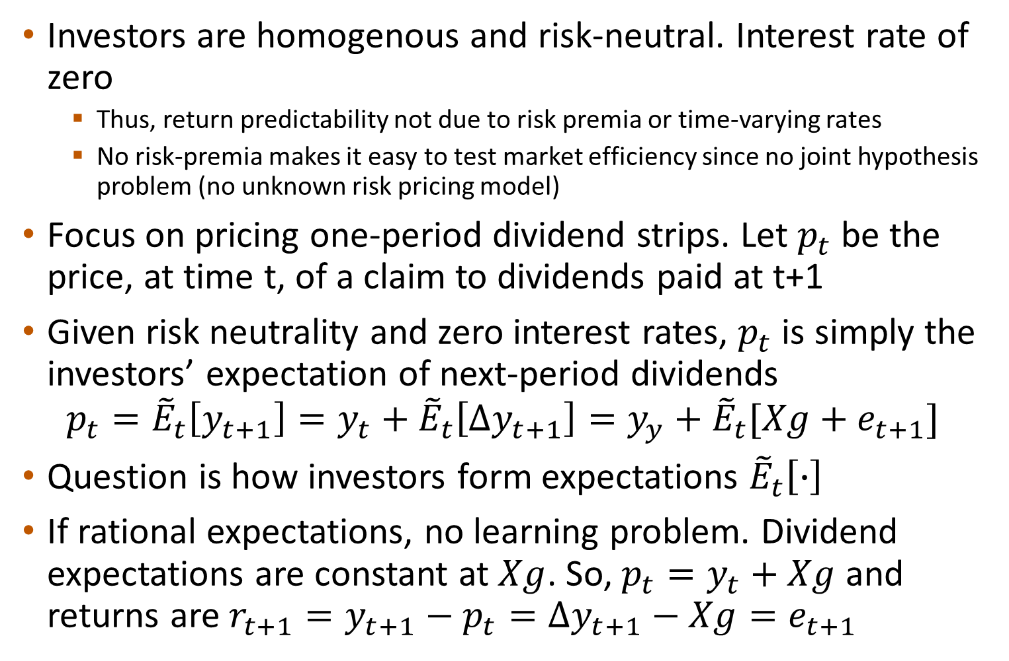
Investors and Pricing
Investors are homogenous and risk-neutral. Interest rate of zero
Thus, return predictability not due to risk premia or time-varying rates
No risk-premia makes it easy to test market efficiency since no joint hypothesis problem (no unknown risk pricing model)
Focus on pricing one-period dividend strips. Let $p_{t}$ be the price, at time t, of a claim to dividends paid at t+1
Given risk neutrality and zero interest rates, $p_{t}$ is simply the investors’ expectation of next-period dividends
$$p_{t}={\tilde{E}}_{t}\left[y_{t+1}\right]=y_{t}+{\tilde{E}}_{t}\left[Δy_{t+1}\right]=y_{y}+{\tilde{E}}_{t}[Xg+e_{t+1}]$$
Question is how investors form expectations ${\tilde{E}}_{t}\left[∙\right]$
If rational expectations, no learning problem. Dividend expectations are constant at $Xg$. So, $p_{t}=y_{t}+Xg$ and returns are $r_{t+1}=y_{t+1}−p_{t}=Δy_{t+1}−Xg=e_{t+1}$

Slide 8
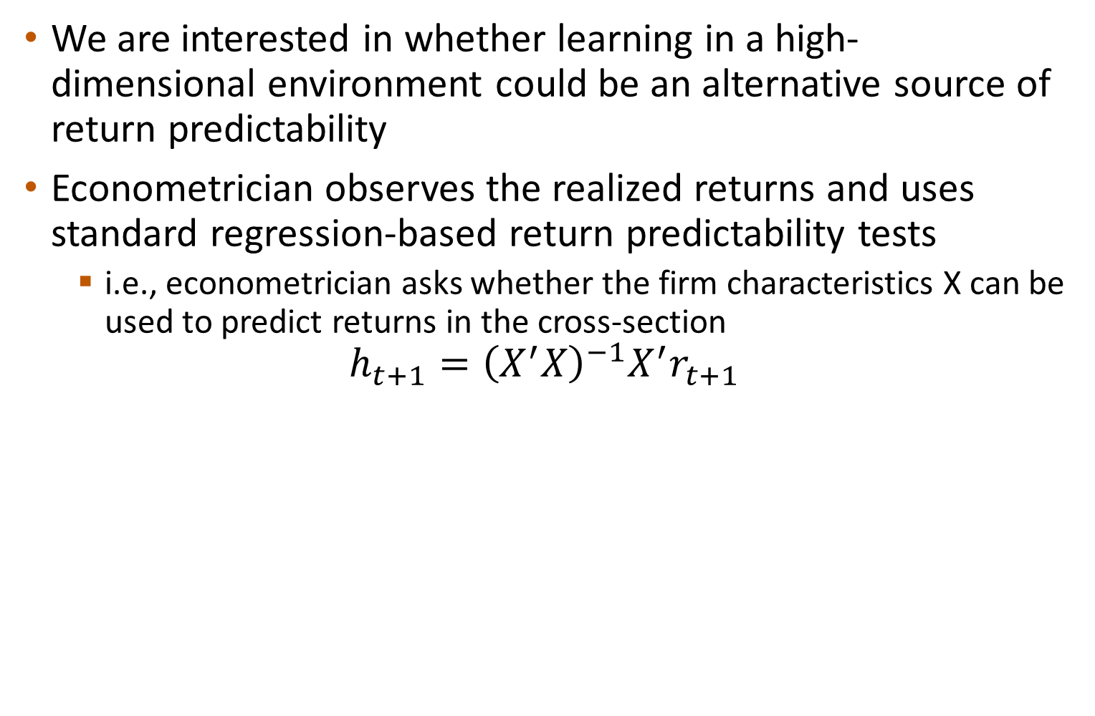
Econometrician Observer
We are interested in whether learning in a high-dimensional environment could be an alternative source of return predictability
Econometrician observes the realized returns and uses standard regression-based return predictability tests
i.e., econometrician asks whether the firm characteristics X can be used to predict returns in the cross-section
$$h_{t+1}={\left(X^{′}X\right)}^{−1}X^{′}r_{t+1}$$

Slide 9
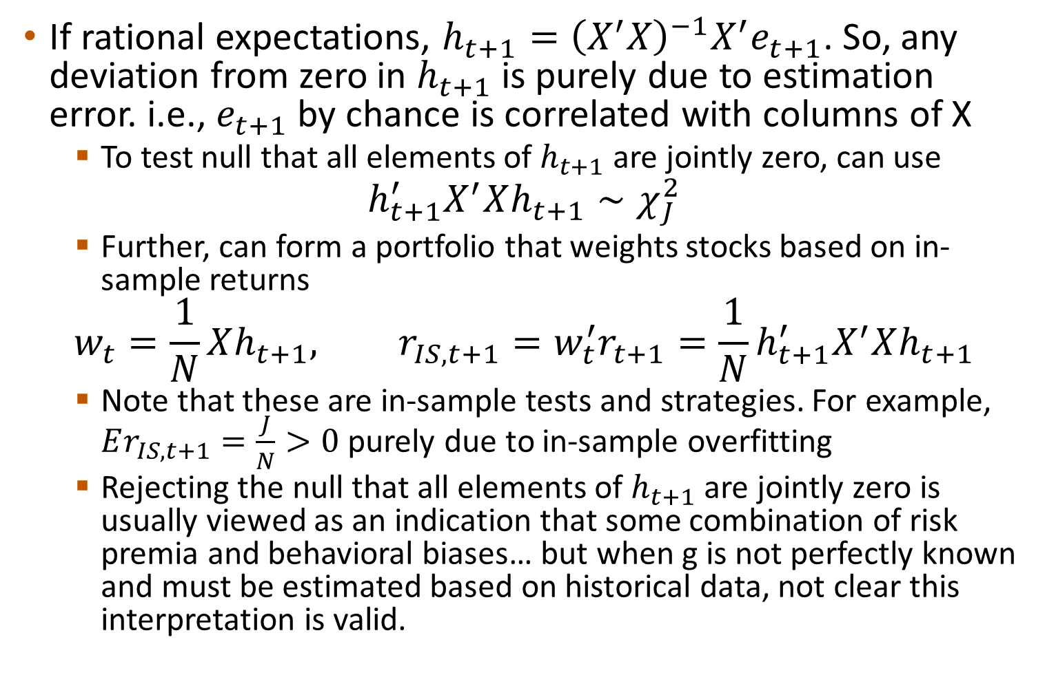
Econometrician Observer
If rational expectations, $h_{t+1}={\left(X^{′}X\right)}^{−1}X^{′}e_{t+1}$. So, any deviation from zero in $h_{t+1}$ is purely due to estimation error. i.e., $e_{t+1}$ by chance is correlated with columns of X
To test null that all elements of $h_{t+1}$ are jointly zero, can use
$$h_{t+1}^{′}X^{′}Xh_{t+1}∼χ_{J}^{2}$$
Further, can form a portfolio that weights stocks based on in-sample returns
$$w_{t}=\frac{1}{N}Xh_{t+1}, r_{IS,t+1}=w_{t}^{′}r_{t+1}=\frac{1}{N}h_{t+1}^{′}X^{′}Xh_{t+1}$$
Note that these are in-sample tests and strategies. For example, $Er_{IS,t+1}=\frac{J}{N}>0$ purely due to in-sample overfitting
Rejecting the null that all elements of $h_{t+1}$ are jointly zero is usually viewed as an indication that some combination of risk premia and behavioral biases… but when g is not perfectly known and must be estimated based on historical data, not clear this interpretation is valid.

Slide 10
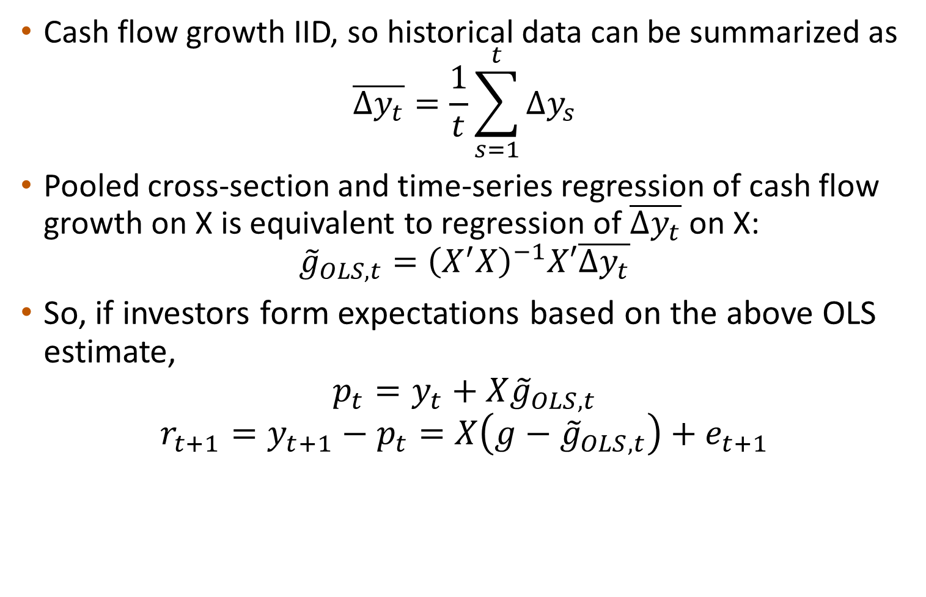
Investor Learning with OLS
Cash flow growth IID, so historical data can be summarized as
$$\overline{Δy_{t}}=\frac{1}{t}\sum_{s=1}^{t}{Δy_{s}}$$
Pooled cross-section and time-series regression of cash flow growth on X is equivalent to regression of $\overline{Δy_{t}}$ on X:
$${\tilde{g}}_{OLS,t}={\left(X^{′}X\right)}^{−1}X′\overline{Δy_{t}}$$
So, if investors form expectations based on the above OLS estimate,
$$p_{t}=y_{t}+X{\tilde{g}}_{OLS,t}$$
$$r_{t+1}=y_{t+1}−p_{t}=X\left(g−{\tilde{g}}_{OLS,t}\right)+e_{t+1}$$

Slide 11
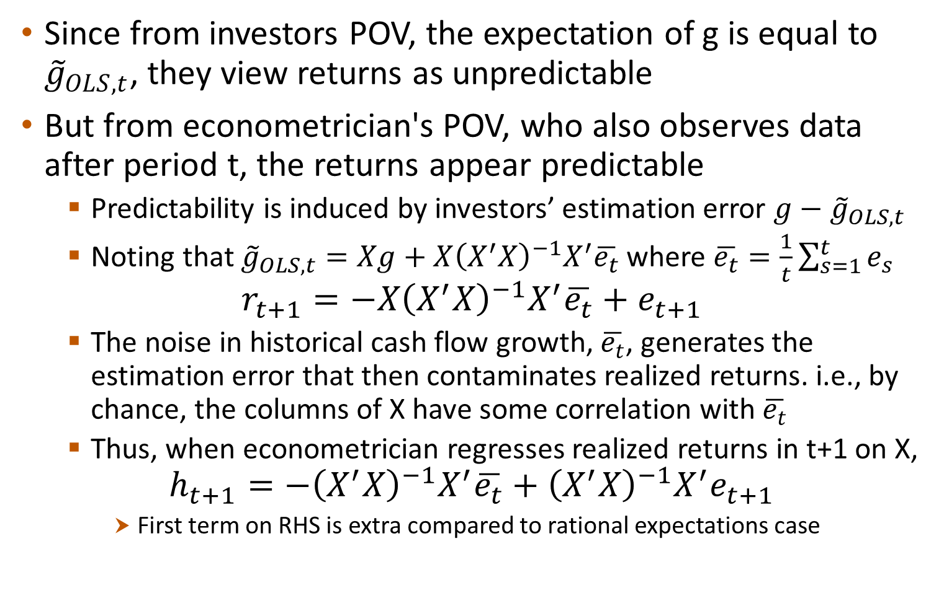
Investor Learning with OLS
Since from investors POV, the expectation of g is equal to ${\tilde{g}}_{OLS,t}$, they view returns as unpredictable
But from econometrician's POV, who also observes data after period t, the returns appear predictable
Predictability is induced by investors’ estimation error $g−{\tilde{g}}_{OLS,t}$
Noting that ${\tilde{g}}_{OLS,t}=Xg+X{\left(X^{′}X\right)}^{−1}X^{′}\overline{e_{t}}$ where $\overline{e_{t}}=\frac{1}{t}\sum_{s=1}^{t}{e_{s}}$
$$r_{t+1}=−X{\left(X^{′}X\right)}^{−1}X^{′}\overline{e_{t}}+e_{t+1}$$
The noise in historical cash flow growth, $\overline{e_{t}}$, generates the estimation error that then contaminates realized returns. i.e., by chance, the columns of X have some correlation with $\overline{e_{t}}$
Thus, when econometrician regresses realized returns in t+1 on X,
$$h_{t+1}={−\left(X^{′}X\right)}^{−1}X^{′}\overline{e_{t}}+{\left(X^{′}X\right)}^{−1}X^{′}e_{t+1}$$
First term on RHS is extra compared to rational expectations case

Slide 12
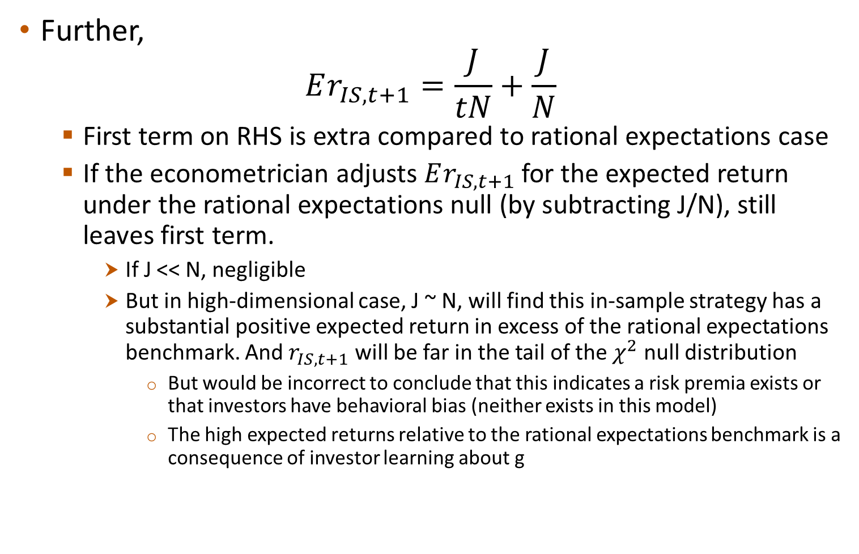
Investor Learning with OLS
Further,
$$Er_{IS,t+1}=\frac{J}{tN}+\frac{J}{N}$$
First term on RHS is extra compared to rational expectations case
If the econometrician adjusts $Er_{IS,t+1}$ for the expected return under the rational expectations null (by subtracting J/N), still leaves first term.
If J << N, negligible
But in high-dimensional case, J ~ N, will find this in-sample strategy has a substantial positive expected return in excess of the rational expectations benchmark. And $r_{IS,t+1}$ will be far in the tail of the $χ^{2}$ null distribution
But would be incorrect to conclude that this indicates a risk premia exists or that investors have behavioral bias (neither exists in this model)
The high expected returns relative to the rational expectations benchmark is a consequence of investor learning about g

Slide 13
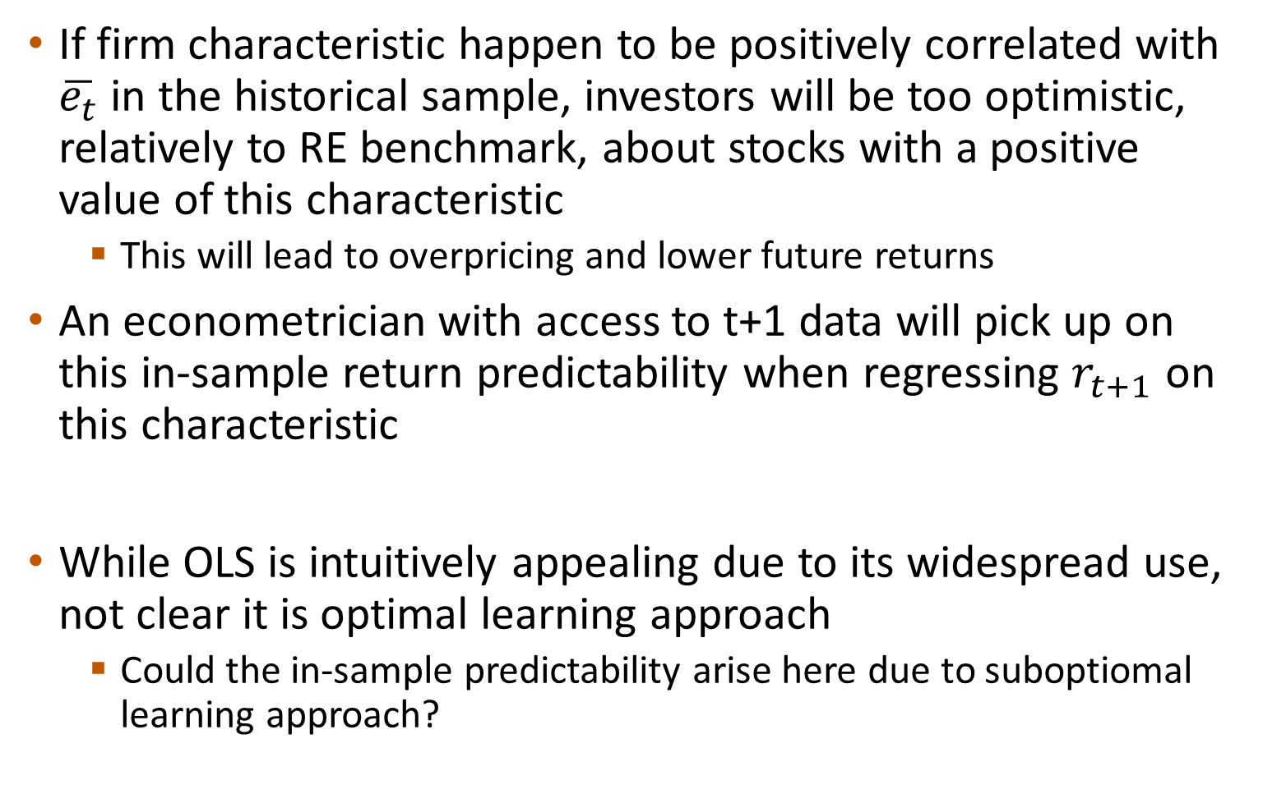
Investor Learning with OLS
If firm characteristic happen to be positively correlated with $\overline{e_{t}}$ in the historical sample, investors will be too optimistic, relatively to RE benchmark, about stocks with a positive value of this characteristic
This will lead to overpricing and lower future returns
An econometrician with access to t+1 data will pick up on this in-sample return predictability when regressing $r_{t+1}$ on this characteristic
While OLS is intuitively appealing due to its widespread use, not clear it is optimal learning approach
Could the in-sample predictability arise here due to suboptiomal learning approach?

Slide 14
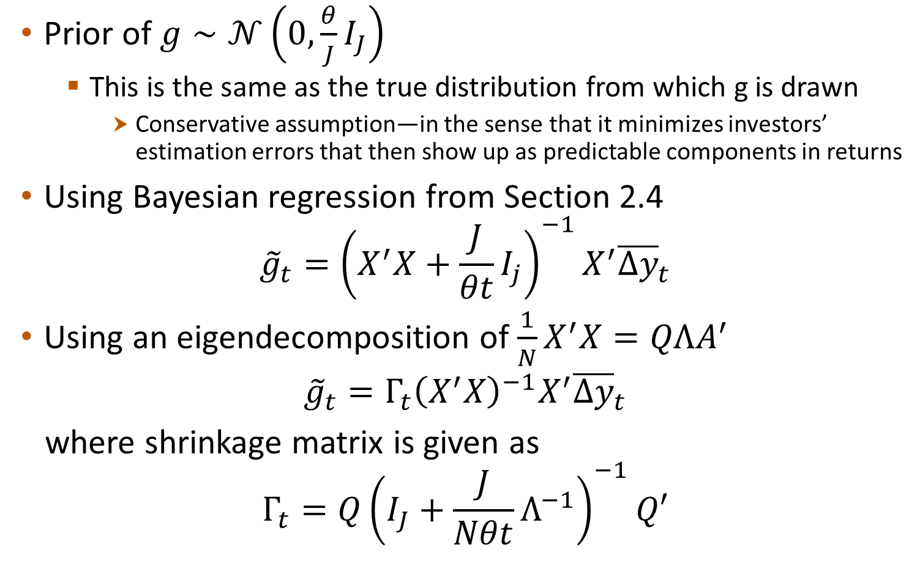
Bayesian Learning
Prior of $g∼𝒩\left(0,\frac{θ}{J}I_{J}\right)$
This is the same as the true distribution from which g is drawn
Conservative assumption—in the sense that it minimizes investors’ estimation errors that then show up as predictable components in returns
Using Bayesian regression from Section 2.4
$${\tilde{g}}_{t}={\left(X^{′}X+\frac{J}{θt}I_{j}\right)}^{−1}X^{′}{\overline{Δy}}_{t}$$
Using an eigendecomposition of $\frac{1}{N}X^{′}X=QΛA^{′}$
$${\tilde{g}}_{t}={Γ_{t}\left(X^{′}X\right)}^{−1}X^{′}{\overline{Δy}}_{t}$$
where shrinkage matrix is given as
$$Γ_{t}=Q{\left(I_{J}+\frac{J}{Nθt}Λ^{−1}\right)}^{−1}Q′$$

Slide 15
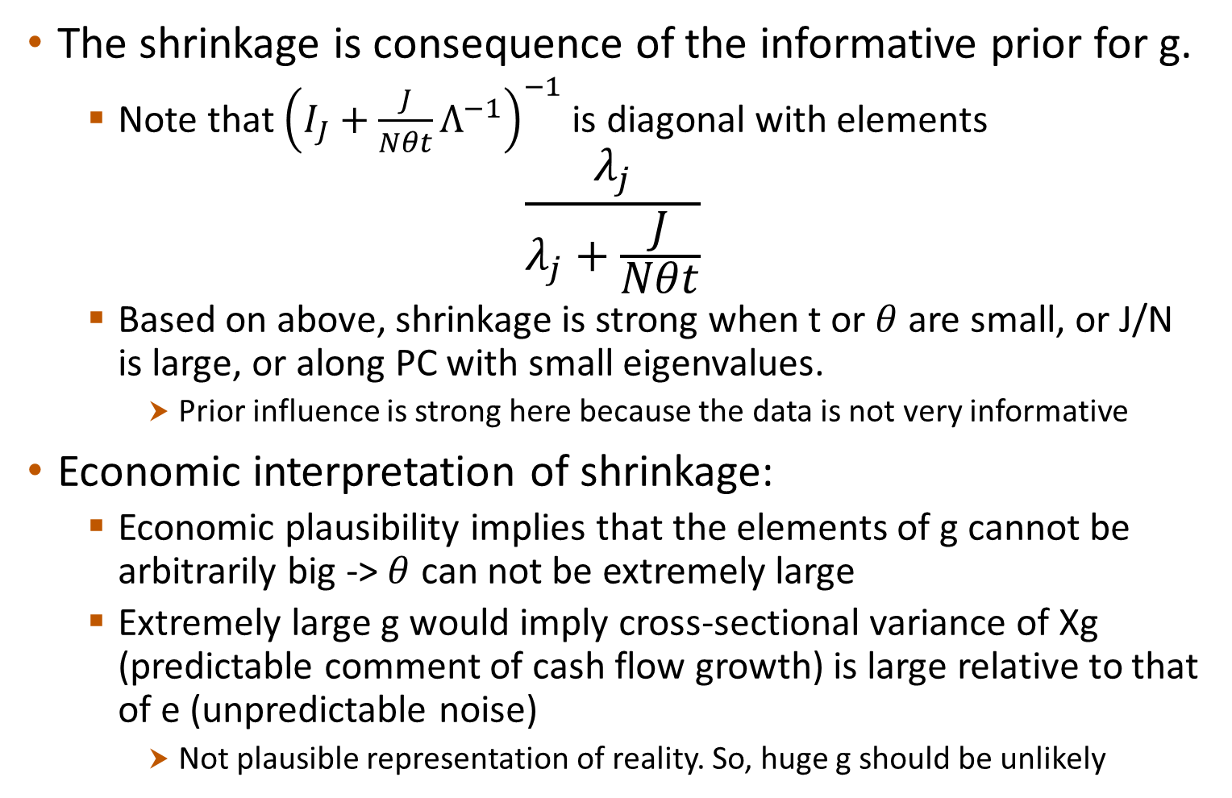
Bayesian Learning
The shrinkage is consequence of the informative prior for g.
Note that ${\left(I_{J}+\frac{J}{Nθt}Λ^{−1}\right)}^{−1}$ is diagonal with elements
$$\frac{λ_{j}}{λ_{j}+\frac{J}{Nθt}}$$
Based on above, shrinkage is strong when t or $θ$ are small, or J/N is large, or along PC with small eigenvalues.
Prior influence is strong here because the data is not very informative
Economic interpretation of shrinkage:
Economic plausibility implies that the elements of g cannot be arbitrarily big -> $θ$ can not be extremely large
Extremely large g would imply cross-sectional variance of Xg (predictable comment of cash flow growth) is large relative to that of e (unpredictable noise)
Not plausible representation of reality. So, huge g should be unlikely

Slide 16
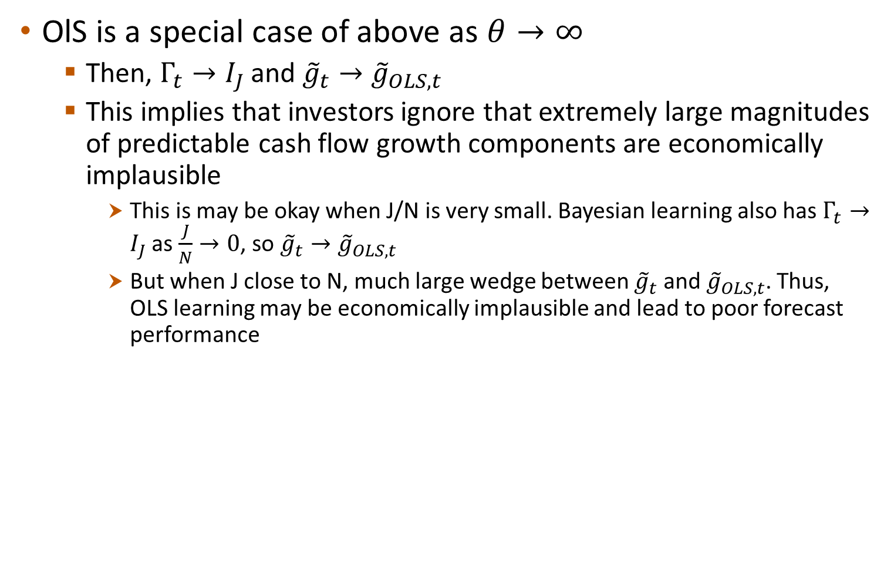
Bayesian Learning
OlS is a special case of above as $θ→∞$
Then, $Γ_{t}→I_{J}$ and ${{\tilde{g}}_{t}→\tilde{g}}_{OLS,t}$
This implies that investors ignore that extremely large magnitudes of predictable cash flow growth components are economically implausible
This is may be okay when J/N is very small. Bayesian learning also has $Γ_{t}→I_{J}$ as $\frac{J}{N}→0$, so ${{\tilde{g}}_{t}→\tilde{g}}_{OLS,t}$
But when J close to N, much large wedge between ${\tilde{g}}_{t}$ and ${\tilde{g}}_{OLS,t}$. Thus, OLS learning may be economically implausible and lead to poor forecast performance

Slide 17
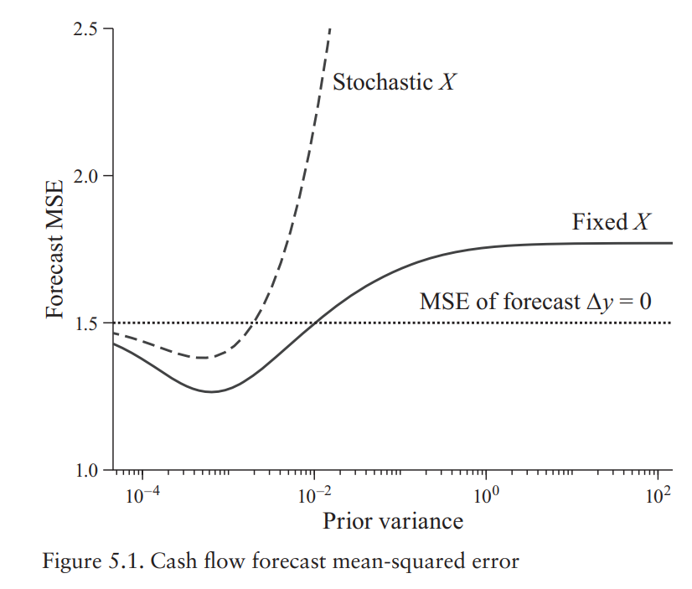

Bayesian Learning
Figure shows MSE in investor forecast of ${\overline{Δy}}_{t}$ when investors use different values of $θ$ in their prior
Minimum MSE when same $θ$ as true distribution used
OLS learning ($θ→∞$), MSE is huge
If substantially higher than true $θ$, even worse than random-walk
If we allow X to be stochastic, performance gets worse even more quickly

