Slide 1

Automation for QCA
Module 0: Introducing ETRM Framework And Demo Applications

Slide 2
Module 0 Objectives
At the end of this module, participants will be able to understand:
Overview of ETRM Framework
Overview of Applications that will be used for Demo and Activities

Slide 3

Course Map / Module Map
Module 8
Module 7
Module 6
Module 5
Module 4
Module 3
Module 3
Module 0 Map
Overview of ETRM Framework
Overview of Applications that will be used for Demo and Activities
Module 1

Slide 4
Module 0 Design Outline
Overview of ETRM Framework
Overview of Applications that will be used for Demo and Activities.

Slide 5
Module 0 Design Outline
Overview of ETRM Framework
Overview of Applications that will be used for Demo and Activities.

Slide 6





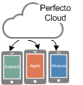

ETRM XML Framework Architecture
Cloud registry
Device registry
Application
registry
Page Elements
Test scripts
Test Data
Test Driver
XML TestDriver
Keyword Driver
Keyword Library
Page
Management
Gestures
Device
Management
Integration
Selenium
Appium
Notes:
Git: Git is Distributed Version Control System that contain the full history of all changes
Maven: Maven is a build automation tool used primarily for Java projects that is based on POM (project object model). It is used for projects build, dependency and documentation.
CI: As an extensible automation server, Jenkins can be used as a simple CI server or turned into the continuous delivery hub for any project.
TestNG: TestNG is a testing framework inspired from JUnit and NUnit but introducing some new functionalities that make it more powerful and easier to use, such as:
Annotations.
Run your tests in arbitrarily big thread pools with various policies available (all methods in their own thread, one thread per test class, etc...).
Test that your code is multithread safe.
Flexible test configuration.
Support for data-driven testing (with @DataProvider).
Support for parameters.
Powerful execution model (no more TestSuite).
Supported by a variety of tools and plug-ins (Eclipse, IDEA, Maven, etc...).
Embeds BeanShell for further flexibility.
Default JDK functions for runtime and logging (no dependencies).
Dependent methods for application server testing.
Selenium : Selenium automates browsers. Primarily, it is for automating web applications for testing purposes
Appium : Appium is an open source test automation framework for use with native, hybrid and mobile web apps. It drives iOS and Android apps using the WebDriver protocol.
Perfecto Mobile : Perfecto Mobile is a global leading provider of cloud-based testing, automation and monitoring solutions for mobile applications and websites, utilizing a wide selection of REAL mobile devices accessible via the web
Grid: Grid allows you to :
scale by distributing tests on several machines ( parallel execution )
manage multiple environments from a central point, making it easy to run the tests against a vast combination of browsers / OS.
minimize the maintenance time for the grid by allowing you to implement custom hooks to leverage virtual infrastructure for instance.
Device Management: The Device Management framework is responsible for acquisition of devices, locking and parallel execution. This library allows access to mobile devices and desktop browsers alike all through a single interface set. Along with device access it also provide artifact production, reporting and integration points for external systems. Using the default Test NG implementation a develop can quickly gain access to a rich feature set out of the box
Gesturing and Device Actions: The Gesturing and Device Action library provides simplified access to various device specific actions in a technology agnostic way. From a gesturing standpoint, the system allows for a plugable implementation of standard gestures with the Perfecto implementation being the standard. With a concentration of best practices, the gesturing libraries use Percentage based gesturing in place of point based allowing for great device acceptance. Page and Data Management: The Page and Data Management libraries off a rich set of functionality for dealing with Page Objects and data along with various Keyword driven testing implementations. This library provides the page object model, data driven testing, content management for multi lingual support, enhanced smart caching for script performance) and a rich XML keyword driven framework
Integrations: The Integrations library offers a set of interfaces for access RESTful API's. The API calls are wrapped up into a east to use interface set backed by an Invocation Handler that does all of the heavy lifting. The Perfecto REST API has been implemented to allow for advanced functionality with simple calls. Adding to the library only requires interfaces chances as the code behind the scenes generates the calls and extracts the data
Test Driver: The Test Driver is a project that ties all libraries together for a powerful test execution environment. The project allows for execution of test using pure XML without any java editor or IDE. When executing the Test Driver a property file is passed in that allows for full cofnigruation of the test run.
Cloud Registry : The Cloud registry controls access to our various cloud instances. All access information and credentials are stored here for use by the system
Device Registry: The device registry format is defined using a XML Schema Definition file
device : Represent a set of device criteria specifying a single device type
name: The name of the device used for reporting purposes
manufacturer: The device manufacturer - this is used as criteria and for reporting
model: The device mode - this is used as criteria and for reporting
os: The device os used as criteria
osVersion: The device os version used as criteria
browserName: The name of the browser used as criteria
browserVersion: The version of the browser used as criteria
id: A specific device identifier
Application Registry : The Application Registry allows for all application details required for testing to be stored in a single place for easy access
Page Elements : Page Element Definition are used with the Page Object library to allow for decoupling of the Page Object names with their underlying definitions
Test Scripts : A test defines a collection of steps to run
Test Data : Test Data is used for providing user data to a test. The data can be presented to a test in various ways and under various conditions

Slide 7
ETRM XML Framework File Structure
xmlDriven
AS-TestDriver
Cloud
cloudRegistry.xml
driverConfig.txt
Referencing:
Devices / Browsers
Cloud
Artifacts
Page Objects
Test Data
Test Scripts
Application
Device
deviceRegistry.xml
Maven Library
Source Code
Application
applicationRegistry.xml
Page Objects
allStateWeb-pageElements.xml
Pom.xml (Maven setup)
JRE Library
Test Data
allStateWeb-pageData.xml
Test Scripts
allStateWeb-Tests.xml
Notes:
Cloud Registry : The Cloud registry controls access to our various cloud instances. All access information and credentials are stored here for use by the system
Device Registry: The device registry format is defined using a XML Schema Definition file
device : Represent a set of device criteria specifying a single device type
name: The name of the device used for reporting purposes
manufacturer: The device manufacturer - this is used as criteria and for reporting
model: The device mode - this is used as criteria and for reporting
os: The device os used as criteria
osVersion: The device os version used as criteria
browserName: The name of the browser used as criteria
browserVersion: The version of the browser used as criteria
id: A specific device identifier
Application Registry : The Application Registry allows for all application details required for testing to be stored in a single place for easy access
Page Objects : Page Objects is the Object Repository allows for a powerful yet simple to use repository for storing page and element data. Designed using the concept of Separation of Responsibility, one group can be responsible for select and naming object of interest on the page while another can be responsible for identifying those objects and storing g the values using one of the specified element providers below. This library offers many performance enhancements as well including client side caching and more efficient wait concepts
TestData: Data-driven testing (DDT) is a term used in the testing of computer software to describe testing done using a table of conditions directly as test inputs and verifiable outputs as well as the process where test environment settings and control are not hard-coded. Data-driven testing is the creation of test scripts to run together with their related data sets in a framework. The framework provides re-usable test logic to reduce maintenance and improve test coverage. Input and result data values can be stored in one or more central data sources. The data comprises variables used for both input values and output verification values. The DDT framework performs "play back" of harvested data producing a powerful automated regression testing tool. While a test may use multiple tables from the data source, only one data source may be used
Test Scripts: A test case is made up of a collection of steps. Each of the steps are executed in sequence. If any of the test steps fail, the entire test case will fail.

Slide 8
Module 0 Design Outline
Overview of ETRM Framework
Overview of Applications that will be used for Demo and Activities.

Slide 9
Introduction
Participants would work on Flood Loss Claim Report Application for Demo.
For Activity and Case Study, they would work on Allstate Online Sales Application of car insurance.
The following URL will be helpful to get connect to the application.
https://messaging-stest.allstate.com/floodloss.aspx
https://purchase-stest.allstate.com/onlinesalesweb/app/auto
Demo
Activity
Case Study

Slide 10
Demo (1 of 2)
In the demo application the participants are supposed to work on Flood Loss Application where customer enters into the flood loss site as a visitor and submits the flood loss claim report by entering all the mandatory fields and generate the claim report.
Once the report is generated customer can proceed to track the claim.
Now the user needs to register and get the credentials to login. After successful login customer can track the claim /file a claim.
Web pages namely
Flood Loss Claim report
The information about executing the activities based on the above mentioned application would be described in the respective modules of the ILT sessions.

Slide 11
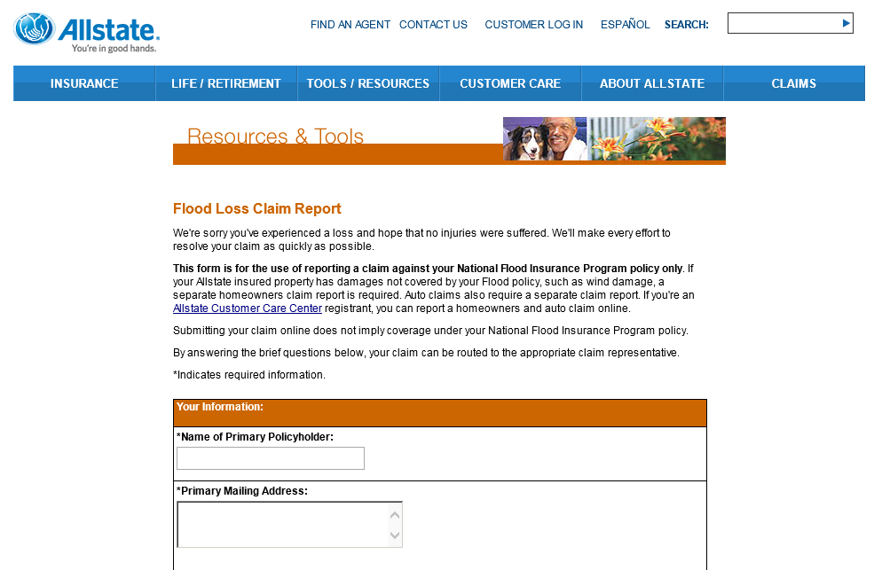
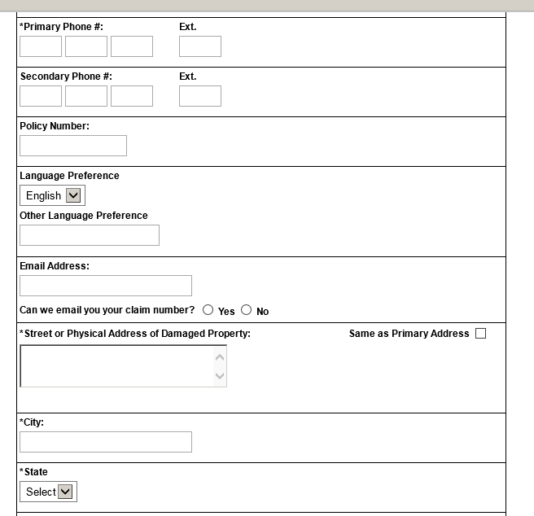
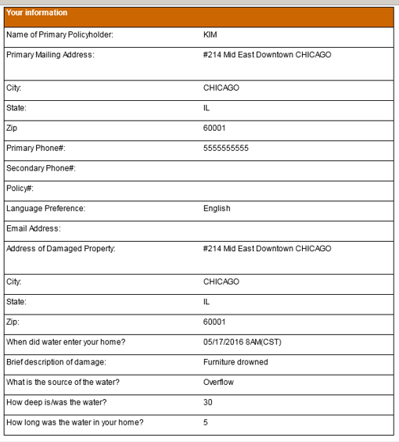
Demo (2 of 2)

Slide 12
Activity (1 of 3)
The participants would work on Allstate Online Sales application for executing their activity.
Customer can get a quotation for their vehicle by entering the required information assisted by the Allstate system, in which customers can add their vehicles details and Vehicle Information, Select offers if available, usage details of the vehicle and family members who are involved in driving the vehicle.
The description about the activity would be given in details in the modules slides and would be explained in ILT mode.

Slide 13
Activity (2 of 3)
Participants are supposed to work on 3 web pages in Allstate Online sales application.
Enter personal details
Add a Vehicle ( Vehicle Information)
Add Vehicle (Ownership information)
Note:- Screen shots for reference are given in next slide

Slide 14
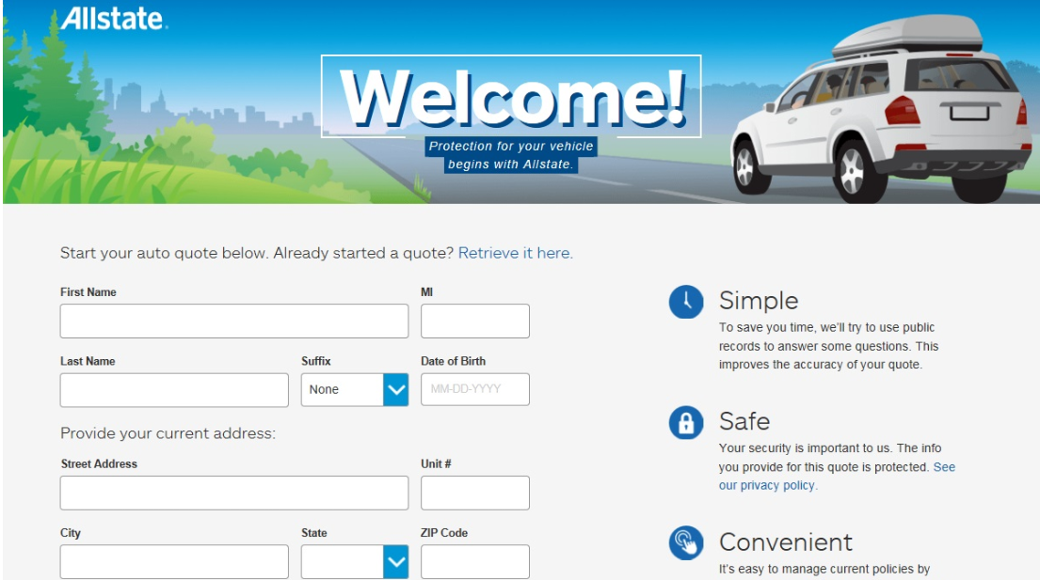
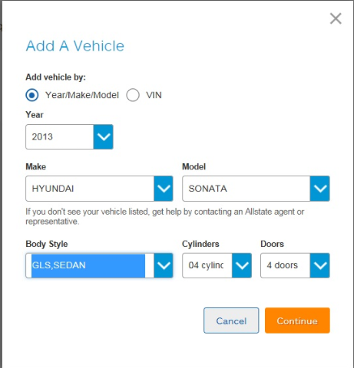
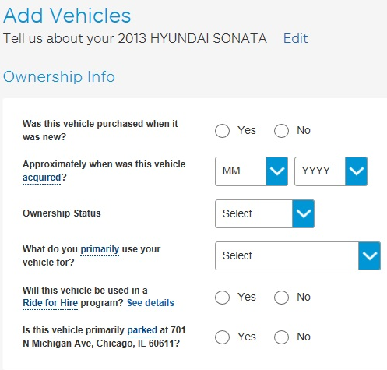
Activity (3 of 3)
Customer can purchase their car insurance Online at Allstate Online Sales.

Slide 15
Summary
At the end of this module, participants should be able to understand:
ETRM XML Framework Architecture & File Structure
Overview of Applications that will be used for Demo and Activities

Slide 16


