Slide 1

Automation for QCA
Module 2: Configuring Project Registry Files

Slide 2
Module 2 Objectives
At the end of this module, participants will be able to understand:
XML, CSV and Excel configuration in Application Registry, Device Registry and Cloud Registry.

Slide 3

Course Map / Module Map
Module 8
Module 7
Module 6
Module 5
Module 4
Module 3
Module 2 Map
Device Registry
Cloud Registry
Application Registry
Driver Config
Hands on Activity
Module 2
Module 1

Slide 4
Module 2 Design Outline
Device Registry
Application Registry
Driver Config
Cloud Registry
Hands on Activity

Slide 5
Module 2 Design Outline
Device Registry
Application Registry
Driver Config
Cloud Registry
Hands on Activity

Slide 6
Device Registry
Device Registry is to specify that test scripts should only run on devices with additional information like device model, manufacturer, operating system, browser name etc.
Device Registry can be configured in different ways like XML, CSV and Excel.
Configuration | Java packages
XML | com.perfectoMobile.device.data.XMLDataProvider
CSV | com.perfectoMobile.device.data.CVSDataProvider
EXCEL | com.perfectoMobile.device.data.ExcelDataProvider
PERFECTO | com.perfectoMobile.device.data.perfectoMobile.PerfectoMobileDataProvider
NAMED | com.perfectoMobile.device.data.NamedDataProvider

Slide 7
Device Registry XML Configuration (1 of 5)
Device Registry is responsible for acquisition of devices, locking and parallel execution. Device Registry allows access to mobile devices and desktop browsers. Using the Device registry allows higher rate of execution and true parallel runs.
The device registry format is defined using a XML Schema Definition file.
This file is located at http://www.xframium.org/xsd/deviceManagement/deviceRegistry.xsd. Below mentioned are some of the elements & attributes that need to be defined in xml.
Elements
deviceRegistry: The root element of the device registry
device: Represent a set of device criteria specifying a single device type.

Slide 8
Device Registry XML Configuration (2 of 5)
Attributes
name: The name of the device used for reporting purposes
manufacturer: The device manufacturer - this is used as criteria and for reporting
model: The device mode - this is used as criteria and for reporting
os: The device os used as criteria
osVersion: The device os version used as criteria
browserName: The name of the browser used as criteria
browserVersion: The version of the browser used as criteria
id: A specific device identifier

Slide 9
Device Registry XML Configuration (3 of 5)
Elements
capability: Each device specification can contain a set of named capabilities in addition to those provided in previous slide.
Attributes
name: The name of the capability
class: Specifies the type of value specified in the text content as STRING,BOOLEAN,PLATFORM or OBJECT)

Slide 10
Device Registry XML Configuration (4 of 5)
Below mentioned is the xml configuration code snippet for Flood Loss Application deviceRegistry.xml
<?xml version="1.0" encoding="UTF-8"?>
<deviceRegistry xmlns="http://www.xframium.org/deviceRegistry" xmlns:xsi="http://www.w3.org/2001/XMLSchema-instance"
xsi:schemaLocation="http://www.xframium.org/deviceRegistry http://www.xframium.org/xsd/deviceManagement/deviceRegistry.xsd">
<device name="NEXUS 6" os="Android" manufacturer="Google" model="NEXUS 6" active="false" />
<device name="S4" os="Android" make="Samsung" model="I545 Galaxy S IV 4.2" active="false" />
<device name="ip6" os="iOS" manufacturer="Apple" model="iPhone-6" availableDevices="2" active="false"/>

Slide 11
Device Registry XML Configuration (5 of 5)
<device name="IE" os="Windows" browserName="Internet Explorer" availableDevices="1" manufacturer="Microsoft" model="IE"
active="false" >
<capability name="ignoreProtectedModeSettings" class="BOOLEAN">true</capability>
</device>
<device name="Firefox" os="Windows" browserName="Firefox" manufacturer="Mozilla" model="Firefox" active="false" />
<device name="Chrome" os="Windows" browserName="Chrome" manufacturer="Google" model="Chrome" active="true" />
</deviceRegistry>

Slide 12
Device Registry CSV Configuration
Below mentioned is the csv configuration for Flood Loss Application deviceRegistry.csv
Nexus6,Android,Google,false,,,
Firefox,Mozilla,true,,,,

Slide 13
Device Registry Excel Configuration
Below mentioned is the csv configuration for Flood Loss Application deviceRegistry.xlsx
Nexus6,Android,Google,false,,,
Firefox,Mozilla,true,,,,

Slide 14
Module 2 Design Outline
Device Registry
Application Registry
Driver Config
Cloud Registry
Hands on Activity

Slide 15
Cloud Registry
The Cloud registry controls access to our various cloud instances. All access information and credentials are stored here for use by the system.
Cloud Registry can be configured in different ways like XML, CSV and Excel.
Configuration | Java Description
XML | com.perfectoMobile.device.cloud.XMLCloudProvider
CSV | com.perfectoMobile.device.cloud.CSVCloudProvider
EXCEL | com.perfectoMobile.device.cloud.ExcelCloudProvider

Slide 16
Cloud Registry XML Configuration (1 of 3)
The cloud registry format is defined using a XML Schema Definition file.
This file is located at http://www.xframium.org/xsd/deviceManagement/cloudRegistry.xsd.
Below mentioned are some of the elements and attributes of the cloud registry xml file.
Elements:
cloudRegistry: The root element of the cloud registry
cloud: Represent a set of device criteria specifying a single device type.

Slide 17
Cloud Registry XML Configuration (2 of 3)
Attributes
name: The name of the cloud that
userName: The user name used to connect to the cloud for test execution
password: The password used to connect to the cloud
hostName: The hose name of the cloud instance
grid: A name of another defined cloud instance pointing to a Selenium grid for desktop browsers
proxyHost: An optional proxy host
proxyPort: An optional proxy port

Slide 18
Cloud Registry XML Configuration (3 of 3)
Below mentioned is the xml configuration code snippet for Flood Loss Application cloudRegistry.xml
<?xml version="1.0" encoding="UTF-8"?>
<cloudRegistry xmlns="http://www.xframium.org/cloudRegistry" xmlns:xsi="http://www.w3.org/2001/XMLSchema-instance"
xsi:schemaLocation="http://www.xframium.org/cloudRegistry http://www.xframium.org/xsd/deviceManagement/cloudRegistry.xsd">
<cloud name="local" userName="" password="" hostName="127.0.0.1:4444" proxyHost=""/>
<cloud name="allstate" userName="bgith@allstate.com" password="PM123!" hostName="allstate.perfectomobile.com"
proxyHost="rdc-proxy.allstate.com" proxyPort="8080" grid="local" />
</cloudRegistry>

Slide 19
Cloud Registry CSV Configuration
Below mentioned is the csv configuration for Flood Loss Application cloudRegistry.csv
local,user@domain.com,password,demo.perfectomobile.com,,,
demo,,,127.0.0.1:4444,,,

Slide 20
Cloud Registry Excel Configuration
Below mentioned is the excel configuration for Flood Loss Application cloudRegistry.xls
local,user@domain.com,password,demo.perfectomobile.com,,,
demo,,,127.0.0.1:4444,,,

Slide 21
Module 2 Design Outline
Device Registry
Application Registry
Driver Config
Cloud Registry
Hands on Activity

Slide 22
Application Registry
The Application Registry allows for all application details required for testing to be stored in a single place for easy access.
Application Registry can be configured in different ways like XML, CSV and Excel.
Configuration | Java Packages
XML | com.morelandLabs.application.XMLApplicationProvider
CSV | com.perfectoMobile.device.cloud.CSVCloudProvider
EXCEL | com.perfectoMobile.device.cloud.ExcelCloudProvider

Slide 23
Application Registry XML Configuration (1 of 4)
The application registry format is defined using a XML Schema Definition file. This file is located at http://www.xframium.org/xsd/deviceManagement/applicationRegistry.xsd.
Below mentioned are the elements and attributes that are used in application registry xml file.
Elements
applicationRegistry: The root element of the application registry
application: Represents the application specifications or url for web sites

Slide 24
Application Registry XML Configuration (2 of 4)
Attributes
name: The name of the application
appPackage: The name of the android package for this application (NATIVE)
bundleId: The name of this IOS bundle for this application (NATIVE)
url: The URL for web applications (WEB)
iosInstall: The Perfecto Cloud location of the IOS Installation file
androidInstall: The Perfecto Cloud location of the Android Installation file

Slide 25
Application Registry XML Configuration (3 of 4)
Elements
capability: Each application can contain a set of named capabilities in addition to those provided above.
Attributes
name: The name of the capability
class: Specifies the type of value specified in the text content as STRING,BOOLEAN,PLATFORM or OBJECT)

Slide 26
Application Registry XML Configuration
Below mentioned is the xml configuration code snippet for Flood Loss Application applicationRegistry.xml
<?xml version="1.0" encoding="UTF-8"?>
<applicationRegistry xmlns="http://www.xframium.org/applicationRegistry" xmlns:xsi="http://www.w3.org/2001/XMLSchema-instance"
xsi:schemaLocation="http://www.xframium.org/applicationRegistry http://www.xframium.org/xsd/deviceManagement/applicationRegistry.xsd">
<application name="FloodLoss" appPackage="" bundleId="" url="https://messaging-stest.allstate.com/floodloss.aspx" />
</applicationRegistry>

Slide 27
Application Registry CSV Configuration
Below mentioned is the xml configuration for Flood Loss Application applicationRegistry.csv
https://messaging-stest.allstate.com/floodloss.aspx,FloodLoss,,

Slide 28
Application Registry Excel Configuration
Below mentioned is the xml configuration for Flood Loss Application applicationRegistry.xlsx
https://messaging-stest.allstate.com/floodloss.aspx,FloodLoss,,

Slide 29
Module 2 Design Outline
Device Registry
Application Registry
Driver Config
Cloud Registry
Hands on Activity

Slide 30
Driver Config (1 of 4)
Driver Config is text file which will be created in a separate folder for the xml driven project.
The Driver config text file contains device, cloud, application registry files information like the path of files.
DriverConfig.txt file is ideally going to be mapped to java project.
To execute the project as a java application driverConfig.txt file need to be send as a command line argument to the main class(TestDriver.java).
Below mentioned is the screen shot of the project configuration in eclipse

Slide 31
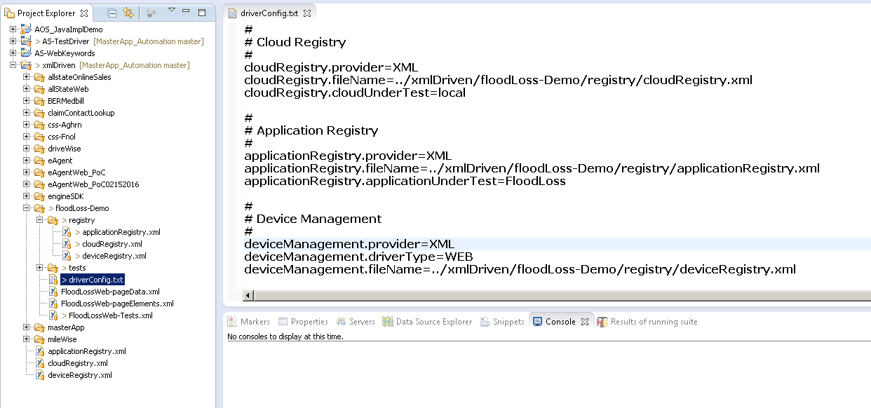
Driver Config (2 of 4)

Slide 32
Driver Config (3 of 4)
Below mentioned is the excel configuration code snippet for Flood Loss Application driverConfig.txt
#
# Cloud Registry
#
cloudRegistry.provider=XML
cloudRegistry.fileName=../xmlDriven/floodLoss-Demo/registry/cloudRegistry.xml
cloudRegistry.cloudUnderTest=local

Slide 33
Driver Config (4 of 4)
#
# Application Registry
#
applicationRegistry.provider=XML
applicationRegistry.fileName=../xmlDriven/floodLoss-Demo/registry/applicationRegistry.xml
applicationRegistry.applicationUnderTest=FloodLoss
#
# Device Management
#
deviceManagement.provider=XML
deviceManagement.driverType=WEB
deviceManagement.fileName=../xmlDriven/floodLoss-Demo/registry/deviceRegistry.xml

Slide 34

Activity
Environment or File: Participants Guide
Steps:
Open the Participants Guide given as word document.
Read the given activity details.
Complete the activities
Submit to faculty

Slide 35
Summary
At the end of this module, participants are able to understand:
XML, CSV and EXCEL configuration in different types of registries like Device Registry, Cloud Registry and Application Registry.

Slide 36


