Slide 1

Automation for QCA –Pre-Requisites
Module 2: XML

Slide 2
Module 2 Objectives
At the end of this module, participants will be able to understand:
XML Introduction
Components of XML Document
XML – Root, Element, Entity, Attribute
XML – Comment
Well Formed and Valid XML
XML DOM

Slide 3

Course Map / Module Map
Module 9
Module 8
Module 7
Module 6
Module 5
Module 4
Module 3
Module 2 Map
XML Introduction
Components of XML Document
XML – Root, Element, Entity Attribute
XML - Comment
XML – Processing Instruction
Well Formed and Valid XML
XML DOM
Hands on Activity
XML
Module1

Slide 4
Module 2 Design Outline
XML Introduction
XML - Root, Element, Entity and Attribute
XML – Comment
Well Formed and Valid XML
Components of XML Document
Hands on Activity
XML Document Object Model

Slide 5
Module 2 Design Outline
XML Introduction
XML - Root, Element, Entity and Attribute
XML – Comment
Well Formed and Valid XML
Components of XML Document
Hands on Activity
XML Document Object Model

Slide 6
XML Introduction
XML stands for EXtensible Markup Language
XML is a software and hardware independent tool for carrying information.
Provides international, vendor independent standard for describing information. It is a w3c recommended language.
It is tag based language. Not replacement to HTML.
XML is the most common for data transmissions between all sorts of applications.
Used extensively in web application configuration files.
Media for data interchange - A better alternative to proprietary data transfer.
Ecommerce – allows to make one data page and use it over again in different web application.
Notes:
W3C - World Wide Web Consortium. It is a standard for world wide web.
Some additional points related to Applications of XML:
It increases data availability – any application can read data from XML.
Simplifies data sharing – since XML is a plain text format it is independent of hardware and software.
Used for creating new Internet languages - If rules are followed in creating XML file, then anyone can create their own language. SVL, WML (Wireless Markup Language) and MathML (Mathematical Markup Language) are examples of languages that are created based on XML. Each language designed for a specific purpose.

Slide 7
Difference between XML and HTML
HTML | XML
Designed to display data, describe how data is formatted in web page | Designed to transport and store data, with focus on what data actually means.
In HTML we will not define any tags. | In XML we can define our own tags
HTML is not case-sensitive | XML is case-sensitive.
HTML - Unidirectional links | XML - Multidirectional links
HTML defines only the data | XML describes the data
Notes:
What XML is not for:
A replacement for HTML
A Programming Language
A Network Transport Protocol
A Database

Slide 8

What does XML really do?
XML does not do anything!
XML was used to structure, store, and transport information.
The following is an example of an employee information:
Employee details comprises name, phone number and date of joining.
However, this document does not perform any operations. It is used to wrap the information in the form of tags.
<Employee>
<Name>ABC</Name>
<Ph.No>111111</Ph.No>
<DOJ>01/01/2001</DOJ>
</Employee>

Slide 9
Module 2 Design Outline
XML Introduction
XML - Root, Element, Entity and Attribute
XML – Comment
Well Formed and Valid XML
Components of XML Document
Hands on Activity
XML Document Object Model

Slide 10
Components of XML Document (1 of 2)
XML Document
Element
Text
Attribute
Processing Instruction
Comment
Root

Slide 11
Components of XML Document (2 of 2)
<?xml version="1.0" encoding="ISO-8859-1"?>
<?xml-stylesheet type=“text/html” href=“college.xsl” ?>
<!– Student Information -->
<students>
<student id=“1221”>
<name>Rajan</name>
<branch>ece</branch>
<cgpa>7.5</cgpa>
</student>
<student id=“1222”>
<name>Peter</name>
<branch>civil</branch>
<cgpa>8.4</cgpa>
</student>
</students>
Comment
Root
Element
Attribute
Text

Slide 12
Module 2 Design Outline
XML Introduction
XML - Root, Element, Entity and Attribute
XML – Comment
Well Formed and Valid XML
Components of XML Document
Hands on Activity
XML Document Object Model

Slide 13
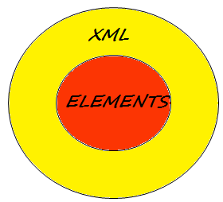
What is an XML Element?
An XML element represents all parts from the element's start tag to (including) the element's end tag.
Elements are the core of XML
An element can contain:
Text
Attribute
Another element
Combination of all he above

Slide 14
Creating XML Elements
While creating XML elements the following points need to be considered.
Elements must have an opening and closing tag.
They can be hierarchically nested.
They are always given a case sensitive name and that begins with a letter
Elements names cannot contain spaces.
An empty tag
or
<student>details</student>
<student></student>
<student/>

Slide 15
XML Attributes (1 of 2)
Attribute provides additional information about an element it belongs to .
Attributes can be used
for enumeration
constrained values or
types.
XML attributes consist of two parts: name and value.
In the above example, id is the attribute name and “1221” is the value of the id attribute
<student id=“1221”>

Slide 16

XML Attributes (2 of 2)
Always a string
Not limited by length or number per element
Always quoted, either single quote or double quote
Attributes can not contain multiple values
Attributes can not contain tree structure but elements can

Slide 17
XML Entities
Some characters have a special meaning in XML, like the less than sign (<) that defines the start of an XML tag.
If we want to use the less than sign inside our XML document then parser will generate error message.
Because the parser will consider the less than sign as start of a tag
So to use the signs with their actual functionality entities exist(then the parser doesn’t generate an error).
Entities are represented by text and preceded by ‘&’ symbol.
Entities are expanded when a document is parsed by an XML parser.

Slide 18


List of Pre-defined Entities
Entity References | Character
&lt; | <
&gt; | >
&amp; | &
&quot; | "
&apos; | '
<count>> 1 & < 5</count>
<count> &gt; 1 &amp; &lt; 5 </count>

Slide 19
Module 2 Design Outline
XML Introduction
XML - Root, Element, Entity and Attribute
XML – Comment
Well Formed and Valid XML
Components of XML Document
Hands on Activity
XML Document Object Model

Slide 20
XML Comments
XML comments are similar to HTML comments.
It starts with <!– (markup declaration open delimiter (<!) and ends with comment open delimiter (--> ).
May be ignored by XML parsers but are recognized by XSLT. Therefore, can be parsed under the program control.
A full XML comment appears as given below.
<!-- I am a valid XML comment -->
Notes:
XSLT.- EXtensible Stylesheet Language

Slide 21
Module 2 Design Outline
XML Introduction
XML- Root, Element, Entity and Attribute
XML – Comment
Well Formed and Valid XML
Components of XML Document
Hands on Activity
XML Document Object Model

Slide 22
Well Formed and Valid XML
An XML file should be well formed and valid file.
A well-formed XML document has to follow several generic rules, such as:
XML declaration
One root element
Proper nesting
Elements must obey the XML naming convention
Every start tag must have a matching end tag
Proper attributes and comments
A Valid XML file is always associated with DTD (Document Type Declaration).
An XML file becomes valid when it is verified against the rule given in the DTD.
Notes:
DTD - Document Type Definition. DTD is used for verifying whether the XML document is valid or not.
Its not necessary that a well formed xml must be valid.
But any xml file must be well formed.
Checking whether an xml is valid or not is done by associated DTD for the specific XML document.

Slide 23
Module 2 Design Outline
XML Introduction
XML - Root, Element, Entity and Attribute
XML – Comment
Well Formed and Valid XML
Components of XML Document
Hands on Activity
XML Document Object Model

Slide 24
XML Document Object Model (1 of 2)
DOM – Document Object Model. It represents each node of the XML tree as an object with properties and behavior for processing the XML.
The XML documents have a hierarchy of informational units called nodes.
Each node has relationship with one another. For describing the nodes and relationship between the nodes DOM can be used.
The terms parent, child, and sibling are used to describe the relationships between elements. Parent elements have children. Children on the same level are called siblings.
Tasks that can be performed with DOM
Navigating an XML document's structure, which is a tree stored in memory.
Reporting the information found at the nodes of the XML tree.
Adding, removing, or modifying elements in the XML document.

Slide 25
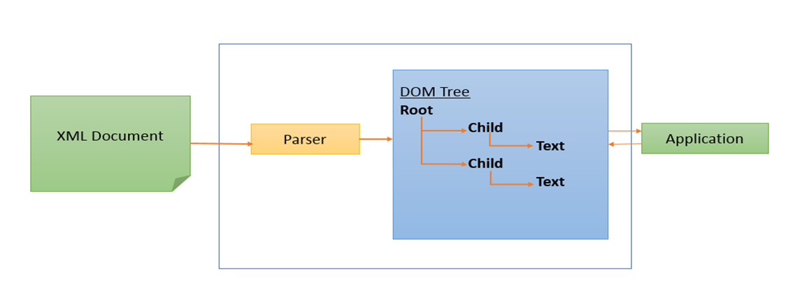
XML Document Object Model (2 of 2)
As XML DOM also provides an API that allows a developer to add, edit, move or remove nodes at any point on the tree in order to create an application.

Slide 26
Representing XML with DOM (1 of 2)
<?xml version=“1.0”?>
<company>
<!- Employee information -->
<emp id=“007”>
<name>suhasan</name>
<type>employee</type>
<address country=“India”>
<road> Mahatma Gandhi Road </road>
<city>Bangalore</city>
</address>
</emp>
</company>

Slide 27
Representing XML with DOM (2 of 2)
Root Element
<company>
Parent
Child
Attribute:
“id”
Element:
<emp>
Element:
<name>
Element:
<type>
Element:
<address>
Attribute:
“country”
Siblings
Text:
suhasan
Text:
employee
Element:
road
Element:
city
Text:
Mahatma Gandhi Road
Text:
Bangalore

Slide 28
Module 2 Design Outline
XML Introduction
XML - Root, Element, Entity and Attribute
XML – Comment
Well Formed and Valid XML
Components of XML Document
Hands on Activity
XML Document Object Model

Slide 29

Activity
Environment or File: M2_XML_Activty_PG_v1
Steps:
Open the Participants Guide given as word document.
Read the given activity details.
Complete the activities
Submit to faculty
Activity

Slide 30
Summary
At the end of this module, participants are able to understand:
What is XML
XML Components
Well formed and Valid XML
XML DOM

Slide 31

Thank You

