Slide 1

Automation for QCA – Pre-Requisites
Module 3: XPath

Slide 2
Module 3 Objectives
At the end of this module, participants will be able to understand:
HTML
HTML Basic Tags
HTML Elements and Attributes
Finding Elements using Browser Inspector
XPath
XPath – Expressions
Choosing Effective XPath (Absolute and Relative XPath)
Usage of Firebug & FirePath (Firefox)
XPath Functions
Hands-on Activity

Slide 3

Course Map / Module Map
Module 9
Module 8
Module 7
Module 6
Module 5
Module 4
Module 3 Map
HTML
HTML Basic Tags
HTML Elements and Attributes
Finding Elements using Browser Inspector
XPath
XPath - Axis
XPath - Expressions
Choosing Effective XPath
Usage of FireBug and FirePath
XPath Functions
Hands on Activity
XPath
Module 2
Module 1

Slide 4
Module 3 Design Outline
HTML
HTML Basic Tags
HTML Elements & Attributes
Finding Elements using Browser Inspector
Usage of Firebug & FirePath (Firefox)
XPath Functions
Hands-on activity
Choosing Effective XPath
XPath
Creating Good XPath

Slide 5
Module 3 Design Outline
HTML
HTML Basic Tags
HTML Elements & Attributes
Finding Elements using Browser Inspector
Usage of Firebug & FirePath (Firefox)
XPath Functions
Hands-on activity
Choosing Effective XPath
XPath
Creating Good XPath

Slide 6

HTML Introduction
HTML is a markup language for describing web pages.
HTML stands for Hyper Text Markup Language.
HTML documents are described by HTML tags.
HTML is designed to display data and describe how data is formatted in web page.

Slide 7
Module 3 Design Outline
HTML
HTML Basic Tags
HTML Elements & Attributes
Finding Elements using Browser Inspector
Usage of Firebug & FirePath (Firefox)
XPath Functions
Hands-on activity
Choosing Effective XPath
XPath
Creating Good XPath

Slide 8
HTML Basic Tags
All HTML documents would start with a type declaration:
The HTML document itself begins with <html> and ends with </html>.
The visible part of the HTML document is between <body> and </body>.
<!DOCTYPE html>
<!DOCTYPE html> <html> <body> <h1>HEADLINES TODAY</h1> <p>As Usual News in Paragraph</p> </body> </html>

Slide 9
HTML Headings and Paragraphs
HTML headings are defined with the <h1> to <h6> tags:
Example
HTML paragraphs are defined with the <p> tag.
Example
<h1>Do you see this</h1>
<h2>Do you see this</h2>
<h3>Do you see this</h3>
... till <h6> </h6>
<p>paragraph content goes here</p>
<p>This is another paragraph</p>

Slide 10
HTML Links & Images
HTML Links
HTML links are defined with <a> tag:
Example
The link's destination is specified in the href attribute.
Attributes are used to provide additional information about HTML elements.
HTML Images
HTML images are defined with the <img> tag.
The source file (src), alternative text (alt), and size (width and height) are provided as attributes:
Example
<a href="http://www.abc.com">This is a link</a>
<img src="scenary.jpg" alt="nature.com" width="102" height="143">

Slide 11
Module 3 Design Outline
HTML
HTML Basic Tags
HTML Elements & Attributes
Finding Elements using Browser Inspector
Usage of Firebug & FirePath (Firefox)
XPath Functions
Hands-on activity
Choosing Effective XPath
XPath
Creating Good XPath

Slide 12
HTML Elements
HTML elements generally written with a start tag, content and end with an end tag.
HTML elements follow the below semantics.
<tagname>content goes here</tagname>
Example
The above code is paragraph element. It starts with start tag - <p> and ends with end tag - </p>. Between the start and end tag the content is given.
Whenever the HTML element is referred, it means start tag, content and the end tag.
HTML elements can be nested (elements can contain sub elements).
All the HTML documents consists of nested HTML elements.
<p>Paragraph statements goes here.</p>
Notes:
<!DOCTYPE html> <html> <body> <h1>My First Heading</h1> <p>My first paragraph.</p> </body> </html>

Slide 13
HTML Attributes
HTML attributes are properties for HTML elements.
All HTML elements can have one or more attributes.
Attributes are mentioned along with start tag of an HTML element.
Attributes are defined with the attribute name and value. If an element has more than one attribute, then they are separated by space.
For example, anchor element in HTML contains ‘href’ attribute which provides address information for links.
Similarly image element has width and height attributes which provide size information for images and src attribute to provide the image location.
<a href=“file1.html”>click here </a>
<img src=“images/education/welcome.jpeg ” width=“120” height=“ 180”>
Notes:
The HTML alt attribute provides text for screen readers

Slide 14
Module 3 Design Outline
HTML
HTML Basic Tags
HTML Elements & Attributes
Finding Elements using Browser Inspector
Usage of Firebug & FirePath (Firefox)
XPath Functions
Hands-on activity
Choosing Effective XPath
XPath
Creating Good XPath

Slide 15
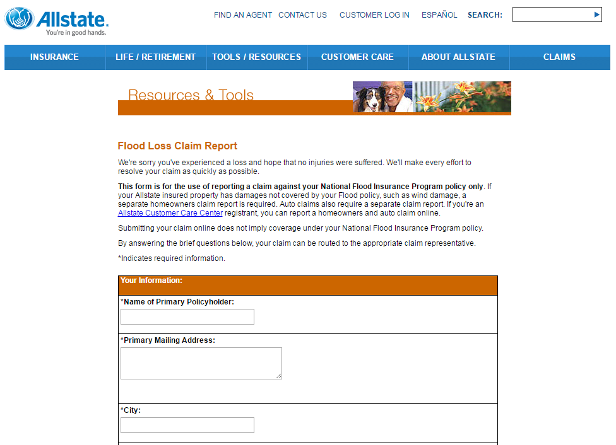
Finding Elements using Browser Inspector (1 of 4)
We will learn inspecting elements using browser inspector.
Now Lets launch the Allstate Flood Loss application.
The user would be able to see the below screen.
Step 1 - To inspect the HTML elements with browser, launch Google Chrome’s Developer tool by pressing F12.
Notes:
The All state Flood loss application url - https://messaging-stest.allstate.com/floodloss.aspx
Use of Browser Inspector is to identify or locate a particular HTML element of a web page.

Slide 16
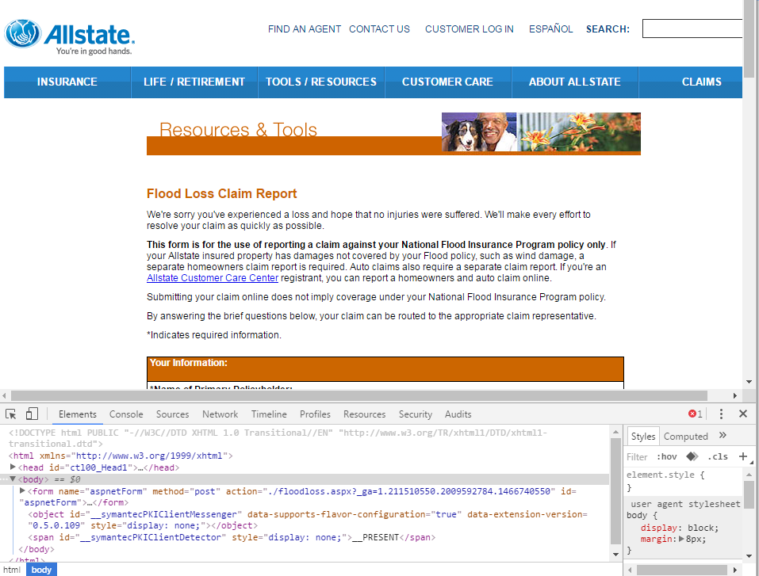
Finding Elements using Browser Inspector (2 of 4)
Notes:
Notes to Faculty:
After pressing the F12, the chrome developer will be launched and shown at the bottom of the web page.

Slide 17
Finding Elements using Browser Inspector (3 of 4)
Please note that the “Element” tab is highlighted in the above screenshot.
The element tab is the one which displays all the HTML properties belonging to the current web page. Navigate to the “Element” tab if it is not opened by default on the launch.
Since the browser shows the attributes, values, elements with different colors the user can understand the element structure , attributes and inspect the code easily.
Step 2 - Right click on the desired web element and choose inspect option to locate the desired object within the web page.
The HTML property belonging to that web element would be highlighted in the developer tool.
Notes:
Shortcuts for inspect elements – F12

Slide 18
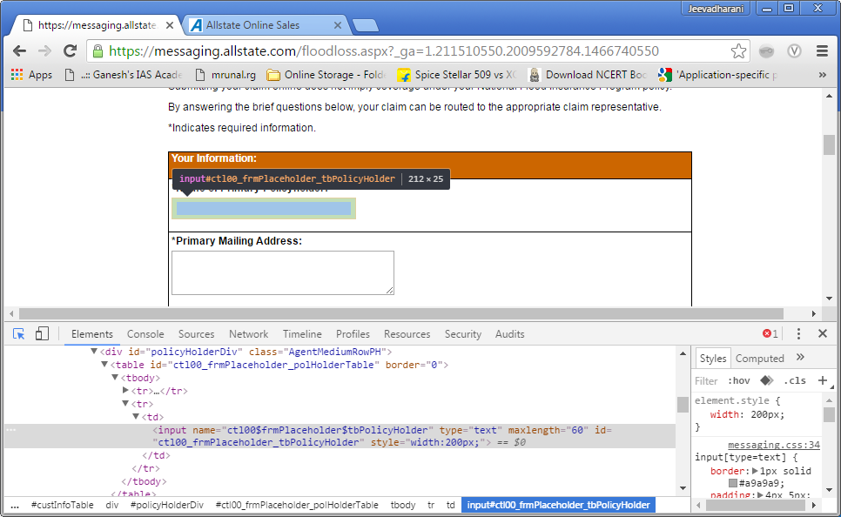
Finding Elements using Browser Inspector (4 of 4)

Slide 19
Module 3 Design Outline
HTML
HTML Basic Tags
HTML Elements & Attributes
Finding Elements using Browser Inspector
Usage of Firebug & FirePath (Firefox)
XPath Functions
Hands-on activity
Choosing Effective XPath
Creating Good XPath
XPath

Slide 20
XPath
XPath is used to navigate information in an XML document.
It can be thought of as syntax, which is created by specifying path expressions in order to identify nodes in the document.
Like other languages, XPath also contains language constructs such as expressions, predicate, functions etc.
XPath models XML documents as tree of nodes using the Document Object Model (DOM), text order is maintained in the tree.
XPath's primary intention is being a component that can be used by other specifications (such as XPointer and XSLT)
XPath is being used as a subset in XQuery which is a query language that is operated on XML documents not databases.

Slide 21
XPath Expression
To create an XPath or to understand an XPath we need to know the following which makes a XPath expression. We will explore them in the next slides.
Location Path and step
Predicates
XPath Axis

Slide 22
XPath : Location Path and Step
What is Location Path ?
The location path is used to specify a location of a node in XML or HTML DOM.
How do location paths work?
Location paths work much like directory paths. For example, consider in windows OS, we have stored a text file named Lesson1.txt under Mynotes directory. To locate the file the path would be as follows.
\Mynotes\Lesson1.txt
The XPath location paths much same as directory path but their syntax will be much complex, detailed than directory path.
The location paths are built out of individual steps, called location steps.
Each location step separated by / or //. We use these steps to specify the data we want, just as we use successive directories in a directory path to get to the location of a file.

Slide 23
Different ways of Identifying XPath
Finding elements with absolute path
xpath= /html/body/form
Finding elements with relative path
xpath= //form
Finding elements using index
xpath= //form/input[1]
Finding elements using attribute values
xpath= //input[@name='username']
With multiple attributes:
xpath= //input[@name='username'][@class='required']
xpath= //input[@name='username and @class=required']
xpath= //input[@name='username or @class=required]
Finding elements using attributes
xpath= //img[@alt]

Slide 24
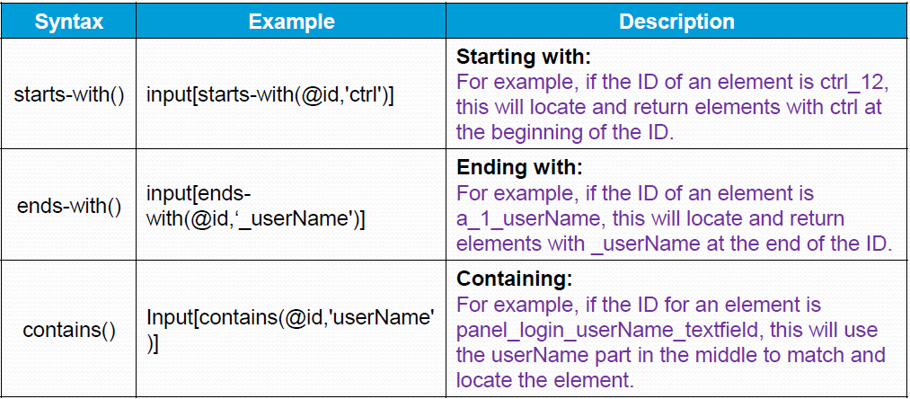
Different ways of Identifying XPath
Performing partial attribute value match

Slide 25
Different ways of Identifying XPath
Matching any element using a value
xpath=//*[@id='username']
Matching any attribute using a value
xpath=//input[@*='username']
Using XPathtext function
xpath= //a[text()='some text']

Slide 26
Common XPath Location Path Identifiers
Expression | Description
. | represents context node.
.. | parent context node.
/ | root node.
// | referring a node anywhere within document.
* | all elements that are child of context node.
text() | selects all text node children of current element.
@ | attribute selector
@* | all attribute of the context node
//@* | all attribute within xml document
//@id | Id attribute within xml document
element_name[n] | specifies the nth element in the xml document

Slide 27
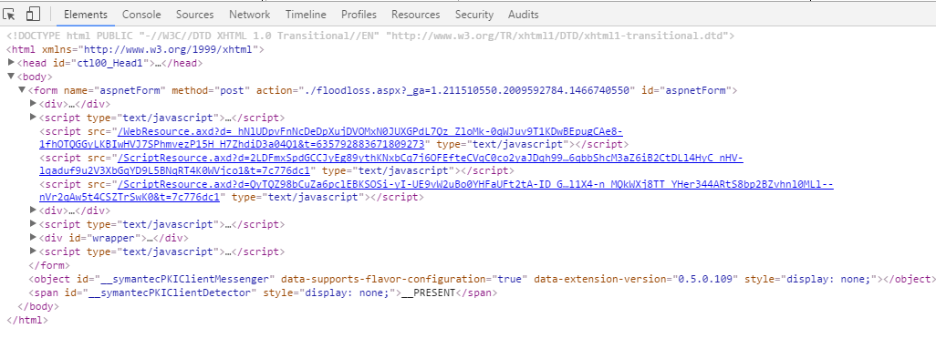
Example - Location Path
Navigate to Allstate Flood Loss application I chrome browser. To open the code press F12 in chrome browser. The code is opened in chrome developer window.

Slide 28
Example - Location Path
In the Flood Loss Application , html is the root node. To locate a node anywhere from the document, without the root node then ‘//’ can be used. (We need to remember ‘Common Location Path Identifiers’ given in the previous slide)
The following examples show location path over Flood Loss Application HTML code.
//form/div - selects all immediate child div elements within the form.
Selects 3 div elements
//form/div[1] - selects first child div element of the form.
Selects the first div element
//@id - selects all attributes with the name ‘id’
Returns 177 id attributes.

Slide 29
XPath : Predicate
The predicate is a condition.
Predicates consists of a well-formed expressions where it contains operators, functions, numbers, strings, comparison operators.
Predicates are enclosed by square brackets.
Syntax
[condition]
Example
[@id=‘header’]
To compare the numeric values quotes are not required. But for characters and strings quotes required.
As well as the equals sign, XPath supports a full complement of relational operators including <, >, >=, <=, and !=. It also supports logical ‘and’ , ‘or’ operators.

Slide 30
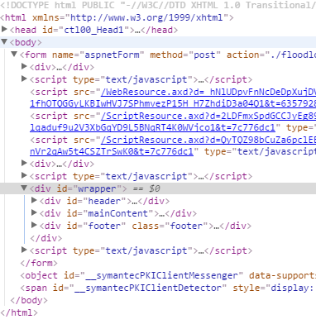
Example - Predicates
Navigate to the AllState Flood Loss Application code.
The simple location path without predicate is
//form/div[3]/div[2]
To achieve the same the following can be used.
//div[@id=“mainContent”]
The example locates the div element which has id as an attribute and ‘mainContent’ as attribute value.

Slide 31
Example - Predicates
//div[@id=‘header’ or @id=‘footer’]
selects the div elements whose id attribute is ‘header’ or ‘footer’ .
Since contains logical ‘or’ operator, any one of the condition must be true.
//div[@id=‘footer’ and @class=‘footer’] -
selects the div element whose id attribute is ‘footer’ and class attribute is ‘footer’.
Since the example uses logical ‘and’ operator both of the conditions must be true.
//span[text()=‘*Zip:’]
Selects span elements whose text is equal to ‘*Zip:’.
Since the Flood Loss Application contains two ZIP field with the same text, the above XPath selects two spans.

Slide 32
XPath Axis (1 of 3)
XML elements are treated as trees of nodes with DOM.
Nodes in an XML document have relationship with other nodes.
An axis represents a relationship to the context node.
It is used to locate nodes relative to the context node on the tree.
There are 13 different axes are there.

Slide 33
XPath Axis (2 of 3)
Axis Name | Result
ancestor | Selects all ancestors (parent, grandparent, etc.) of the current node
ancestor-or-self | Selects all ancestors (parent, grandparent, etc.) of the current node and the current node itself
attribute | Selects all attributes of the current node
child | Selects all children of the current node
descendant | Selects all descendants (children, grandchildren, etc.) of the current node
descendant-or-self | Selects all descendants (children, grandchildren, etc.) of the current node and the current node itself
following | Selects everything in the document after the closing tag of the current node
following-sibling | Selects all siblings after the current node
namespace | Selects all namespace nodes of the current node
parent | Selects the parent of the current node
preceding | Selects all nodes that appear before the current node in the document, except ancestors, attribute nodes and namespace nodes
preceding-sibling | Selects all siblings before the current node
self | Selects the current node

Slide 34
XPath Axis (3 of 3)
The below pictures is the html code of All state Flood Loss Application. Which is opened with chrome developer tool.
Now lets visualize this html code with DOM.

Slide 35
XPath Axis - AllState Flood Loss Application
document
html
head
body
form
object
span
div
script
div
script
div
script
Id=footer
Id =header
div
div
div
Id=mainContent
Notes:
Notes to Faculty: Explain the xpath axis with the above image which is the DOM visualization of AllState Flood Loss application
1. document is the root node.
2. Head and body are child or descendant of html
3. Html is the ancestor for all the elements
4. Form is the child of body element descendant for both html and html.
Hence child refers immediate child. But descendant represents child from all level. i.e child of child, child of grand child etc.
5.Body is parent for form, object and span elements.
6. Body is ancestor for div, script elements
Hence parent refers immediate parent. But ancestor represents parents from all level parent of parent, parent of grand parent etc.
7. All elements after the form are following elements for form element.
8. Object and span elements are following-sibling of form element.
Hence Following refers to all the elements in a document after an element. But following-sibling represents only following elements of same parent (i.e sibling)
9. Object and form elements are preceding-sibling for span element

Slide 36
Knowledge Check
Analogy to the previous image, answer to the following:
The object element is following-sibling of ________.
List the ancestors of form element.
List following elements for span.
How many preceding siblings are there for div element whose attribute is ‘footer’?
List descendant of form element.
Notes:
Answers:
Form element
Body and html elements, (note: head is not ancestor of form)
None. (note: there is no elements after span in the document. Kindly refer slide 30 for document structure)
2 (2 div elements)
All the sub elements within the form. (including child, grandchild etc)

Slide 37
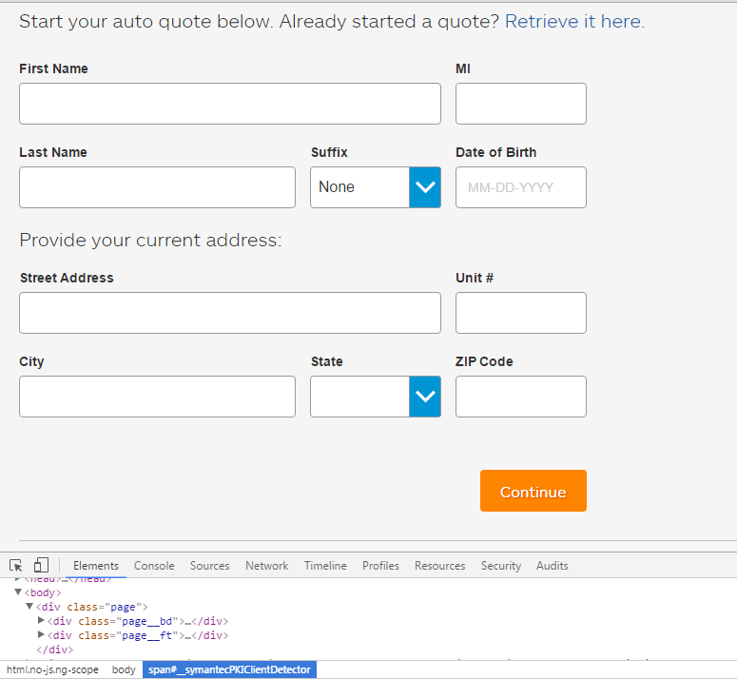
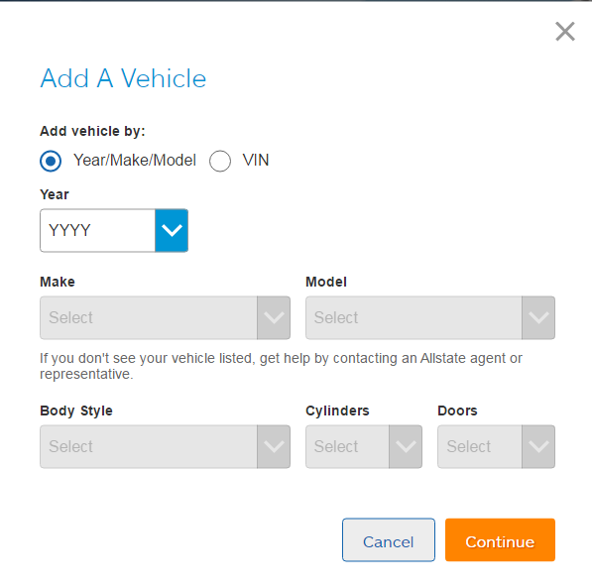
Example - Axis (1 of 6)
Navigate to the Allstate Purchase Application
AllState Purchase Application - First Page
AllState Purchase Application - Second Page

Slide 38
Example - Axis (2 of 6)
From the Allstate purchase application first page, we will try the following XPath and analyze the resulting elements from the web page.
Ancestor and Parent Axes
The XPath selects parent elements from all levels. i.e. immediate parent, grand parent, parent of grand parent etc.
Hence ancestor::div does not select ancestor of div. Instead it checks whether the div is ancestor for the input element or not.
The XPath selects only immediate parents of input element with the specified attribute value
//input[@id='first_name']/ancestor::div
//input[@id='first_name']/parent::div
Notes:
Notes to Faculty:
Explain the above XPath by executing them in the browser. With the output explain the given points
Similar to Parent and ancestor, Explain child and descendant.
Child will select immediate child of a node where descendant will select child from all levels such as grand child, child of grand child etc.

Slide 39
Example - Axis (3 of 6)
Descendant and Descendant-or-self Axes
The XPath selects all descendant div elements to the div element which is a parent to input element.
The XPath selects all descendant div elements including the div element which is parent to input element.
//input[@id='first_name']/parent::div/descendant::div
//input[@id='first_name']/parent::div/descendant-or-self::div
Notes:
Notes to Faculty:
Similar to descendant and descendant-or-self, explain the ancestor and ancestor-or-self.

Slide 40
Example - Axis (4 of 6)
To examine the below XPath, Navigate to the Allstate Purchase application, fill all the details like First Name, state, city etc. and navigate to the next page ‘Add Vehicle’.
Preceding Axis
To select the radio button’ year/make/model’ we can use the following XPath.
The above XPath selects all span tag which are preceding the current span tag excluding ancestor
From the above XPath results to select the first span tag we can use the location path identifier ‘[]’ by mentioning the position number.
//span[attribute::id='v_add_by_make']/preceding::span
(//span[attribute::id='v_add_by_make']/preceding::span)[1]

Slide 41
Example - Axis (5 of 6)
Preceding-sibling Axis
To locate the radio button ‘year/make/model’ from the ‘Add Vehicle’ page the following Xpath also can be used.
The XPath selects all the preceding span tag which are sibling to the span with attribute id value ‘v_add_by_make’.
The preceding-sibling selects child of same parent. So it is called as preceding-sibling.
//span[attribute::id='v_add_by_make']/preceding-sibling::span

Slide 42
Example - Axis (6 of 6)
Following and following-sibling Axes
To select the year drop-down button in the Add Vehicle page, we can use the following Xpath
This selects all the div elements after the select element with attribute id value as ‘v_ymm’. From all the div elements selects the first div.
The below example also locates the year drop-down button from the ‘Add Vehicle’ page.
//select[@id='v_ymm']/following::div[1]
//select[@id='v_ymm']/following-sibling::div

Slide 43
XPath Expression - Overview
An XPath expression is made up of location path and steps. The steps may contain node test and predicates. Node test will contain axis.
Location path identifier
Node test
// span[@id=‘v_add_by_make’]/ancestor::label/descendant::span[1]
Predicate
Axis

Slide 44
Module 3 Design Outline
HTML
HTML Basic Tags
HTML Elements & Attributes
Finding Elements using Browser Inspector
Usage of Firebug & FirePath (Firefox)
XPath Functions
Hands-on activity
Choosing Effective XPath
XPath
Creating Good XPath

Slide 45
Creating Good XPath (1 of 5)
We can generate XPath for HTML elements in a web page using FireBug which is a tool available in FireFox browser.
Generally XPath generated by Firebug are too lengthy and there is a possibility of getting a shorter XPath. In such scenarios we create our own XPath or custom XPath.
Firebug and Firepath are extensions to Firefox and it’s highly recommended tool.
In order to create our own XPath for HTML elements, we depend on html code of a web element and predominantly its properties.
Notes:
Finding an XPath of an HTML element using FireBug will be discussed in later slides.

Slide 46
Creating Good XPath (2 of 5)
Use unique attributes to locate elements
IDs are the safest locator option and should always be our first choice.
By W3C standards, it should be unique in the page meaning we will never have a problem with finding more than one element matching the locator.
Find Anchoring element
A good way to start a XPath locator is to start with an element that we know is not likely to change much and we have to use it as an ‘anchor’ in our locator.
It may have an ID or stable location but not be the element we need to locate but is a reliable position to search from.
Our anchoring element can be above or below the current element in the HTML tree, but most often it’s above.

Slide 47


Creating Good XPath (3 of 5)
Consider the text fields on a webpage and its HTML code.
In this example there are various properties like id, class and name which uniquely identifies the web element.
We can have multiple XPath for the same element as follows,
<input type="text" id="itemsearchbox" class="itemclass" name="searchbox" />
Input type=“text” id=“searchbydate” class=“itemclass” name=“searchbox”
//[@id='itemsearchbox‘]
//[@class='itemclass']
//[@name='searchbox']
Id attribute uniquely identifies a web element
Class and name attributes value can be same for multiple elements
Notes:
Note: Syntax of XPath derived from properties of a web element is //[@property='value']
At times we see XPath generated from Firebug are too lengthy. This is because the element we are planning to locate is not assigned with properties like ID, Name and Class. We have seen how important it is to assign properties like ID, Name and Class to a HTML web element. Assigning these properties will make a web application Selenium friendly to be automated and this is the same reason for assigning web elements with properties and unique values.
And if two elements have the same property then use of auto generated Xpath will result in unexpected behavior. For example, There cannot be two vehicles with the same registration. If there are two vehicles with the same registration then we cannot uniquely identify them. We should always pick unique property of a web element to create our Xpath.

Slide 48
Creating Good XPath (4 of 5)
Know when to use index locator
The nth-child(), first-child, [1] and such index-type locators should only be used if we are using it against a list itself.
In that case the test should explicitly know it wants to pick an item at that index from the list, for example validating the first item of search results.
Using an index-type locator to locate an element that is not index-placed is likely to cause problems when the order of the elements is changed and thus should be avoided.

Slide 49
Creating Good XPath (5 of 5)
Use Axis
When we are composing a locator to look for an ID first and failing that, use the next nearest element with an ID (to use as an anchoring element).
From there, look at descendants and element attributes to narrow down to the element we want to locate.
Example
The below example from All state Purchase applicaion uses axis to locate div element which does not have id attribute. So to locate the div element the descendant ‘input’ element’ is used.
//input[@id='first_name']/ancestor::div

Slide 50
Module 3 Design Outline
HTML
HTML Basic Tags
HTML Elements & Attributes
Finding Elements using Browser Inspector
Usage of Firebug & FirePath (Firefox)
XPath Functions
Hands-on activity
Choosing Effective XPath
XPath
Creating Good XPath

Slide 51
Choosing Effective XPath (1 of 2)
Path expressions may be absolute or relative.
Absolute Path
Absolute XPath starts with the root node or a forward slash (/).
The advantage of using absolute XPath is, it identifies the element very fast as it starts from the root node.
Disadvantage here is, if any thing goes wrong or some other tag added in between, then this path will no longer works.
At times the absolute path will grow in length.
Following is the example of absolute path to locate Text box below the label ‘ *Name of Primary Policy Holder:’.
/html/body/form/div[3]/descendant::div[@id=‘mainContent’]/descendant::div[@id='policyHolderDiv’]/descendant::input

Slide 52
Choosing Effective XPath (2 of 2)
Relative Path
A relative XPath is one where the path starts from the node of our choice - it doesn't need to start from the root node. It starts with Double forward slash(//).
Advantage of using relative XPath is, you don't need to mention the long XPath, you can start from the middle or in between.
Disadvantage here is, it will take more time in identifying the element as we specify the partial path.
Another drawback is that if there are multiple elements for the same path, it will select the first element that is identified.
Following is the example of relative path to locate Text box below the label ‘ *Name of Primary Policy Holder:’.
//self::div[@id='policyHolderDiv’]/descendant::input

Slide 53
Module 3 Design Outline
HTML
HTML Basic Tags
HTML Elements & Attributes
Finding Elements using Browser Inspector
Usage of Firebug & FirePath (Firefox)
XPath Functions
Hands-on activity
Choosing Effective XPath
XPath
Creating Good XPath

Slide 54
Firebug & FirePath
Firebug is a free and open-source web browser extension for Mozilla Firefox browser. It helps to live debugging, editing, monitoring of any web page.
It was initially written in January 2006 by Joe Hewitt. Now the version 2.0 or above is used by Firefox browsers.
The Firebug command line accepts java script commands. The users can inspect values returned from JavaScript functions.
Firebug provides DOM event inspector to handle all event handlers on a web page. The HTML and CSS tools in Firebug allow for the inspection and editing of HTML and CSS elements on a web page.
Firepath is an extension to Firebug which adds a development tool to edit, inspect and generate XPath expressions, CSS3 and JQuery Selectors.
Notes:
Notes to Faculty:
The Firebug version 3.0 was released by November 2014. But Fire bug 2.0 is widely used.

Slide 55
Firebug
Following steps describes the extraction of XPath for “Gmail element” in Google page.
Open Firefox Browser and type the url “www.google.com”
Select the Gmail element which we are going to inspect and right click on that element.
A popup menu will appear. From that popup menu choose "Inspect Element with Firebug" option.
It will open a console window at bottom of the browser. The Console window displays the HTML code for the web page.
Now if we are moving the mouse on to the Gmail element it will be highlighted in a blue box. As well as the code for the selected web page element will be highlighted in the console window.
Right click on the selected content in the firebug console window and select the option “Copy Xpath” from the list.

Slide 56
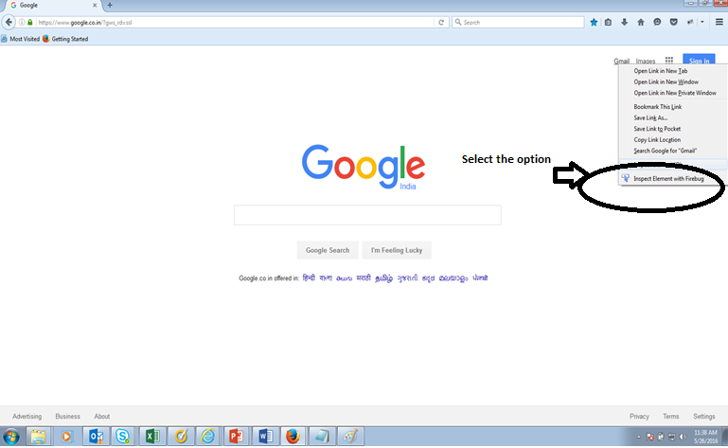
Using Firebug (1 of 3)

Slide 57
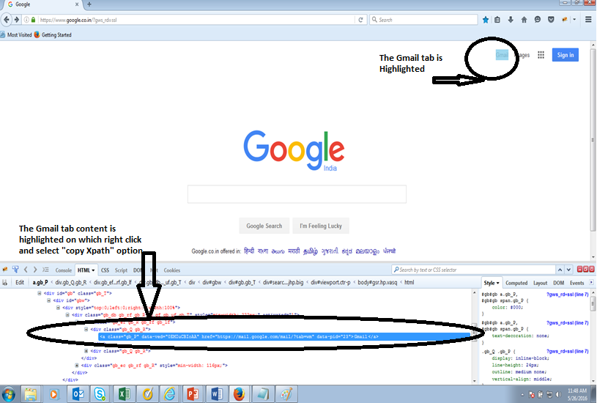
Using Firebug (2 of 3)

Slide 58
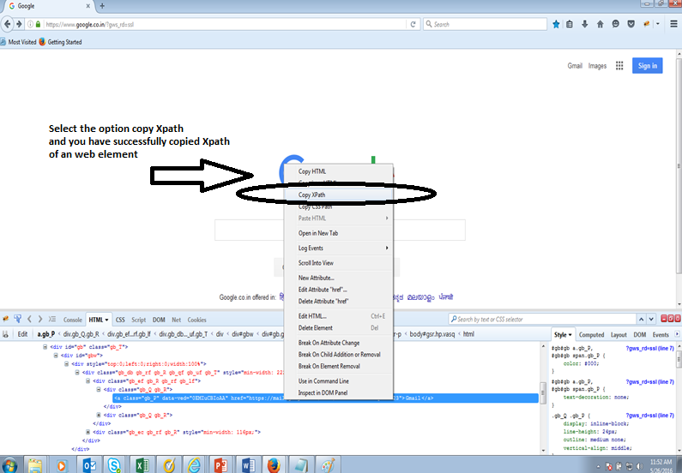
Using Firebug (3 of 3)
Notes:
Congrats you have learned and extracted your first Xpath. Note: Xpath generated in above example is /html/body/div/div[3]/div[1]/div/div/div/div[1]/div[1]/a from the Xpath when we use it. we use this Xpath as element locator in Selenium IDE , RC and WebDriver.

Slide 59
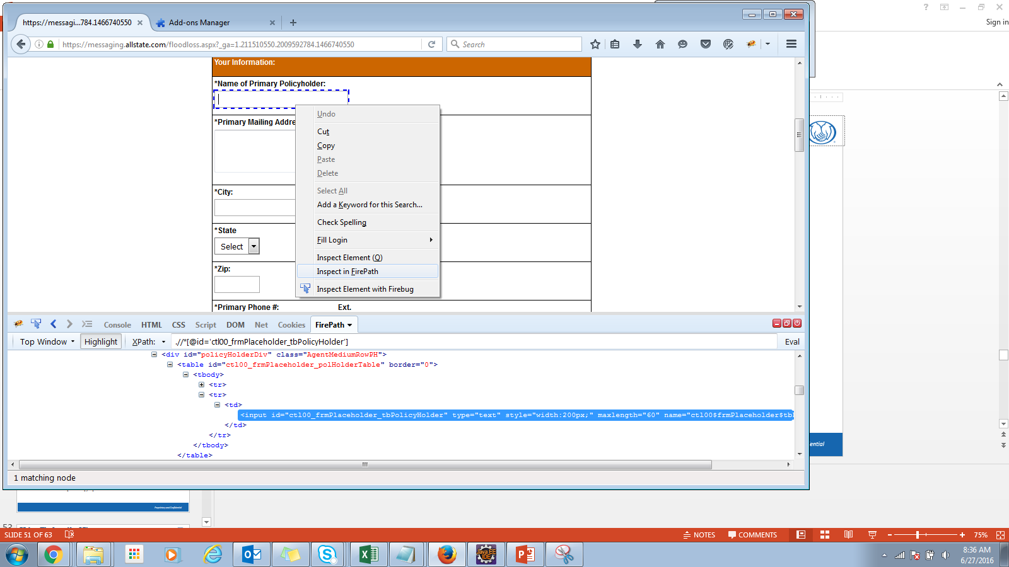
Using Firepath (1 of 2)
To extract an element’s XPath, we can also use Fire path. Open All state Flood Loss Application URL. Right click on any web element to extract Xpath. Choose the option ‘Inspect in Firepath’.

Slide 60
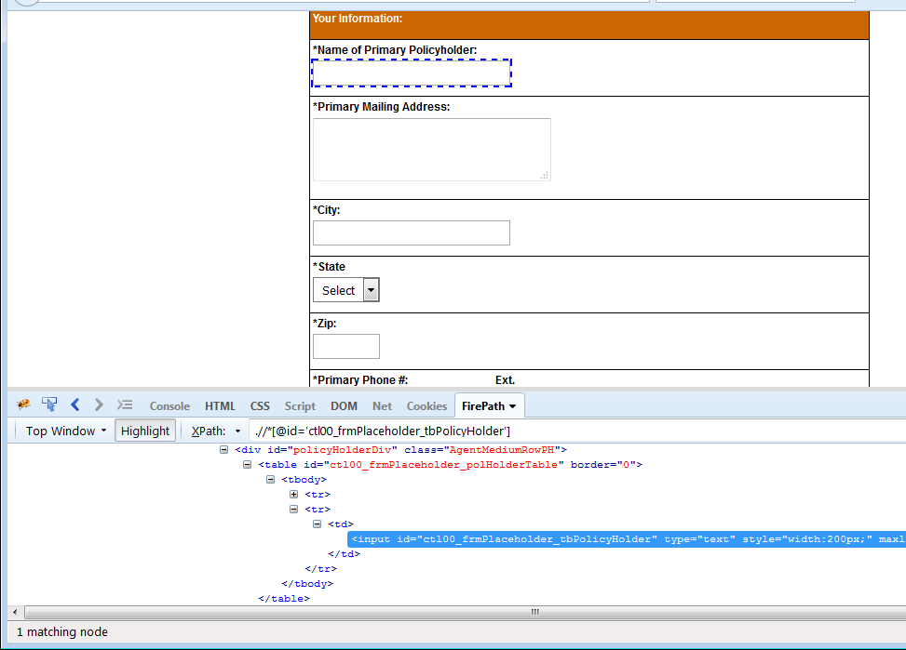
Using Firepath (2 of 2)
The below picture shows the extraction of a Text box’s XPath in Firepath.
XPath expression

Slide 61
Module 3 Design Outline
HTML
HTML Basic Tags
HTML Elements & Attributes
Finding Elements using Browser Inspector
Usage of Firebug & FirePath (Firefox)
XPath Functions
Hands-on activity
Choosing Effective XPath
XPath
Creating Good XPath

Slide 62
XPATH : Functions (1 of 3)
XPath provides a number of useful functions for converting and translating data.
There are different categories of functions. They are
Node Set Functions
String Functions
Number Functions
Boolean Functions
Error and trace functions etc.
Similar to other programming languages, XPath functions also has function syntax.
A function will have function name followed by pair of opening and closing parenthesis.
Functions may or may not contain arguments but returns a value.

Slide 63
XPATH : Functions (2 of 3)
Node set functions – as the name implies, these functions works on node set and may or may not return node set as a result.
Some of the commonly used node set functions are given below.
last() – returns the last element
position() – returns the ordinal position
count(nodeset) – returns the number of nodes
name(nodeset) – returns the QName of the node
Consider the following example.
The below examples are analogy to the All State Flood Loss Application first Page.
//form/div[last()] – this will return last div element in the form.
count(//div) – this will return the number of div elements. (return 177 div elements from All state page)

Slide 64
XPATH : Functions (3 of 3)
String functions – as the name implies, these functions works on strings type and may return strings as a result.
Some of the commonly used string functions are given below.
concat(string1, string2…string n) – returns the concatenated string
contains(string1, string2) – checks whether sstring1 contains string2 and returns the boolean value
starts-with(string1, string2) – checks whether the string1 starts with string2 and returns the boolean value
string-length(string) – returns the number of characters in the string

Slide 65
Module 3 Design Outline
HTML
HTML Basic Tags
HTML Elements & Attributes
Finding Elements using Browser Inspector
Usage of Firebug & FirePath (Firefox)
XPath Functions
Hands-on activity
Choosing Effective XPath
XPath
Creating Good XPath

Slide 66

Activity
Environment or File: M3_Xpath_Activity_PG_v1
Steps:
Open the Participants Guide given as word document.
Read the given activity details.
Complete the activities
Submit to faculty
Activity

Slide 67
Summary
At the end of this module, participants are able to understand:
Basics of HTML such as tags, element and attribute.
Finding Elements using Browser Inspector (IE, Firefox and Chrome).
Basics of XPath.
Usage of XPath expressions, axis etc.
How to choose Effective XPath (Absolute XPath and Relative XPath).
XPath Functions.
Hands-on Activity.

Slide 68

Thank You

